Slide 1

Lecture 1.10 - Diversity Gaps in Science and Engineering
DLI Accelerated Data Science Teaching Kit
Notes:
This section will present key points on diversity gaps in science and engineering.

Slide 2

The Accelerated Data Science Teaching Kit is licensed by NVIDIA, Georgia Institute of Technology, and Prairie View A&M University under the
Creative Commons Attribution-NonCommercial 4.0 International License.

Slide 3
Statistical Challenges Faced by Underrepresented Groups
Small Percentage of Students Graduating in CS and Engineering
Small Representation in Science and Engineering Careers
Almost no Black or Latino Representation Among Venture Capitalists
Lack of Enrollment and Funding for Historically Black Colleges and Universities (HBCUs)
Notes:
First, we will discuss the challenges faced by underrepresented groups in computer science and engineering.
Only Small Percentage of Students will graduate in majors related to Computer Science and Engineering.
This will lead to only a Small Representation in Science and Engineering Careers
There is currently no Black or Latino Representation Among Venture Capitalists
The main reason for these observations is caused by Lack of Enrollment and Funding for underrepresented groups such as Historically Black Colleges and Universities (HBCUs).

Slide 4
Low CS Graduation Rates Among Blacks and Latinos
In 2016, 8.6% of graduates with a bachelor’s degree in computer and information science were Black and a little over 10% were Latino, according to the National Center for Education Statistics.
Source: https://www.latimes.com/business/technology/story/2020-06-24/tech-started-publicly-taking-lack-of-diversity-seriously-in-2014-why-has-so-little-changed-for-black-workers
Notes:
According to the National Center for Education Statistics, graduation rates, in 2016, 8.6% of graduates with a bachelor’s degree in computer and information science were Black and a little over 10% were Latino.

Slide 5
Minority Graduation Rates Declining in CS and Engineering
Percentage of US bachelor's degrees awarded to Black and African American students in Science, Technology, Engineering, and Mathematics (STEM) fields
Data on the college age population are collected from the US Census
Graduation rates of CS and EE are decreased between 2013 and 2018
Source: https://www.aps.org/programs/education/statistics/aamajors.cfm
Notes:
This graph shows the percentage of US bachelor's degrees awarded to Black and African American students in Science, Technology, Engineering, and Mathematics (STEM) fields as well as the percentage of college-age (18-24 years) United States permanent residents who are Black or African American.
Degrees awarded to temporary residents are excluded from calculations.
Data on the college age population are collected from the US Census.
We can observe that underrepresented groups like African Americans show a trend that less African Americans obtained degrees in Computer Science and engineering from 2008 to 2018.

Slide 6
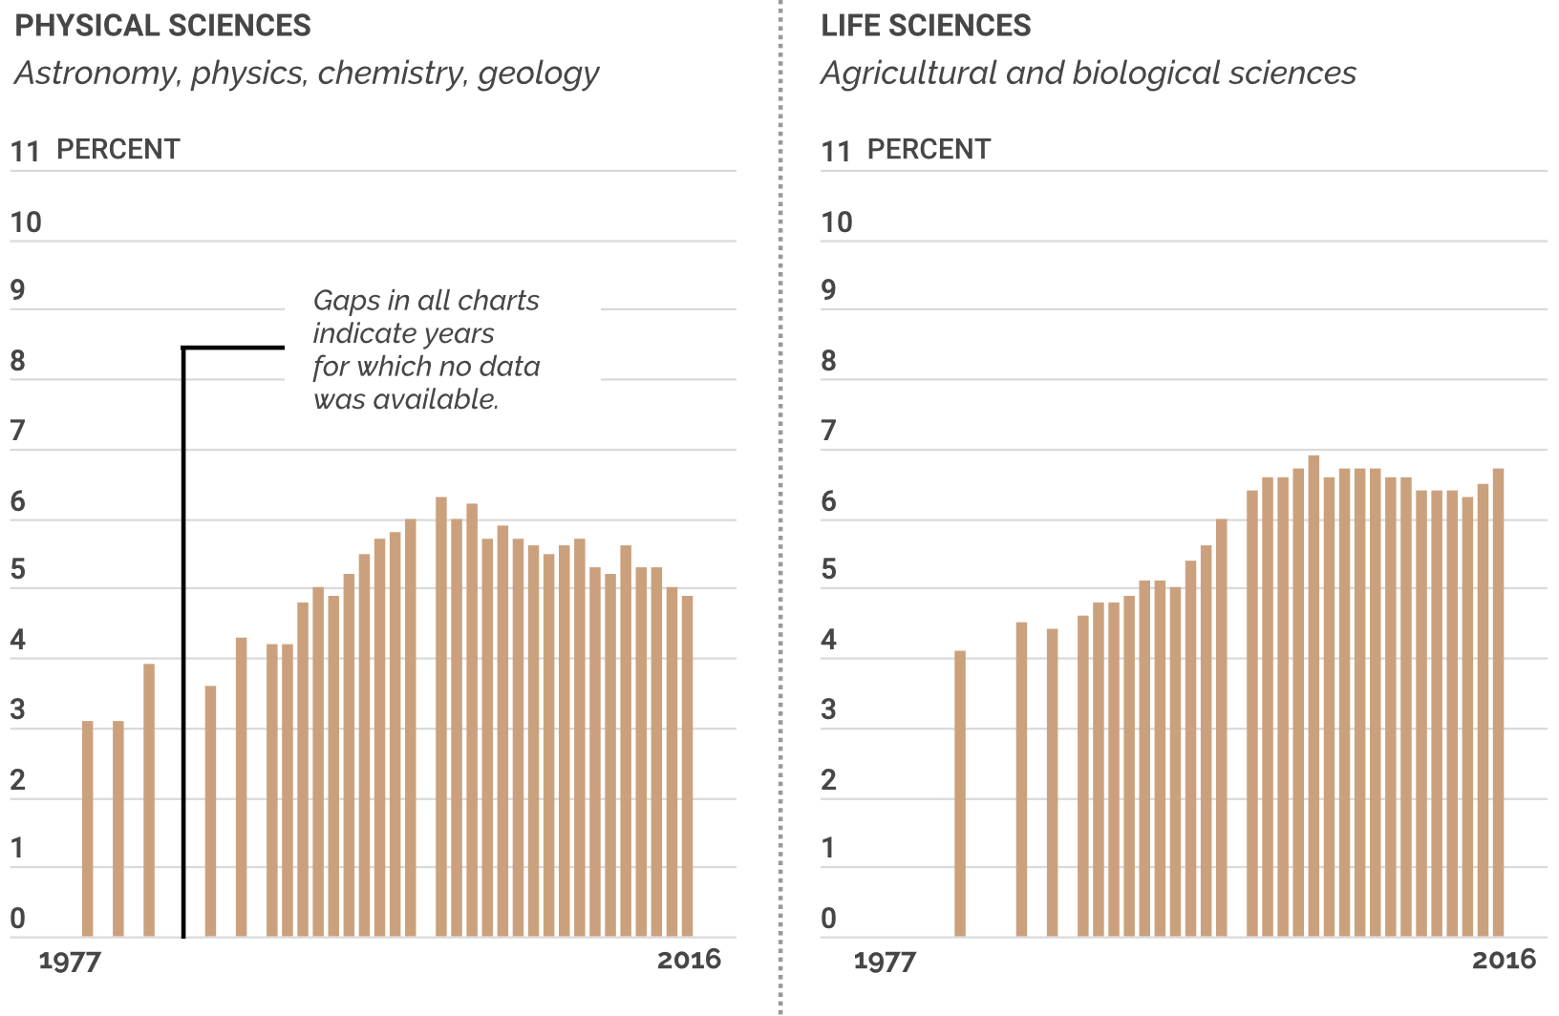
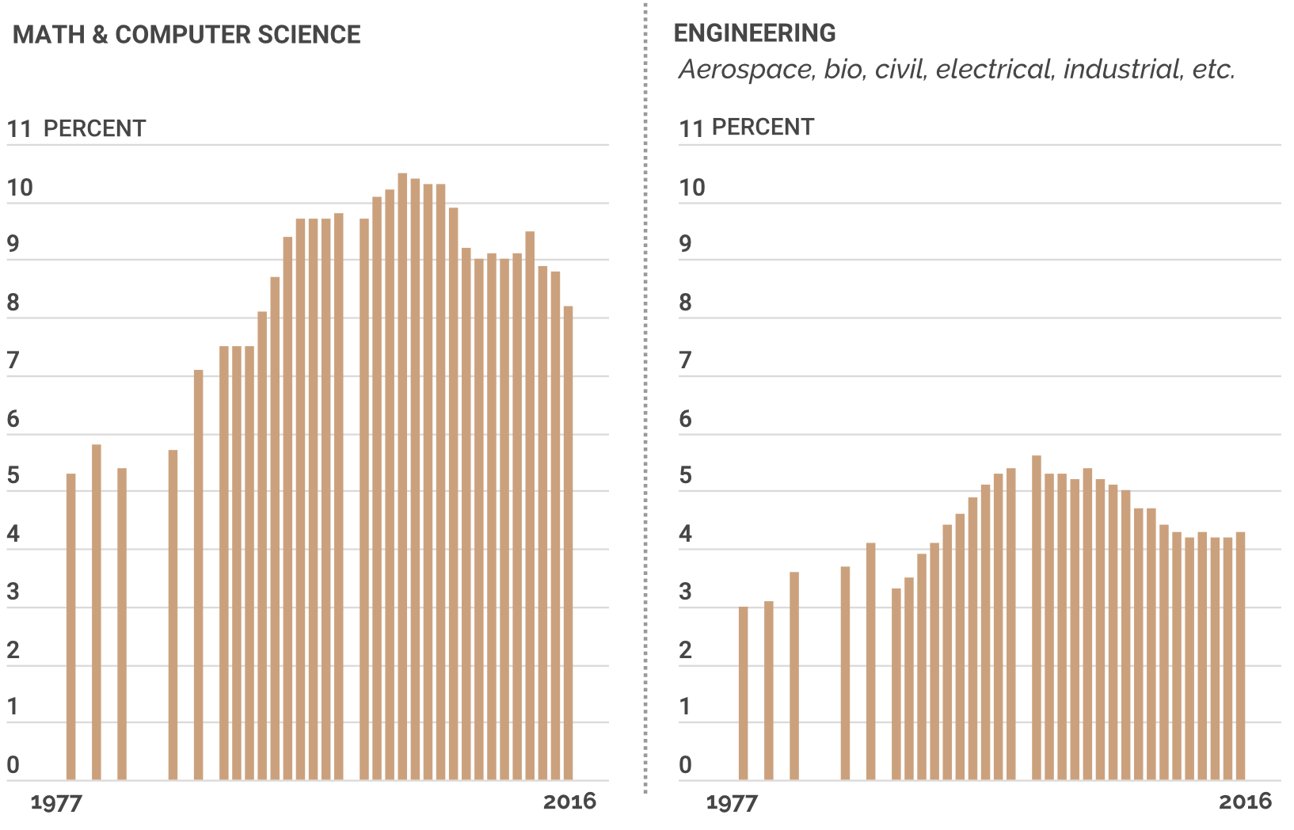
Graduation Rates Declining in Important Disciplines
Source: https://undark.org/2020/09/11/after-years-of-gains-black-stem-representation-is-falling-why/
Notes:
Compared to major disciplines such as physical sciences, Life sciences, math and computer science; engineering gained even lower percentages of graduation rates.

Slide 7
Representation Varies Across Minority Groups
The share of Hispanics among psychologists (15%), political scientists (33%), postsecondary teachers in computer science (13%), and industrial engineers (17%) is large relative to the Hispanic share of science and engineering occupations overall (7%).
The share of black individuals among computer systems analysts (13%), computer support specialists (14%), and network and computer systems administrators (14%) is large relative to the share of black individuals in science and engineering occupations overall (6%).
Source:https://ncses.nsf.gov/pubs/nsb20201/u-s-s-e-workforce#women-and-underrepresented-minorities
Notes:
The share of Hispanics in disciplines such as psychology (@15%), political science (@33%), postsecondary teachers in computer science (@13%), and industrial engineers (@17%) is large compared to the overall Hispanic share in science and engineering occupations(@7%).
On the contrary, the share of black individuals among computer systems analysts (@13%), computer support specialists (@14%), and network and computer systems administrators (@14%) is large relative to the share of black individuals in science and engineering occupations overall (@6%).

Slide 8
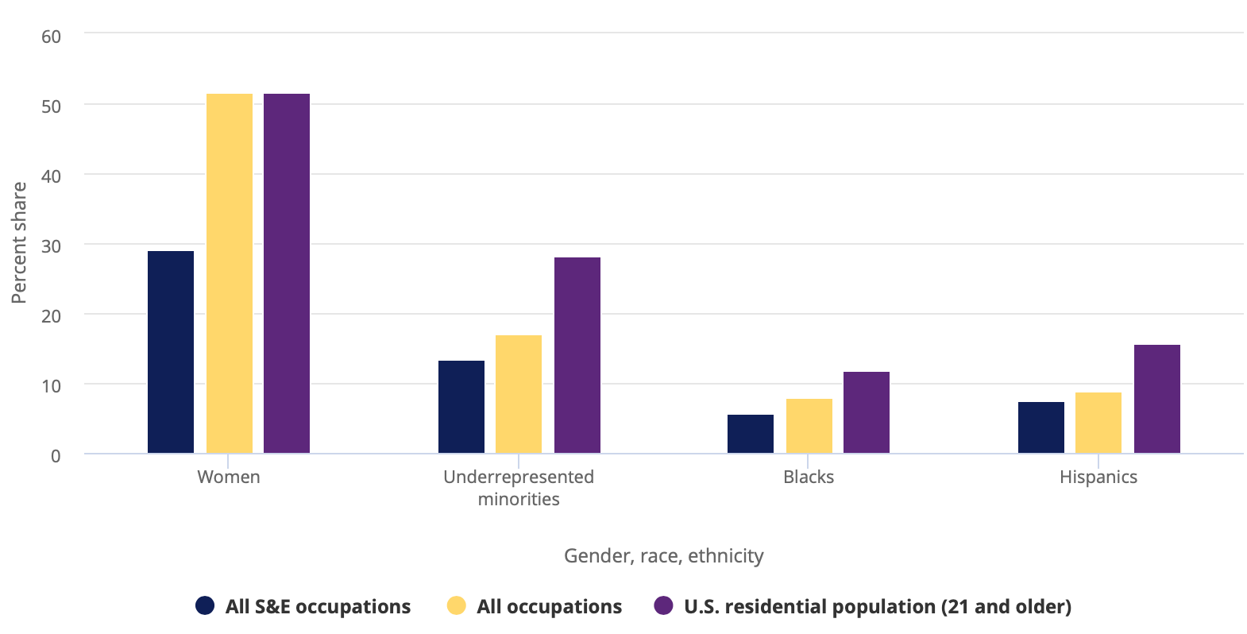
Proportion of Individuals from URM Groups Remains Smalll
The proportion of individuals from URM groups in science and engineering jobs, although up from 9% in 2003 to 13% in 2017, remains below their share of the college-educated workforce (17%)
Source: https://ncses.nsf.gov/pubs/nsb20201/u-s-s-e-workforce#women-and-underrepresented-minorities
Notes:
The proportion of individuals from Underrepresented Minority (URM) groups in science and engineering jobs, although up from 9% in 2003 to 13% in 2017, remains below their share of the college-educated workforce (@17%).
Data collected for Underrepresented minorities (URM) here includes individuals who are black, Hispanic, or American Indian or Alaska Native. And the U.S. residential population data refers to those at all education levels.

Slide 9
Almost no Representation Among Venture Capitalists
Black investors make up less than 1% of venture capitalists.
In 2018, just 713 individual investors at large venture funds, defined as having more than $250 million under management, had the power to lead deals, sit on boards, and write checks to invest in companies, according to an Information survey.
Of that group, 11 were Latino and seven were Black.
Source: https://www.latimes.com/business/technology/story/2020-06-24/tech-started-publicly-taking-lack-of-diversity-seriously-in-2014-why-has-so-little-changed-for-black-workers
Notes:
Almost no Representation Among Venture Capitalists
Black investors make up less than 1% of venture capitalists
According to an Information survey In 2018, there was just 713 individual investors at large venture funds, defined as having more than $250 million under management, had the power to lead deals, sit on boards, and write checks to invest in companies
Of that group, 11 were Latino and seven were Black.

Slide 10
Challenges Faced by HBCUs in AI and Data Science
Relatively lower enrollment of well-prepared students in STEM
Relatively less funding support
Less opportunities to collaborate with industry
Notes:
Development of researchers in AI and Data Science in HBCUs requires more students with strong background of mathematics and programming. HBCUs have challenges in recruiting and training such students.
More funding is needed to enhance facilities and environments including software and hardware.
More opportunities to involve HBCU researchers and students in projects that are in collaboration with industry will be imperative to improve research and education on AI and data science.

Slide 11
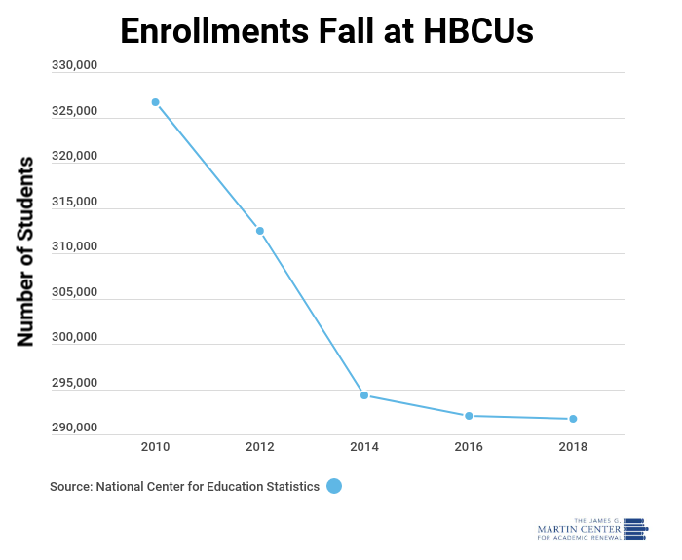
Enrollment Falling at HBCUs
HBCU enrollment fell 11% in last decade
HBCU enrollment also reduced between 2018 and 2019.
Historically black institutions have dealt with issues keeping enrollments predominantly black.
Source: https://www.jamesgmartin.center/2020/06/did-you-know-hbcu-enrollments-fall-10-in-last-decade/
Notes:
In recent years, many historically black institutions have dealt with issues keeping their enrollments predominantly black, as issues related to finance and status continue to build.
According to the U.S. Department of Education, there are currently 101 historically black colleges in the United States serving more than 228,000 students. Between 2018-2019, HBCUs had the second-lowest enrollment in 17 years.
And, according to the National Center for Educational Statistics, more than 6,000 fewer students attended the 101 black colleges and universities in the U.S during the 2018-19 school year. The 291,767 total was down from the 298,134 in the previous year and this was the lowest total since 2001 when there were 289,985 students at historically black colleges.

Slide 12
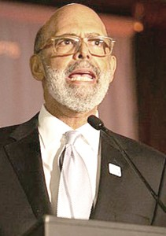
HBCUs Lack Funding Support
Current funding is not enough to support HBCUs
Removal of programs such as federal work study would have large negative impact on HBCU students
Federal government is not the only sector responsible for the inequitable funding of HBCUs, but also “subtler forms of disparate and unfair treatment” by philanthropists, accreditor, corporations and lender
Dr. Michael Lomax
Source: http://www.louisianaweekly.com/despite-future-act-hbcus-still-woefully-underfunded-according-to-uncf-president/
Notes:
Dr. Michael Lomax, president and CEO of the United Negro College Fund (UNCF), argued that the permanent annual $255 million in federal funding for minority serving institutions, with $85 million designated for HBCUs, marks progress, but it isn’t enough to solve the “HBCU paradox” – the fact that HBCUs enjoy broad bipartisan support but continue to be “woefully underfunded.”
He also noted that the FUTURE Act wasn’t included in Trump’s 2021 federal budget and Trump’s efforts to remove programs like federal work study would hurt HBCU students if successful.
But the federal government isn’t the only sector responsible for the inequitable funding of HBCUs, he said, pointing to “subtler forms of disparate and unfair treatment” by philanthropists, accreditors, corporations and lenders.

Slide 13
DLI Accelerated Data Science Teaching Kit
Thank You

