Slide 1

Lecture 1.11 - Hidden Figures in Data Science from Underrepresented Groups​​​​
DLI Accelerated Data Science Teaching Kit
Notes:
This section will focus on excellent researchers, labs, and centers in the underrepresented groups for data science.

Slide 2

The Accelerated Data Science Teaching Kit is licensed by NVIDIA, Georgia Institute of Technology, and Prairie View A&M University under the
Creative Commons Attribution-NonCommercial 4.0 International License.

Slide 3
Data Scientists and Labs from Underrepresented Groups​​​​
Data scientists from underrepresented groups​​​​ made significant contributions to data science and AI research in different areas
Minority-serving centers/labs working on important data science and AI research
Notes:
We will introduce scientists and their research centers/labs from underrepresented groups​​​​.

Slide 4

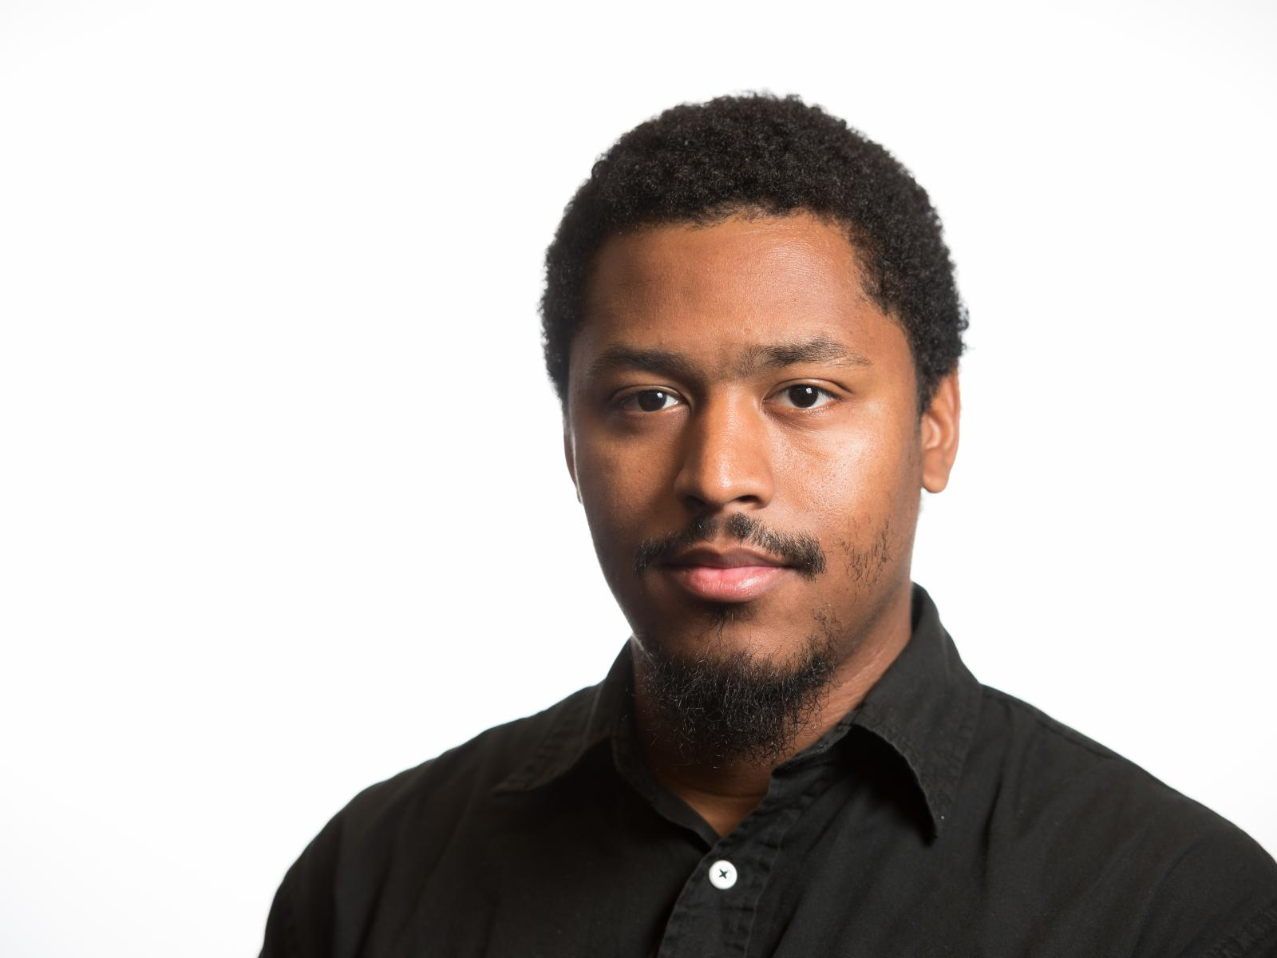
Pacific Northwest National Laboratory
Dr. Brett Jefferson
Data Scientist
Pacific Northwest National Laboratory
Source: https://www.pnnl.gov/news-media/brett-jefferson-wins-nam-new-phd-best-speaker-award
Notes:
Dr. Brett Jefferson, a Data Scientist from Pacific Northwest National Laboratory, developed A method that can interpret data relationships to consistently cover an area using only four points.
The study used power generator data, but the approach could also benefit city planning, environmental monitoring, cell phone tower placement, and any other instance when resources must be spread out to service an area with disparate needs.

Slide 5
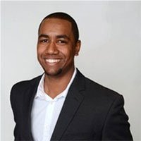
Oak Ridge Institute
Creative technologist with Bioengineering PhD, extensive managerial training, and over 10 years of data science experience building high-performance computing systems
Active developer of data science, machine learning, and artificial intelligence technologies with deep expertise in real-world application and theoretical underpinnings
Passion for presenting complex systems, methodologies, analyses, and insights in a simple and concise manner to stakeholders, business partners, and senior leaders
Recognized thought leader giving regular talks to regional, national, and international audiences on implementations and implications of artificial intelligence
Dr. Byron Gaskin
Emerging Leaders
in Data Science Fellow
National Institute of Allergy and Infectious Diseases
Oak Ridge Institute
Notes:
Dr. Byron Gaskin, as Emerging Leader in Data Science Fellow from National Institute of Allergy and Infectious Diseases Oak Ridge Institute, paid efforts in the area of Machine Learning, Emerging Technologies, and AI Ethics.
He is an active developer of data science, machine learning, and artificial intelligence technologies with deep expertise in real-world application and theoretical underpinnings.

Slide 6
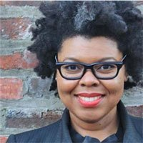
Capital One
Leads learning and research for conversational AI, developing insights that inform our understanding of human experiences, for our customers and our design, product, and technology partners.
Part of the Artificial Intelligence (AI) Design team that supports the conversational (and intelligent) agent, Eno, at Capital One.
Co-founder, blackcomputeHER. blackcomputeHER.org (pronounced 'black computer') is transforming computing+tech education & workforce development for black women and girls.
Dr. Jamika D. Burge
Head of Artificial Intelligence Design Learning & Research Insights, Advisory Board in Computer Science Department, Virginia Technical Institute;
Advisory Board for Inclusive Computing, Northeastern University
Notes:
Dr. Jamika D. Burge leads learning and research for conversational AI, developing insights that inform our understanding of human experiences, for our customers and our design, product, and technology partners.
She is also a Part of the Artificial Intelligence (AI) Design team that supports the conversational (and intelligent) agent, Eno, at Capital One.
She is Co-founder of blackcomputeHER. blackcomputeHER.org (pronounced 'black computer') is transforming computing+tech education & workforce development for black women and girls.

Slide 7
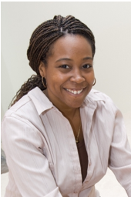
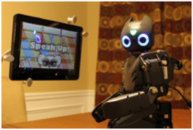
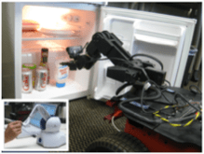
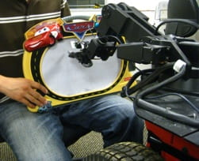
Georgia Institute of Technology
Dr. Ayanna MacCalla Howard
Professor; Chair for the School of Interactive Computing;
Linda J. and Mark C. Smith Chair Professor Technical Interest Groups: Systems and Controls
Georgia Institute of Technology
Source: https://humanslab.ece.gatech.edu
Notes:
Dr. Ayanna Howard received her B.S. in Engineering from Brown University, her M.S.E.E. from the University of Southern California, and her Ph.D. in Electrical Engineering from the University of Southern California, Los Angeles in 1999.
Her area of research is centered around the concept of humanized intelligence, the process of embedding human cognitive capability into the control path of autonomous systems.
This work, which addresses issues of human-robot interaction, learning, and autonomous control, has resulted in over 180 peer-reviewed publications in a number of projects - from scientific rover navigation in glacier environments to assistive robots for the home.

Slide 8
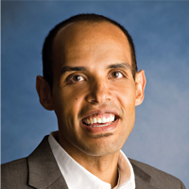
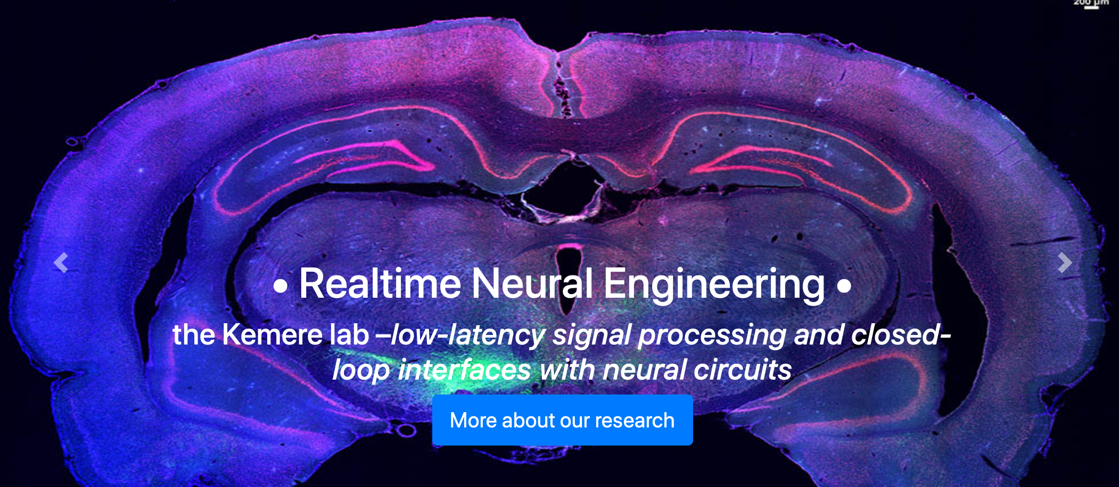
Rice University
Dr. Caleb Kemere
Assistant Professor
Electrical and Computer Engineering,
Rice University
Source: https://humanslab.ece.gatech.edu
Notes:
Dr. Caleb Kemere, Assistant Professor from Electrical and Computer Engineering at Rice University focuses on Realtime Neural Engineering.
His team designed systems to interact with complex neural circuits in vivo in behaving rodents. These systems enable us to explore how information is processed, stored, and retrieved in both healthy brains and in models of human neurological diseases and disorders. The experimental neurobiological topics we focus most on are understanding memory and the mechanisms of deep brain stimulation. Additionally, they did a significant amount of pure neural interface technology development as well as building software and embedded tools for data analysis and experiments.

Slide 9
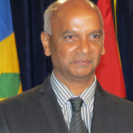
University of the West Indies
CEO of the Trinidad and Tobago Network Information Centre (TTNIC)
Active areas
Open Data and set up and manages Open Data repositories (data.tt and maps.tt) for Trinidad & Tobago
Smart Grids and one on the use of ICT for Agriculture
Senior Member of the Institute of Electrical and Electronics Engineers and has been honoured by the NIHERST as an Icon in Science.
A member of the US honor societies
Dr. Patrick Hosein
Professor
Department of Computing and Information Technology
The University of the West Indies
Notes:
Professor Hosein obtained five degrees from the Massachusetts Institute of Technology (MIT) including a PhD in Electrical Engineering and Computer Science. After his graduation he briefly worked at Bell Laboratories before returning to Trinidad where he worked at UWI as a lecturer in the Department of Electrical and Computer Engineering.
Presently Professor Hosein is the CEO of the Trinidad and Tobago Network Information Centre (TTNIC) which manages the .tt Top Level Domain. He also personally supports the hosting of web sites and provides domain names for over 100 schools in Trinidad and Tobago. He also personally supports the hosting of web sites and provides domain names for over 100 schools in Trinidad and Tobago.
He is also active in the area of Open Data and has set up and manages Open Data repositories (data.tt and maps.tt) for Trinidad & Tobago. After a very fulfilling international career he is now a Professor of Computer Science at the UWI. He recently re-designed the MSc. in Computer Science and replaced most of the courses with new ones that better reflect the needs of the country (mobile computing and cloud tech-nologies). He is also active in a project on Smart Grids and one on the use of ICT for Agricul-ture.
He is a Senior Member of the Institute of Electrical and Electronics Engineers and has been honoured by the NIHERST as an Icon in Science. He is also a member of the US honour socie-ties Tau Beta Pi, Sigma Xi, and Eta Kappa Nu, was nominated for the Ericsson Inventor of the Year award in 2004.

Slide 10
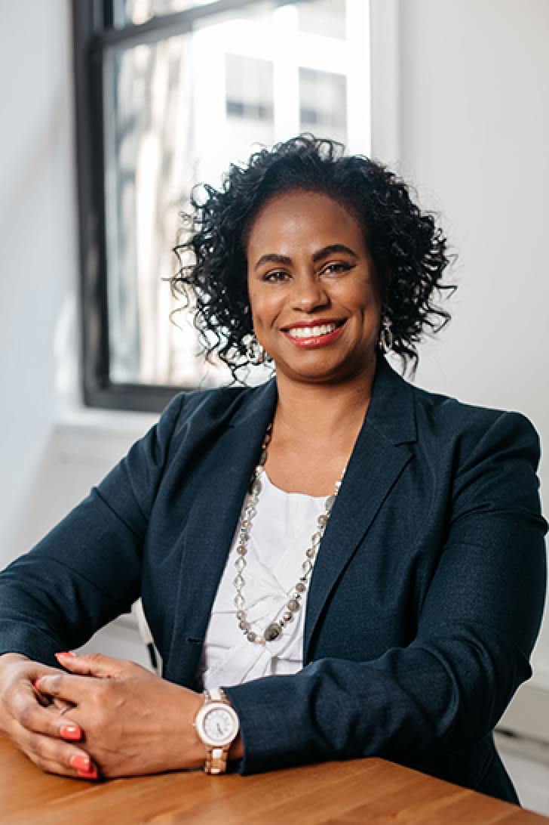
AnitaB.org
An advocate for access, opportunity, and social justice for underrepresented communities in technology
Currently she serves as the President and CEO of AnitaB.org, an organization that connects, inspires, and strives for greater equality for women technologists in business, academia, and government.
She founded the original Computer Science for All program, building computer science classes into the curriculum for every student in the Chicago Public Schools, and serving as the inspiration for the Obama administration’s national CS For All initiatives.
Brenda Darden Wilkerson
President and CEO of AnitaB.org
Notes:
Brenda Darden Wilkerson serves as the President and CEO of AnitaB.org, an organization that connects, inspires, and strives for greater equality for women technologists in business, academia, and government.
She founded the original Computer Science for All program, building computer science classes into the curriculum for every student in the Chicago Public Schools, and serving as the inspiration for the Obama administration’s national CS For All initiatives.

Slide 11
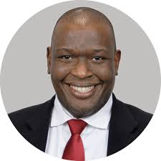

Dr. Tyrone Grandison
Board Chairman of The Data-Driven institute,
Civic Tech Program Manager for the US Census Bureau,
Vice President of Data for U.Group
Source: https://www.tyronegrandison.org
Notes:
Dr. Grandison’s career started as a software engineer in Jamaica. He received a B.S. degree in Computer Studies (Computer Science and Economics) from the University of the West Indies in 1997, a M.S. degree in Software Engineering in 1998 and a Ph.D. degree in Computer Science from the Imperial College of Science, Technology & Medicine in London (2003).
Dr. Grandison has over 25 years experience in software engineering, security and privacy. His work in database security and privacy has been internationally recognized as pioneering and impactful. In addition to relational data privacy and security, he has created and successfully led research and product initiatives in RFID data management, privacy-preserving mobile data management, private social network analysis, text analytics and healthcare management systems.
He has authored over a 100 technical papers, co-invented over 47 patents and written several books, including "Practical Privacy Protection Online for Free", "Trust Management Middleware for Internet Applications: Combining Trust, Recommendation, Risk and Experience", and "Cybersecurity Risk Assessment for Business".

Slide 12
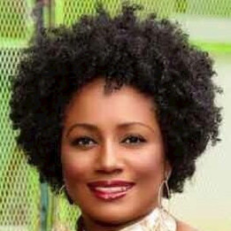
A New York-based criminologist who specializes in Artificial Intelligence (AI);
ethical AI, bias in AI, diversity and inclusion in AI, algorithmic authenticity and accountability, data integrity and equity, AI for social good and social justice in AI policy and governance.
She's committed to diverse and inclusive AI strategy development;
using AI to empower and transform communities and cultures;
securing diverse and inclusive participation in the 4IR, helping companies navigate the AI landscape and developing future AI leaders.
A multicultural cross-connector of multiple fields and an innovative collaborator, her passion is forming connections and unifying people and technologies; enhancing quality of life and economic prosperity.
A sought after thought-leader, inspirational motivational speaker and mentor, Ms. Cummings is also a Columbia University community scholar.
Renée Cummings
Criminologist, Criminal psychologist, AI ethicist and AI strategist
Founder and CEO of Urban AI LLC.
Notes:
Renée Cummings, Criminologist, Criminal psychologist, AI ethicist and AI strategist
She's committed to diverse and inclusive AI strategy development;
using AI to empower and transform communities and cultures;
securing diverse and inclusive participation in the 4IR, helping companies navigate the AI landscape and developing future AI leaders.

Slide 13
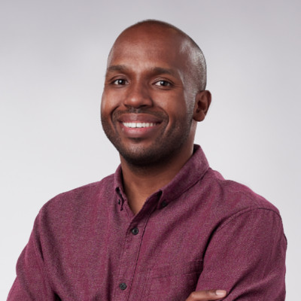
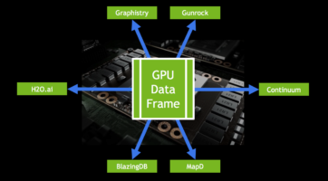
NVIDIA
Joshua Patterson
Senior Director
Engineering RAPIDS
NVIDIA
Source: https://developer.nvidia.com/blog/author/jpatterson/
Notes:
Joshua Patterson is a Director of AI Infrastructure at NVIDIA leading engineering for RAPIDS.AI, and a former White House Presidential Innovation Fellow.
Prior to NVIDIA, Josh worked with leading experts across public sector, private sector, and academia to build a next-generation cyber defense platform.
His current passions are graph analytics, machine learning, and large-scale system design. Josh also loves storytelling with data and creating interactive data visualizations. Josh holds a B.A. in economics from the University of North Carolina at Chapel Hill and an M.A. in economics from the University of South Carolina Moore School of Business.

Slide 14
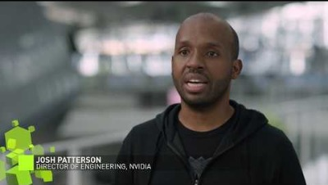
NVIDIA
Joshua Patterson
Senior Director
Engineering RAPIDS
NVIDIA
Source: https://www.youtube.com/watch?v=dzPZksaqGNU
Notes:
Josh Patterson, NVIDIA's Director of Engineering for RAPIDS software libraries for data science, provides his perspective about #datascience​ and the opportunity for data scientists to have a positive impact on society.
He talks about NVIDIA’s culture of solving challenging problems and giving opportunities to employees of all backgrounds to do their life’s work. This video was created in partnership with HBCU House and U.S. Representative Alma Adams, North Carolina.

Slide 15


Prairie View A&M University (PVAMU)
Center of excellence in Research and Education for big military Data InTelligence (CREDIT)
Center for Computational Systems Biology (CCSB)
Notes:
For PVAMU, we will mention two centers, namely, CREDIT center and CCSB center.
CREDIT will focus on more general tasks of data analytics such as machine learning based big data analysis.
CCSB will pay more attentions on biomedical data analysis.

Slide 16
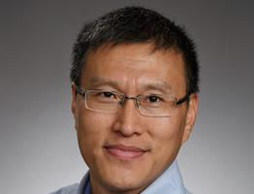

CREDIT at PVAMU
Dr. Lijun Qian
PI and Director
Regents Professor
AT&T Endowed Professor of Electrical and Computer Engineering
Roy G. Perry College of Engineering
Prairie View A&M University
Source: http://credit.pvamu.edu
Notes:
Lijun Qian is Regents Professor and holds the AT&T Endowment in the Department of Electrical and Computer Engineering at Prairie View A&M University (PVAMU).
He is also the Director of the DOD Center of Excellence in Research and Education for Big Military Data Intelligence (CREDIT Center).
Before joining PVAMU, he was a member of technical staff in the Networks and Systems Research Department of Bell-Labs at Murray Hill, New Jersey. He is a visiting professor of Aalto University, Finland. He has published more than 160 papers in journals and peer-reviewed conferences.
His research interests are in the area of big data processing, artificial intelligence, wireless communications and mobile networks, network security and intrusion detection, and computational and systems biology.

Slide 17
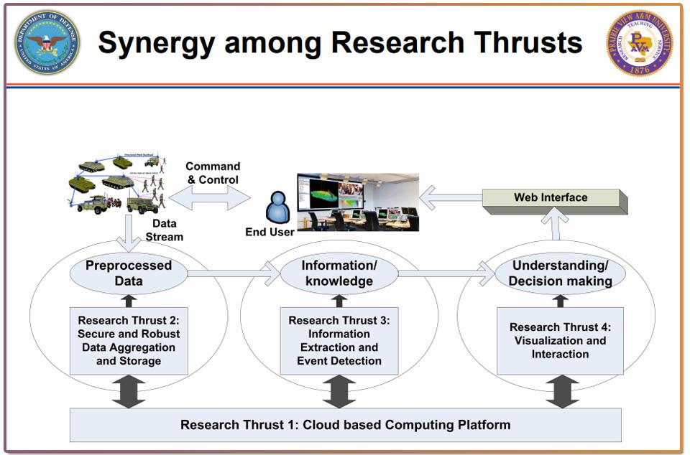
CREDIT at PVAMU
Center of excellence in Research and Education for big military Data InTelligence (CREDIT)
Big Data Analytics
Artificial Intelligence
Various Applications
Notes:
Today’s military analysts are faced with the monumental and escalating task of handling massive volumes of complex data from multiple sources.
To enhance their ability to more effectively and efficiently process data, a multidisciplinary team of researchers from Prairie View A&M University establish Center of excellence in Research and Education for big military Data InTelligence (CREDIT).
The center’s mission is to accelerate research and education in predictive analytics for science and engineering to transform our ability to effectively address and solve many complex problems posed by big data.
The center will bring together sensing, perception, and decision support for mission-critical applications of DoD. CREDIT center will build partnerships with DoD labs, government agencies and business to focus on research data analysis and educating and training students to become data scientists and engineers in the future data-centric economy and contribute to DoD missions.

Slide 18
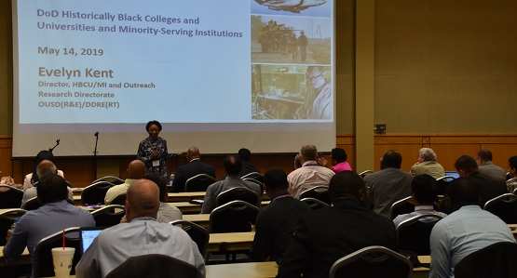
CREDIT at PVAMU
The Workshop of Mission-Critical Big Data Analytics (MCBDA, 2016 ~ 2019)
Covered state-of-the-art research and development in big data analytics, especially for mission-critical applications.
Source: http://credit.pvamu.edu/MCBDA2019/index.html
Notes:
CREDIT center organized The Workshop of Mission-Critical Big Data Analytics.
This two-day workshop covered state-of-the-art research and development in big data analytics, especially for mission-critical applications.
There were keynote speeches by invited renowned speakers, and tutorial sessions with hands-on training.
Research works of cutting-edge research topics in big data was presented, plus a poster session and a demo session where students presented their work.

Slide 19
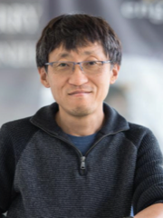
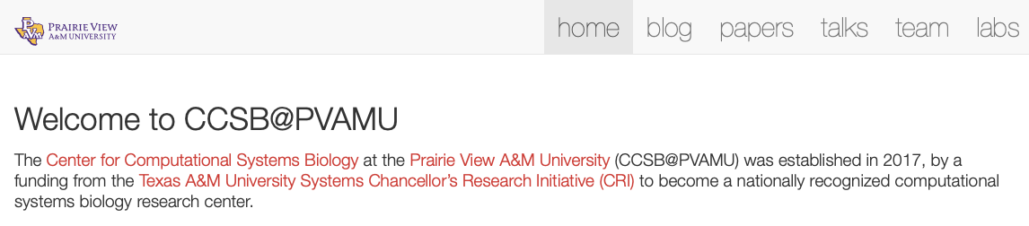
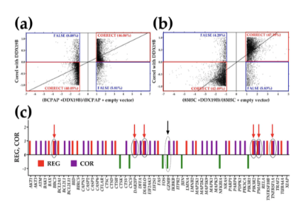
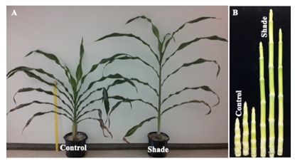
CCSB at PVAMU
Dr. Seungchan Kim
Chief Scientist and Executive of Center for Computational Systems Biology
Department of Electrical and Computer Engineering
Roy G. Perry College of Engineering
Prairie View A&M University
Source: https://ccsb.pvamu.edu
Notes:
Dr. Seungchan Kim is a Chief Scientist and Executive Professor at the Department of Electrical and Computer Engineering and Director of the CRI Center for Computational Systems Biology at the Prairie View A&M University (PVAMU), initiated by funding from Texas A&M University Systems’ Chancellor’s Research Initiative (CRI) and Prairie View A&M University.
Prior to this appointment, he was the Head of Biocomputing Unit and an Associate Professor at Integrated Cancer Genomics Division of Translational Genomics Research Institute (TGen).
He was one of the founding faculty members of TGen, founded in 2002, by Dr. Trent; then-Scientific Director of the National Human Genome Research Institute at the National Institutes of Health.
Dr. Kim is well recognized in the field of Bioinformatics and Computational Systems Biology research, both nationally and internationally, with more than 70 peer-reviewed articles with more than 5,000 citations.
His research interests include: 1) mathematical modeling of genetic regulatory networks, 2) development of computational methods to analyze multitude of high throughput multi-omics data to identify disease biomarkers, and 3) computational models to diagnose patients or predict patient outcomes, for example, disease subtypes or drug response.
His studies have had a large influence on the development of computational tools to study underlying mechanisms for cancer development and better understand the molecular mechanisms behind cancer biology and biological systems.

Slide 20
CCSB at PVAMU
The Center for Computational Systems Biology (CCSB) was established in 2017 through funding from the Texas A&M University Systems Chancellor’s Research Initiative (CRI) to become a nationally recognized computational systems biology research center.
Genomics Lab offers Illumina sequencing by synthesis. It is equipped to isolate, quantitate, evaluate quality of nucleic acid preparations and prepare libraries for sequencing using a workflow that minimizes contamination.
Personalized Genomics Lab uses Illumina NextSeq 550 and Agilent gene expression microarrays to profile the transcriptomes of cells and tissues from humans and animal models of human diseases.
Machine Intelligence Biology Lab focuses on computational biology using existing tools or developing novel methods to speed up the procedure of genetic data analysis or enhance the analysis performance.
Notes:
The Center for Computational Systems Biology (CCSB) at the Prairie View A&M University was established in 2017 through funding from the Texas A&M University Systems Chancellor’s Research Initiative (CRI) to become a nationally recognized computational systems biology research center.

Slide 21
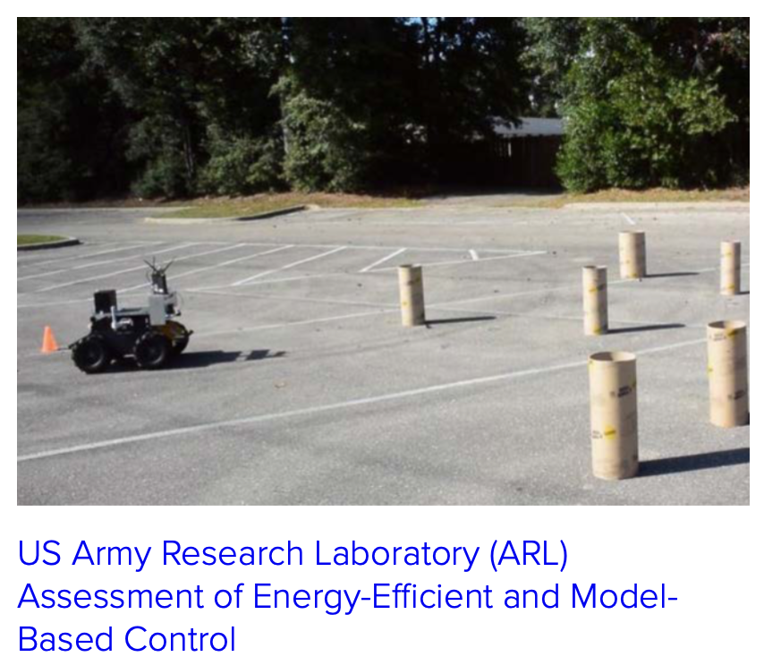
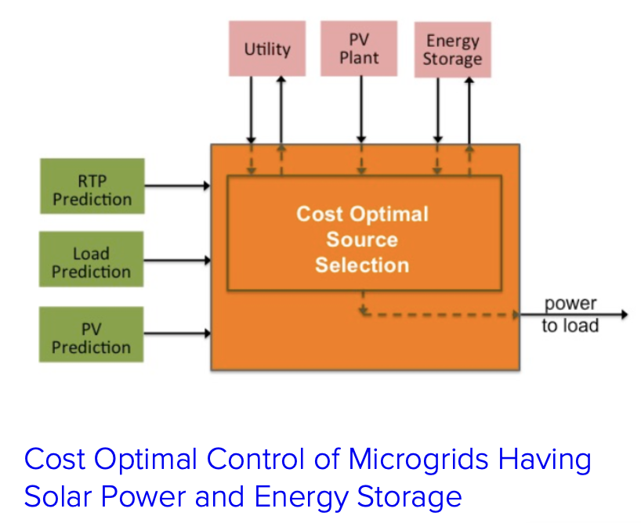
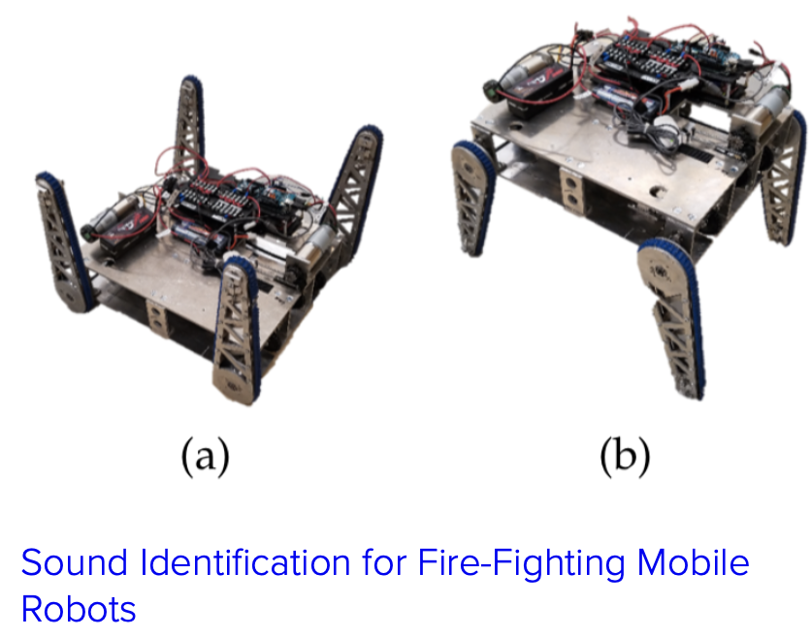
Florida Agricultural and Mechanical University (FAMU)
Center for Intelligent Systems, Control, and Robotics (CISCOR)
Source: https://www.ciscor.org
Notes:
The vision of the Center for Intelligent Systems, Control, and Robotics (CISCOR) is to use state-of-the-art technology to develop practical solutions for problems in systems, control and robotics for applications in industry and government.
CISCOR represents a cooperative approach for conducting interdisciplinary research in the automated systems area across two departments (Mechanical and Electrical & Computer) in the FAMU/FSU College of Engineering and the FSU Departments of Scientific Computing and Computer Science.
The Center's goal is to provide a means for the state of Florida to achieve national prominence in the area of automated systems and to assume a leadership role in the state of Florida's technology of the future. Established in 2003, CISCOR has become a leading center in Florida for the development and implementation of technologies related to Intelligent Systems, Control, and Robotics.

Slide 22
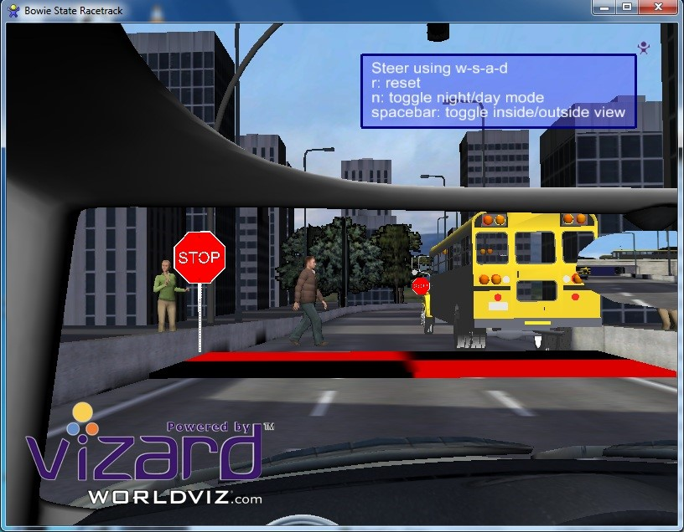
Bowie State Virtual Reality Laboratory
Develop student research and development skills in VR
Understand the potential for VR for instruction and visualization
Source: http://www.cs.bowiestate.edu/sharad/vrlab/
Notes:
Bowie State Virtual Reality Laboratory is to introduce students to Virtual Reality (VR) hardware, software, and provide an opportunity for them to apply this knowledge to applications for education and games. This laboratory applies cutting-edge VR technology currently available in academia and industry. The lab applies research methods from social science, artificial intelligence, software engineering, data science, and data visualization to address the challenge of including social, emotional, and communication factors in several applications, including healthcare and evacuation.

Slide 23
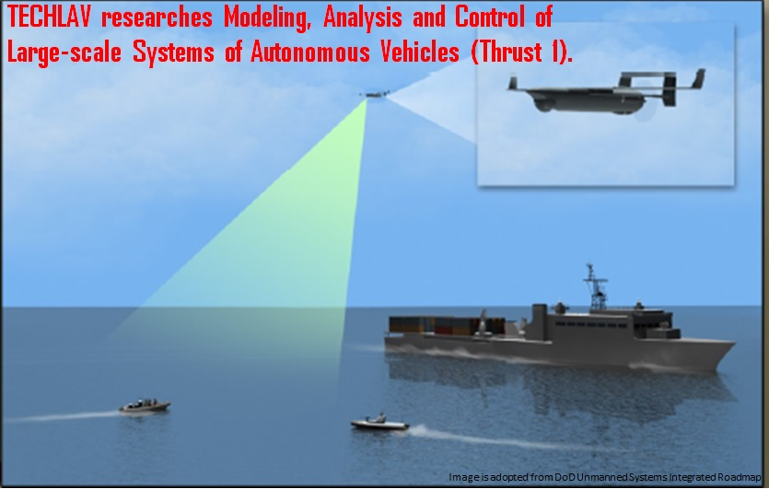
North Carolina A&T State University
Center of Excellence in Autonomy
Testing Evaluation and Control of Heterogeneous Large-scale Systems of Autonomous Vehicles
Source: http://techlav.ncat.edu/about_us.html
Notes:
The Testing, Evaluation, and Control of Heterogeneous Large Scale systems of Autonomous Vehicles (TECHLAV) Center was initially funded by the DoD Air Force Research Laboratory as a Center of Excellence in Autonomy in 2015.
The TECHLAV Center, led by North Carolina Agricultural and Technical State University (N.C. A&T) is comprised of a strong multi-disciplinary team and synergizes expertise in Control, Communication, and Human Cognition from N.C. A&T and its collaborator, University of Texas San Antonio.
The Center is also partnering with Southwestern Indian Polytechnic Institute (SIPI) to provide and promote education, outreach activities, and curriculum development to a larger Native American community.
TECHLAV is a multi-disciplinary Center of Excellence in Autonomy that will conduct collaborative and integrated research to address two fundamental grand challenges:
Teaming and Cooperative Control of Large-scale Autonomous Systems of Vehicles (LSASVs) integrated with human operators.
Testing, Evaluation, Validation, and Verification of LSASVs .

Slide 24
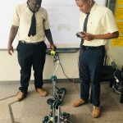
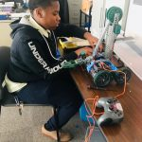
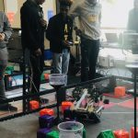
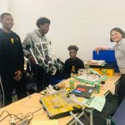
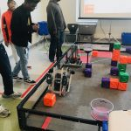
Coppin State University
Lab for Artificial Intelligence and its Applications (LAIA)
Research and development in robotics, artificial intelligence, human-computer interaction, the internet of things (IoT), and culturally relevant learning technologies.
Coppin Academy Robotics
Notes:
LAIA (Lab for Artificial Intelligence and its Applications) is a physical space (a research lab) and a community of practice (CoP) in the Department of Mathematics and Computer Science at Coppin State University, led by Dr. Leshell Hatley.
Within it, student research scientists collaborate to enhance their skills by learning, using, and creating technologies (software and hardware) to improve the community around us. These technologies focus on applications of Artificial Intelligence and related computing technologies.
Our research including:
1. Expert Systems/Intelligent Tutoring Systems 2. Intelligent Robotics 3. Game Design & Development 4. Undergraduate Research Experiences 5. PreK-16 Computer Science & Computer Engineering Education 6. Cultural Relevance & Ethics

Slide 25
DLI Accelerated Data Science Teaching Kit
Thank You
Notes:
Thanks for your attentions and time!

