Slide 1
Lecture 1.8 - Data Science Buzzwords, Hype Cycle, General vs Narrow AI
DLI Accelerated Data Science Teaching Kit

Slide 2

The Accelerated Data Science Teaching Kit is licensed by NVIDIA, Georgia Institute of Technology, and Prairie View A&M University under the
Creative Commons Attribution-NonCommercial 4.0 International License.

Slide 3
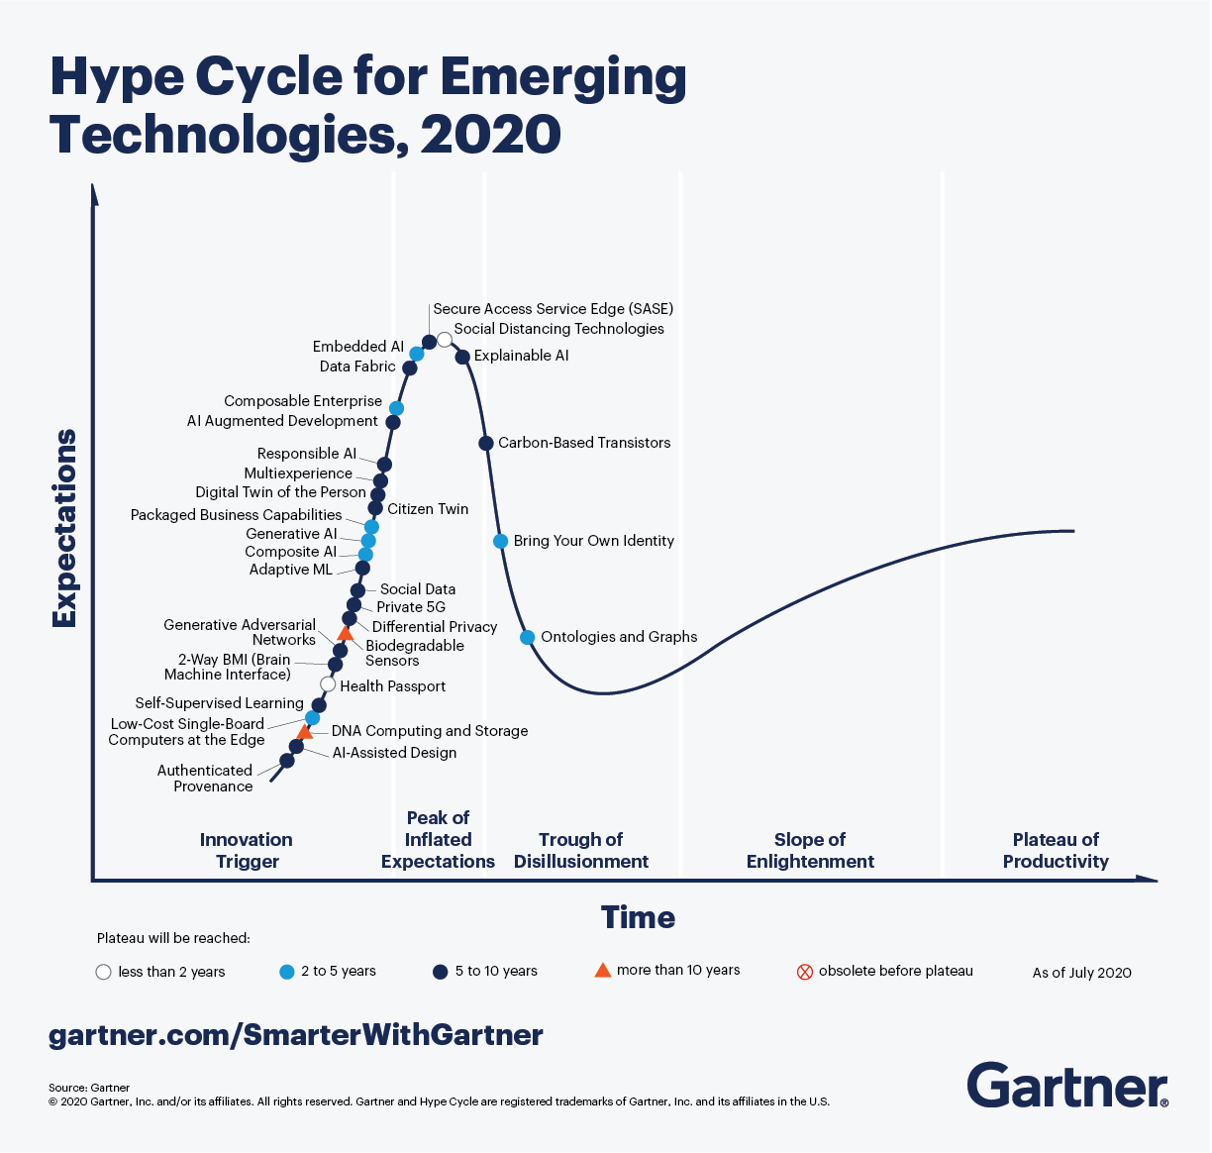
Retrieved from: https://www.gartner.com/smarterwithgartner/5-trends-drive-the-gartner-hype-cycle-for-emerging-technologies-2020/

Slide 4
Polo’s Motto
Learn New Things.
Be Cautiously Optimistic.

Slide 5
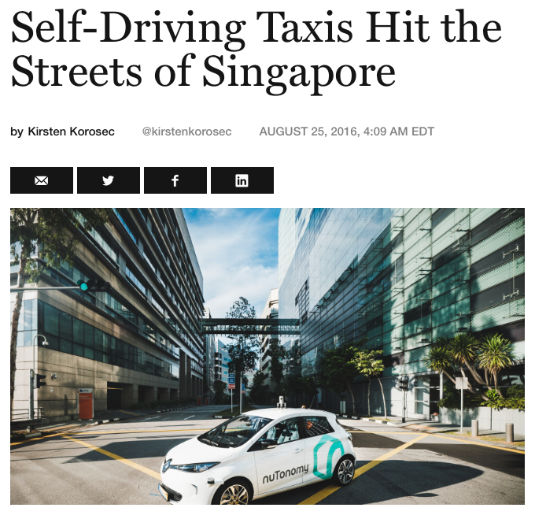
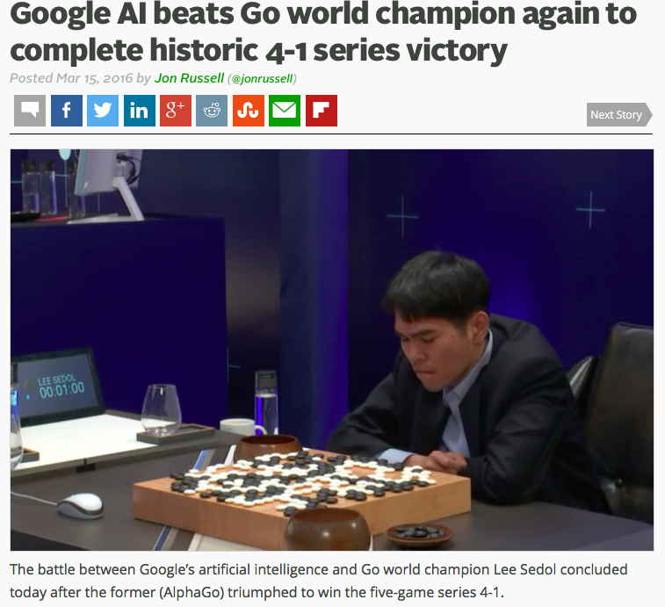
“Artificial Intelligence”
Retrived from: http://www.theaustralian.com.au/business/wall-street-journal/selfdriving-taxis-hit-the-road-in-singapore/news-story/73116ddc2e7c043578cb7b87d8264f5b
Retrieved from: https://techcrunch.com/2016/03/15/google-ai-beats-go-world-champion-again-to-complete-historic-4-1-series-victory/

Slide 6
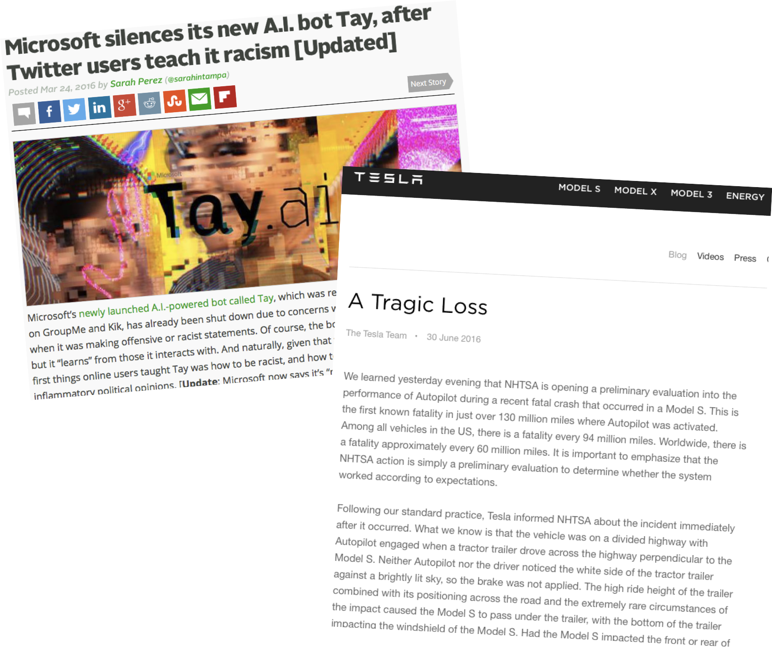
When AI Doesn’t Work Well…
“Neither Autopilot nor the driver noticed the white side of the tractor trailer against a brightly lit sky, so the brake was not applied”
https://techcrunch.com/2016/03/24/microsoft-silences-its-new-a-i-bot-tay-after-twitter-users-teach-it-racism/
https://www.tesla.com/en_GB/blog/tragic-loss?redirect=no

Slide 7
We’re in 3rd Wave of AI Boom
Two “AI winters” before
https://en.wikipedia.org/wiki/History_of_artificial_intelligence

Slide 8
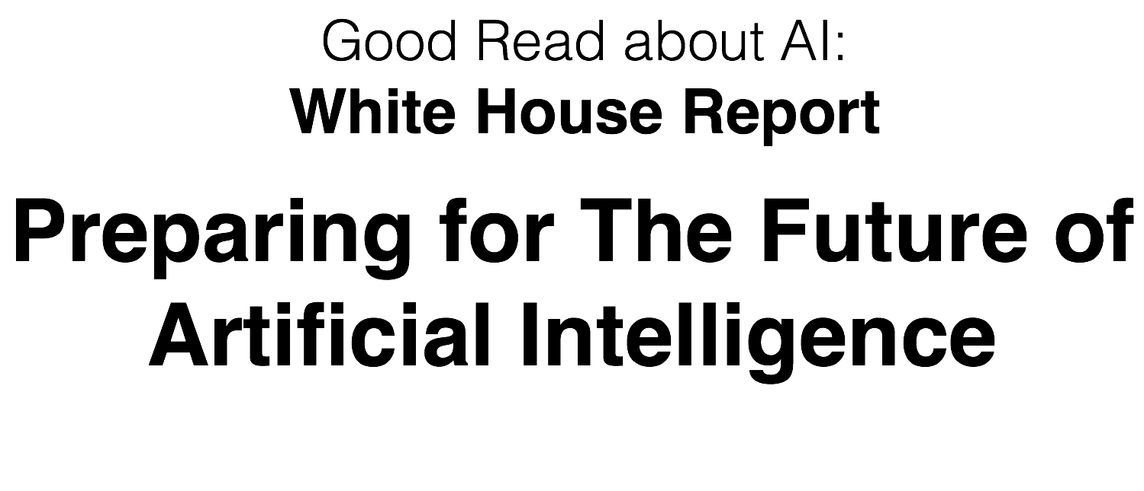
White House Report
https://obamawhitehouse.archives.gov/sites/default/files/whitehouse_files/microsites/ostp/NSTC/preparing_for_the_future_of_ai.pdf

Slide 9
The Current State of AI
Remarkable progress has been made on what is known as Narrow AI, which addresses specific application areas such as playing strategic games, language translation, self-driving vehicles, and image recognition. Narrow AI underpins many commercial services such as trip planning, shopper recommendation systems, and ad targeting, and is finding important applications in medical diagnosis, education, and scientific research. These have all had significant societal benefits and have contributed to the economic vitality of the Nation.

Slide 10
The Current State of AI
General AI (sometimes called Artificial General Intelligence, or AGI) refers to a notional future AI system that exhibits apparently intelligent behavior at least as advanced as a person across the full range of cognitive tasks. A broad chasm seems to separate today’s Narrow AI from the much more difficult challenge of General AI. Attempts to reach General AI by expanding Narrow AI solutions have made little headway over many decades of research. The current consensus of the private-sector expert community, with which the NSTC Committee on Technology concurs, is that General AI will not be achieved for at least decades.

Slide 11
DLI Accelerated Data Science Teaching Kit
Thank You

