Slide 1

Lecture 1.9 - Career Paths and Challenges
DLI Accelerated Data Science Teaching Kit
Notes:
This section will present key points on potential careers with AI and data science.
We will pay more attention to skills needed for these careers.
In addition, we will also show challenges faced in successful training of students to obtain good jobs of AI and data science.

Slide 2


The Accelerated Data Science Teaching Kit is licensed by NVIDIA, Georgia Institute of Technology, and Prairie View A&M University under the
Creative Commons Attribution-NonCommercial 4.0 International License.

Slide 3
Career Paths and Challenges
What Does a Data Scientist Do?
Skills Needed to Be a Data Scientist
What Salary Can a Data Scientist Earn?
Where Do Data Scientists Work?
Related Jobs in Data Science
Challenges in Data Science Careers
Notes:
This slide shows the topics which will be covered in this sub-module on data science career paths and challenges.
What Does a Data Scientist Do?
Skills Needed to Be a Data Scientist
What Salary Can a Data Scientist Earn?
Where Do Data Scientists Work?
Related Jobs in Data Science
Challenges in Data Science Careers

Slide 4
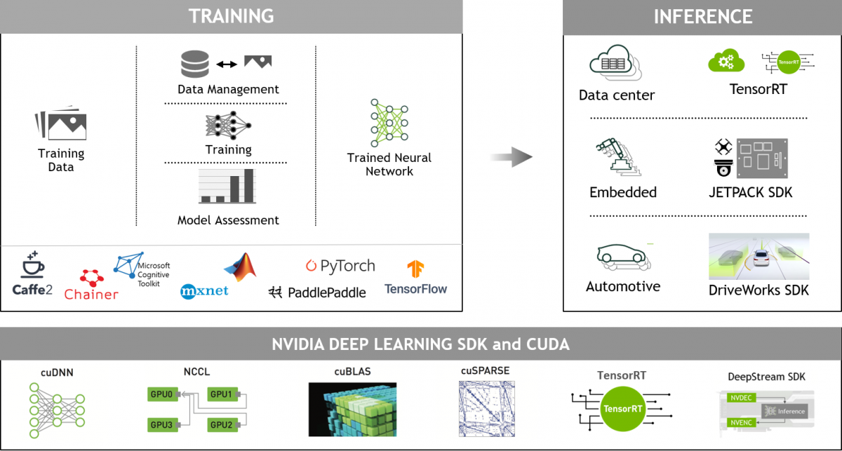
What Does a Data Scientist Do?
Data Collection
Data Preprocessing
Data Visualization
Data Analytics and Application
Notes:
As a data scientist you might be responsible for any aspect of data science including Data Collection, Data Preprocessing, Data Visualization, and Data Analytics and Application
This figure shows NVIDIA’s ecosystem framework for processing data with deep learning, support of NVIDIA tools such as the deep learning SDK and CUDA, and different deep learning platforms like Google’s TensorFlow and Apache MXNet.
These tools work together to accomplish data analysis such as TRAINING and INFERENCE, and implementation of applications such as Autodrive.

Slide 5

What Does a Data Scientist Do?
Data Collection
Data Preprocessing
Data Visualization
Data Analytics and Application
Collecting Data from Various Sources
Source: https://innovativeadagency.com/blog/importance-data-collection/
Notes:
One of the first task for data scientists is to collect data in terms of features of project tasks.
With the development of IoT, large data sets (“Big data”) can be readily available for different projects such as computer vision and natural language processing.
We however should be careful to collect useful data since more and more “noise” comes with more and more data.
For example, text clustering is a general task for a number of applications including recommendation systems. Collecting text from social media platforms like Twitter and Facebook for such applications is becoming more challenging since social language is evolving and changing on these platforms (i.e. “Imma”- instead of “I will”). This mutation of words can create a large challenge when collecting “clean” data.

Slide 6
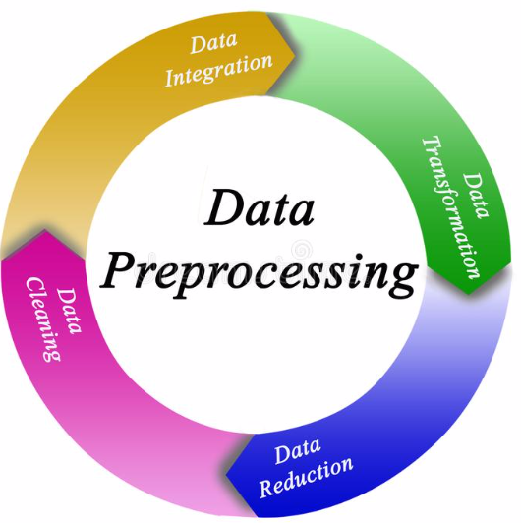
What Does a Data Scientist Do?
Data Collection
Data Preprocessing
Data Visualization
Data Analytics and Application
Source: https://www.dreamstime.com/illustration/data-preprocessing.html
Notes:
Data Preprocessing is a complex task to prepare raw data for data analysis.
It includes subtasks such as data integration, data cleaning, data reduction, and data transformation.
For example, data integration will merge different sources of data.
Each subtask is a hot topic in data science research.
In a future module we will cover details on certain subtasks such as data cleaning and data reduction, and data transformation.

Slide 7
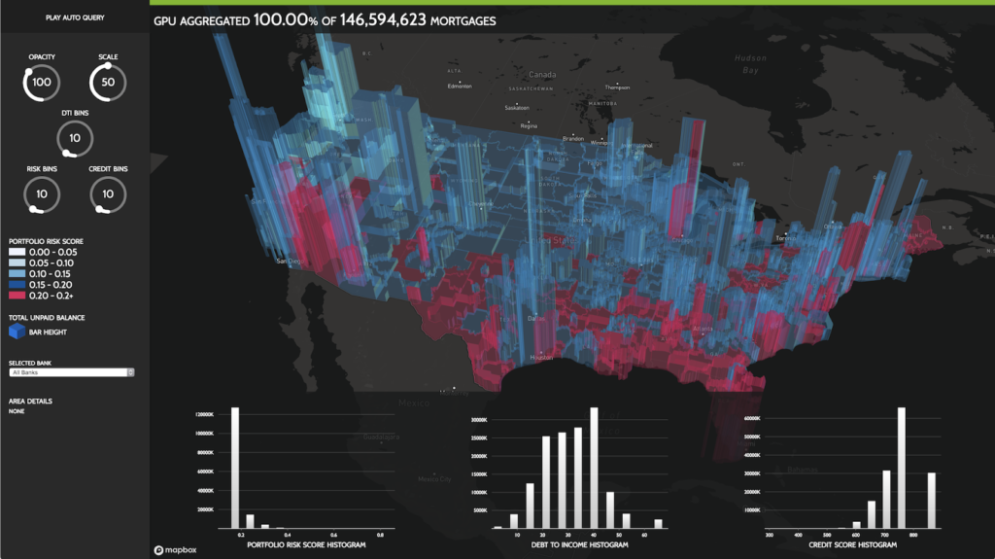
What Does a Data Scientist Do?
Data Collection
Data Preprocessing
Data Visualization
Data Analytics and Application
Source: https://developer.nvidia.com/blog/gpu-accelerated-analytics-rapids/
Notes:
Data Visualization is visualizing data collected to present data features with figures.
Here is an example of visualization of mortgage data risk assessment.
The example loads the data into GPU memory using the RAPIDS CSV reader. The ETL in this example performs a number of operations including extracting months and years from datetime fields, joining of multiple columns between DataFrames, and groupby aggregations for feature engineering. The resulting feature data is then converted and used to train a gradient boosted decision tree model on the GPU using XGBoost.
Extract, Transform, Load (ETL) is often an iterative, exploratory process. As datasets grow, the interactivity of this process suffers when running on CPUs.

Slide 8
What Does a Data Scientist Do?
Data Collection
Data Preprocessing
Data Visualization
Data Analytics and Application
Notes:
Finally, with the help of data collection, data preprocessing, and data visualization, data scientists can start to complete data analysis and build applications.
NVIDIA provides a series of SDKs to help accomplish data analysis.
Deep learning is a popular tool today to complete data analysis for different tasks such as image classification with GPU acceleration.
Data scientists then design and verify deep learning models on data collected.

Slide 9
Skills Needed to Be a Data Scientist
Analytical Skills
Communication Skills
Critical and Logical Thinking Skills
Math Skills
Computer Programming Competency
Notes:
As a data scientist you will need to work with other domain experts for many projects.
You therefore will need different skills including analytical skills, communication skills, critical and logical thinking skills, math skills, and programming skills to collaborate with them.

Slide 10
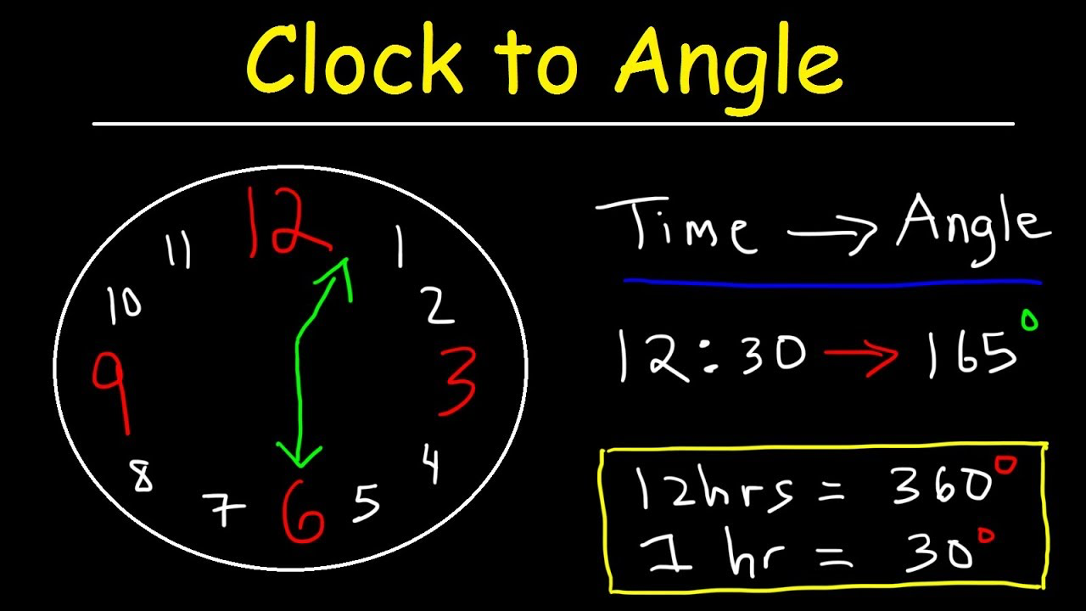
Skills Needed to Be a Data Scientist
Analytical Skills
Communication Skills
Critical and Logical Thinking Skills
Math Skills
Computer Programming Competency
Source: https://www.youtube.com/watch?v=LEHYr0XfSyI
Notes:
Analytical skills will help you investigate a problem and find the ideal solution in a timely, efficient manner.
They will help you complete tasks that involves detecting patterns, brainstorming, observing, interpreting data, integrating new information, theorizing, and making decisions.
Finally, with these skills, you will design solutions.
Another key skills is communication..

Slide 11
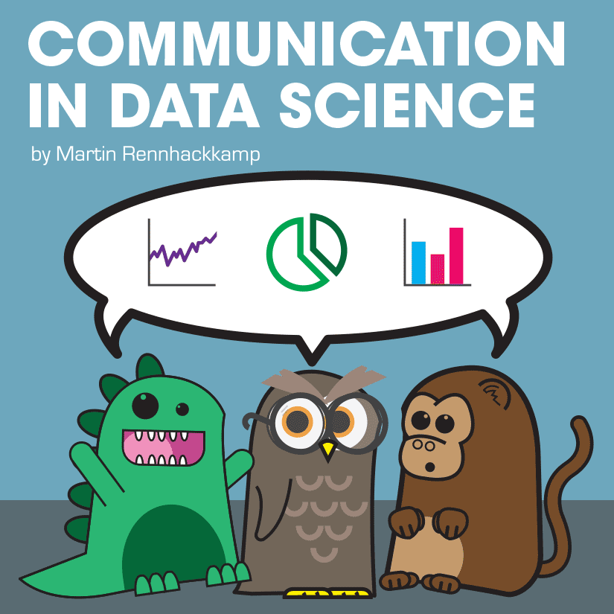
Skills Needed to Be a Data Scientist
Analytical Skills
Communication Skills
Critical and Logical Thinking Skills
Math Skills
Computer Programming Competency
Source: https://www.martinsights.com/?p=1256
Notes:
You need to be an effective communicator to discuss data patterns, conclusions, and recommendations with others involved in the project.
Such communication skills include problem sensitivity, teamwork, oral and written communication, and presentation skills.

Slide 12
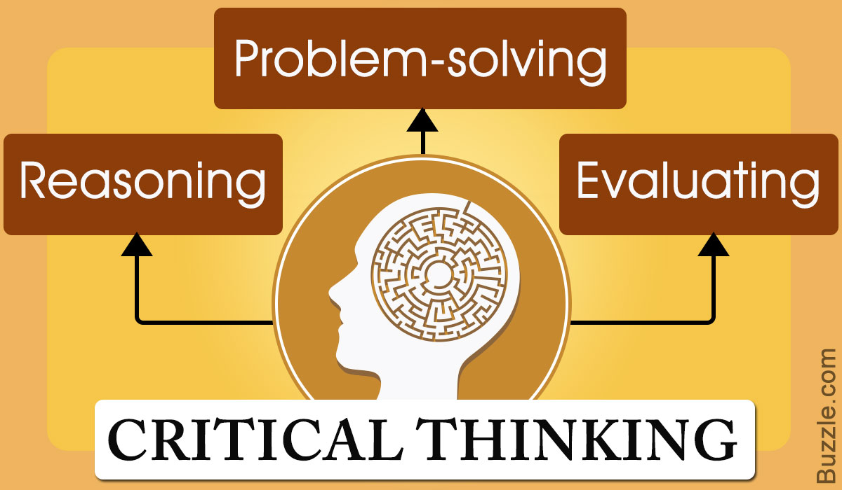
Skills Needed to Be a Data Scientist
Analytical Skills
Communication Skills
Critical and Logical Thinking Skills
Math Skills
Computer Programming Competency
Source:https://kingdomecon.wordpress.com/2018/10/16/critical-thinking-encourages-disagreement-why/
Notes:
Critical thinking will help resolve problems through evaluating information collected.
For data analysis, it is preferable to learn skills in information evaluation, deductive reasoning, data interpretation and inductive reasoning.

Slide 13
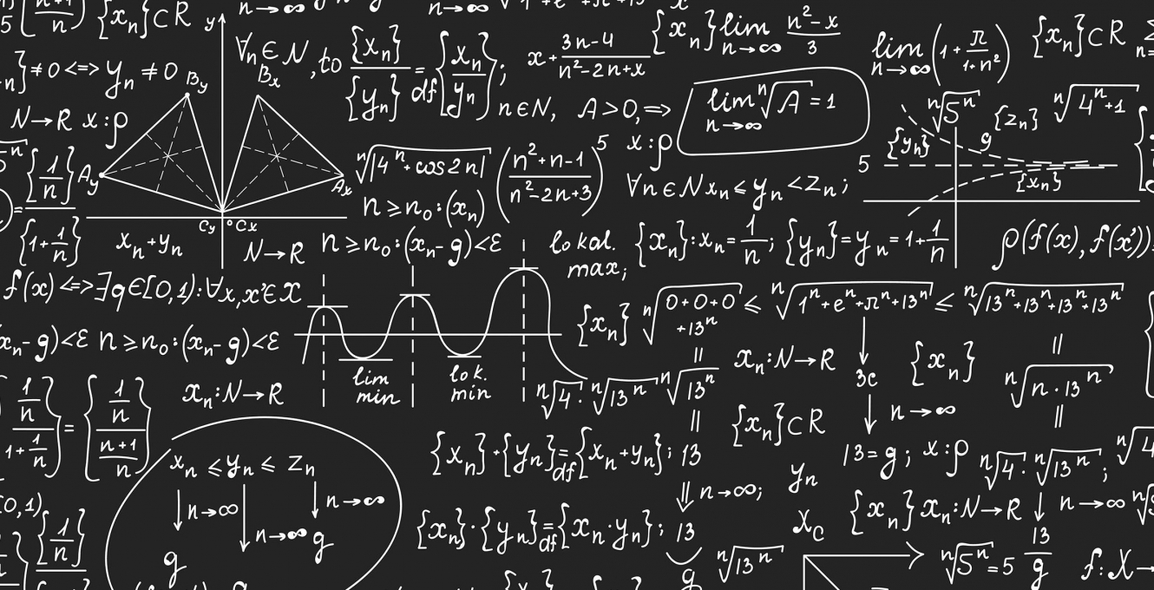
Skills Needed to Be a Data Scientist
Analytical Skills
Communication Skills
Critical and Logical Thinking Skills
Math Skills
Computer Programming Competency
Source:https://press.princeton.edu/subjects/mathematics
Notes:
Math skills are very important to data analysis since it can help design models to resolve problems.
This includes calculus, algebra, probability, Stochastic process, and dynamic programming.
For example, deep learning models are built through combining methods from calculus, algebra, information theory, and probability.

Slide 14
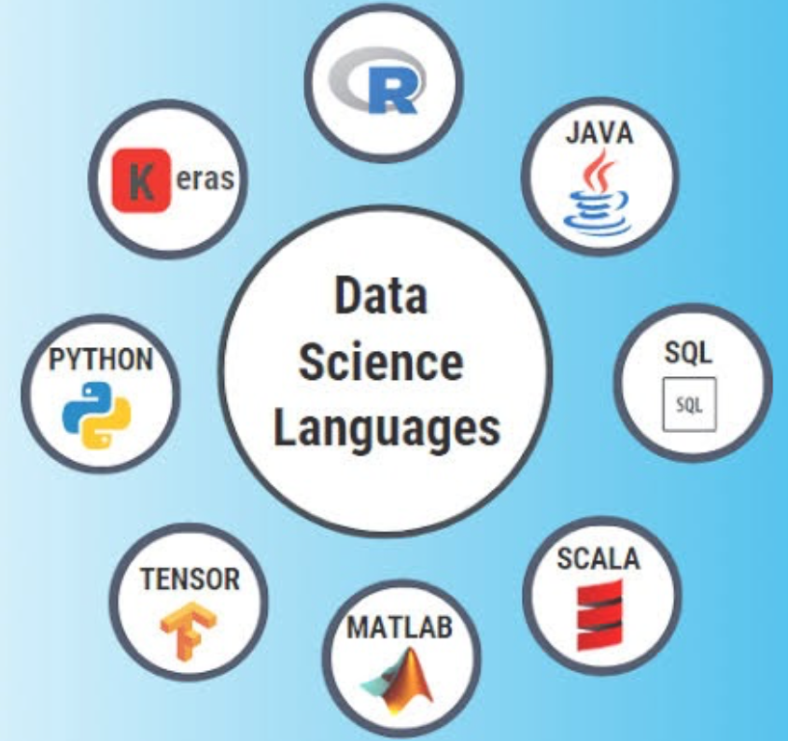
Skills Needed to Be a Data Scientist
Analytical Skills
Communication Skills
Critical and Logical Thinking Skills
Math Skills
Computer Programming Competency
Source: https://www.henryharvin.com/blog/top-programming-languages-for-data-scientists/
Notes:
Finally, you have to implement the solutions (models) to solve the problems by programming with certain programming languages.
So far it seems the Python programming language dominates data analysis with AI techniques.
For biomedical data analysis, R is viewed by many as best programming language to complete various tasks as it provides different powerful packages and libraries.
Keras is a platform that simplifies programming since it provides high-level interfaces to implement deep learning models efficiently.

Slide 15
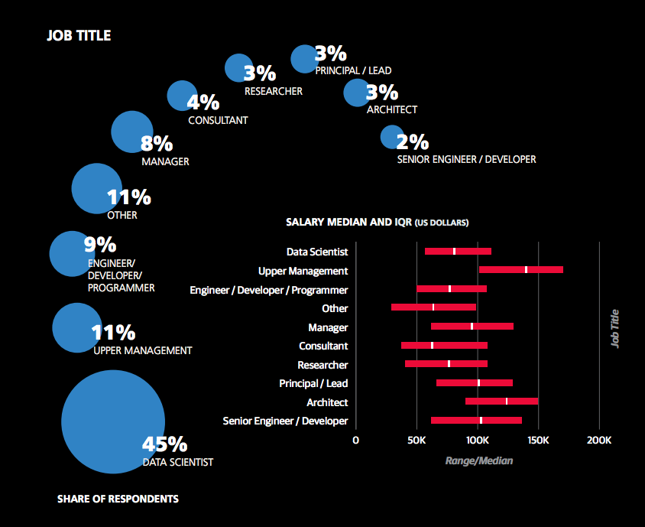
What Salary Can a Data Scientist Earn?
Data Scientist Salary by Job Title
According to an O’Reilly data science salary report, 45 percent of those surveyed said they hold the title of “data scientist.”
In general, the more a data science professional engages in managerial tasks, the higher the salary.
Source: https://datasciencedegree.wisconsin.edu/data-science/data-scientist-salary/
Notes:
If you have the skills discussed previously, you are more likely to be able to gain a job in data science.
In O’Reilly’s data science salary report, 45 percent of those surveyed said they hold the title of “data scientist.”
Another 31 percent said they are upper management; an engineer, developer, or programmer; or other. In general, the more a data science professional engages in managerial tasks—such as leading team projects, identifying business problems to be solved with analytics, or communicating with external parties—the higher the salary.
Data scientist: Salary range: $85,000-$170,000
Data analyst: Entry-level salary ranges: $50,000-$75,000, Experienced salary ranges: $65,000-$110,000
Data science/analytics manager: Salary range: $90,000-$140,000
Big data engineer: Junior/generalist salary ranges: $70,000-$115,000, Domain expert salary ranges: $100,000-$165,000

Slide 16
Where Do Data Scientists Work?
Government
Academia
Research and development
Colleges and universities
…
Industry
Software companies
Car companies
Delivery companies
…
Notes:
Data scientists have opportunities to work in government departments related to data analytics.
In addition, they can work as educators or researchers in colleges and universities.
Moreover, they can be employed by industry/ companies involved in AI such as Google, Facebook, Tesla, Amazon, NVIDIA, etc.

Slide 17
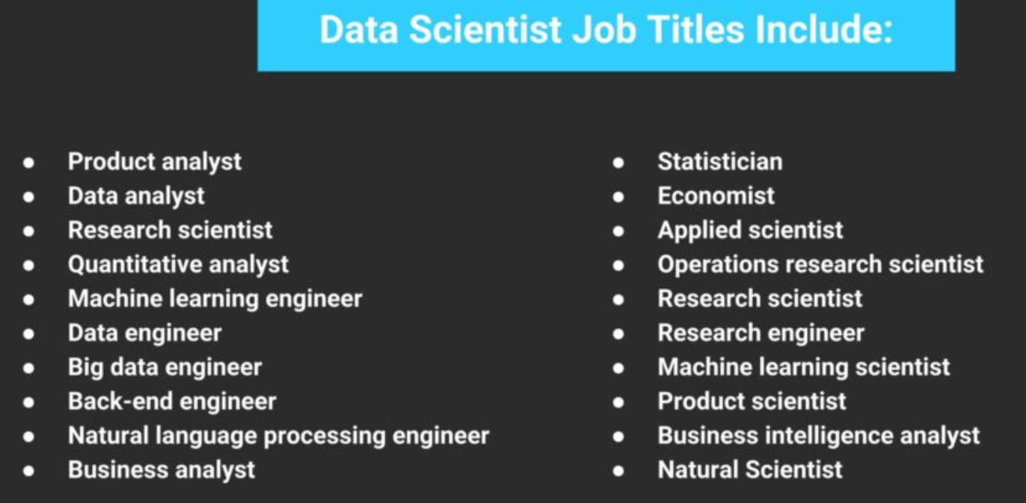
Related Jobs in Data Science
Data analyst
Research scientist
Machine learning engineer
Big data engineer
…
Source:https://www.google.com/search?q=data+scientist+job+description&tbm=isch&client=safari&hl=en&sa=X&ved=2ahUKEwif4PfehPLsAhXnAd8KHZxpCVIQrNwCKAJ6BQgBEOEB&biw=1403&bih=760#imgrc=zh7H_HOileXupM
Notes:
A number of additional jobs are related to data science.
For example, Data analysts work hands-on with data and tend to be at a point in their careers where they focus on building up data science tools and skill sets.
Big data engineers solve problems and drive business value by building the platforms and applications that data scientists use to perform data analytics.
Machine Learning Scientists develop new data approaches and algorithms to be used in adaptive systems including supervised, unsupervised, and deep learning techniques.
Machine Learning Engineers create data funnels and deliver software solutions. They typically need strong statistics and programming skills, as well as a knowledge of software engineering. In addition to designing and building machine learning systems, they are also responsible for running tests and experiments to monitor the performance and functionality of such systems.

Slide 18
Challenges in Data Science Careers
Insights not Used in Decision Making
Data Privacy, Veracity, Unavailability
Limitations of tools to scale/deploy
Wrong Questions Asked
Notes:
Insights obtained from data are not very useful in decision making because of their weak interpretable features.
Big data is not available with respect to the data privacy in some fields like medical domains.
Few tools are available to visualize high-dimensional data.
Sometimes, it is not easy to formulate the problems, which will lead to incorrect directions.

Slide 19
DLI Accelerated Data Science Teaching Kit
Thank You
Notes:
Thank you for your time and attention!

