Slide 1
Lecture ​10.1 - Big Data is Common.
How to Store It?
DLI Accelerated Data Science Teaching Kit

Slide 2

The Accelerated Data Science Teaching Kit is licensed by NVIDIA, Georgia Institute of Technology, and Prairie View A&M University under the
Creative Commons Attribution-NonCommercial 4.0 International License.

Slide 3
How to Handle Data that is Really Big?
Really big, as in...
  Petabytes (PB, about 1000 times of terabytes)
  Or beyond: exabyte, zettabyte, etc.
Do we really need to deal with such scale?
  Yes!

Slide 4

“Big Data” is Common...
Google processed 24 PB / day (2009)
Facebook’s add 0.5 PB / day to its data warehouses
CERN generated 200 PB of data from “Higgs boson” experiments
Avatar’s 3D effects took 1 PB to store
So, think BIG!
https://en.wikipedia.org/wiki/File:Avatar-Teaser-Poster.jpg
http://www.theregister.co.uk/2012/11/09/facebook_open_sources_corona/
http://thenextweb.com/2010/01/01/avatar-takes-1-petabyte-storage-space-equivalent-32-year-long-mp3/
http://dl.acm.org/citation.cfm?doid=1327452.1327492

Slide 5
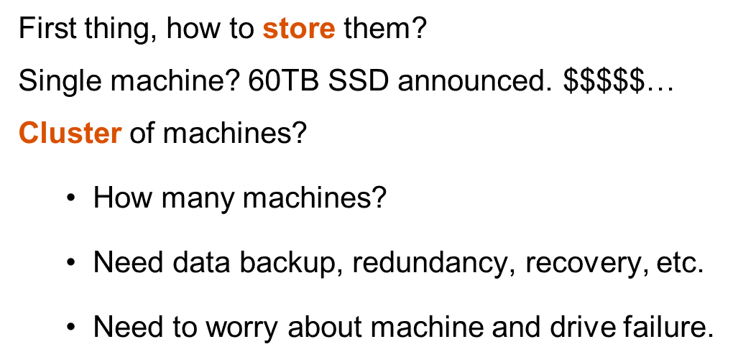
How to Store Large Datasets?
  Really? Really???
https://arstechnica.com/gadgets/2016/08/seagate-unveils-60tb-ssd-the-worlds-largest-hard-drive/
Notes:
Missed animation.

Slide 6

  Computers and Disks Die!
  Often at the most inconvenient time.

Slide 7
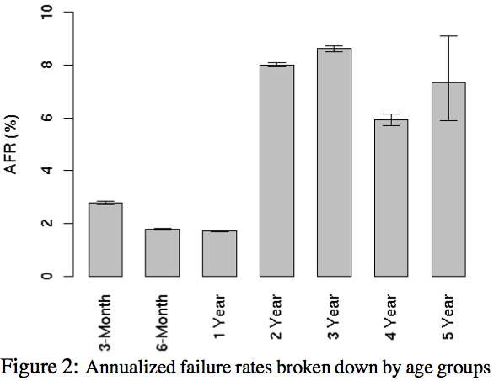
How Often Do Disks Fail?
3% of 100,000 hard drives fail within first 3 months
https://research.google.com/pubs/pub32774.html

Slide 8
DLI Accelerated Data Science Teaching Kit
Thank You

