Slide 1
Lecture 10.2 ​- Why Hadoop?
DLI Accelerated Data Science Teaching Kit

Slide 2

The Accelerated Data Science Teaching Kit is licensed by NVIDIA, Georgia Institute of Technology, and Prairie View A&M University under the
Creative Commons Attribution-NonCommercial 4.0 International License.

Slide 3
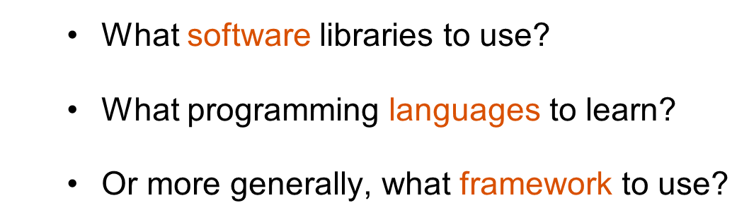
How to Analyze Large Datasets?

Slide 4
Lecture based on Hadoop: The Definitive Guide
Book covers Hadoop, some Pig, some HBase, and other things.
http://shop.oreilly.com/product/0636920033448.do

Slide 5

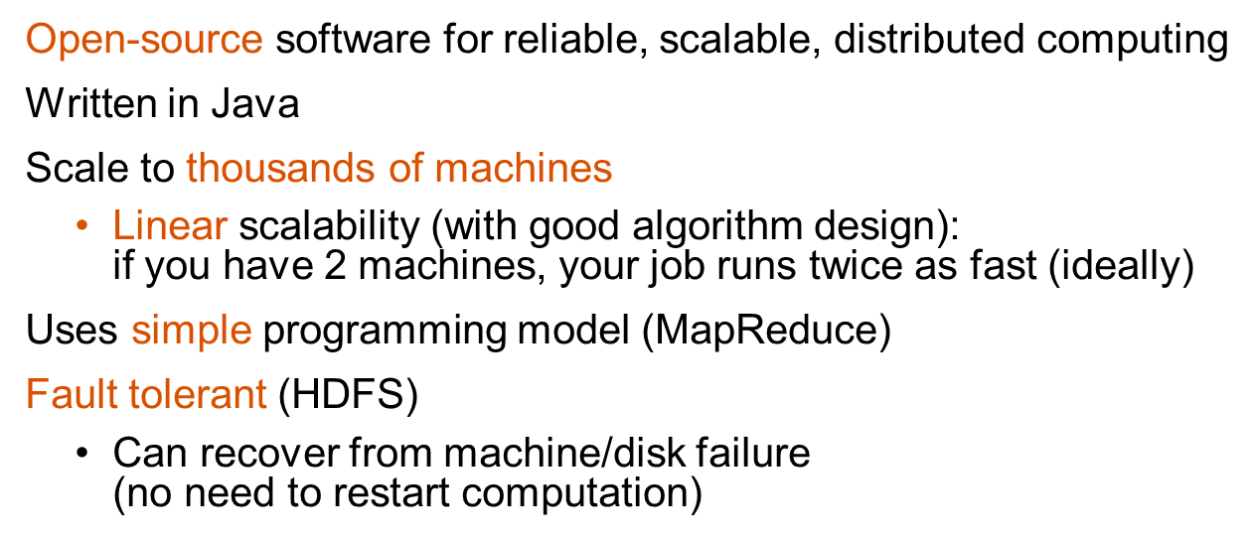
͏
͏
http://hadoop.apache.org

Slide 6
Why Learn Hadoop?
Fortune 500 companies use it
Many research groups/projects use it
Strong community support, and favored/backed my major companies, e.g., IBM, Google, Yahoo, eBay, Microsoft, etc.
It’s free, open-source
Low cost to set up (works on commodity machines)
An “essential skill”, like SQL
http://strataconf.com/strata2012/public/schedule/detail/22497

Slide 7

Elephant in the Room

Slide 8
DLI Accelerated Data Science Teaching Kit
Thank You

