Slide 1
Lecture 10.3 - MapReduce Overview
DLI Accelerated Data Science Teaching Kit

Slide 2

The Accelerated Data Science Teaching Kit is licensed by NVIDIA, Georgia Institute of Technology, and Prairie View A&M University under the
Creative Commons Attribution-NonCommercial 4.0 International License.

Slide 3
How Hadoop Scales Up Computation?
Uses master-worker architecture, and a simple computation model called MapReduce.
A simplified way to think about it
Divide data and computation into smaller pieces; each machine works on one piece
Combine results to produce final results
MapReduce: Simplified Data Processing on Large Clusters
http://static.usenix.org/event/osdi04/tech/full_papers/dean/dean.pdf

Slide 4
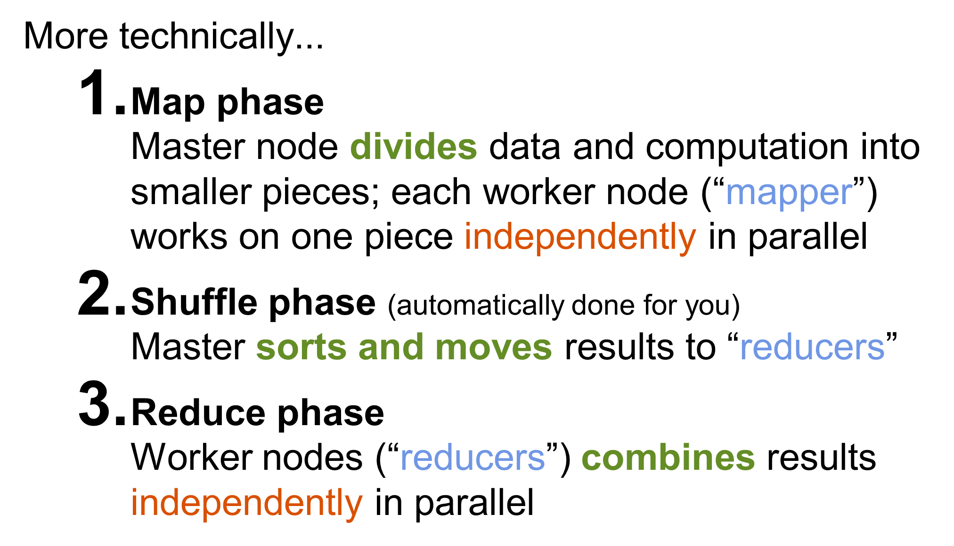
How Hadoop Scales Up Computation?

Slide 5
DLI Accelerated Data Science Teaching Kit
Thank You

