Slide 1
Lecture 10.4 - Example MapReduce Program
DLI Accelerated Data Science Teaching Kit

Slide 2

The Accelerated Data Science Teaching Kit is licensed by NVIDIA, Georgia Institute of Technology, and Prairie View A&M University under the
Creative Commons Attribution-NonCommercial 4.0 International License.

Slide 3
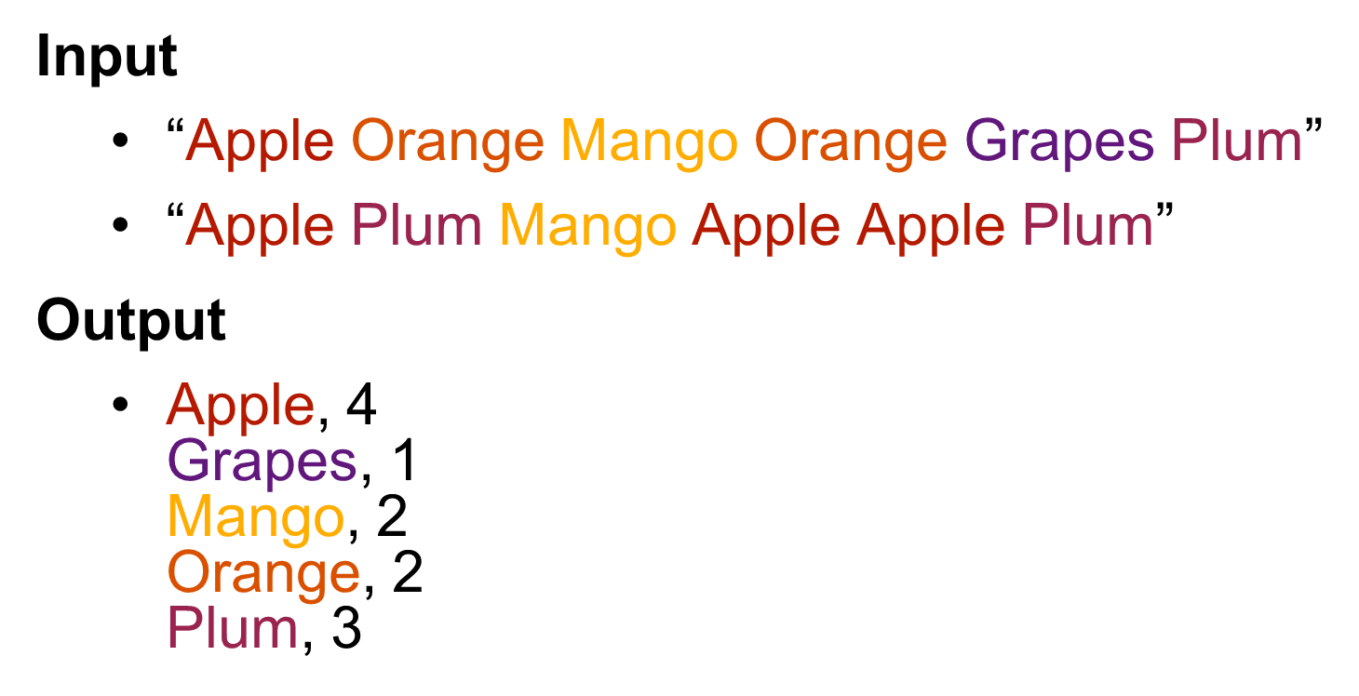
Example: Compute Word Counts
http://kickstarthadoop.blogspot.com/2011/04/word-count-hadoop-map-reduce-example.html

Slide 4
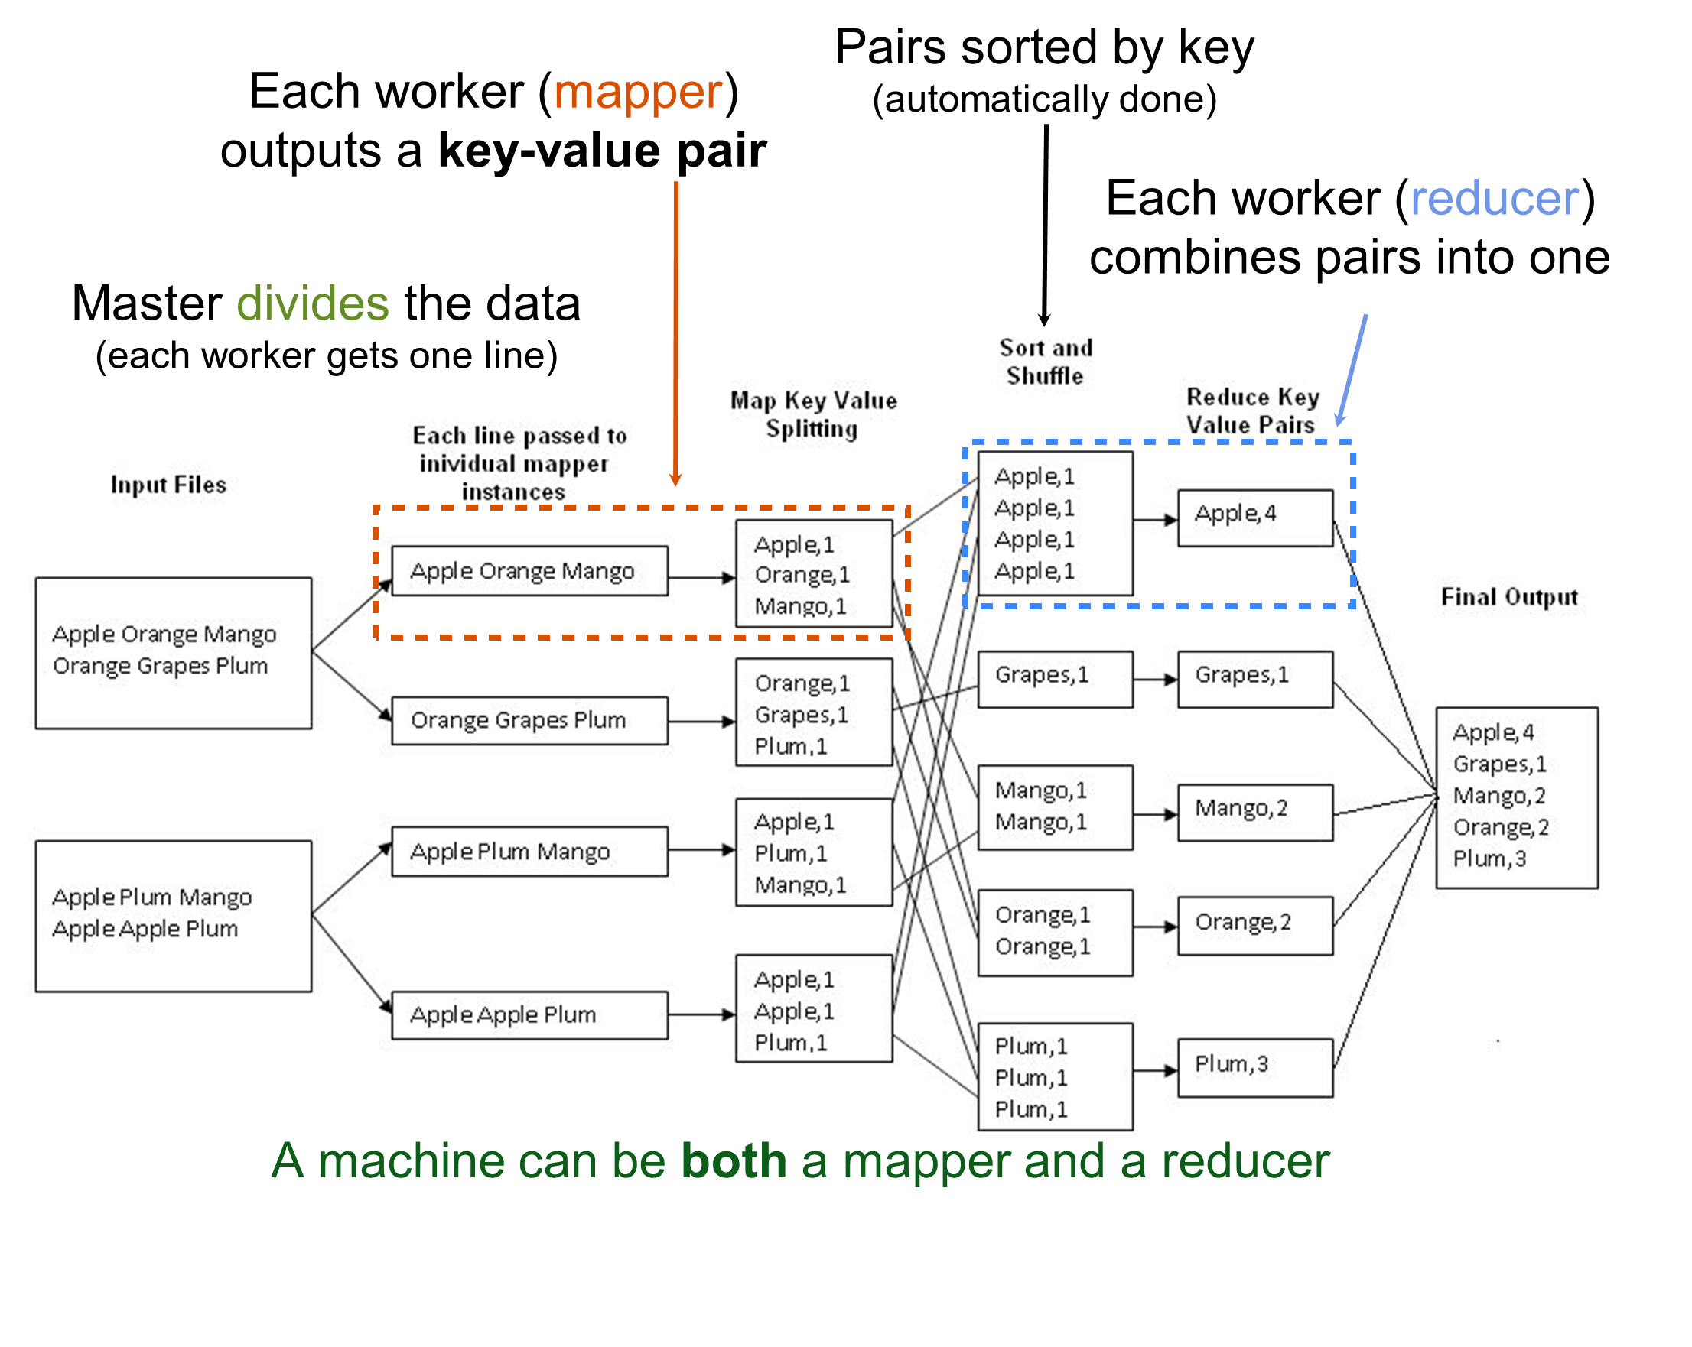

Slide 5
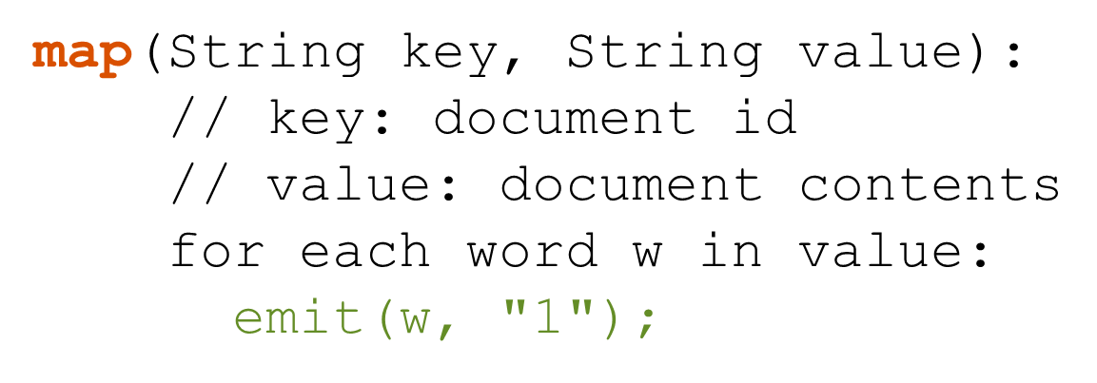
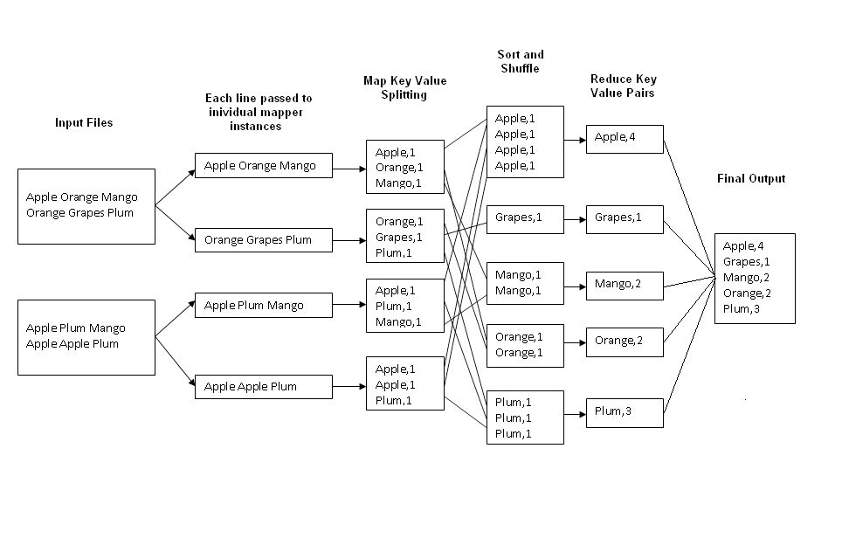

How to Implement This?

Slide 6
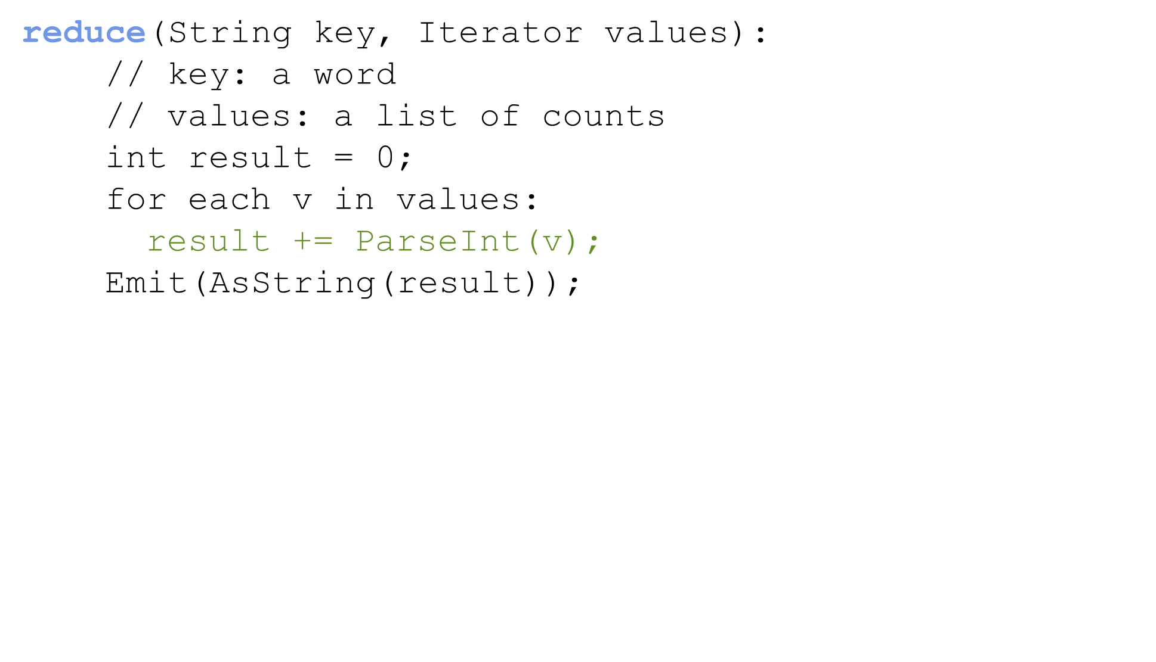
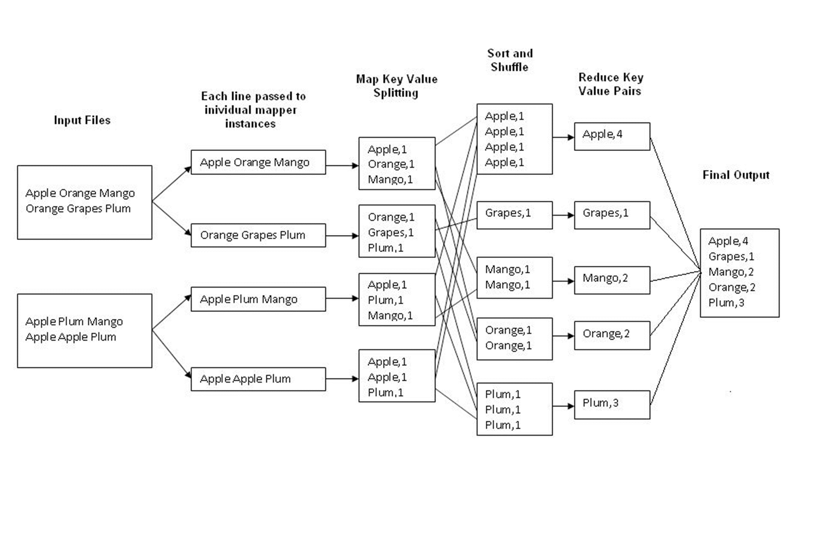

How to Implement This?

Slide 7
DLI Accelerated Data Science Teaching Kit
Thank You

