Slide 1
Lecture 10.6 - Pig and Hive
DLI Accelerated Data Science Teaching Kit

Slide 2

The Accelerated Data Science Teaching Kit is licensed by NVIDIA, Georgia Institute of Technology, and Prairie View A&M University under the
Creative Commons Attribution-NonCommercial 4.0 International License.

Slide 3

Pig
High-level language
  instead of writing low-level map and reduce functions
Easier to program, understand and maintain
Created at Yahoo!
Produces sequences of Map-Reduce programs
http://pig.apache.org

Slide 4
Pig
Your program becomes a data flow sequence
(i.e., data transformations).
  Input ➡ data flow ➡ output
You specify data flow in Pig Latin (Pig’s language). Then, Pig turns the data flow into a sequence of MapReduce jobs automatically!
http://pig.apache.org

Slide 5
Pig: 1st Benefit
Save time and effort!
Write only a few lines of Pig Latin
Quite easy to learn

Slide 6
Pig: 2nd Benefit
Pig can perform a sample run on representative subset of your input data automatically!
Helps debug your code in smaller scale (much faster!), before applying on full data

Slide 7
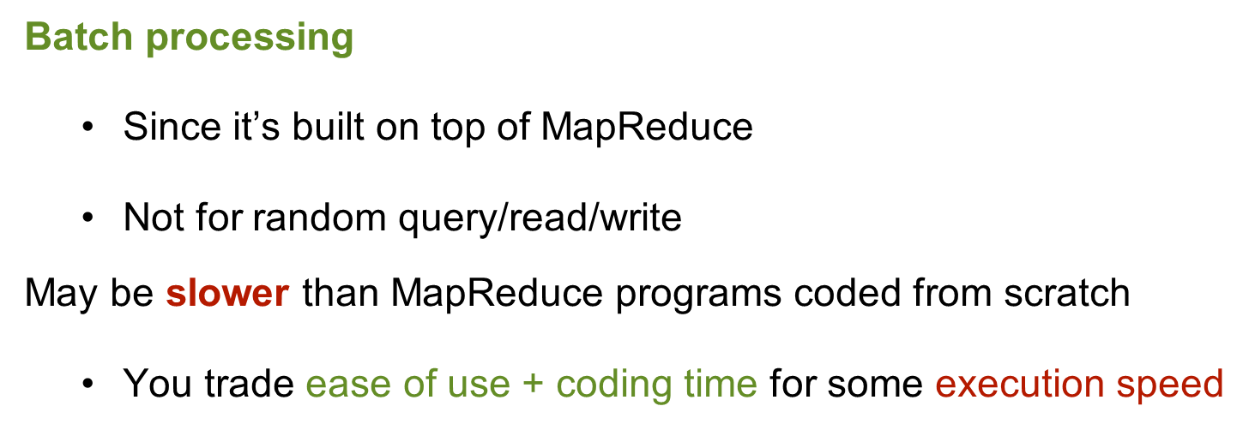
What Pig is good for?

Slide 8
How to Run Pig
Pig is a client-side application (run on your computer)
Nothing to install on Hadoop cluster

Slide 9
How to Run Pig: 2 modes
Local Mode
  Run on your computer (e.g., laptop)
  Great for trying out Pig on small datasets
MapReduce Mode
  Pig translates your commands into MapReduce jobs
  Remember you can have a single-machine cluster set up on your computer
Difference between PIG local and mapreduce mode:
http://stackoverflow.com/questions/11669394/difference-between-pig-local-and-mapreduce-mode

Slide 10
Pig program: 3 ways to write
Script
Grunt (interactive shell)
  Great for debugging
  Provides code completion (press Tab key)
Embedded (into Java program)
  Use PigServer class (like JDBC for SQL)
  Use PigRunner to access Grunt

Slide 11
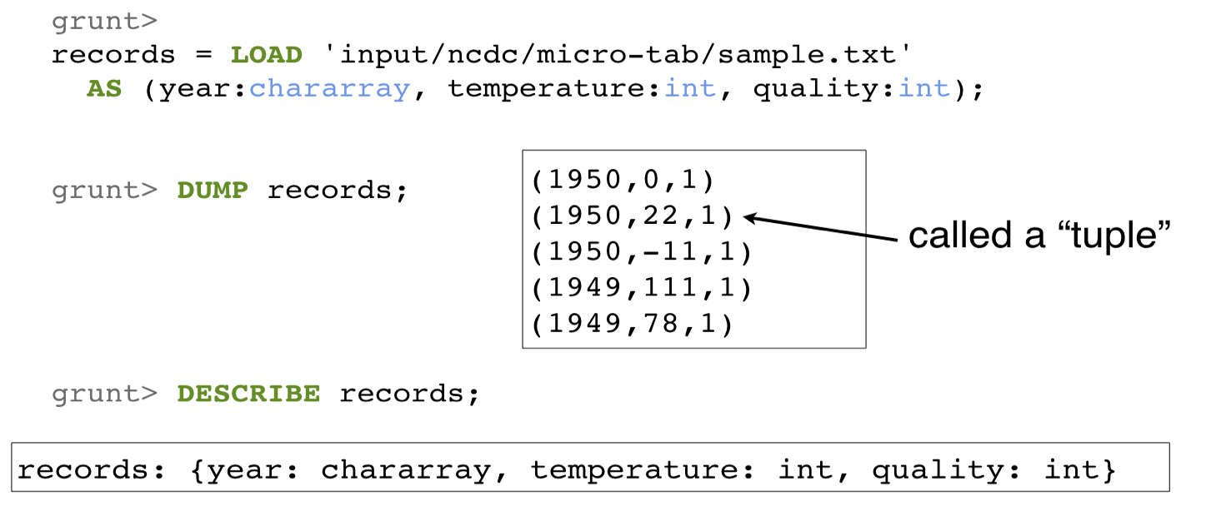
Find Highest Temperature by Year

Slide 12
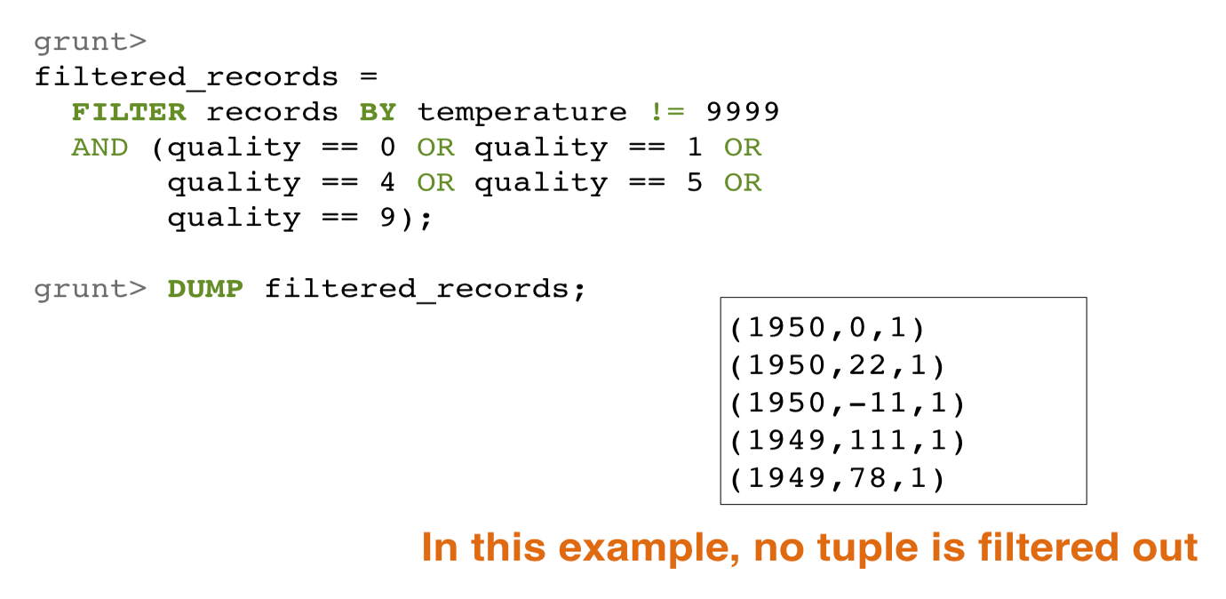
Find Highest Temperature by Year

Slide 13
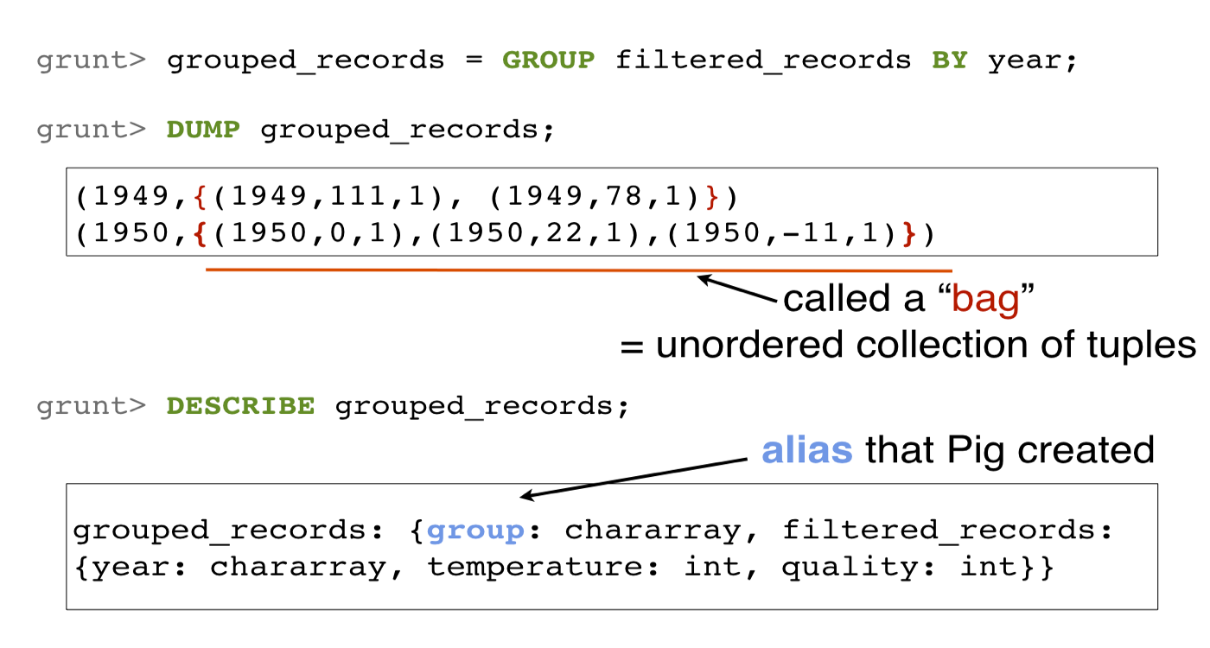
Find Highest Temperature by Year

Slide 14
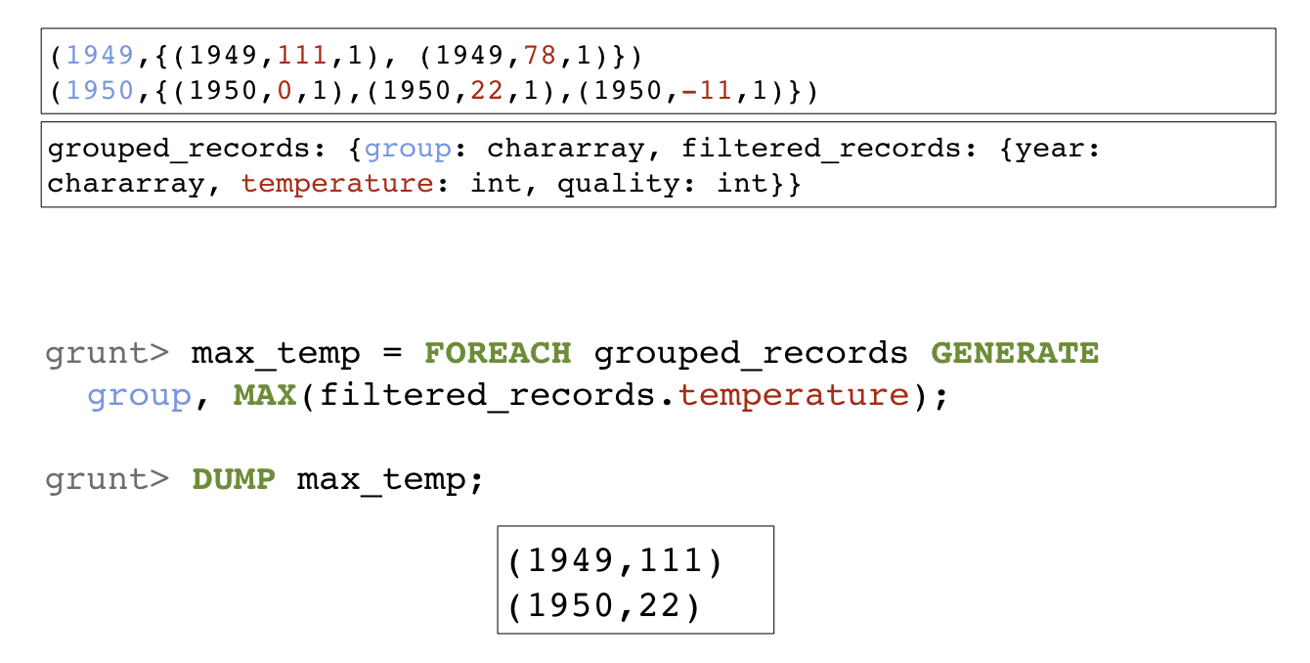
Find Highest Temperature by Year

Slide 15
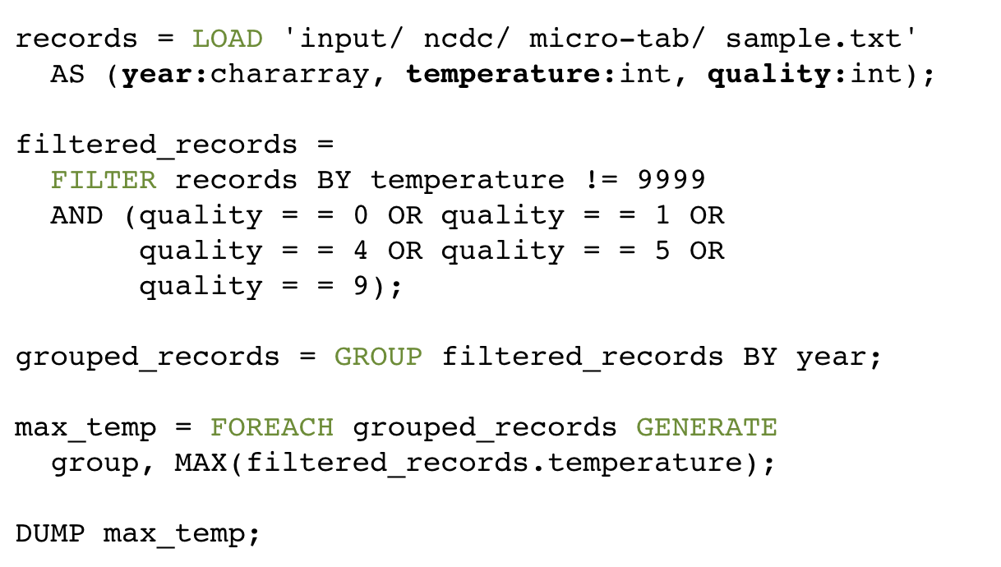
Find Highest Temperature by Year

Slide 16
Run Pig on a Subset of Your Data
You saw an example run on a tiny dataset
How to test your program on a larger dataset, without having to wait for a long time?
  Use the ILLUSTRATE command to generate sample dataset

Slide 17
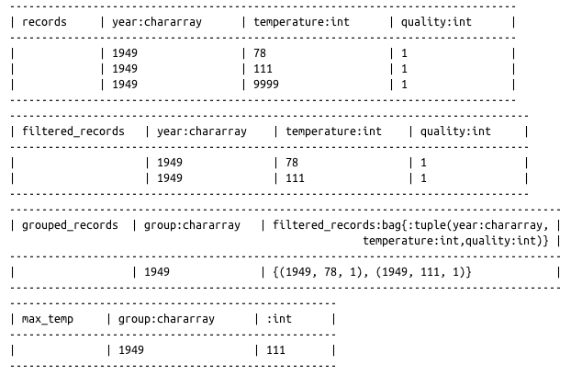
Run Pig on a Subset of Your Data
  grunt> ILLUSTRATE max_temp;

Slide 18
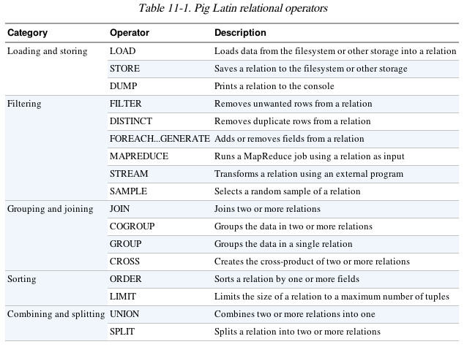
Much More to Learn About Pig
Relational Operators, Diagnostic Operators (e.g., describe, explain, illustrate), utility commands (cat, cd, kill, exec), etc.

Slide 19

Hive
Use SQL to run queries on large datasets
Developed at Facebook
Similar to Pig, Hive runs on client computer that submit jobs
(no need to install on Hadoop cluster)
  You write HiveQL (Hive’s query language), which gets converted into MapReduce jobs
http://hive.apache.org

Slide 20
Example: create table, load data
CREATE TABLE records (year STRING, temperature INT, quality INT)
ROW FORMAT DELIMITED
FIELDS TERMINATED BY ‘\t’;
Specify that data file is tab-separated
LOAD DATA LOCAL INPATH 'input/ncdc/micro-tab/sample.txt'
OVERWRITE INTO TABLE records;
Overwrite old file
This data file will be copied to Hive’s internal data directory

Slide 21
Example: Query
hive> SELECT year, MAX(temperature)
> FROM records
> WHERE temperature != 9999
> AND (quality =0 OR quality =1 OR quality =4 OR
quality = 5 OR quality = 9)
> GROUP BY year;
1949 111
1950 22

Slide 22
Find Highest Temperature by Year
hive> SELECT year, MAX(temperature)
> FROM records
> WHERE temperature != 9999
> AND (quality =0 OR quality =1 OR quality =4 OR
quality = 5 OR quality = 9)
> GROUP BY year;
1949 111
1950 22

Slide 23
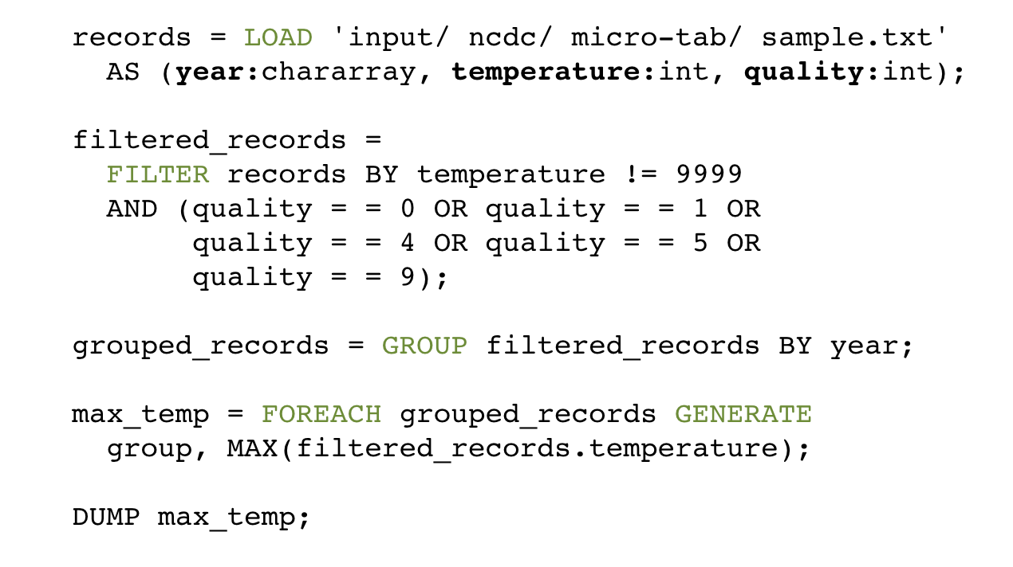
Same Thing Done using Pig

Slide 24
Hive (~SQL) vs Pig
Pig is procedural (SQL is declarative)
͏Checkpointing data in the pipeline
Use specific operator implementations vs. relying on optimizer
͏Splitting pipeline
e.g., do multiple things to intermediate data
Use developer’s own code
e.g., different ways of loading data

Slide 25
DLI Accelerated Data Science Teaching Kit
Thank You

