Slide 1
Lecture 11.1 - Spark Overview
DLI Accelerated Data Science Teaching Kit

Slide 2

The Accelerated Data Science Teaching Kit is licensed by NVIDIA, Georgia Institute of Technology, and Prairie View A&M University under the
Creative Commons Attribution-NonCommercial 4.0 International License.

Slide 3

http://spark.apache.org
Not a modified version of Hadoop
Separate, fast, MapReduce-like engine
In-memory data storage for very fast iterative queries
General execution graphs and powerful optimizations
Up to 100x faster than Hadoop MapReduce in memory
Compatible with Hadoop’s storage APIs
Can read/write to any Hadoop-supported system, including HDFS, HBase, SequenceFiles, etc.

Slide 4

Port of Apache Hive to run on Spark
Compatible with Hive data, metastores, and queries (HiveQL, UDFs, etc)
Similar speedups of up to 40x

Slide 5

Project History
UC BERKELEY
Spark project started in 2009 at UC Berkeley AMP lab, open sourced 2010
Became Apache Top-Level Project in Feb 2014
Spark SQL started summer 2011
Built by 1000+ developers and people from 200 companies
Scale to 1000+ nodes in production
Used by many companies and organizations: Amazon, eBay, IBM, NASA, Yahoo, …
http://en.wikipedia.org/wiki/Apache_Spark

Slide 6
Why a New Programming Model?
MapReduce greatly simplified big data analysis
But as soon as it got popular, users wanted more:
More complex, multi-stage applications (e.g. iterative graph algorithms and machine learning)
More interactive ad-hoc queries
Require faster data sharing across parallel jobs

Slide 7
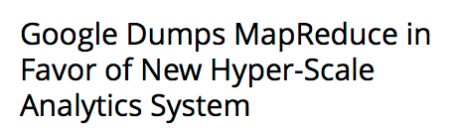
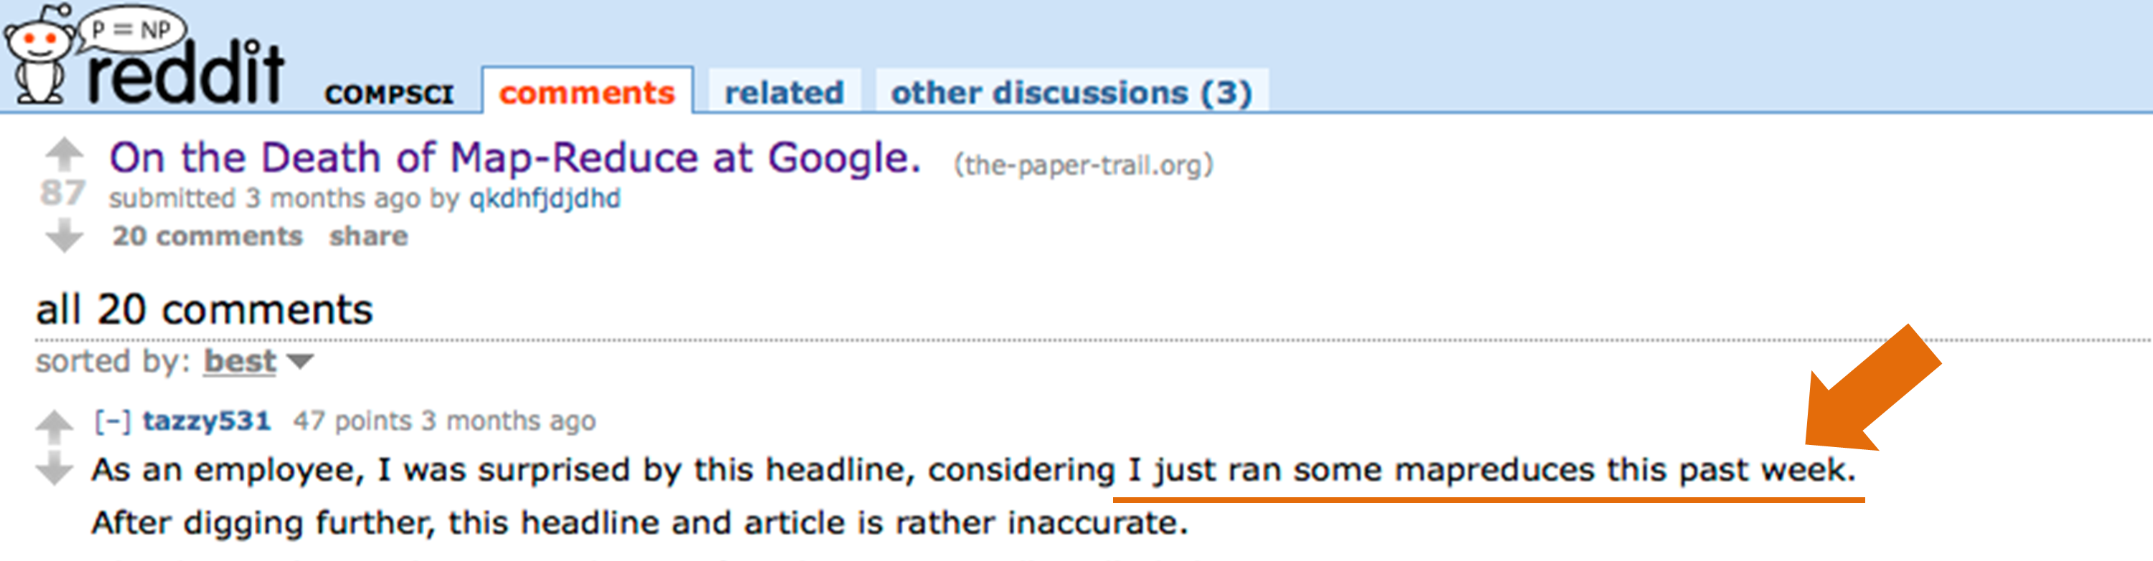
Is MapReduce dead? Not really.
http://www.datacenterknowledge.com/archives/2014/06/25/google-dumps-mapreduce-favor-new-hyper-scale-analytics-system/
http://www.reddit.com/r/compsci/comments/296aqr/on_the_death_of_mapreduce_at_google/

Slide 8
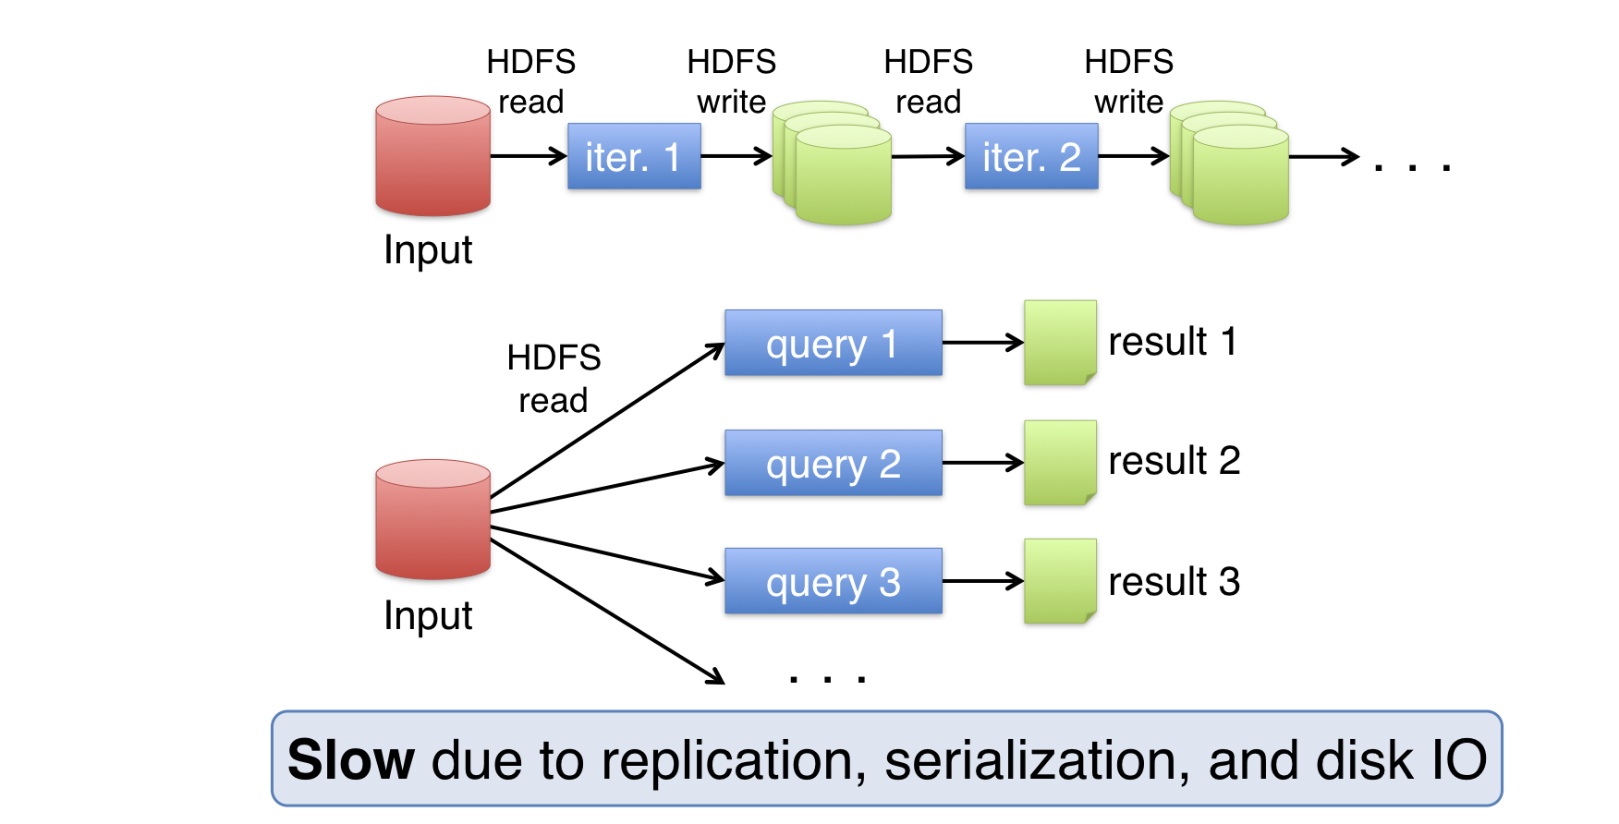
Data Sharing in Hadoop MapReduce

Slide 9
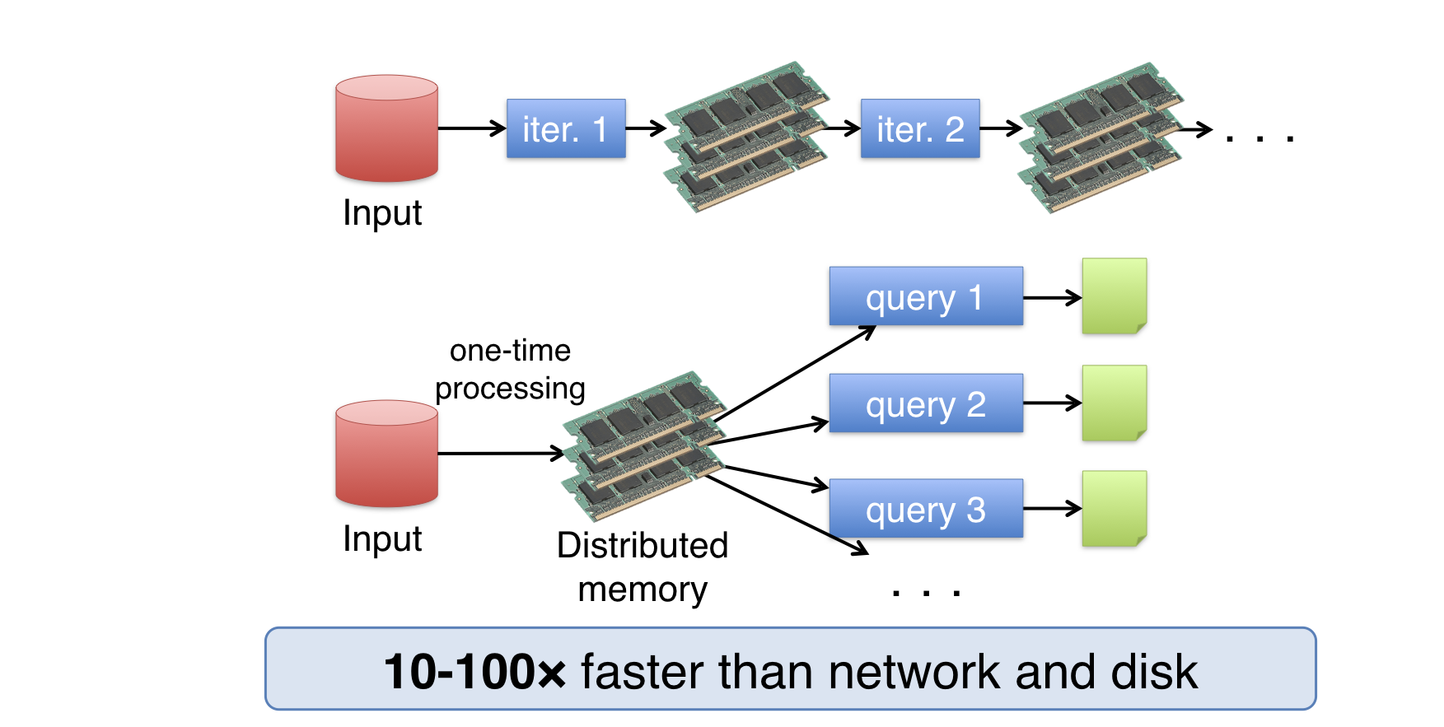
Data Sharing in Spark

Slide 10
Spark Programming Model
Key idea: resilient distributed datasets (RDDs)
Distributed collections of objects that can be cached in memory across cluster nodes
Manipulated through various parallel operators
Automatically rebuilt on failure
Interface
Supported languages: Java, Scala, Python, R
Can be used interactively from Scala, Python console

Slide 11
DLI Accelerated Data Science Teaching Kit
Thank You
We thank Dr. Matei Zaharia for sharing teaching materials for Spark.

