Slide 1
Lecture 11.2 - Example Spark Programs
DLI Accelerated Data Science Teaching Kit

Slide 2

The Accelerated Data Science Teaching Kit is licensed by NVIDIA, Georgia Institute of Technology, and Prairie View A&M University under the
Creative Commons Attribution-NonCommercial 4.0 International License.

Slide 3
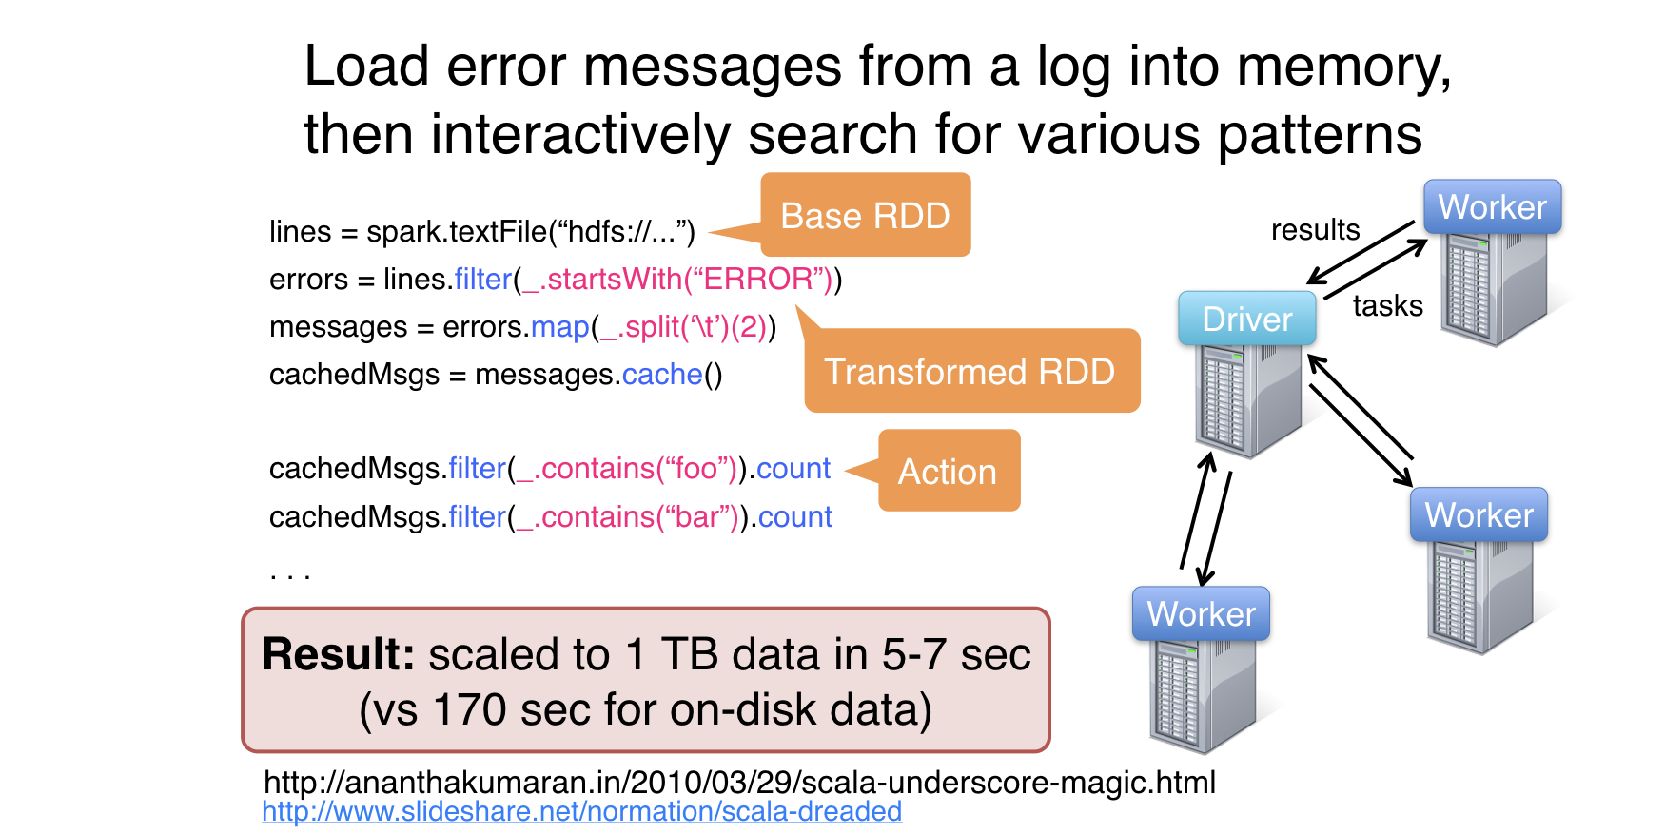
Example: Log Mining

Slide 4
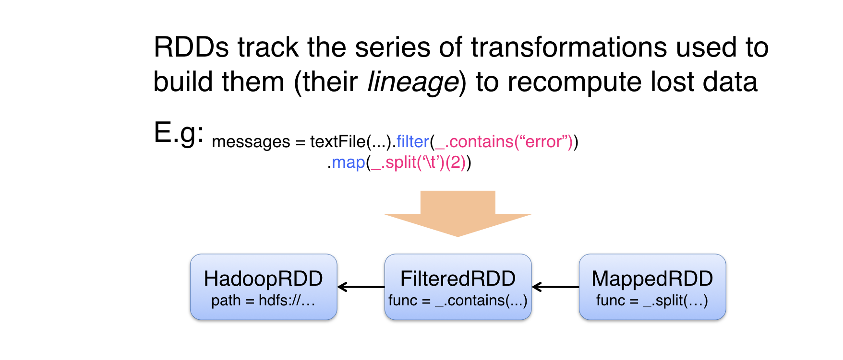
Fault Tolerance

Slide 5
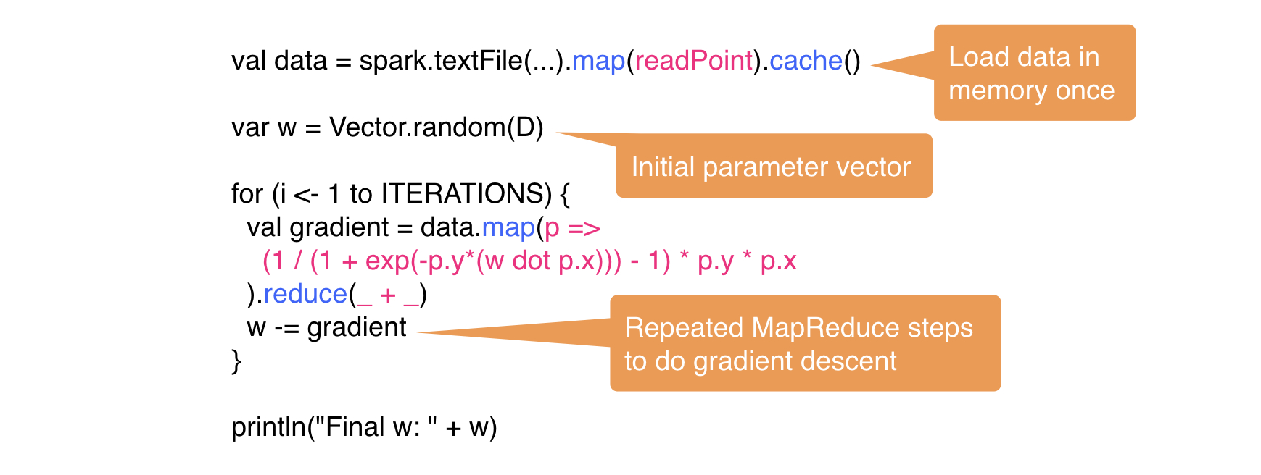
Example: Logistic Regression

Slide 6
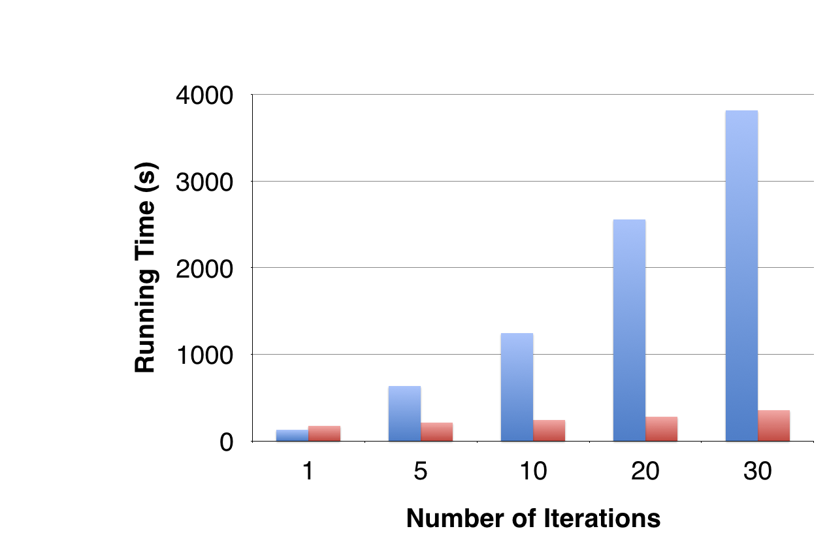
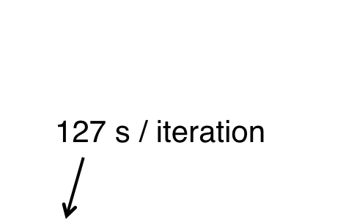

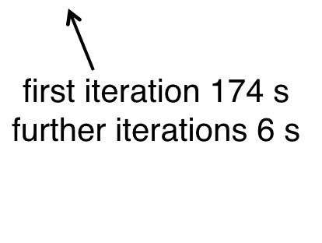
Logistic Regression Performance

Slide 7
DLI Accelerated Data Science Teaching Kit
Thank You
We thank Dr. Matei Zaharia for sharing teaching materials for Spark.

