Slide 1
Lecture 11.3 - Spark SQL and Other Spark Libraries
DLI Accelerated Data Science Teaching Kit

Slide 2

The Accelerated Data Science Teaching Kit is licensed by NVIDIA, Georgia Institute of Technology, and Prairie View A&M University under the
Creative Commons Attribution-NonCommercial 4.0 International License.

Slide 3
Motivation
Hive is great, but Hadoop’s disk-based engine can make even the smallest queries take minutes
Can we extend Hive to run on Spark?
Yes! Spark SQL = Hive on Spark

Slide 4
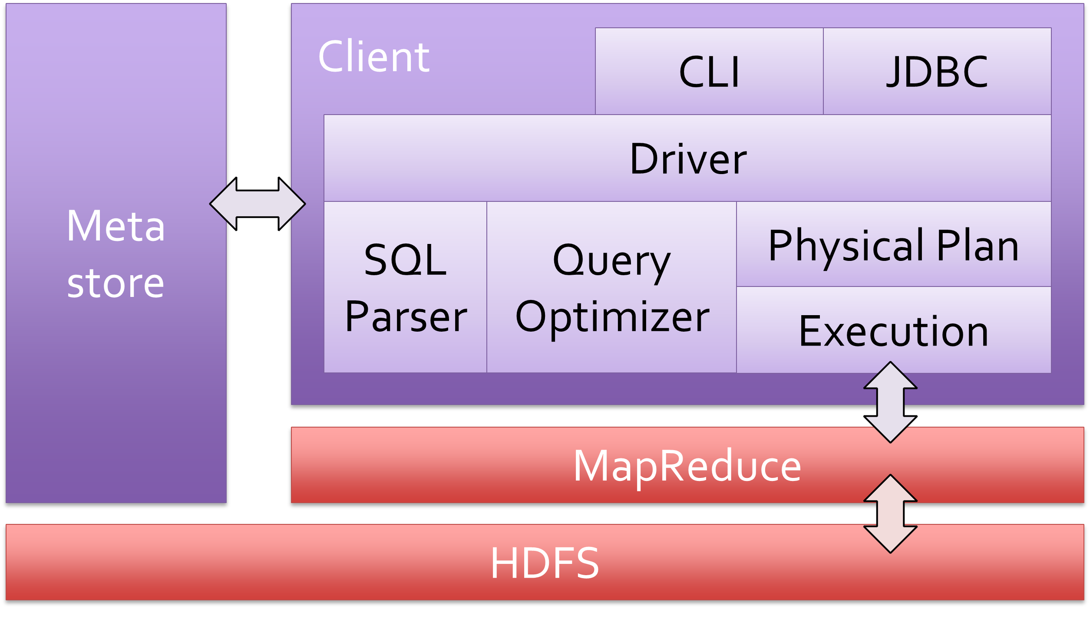
Hive Architecture

Slide 5
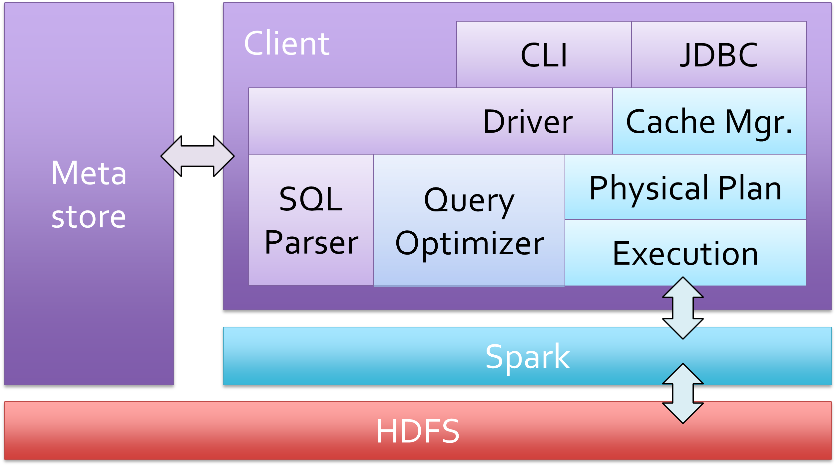
Spark SQL Architecture
[Engle et al, SIGMOD 2012]

Slide 6
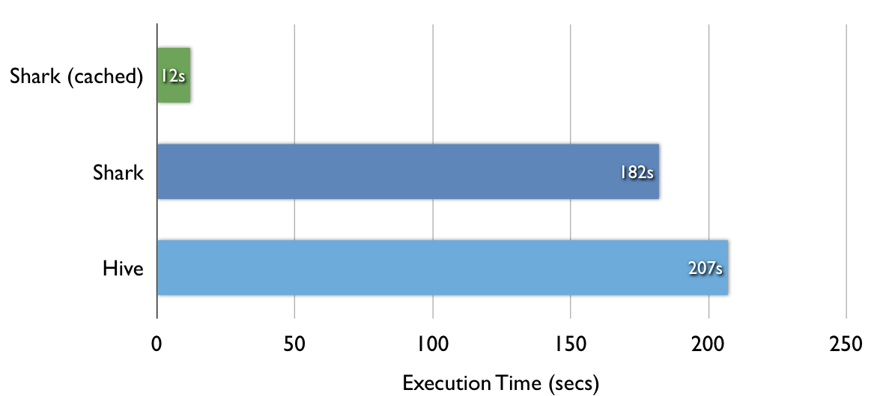
Benchmark Query 1
SELECT * FROM grep WHERE field LIKE ‘%XYZ%’;
Spark (cached)
Spark

Slide 7
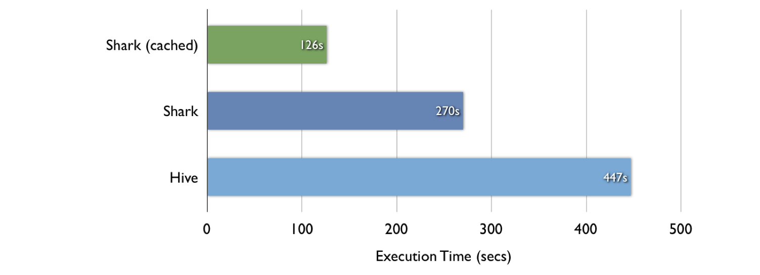
Benchmark Query 2
SELECT sourceIP, AVG(pageRank), SUM(adRevenue) AS earnings
FROM rankings AS R, userVisits AS V ON R.pageURL =V.destURL
WHERE V.visitDate BETWEEN ‘1999-01-01’ AND ‘2000-01-01’
GROUP BY V.sourceIP
ORDER BY earnings DESC
LIMIT 1;
Spark (cached)
Spark

Slide 8
Spark Streaming
Recall that Spark’s model was motivated by two emerging uses (interactive and multi-stage apps)
Another emerging use case that needs fast data sharing is stream processing
Track and update state in memory as events arrive
Large-scale reporting, click analysis, spam filtering, etc.

Slide 9
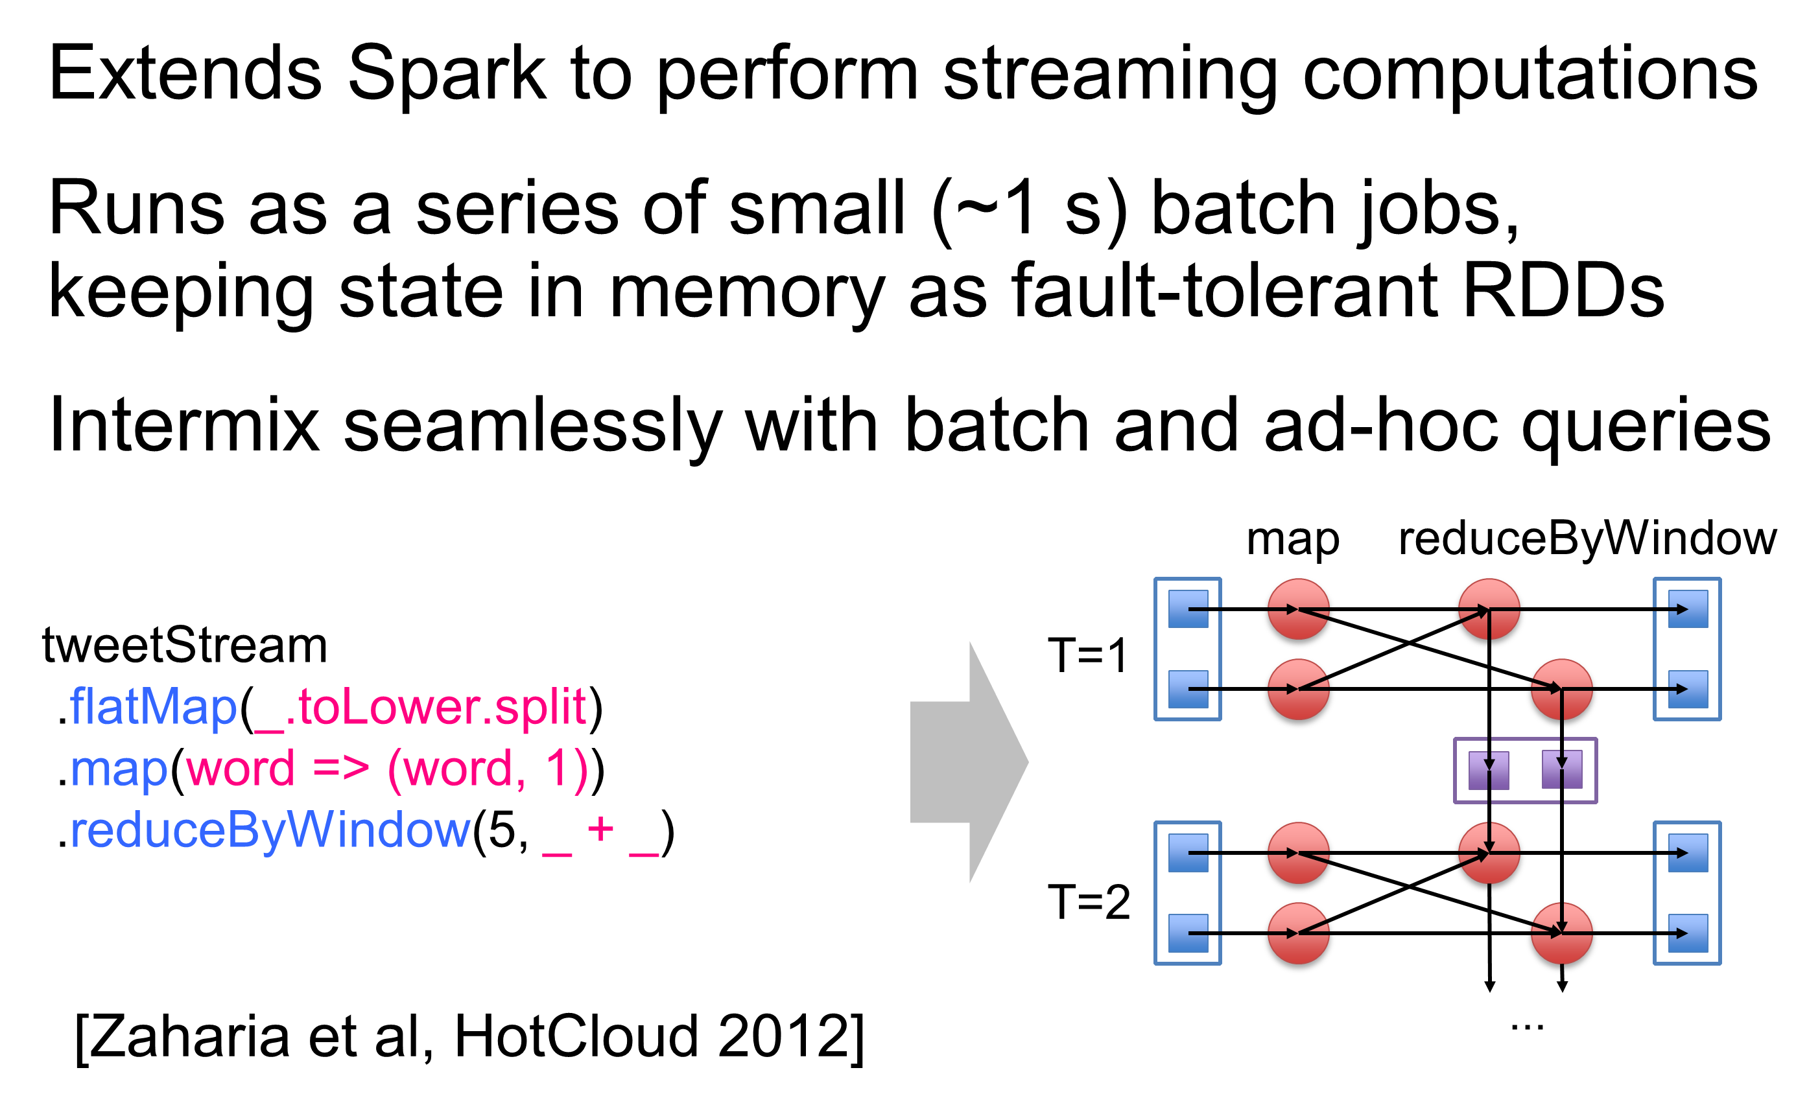
Spark Streaming

Slide 10
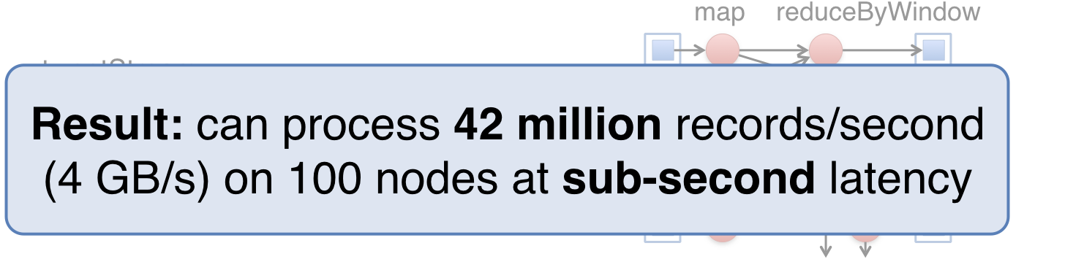

Spark Streaming

Slide 11
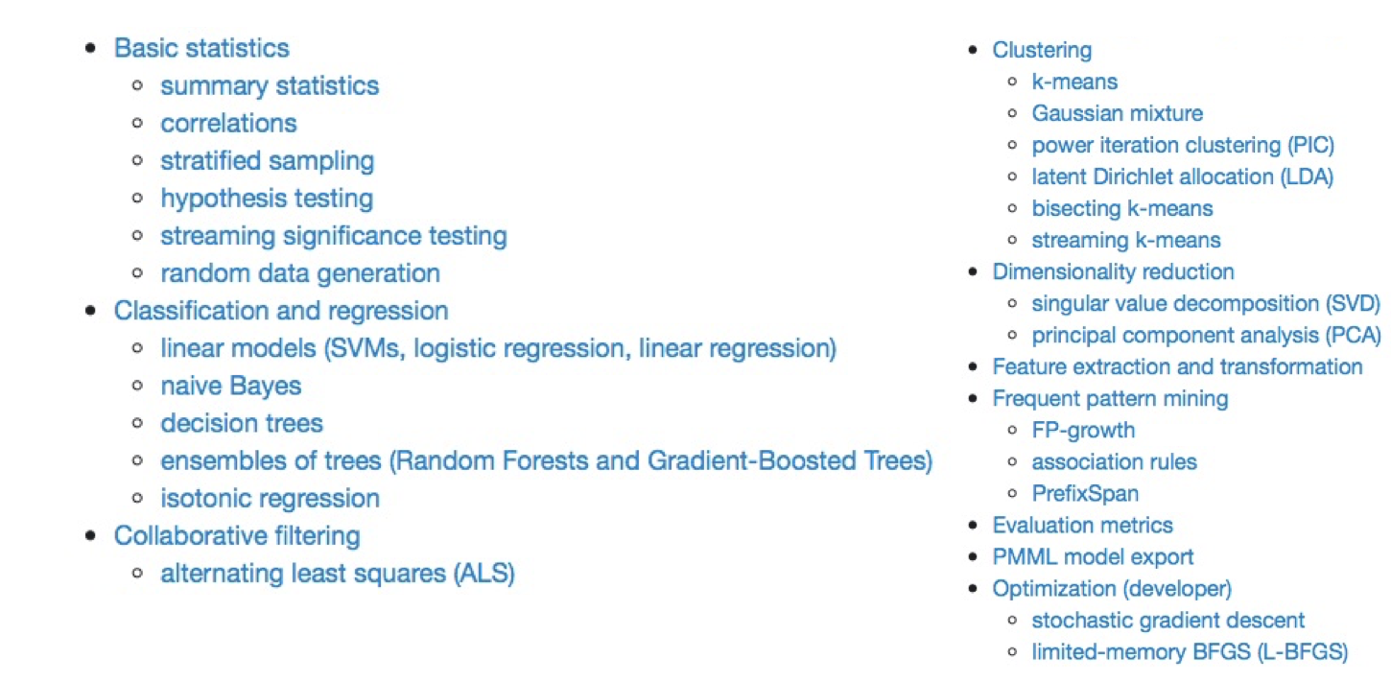
MLlib
https://spark.apache.org/docs/latest/ml-guide.html

Slide 12
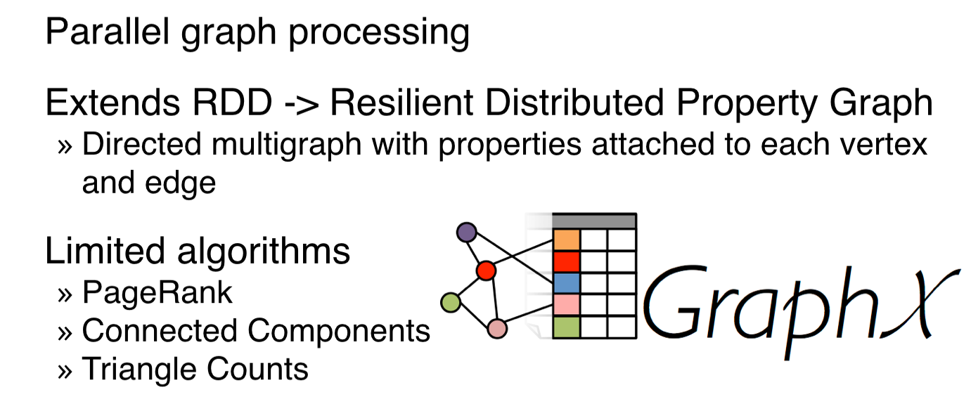
GraphX

Slide 13
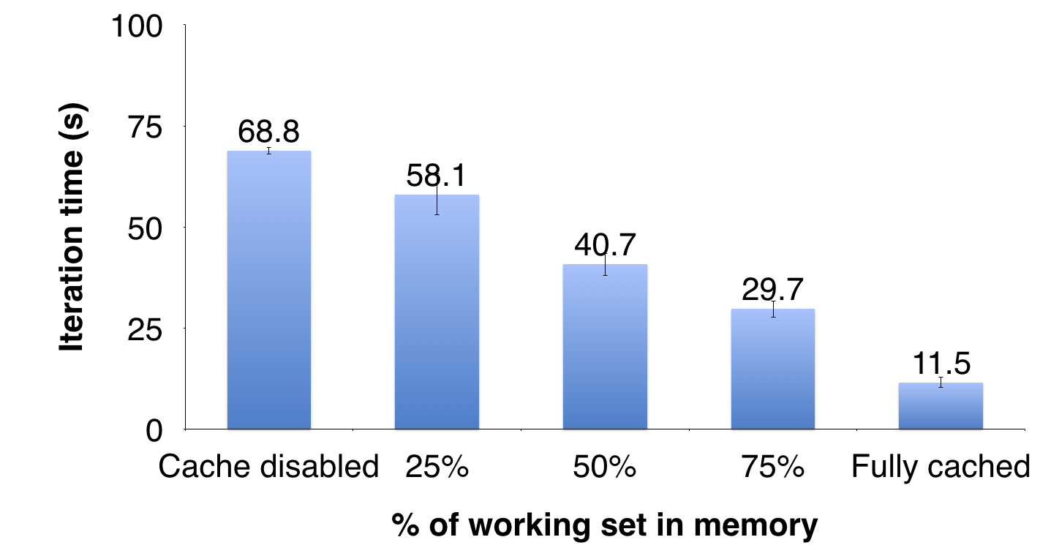
Behavior with Not Enough RAM

Slide 14
DLI Accelerated Data Science Teaching Kit
Thank You
We thank Dr. Matei Zaharia for sharing teaching materials for Spark.

