Slide 1
Lecture 11.4 – RAPIDS and Spark
DLI Accelerated Data Science Teaching Kit

Slide 2

The Accelerated Data Science Teaching Kit is licensed by NVIDIA, Georgia Institute of Technology, and Prairie View A&M University under the
Creative Commons Attribution-NonCommercial 4.0 International License.

Slide 3


What is RAPIDS Accelerator for Spark?
Accelerate Spark distributed computing framework using GPUs, via
RAPIDS cuDF library
Accelerated shuffle based on UCX (GPU-to-GPU communication)
Existing Spark applications run with no code change
Launch Spark with RAPIDS accelerator (plugin jar)
Enable configuration setting
spark.conf.set('spark.rapids.sql.enabled','true')
https://nvidia.github.io/spark-rapids/

Slide 4
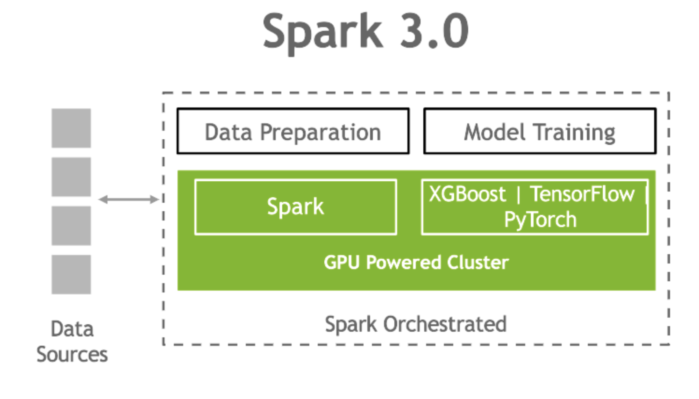
Spark 3.0 Offers Unified AI framework for ETL + ML/DL
Single pipeline from data input to model training

Slide 5
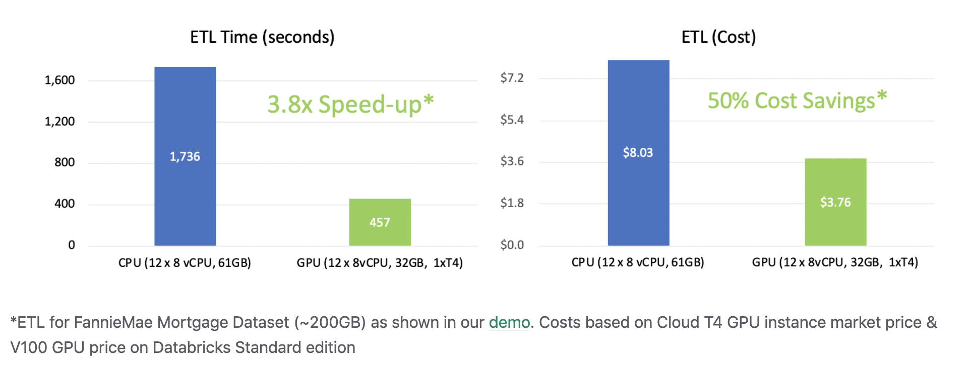
Accelerating Spark with RAPIDS
Higher speed, and lower costs

Slide 6
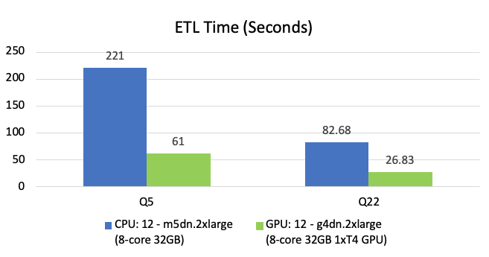
Accelerating Spark with RAPIDS on AWS
Higher speed, and lower costs
~3.5x Speed-up
~40% Cost Savings
Based on TPCx-BB like Queries #5 & #22 with 1TB scale factor input

Slide 7
GPU Scheduling Example: Starting Code
./bin/spark-shell --master yarn --executor-cores 2 \
--conf spark.driver.resource.gpu.amount=1 \
--conf spark.driver.resource.gpu.discoveryScript=/opt/spark/getGpuResources.sh \
--conf spark.executor.resource.gpu.amount=2 \
--conf spark.executor.resource.gpu.discoveryScript=./getGpuResources.sh \
--conf spark.task.resource.gpu.amount=1 \
--files examples/src/main/scripts/getGpusResources.sh

Slide 8
GPU Scheduling Example: Discovery Script
#!/bin/bash #
# Outputs a JSON formatted string that is expected by the
# spark.{driver/executor}.resource.gpu.discoveryScript config. #
# Example output: {"name": "gpu", "addresses":["0","1","2","3","4","5","6","7"]}
ADDRS=$(nvidia-smi --query-gpu=index --format=csv,noheader \
| sed -e :a -e N -e'$!ba' -e 's/\n/","/g')
echo {\"name\": \"gpu\", \"addresses\":[\"$ADDRS\"]}

Slide 9
GPU Scheduling Example: Assignments API
// Task API
val context = TaskContext.get() val resources = context.resources()
val assignedGpuAddrs = resources("gpu").addresses
// Pass assignedGpuAddrs into TensorFlow or other AI code
// Driver API
scala> sc.resources("gpu").addresses
Array[String] = Array(0)

Slide 10
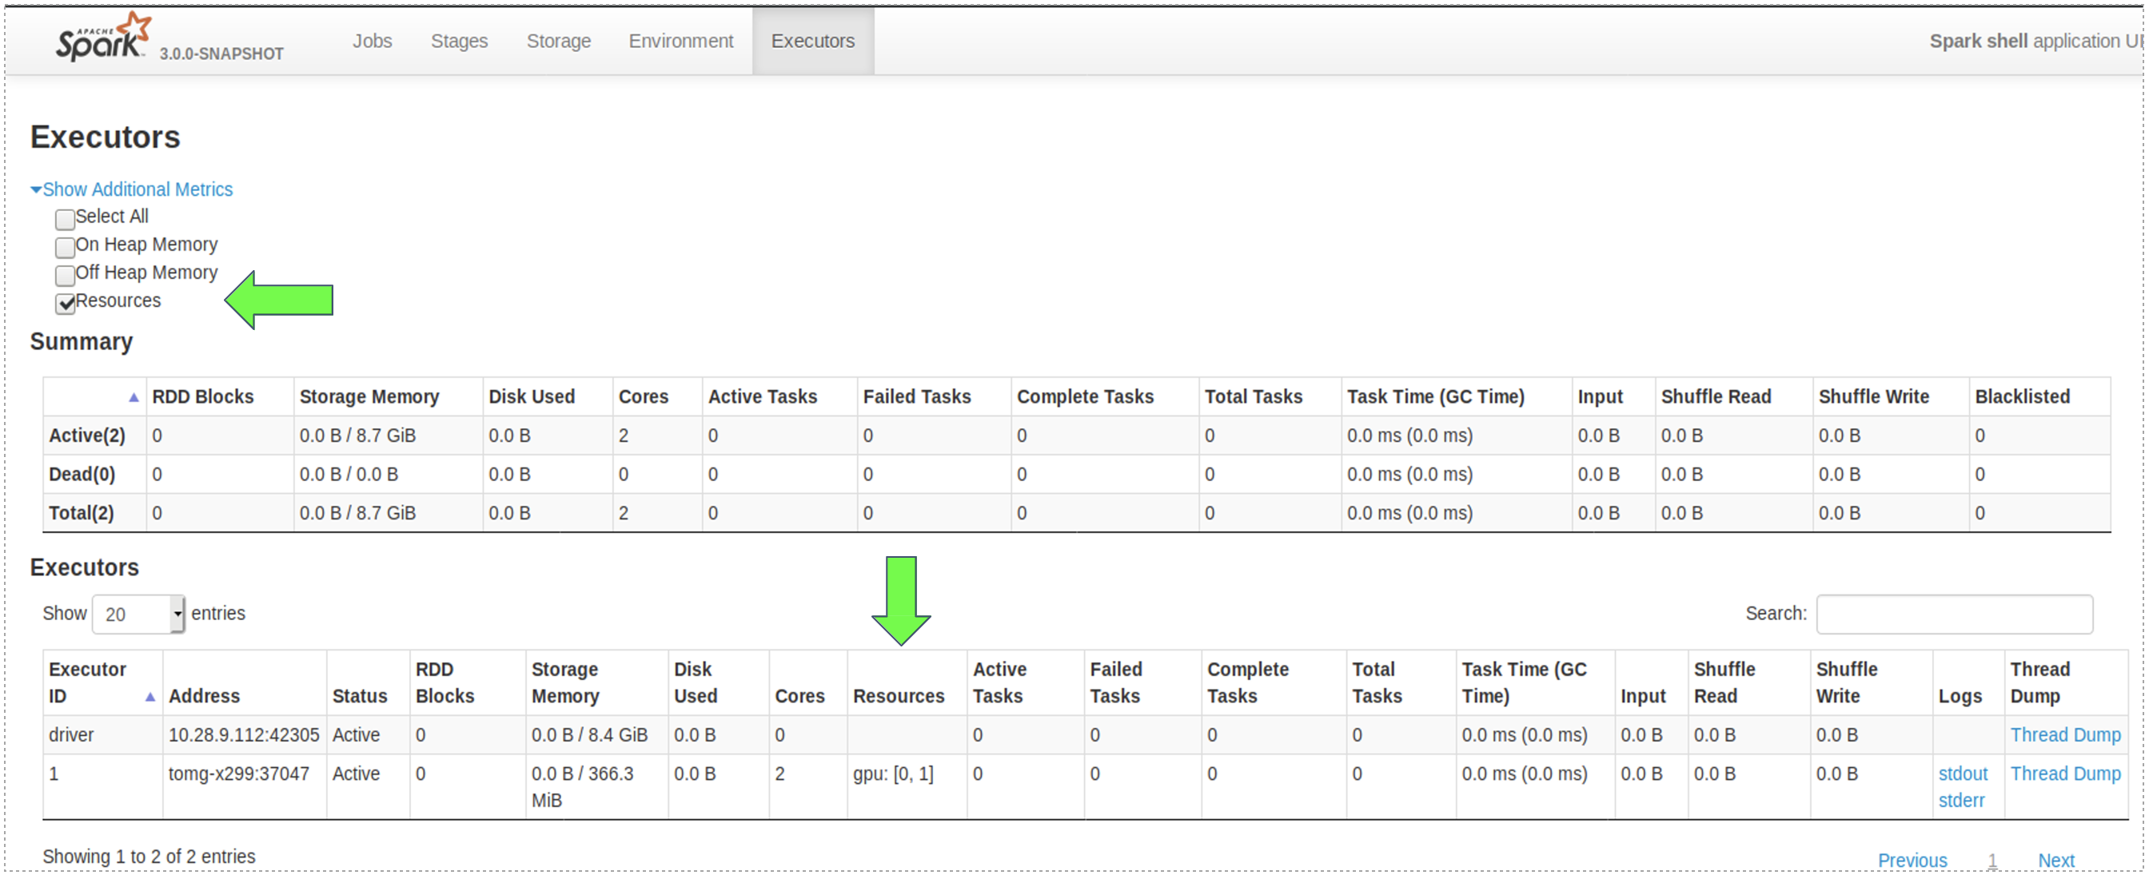
GPU Scheduling Example: Schedule API

Slide 11
Sparks + RAPIDS Resources
https://nvidia.github.io/spark-rapids/https://nvidia.github.io/spark-rapids/
https://github.com/nvidia/spark-rapids/
https://www.nvidia.com/en-us/deep-learning-ai/solutions/data-science/apache-spark-3/
https://ngc.nvidia.com

Slide 12
DLI Accelerated Data Science Teaching Kit
Questions?

