Slide 1
Lecture 12.1 - HBase Overview
DLI Accelerated Data Science Teaching Kit

Slide 2

The Accelerated Data Science Teaching Kit is licensed by NVIDIA, Georgia Institute of Technology, and Prairie View A&M University under the
Creative Commons Attribution-NonCommercial 4.0 International License.

Slide 3
Lesson Based on
http://shop.oreilly.com/product/0636920014348.do

Slide 4

http://hbase.apache.org
Built on top of HDFS
Supports real-time read/write random access
Scale to very large datasets, many machines
Not relational, does NOT support SQL
(“NoSQL” = “not only SQL”) http://en.wikipedia.org/wiki/NoSQL
Supports billions of rows, millions of columns
(e.g., serving Facebook’s Messaging Platform)
Written in Java; works with other APIs/languages (REST, Thrift, Scala)
http://radar.oreilly.com/2014/04/5-fun-facts-about-hbase-that-you-didnt-know.html
http://hbase.apache.org/poweredbyhbase.html

Slide 5
HBase is Column-Oriented
Data is stored by columns physically (instead of by rows)
      A row conceptually consists on many columns (millions!)
Rows form a table
Row key uniquely locates a row, like an “index”, only one “index” per table
    No built-in support for multiple indices; possible via extensions
Rows sorted by row key lexicographically (~ alphabetically)

Slide 6
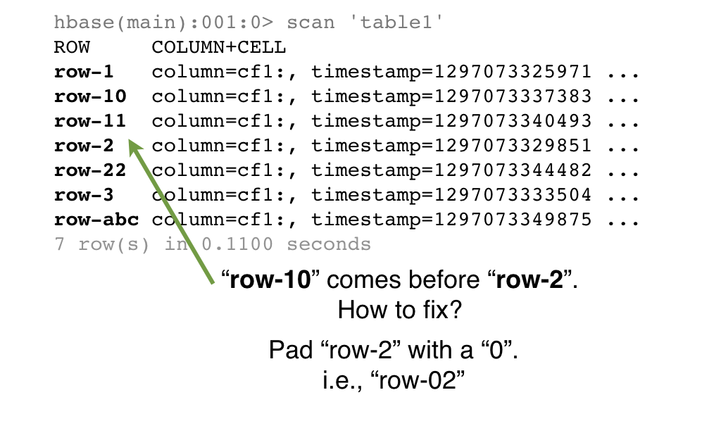
Rows Sorted Lexicographically (=alphabetically)

Slide 7
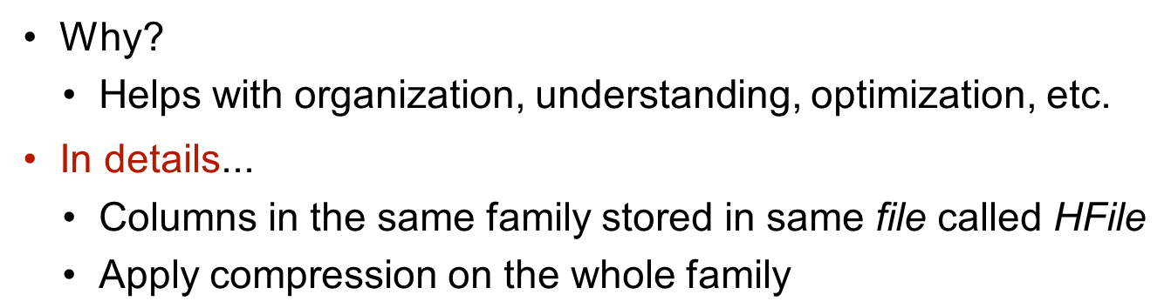
Columns grouped into column families

Slide 8
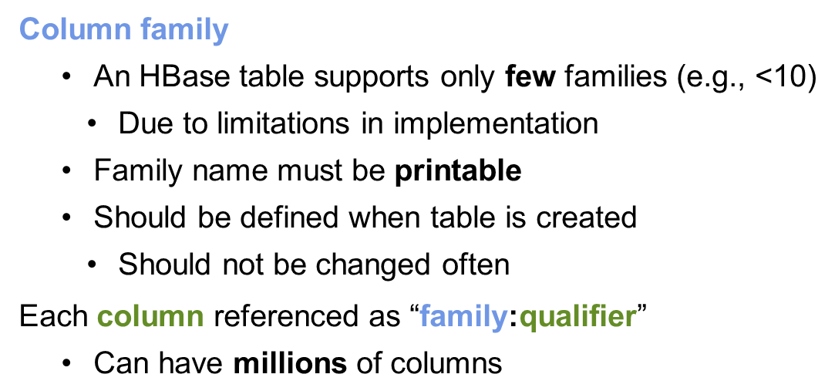
More on column family, column

Slide 9
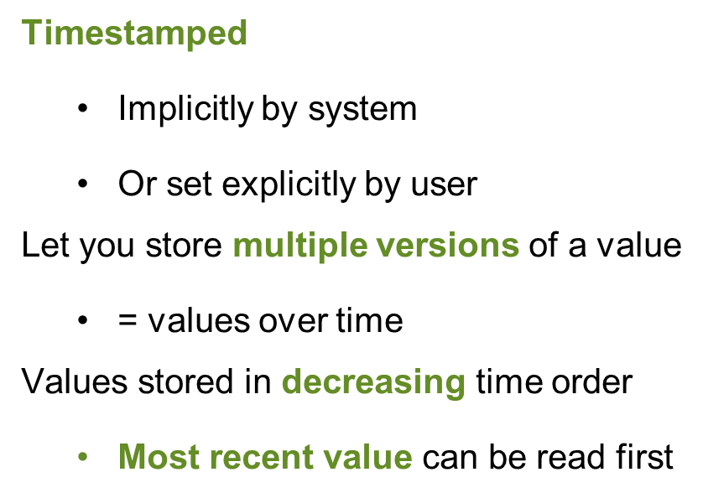
Cell Value
Notes:
Content at center, so slide looks empty.

Slide 10
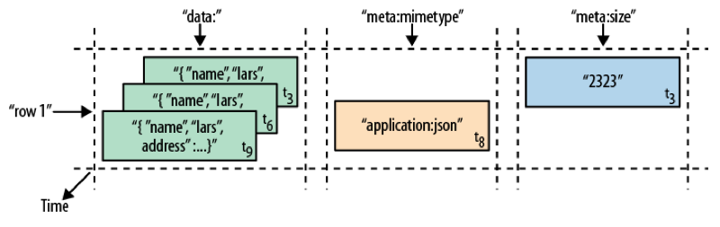
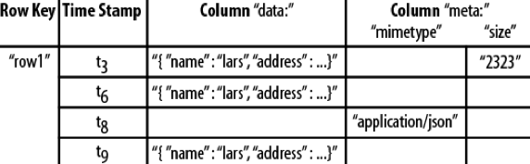
Time-oriented view of a row

Slide 11
An Exercise
How would you use HBase to create a webtable to store snapshots of every webpage on the planet, over time?
Row key | Time stamp | html | javascript | image1 | image2 | ...
“com.cnn.www” | t8 | <html>… | <javascript>… |  |  | ...
 |  |  |  |  |  | ...
 |  |  |  |  |  | ...
 |  |  |  |  |  | ...

Slide 12
An Exercise
How would you use HBase to create a webtable to store snapshots of every webpage on the planet, over time?

Slide 13
DLI Accelerated Data Science Teaching Kit
Thank You

