Slide 1
Lecture 12.2 - How HBase Scales Up Storage
DLI Accelerated Data Science Teaching Kit

Slide 2

The Accelerated Data Science Teaching Kit is licensed by NVIDIA, Georgia Institute of Technology, and Prairie View A&M University under the
Creative Commons Attribution-NonCommercial 4.0 International License.

Slide 3
How HBase scales up storage?
Automatically divide contiguous ranges of rows into regions
Start with one region, split into two when getting too large, and so on.

Slide 4
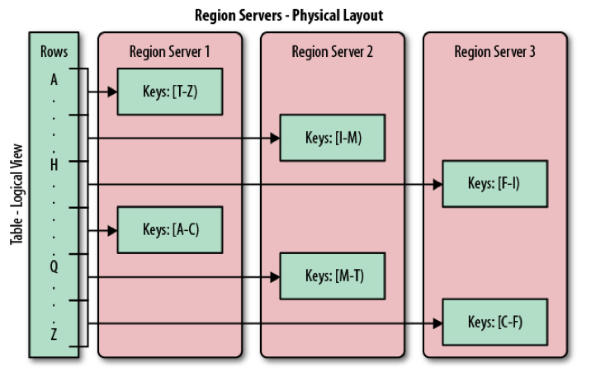
How HBase scales up storage?
Excellent Summary: http://blog.cloudera.com/blog/2013/04/how-scaling-really-works-in-apache-hbase/

Slide 5
Concise way to describe all these?
HBase data model
  Sparse, distributed, persistent, multidimensional map
  Indexed by row key + column key + timestamp
(Table, RowKey, Family, Column, Timestamp) → Value

Slide 6
DLI Accelerated Data Science Teaching Kit
Thank You

