Slide 1
Lecture 12.3 - How to Use HBase
DLI Accelerated Data Science Teaching Kit

Slide 2

The Accelerated Data Science Teaching Kit is licensed by NVIDIA, Georgia Institute of Technology, and Prairie View A&M University under the
Creative Commons Attribution-NonCommercial 4.0 International License.

Slide 3
How to use HBase
Interactive shell Can run on your computer, without using HDFS
Programmatically e.g., via Java, Python, etc.

Slide 4
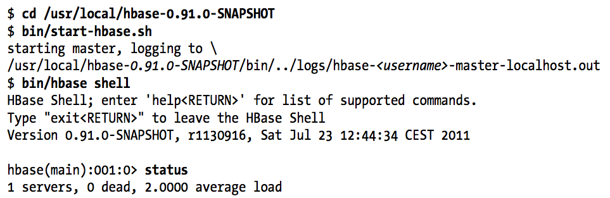
Example, using interactive shell
Start HBase
Start Interactive Shell
Check HBase is running

Slide 5
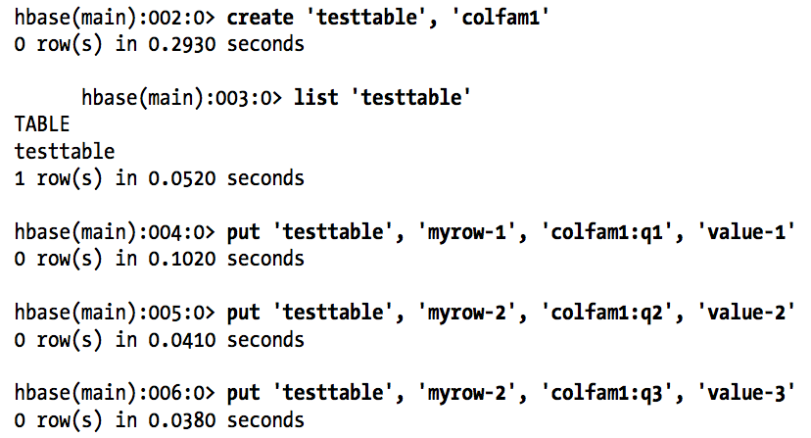
Example: Create table, add values

Slide 6
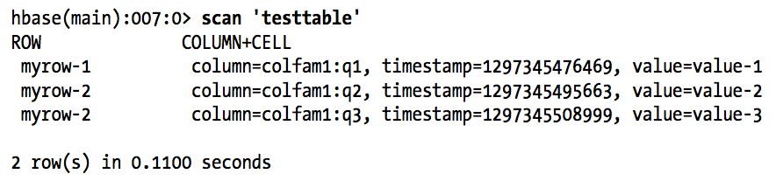
Example: Scan (show all cell values)

Slide 7
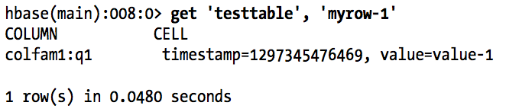
Example: Get (look up a row)
Can also look up a particular cell value with a certain timestamp, etc.

Slide 8
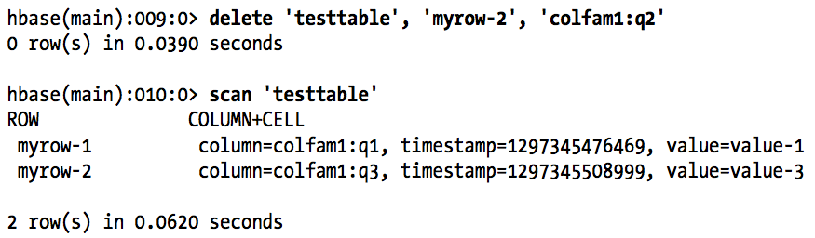
Example: Delete a value

Slide 9
DLI Accelerated Data Science Teaching Kit
Thank You

