Slide 1
Lecture 13.1 - Using Dask and UCX with RAPIDS
DLI Accelerated Data Science Teaching Kit

Slide 2

The Accelerated Data Science Teaching Kit is licensed by NVIDIA, Georgia Institute of Technology, and Prairie View A&M University under the
Creative Commons Attribution-NonCommercial 4.0 International License.

Slide 3

DASK
Introduction
A flexible library for parallel computing in Python.
DASK comprises of two major parts:
Dynamic task scheduling
Optimized for interactive computational workloads.
“Big Data” collections
Like parallel arrays, dataframes, and lists that extend common interfaces like NumPy, Pandas, or Python iterators to larger-than-memory or distributed environments
Run on top of dynamic task scheduler

Slide 4
DASK
Why DASK?
Familiar: Provides parallelized NumPy array and Pandas DataFrame objects
Flexible: Provides a task scheduling interface for more custom workloads and integration with other projects.
Native: Enables distributed computing in pure Python with access to the PyData stack.
Fast: Operates with low overhead, low latency, and minimal serialization necessary for fast numerical algorithms
Scales up: Runs resiliently on clusters with 1000s of cores
Scales down: Trivial to set up and run on a laptop in a single process
Responsive: Designed with interactive computing in mind, it provides rapid feedback and diagnostics to aid humans

Slide 5
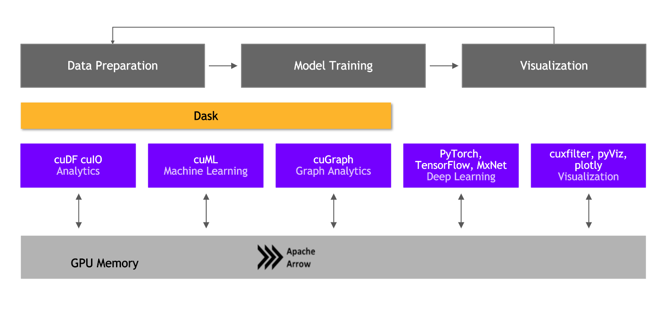
DASK and RAPIDS
Scaling up and Scaling out
Image Credit: NVIDIA

Slide 6

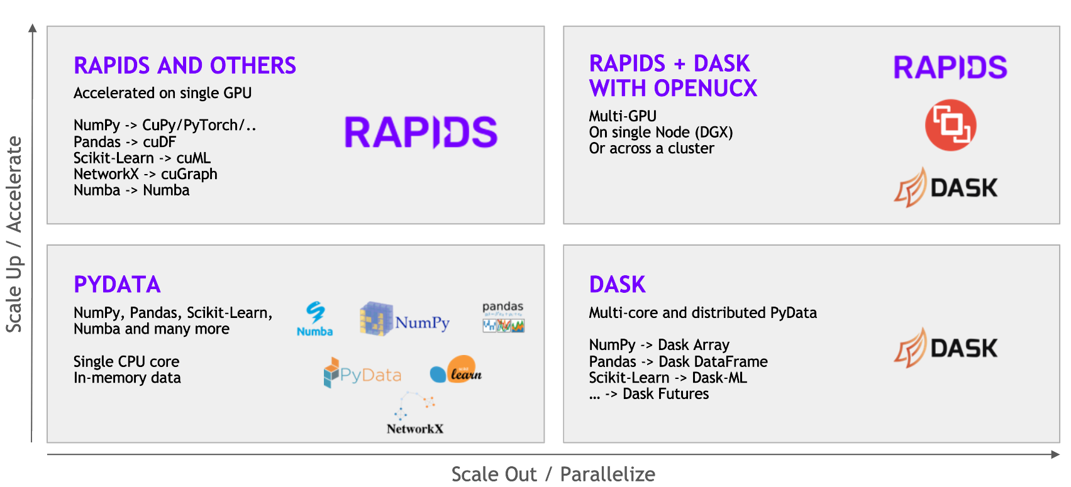
DASK and RAPIDS
Scaling up and Scaling out
+
= Scalable distributed performance
Image Credit: NVIDIA

Slide 7
UCX
Introduction
Unified Communication X is a framework that facilitates an easy and efficient way to construct widely used high-performance computing (HPC) protocols
Example protocols: MPI tag matching, RMA operations, rendezvous protocols, stream, fragmentation, remote atomic operations, etc.
Accelerated networking library designed for low-latency, high-bandwidth transfers for host and GPU device memory objects
UCX-Py is the python interface for UCX which is a high-level library that is easy for users to interact with

Slide 8
UCX with RAPIDS
Improved performance
Leverage UCX-Py to handle communication bottleneck for distributed computation
UCX-Py allows RAPIDS to use hardware interconnects like NVLink and InfiniBand
Applications using DASK can easily make use of UCX with small code changes:
Instead of the default TCP protocol, use UCX protocol!
To enable to UCX protocol in applications using Dask, set:
cluster = LocalCUDACluster(protocol= "ucx", enable_tcp_over_ucx= True)
Efficient passing of single message passing GPU objects between endpoints

Slide 9
DLI Accelerated Data Science Teaching Kit
Thank You

