Slide 1
Lecture 14.1 - Overview
DLI Accelerated Data Science Teaching Kit

Slide 2

The Accelerated Data Science Teaching Kit is licensed by NVIDIA, Georgia Institute of Technology, and Prairie View A&M University under the
Creative Commons Attribution-NonCommercial 4.0 International License.

Slide 3
How will I rate "Chopin's 5th Symphony"?
Songs | Like?
Some nights
Skyfall
Comfortably numb
We are young
... | ...
... | ...
Chopin's 5th | ???

Slide 4

Classification
What tools do you need for classification?
1. Data S = {(x_{i}, y_{i})}_{i = 1,...,n}
x_{i} : data example with d attributes
y_{i} : label of example (what you care about)
2. Classification model f_{(a,b,c,....)} with some
parameters a, b, c,...
3. Loss function L(y, f(x))
how to penalize mistakes

Slide 5
Terminology Explanation
data example = data instance
Data S = {(x_{i}, y_{i})}_{i = 1,...,n}
x_{i} : data example with d attributes
y_{i} : label of example
attribute = feature = dimension
label = target attribute
Song name | Artist | Length | ... | Like?
Some nights | Fun | 4:23 | ...
Skyfall | Adele | 4:00 | ...
Comf. numb | Pink Fl. | 6:13 | ...
We are young | Fun | 3:50 | ...
... | ... | ... | ... | ...
Chopin's 5th | Chopin | 5:32 | ... | ??

Slide 6
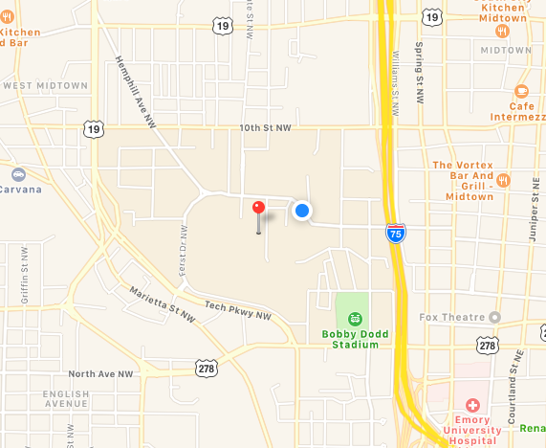
What is a “model”?
“a simplified representation of reality created to serve a purpose” Data Science for Business
Example: maps are abstract models of the physical world
There can be many models!!
(Everyone sees the world differently, so each of us has a different model.)
In data science, a model is formula to estimate what
you care about. The formula may be mathematical, a set
of rules, a combination, etc.
Screenshot from Apple Maps

Slide 7
Training a classifier = building the “model”
How do you learn appropriate values for parameters a, b, c, ... ?
Analogy: how do you know your map is a “good” map of
the physical world?
Screenshot from Apple Maps

Slide 8

Classification Loss Function
Most common loss: 0-1 loss function
More general loss functions are defined by a m x
m cost matrix C such that
where y = a and f(x) = b
T0 (true class 0), T1 (true class 1)
P0 (predicted class 0), P1 (predicted class 1)
L₀₋₁(y, f(x)) = I(y ≠ f(x))
Class | T0 | T1
P0 | 0 | C₁₀
P1 | C₀₁ | 0
L(y, f(x)) = C_{ab}

Slide 9
DLI Accelerated Data Science Teaching Kit
Thank You

