Slide 1

Lecture 14.10 - RAPIDS Acceleration: Random Forest
DLI Accelerated Data Science Teaching Kt
Notes:
This section will introduce how to use RAPIDS to accelerate the training of Random Forest.

Slide 2

The Accelerated Data Science Teaching Kit is licensed by NVIDIA, Georgia Institute of Technology, and Prairie View A&M University under the
Creative Commons Attribution-NonCommercial 4.0 International License.

Slide 3

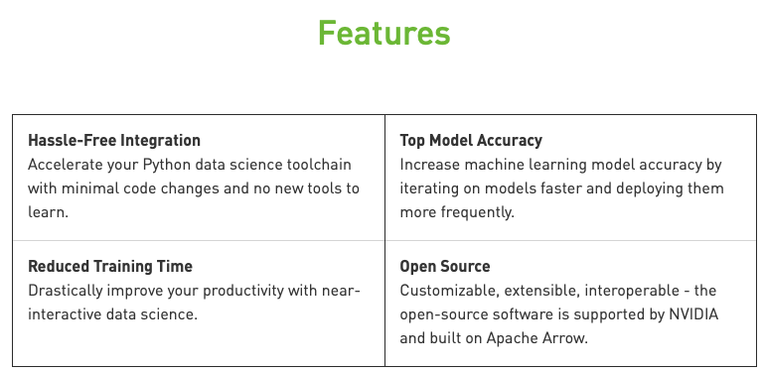
RAPIDS
The RAPIDS data science framework includes a collection of libraries for executing end-to-end data science pipelines completely in the GPU.
It is designed to have a familiar look and feel to data scientists working in Python.
Source: https://rapids.ai/start.html
Notes:
RAPIDS is developed by NVIDIA for accelerating the process of building machine learning models with GPUs.
Moreover, it will help improve the model accuracy.
It is a collection of libraries for executing end-to-end data science pipelines completely in the GPU.
The detailed features are shown on this figure.

Slide 4
Speed Up Learning of Random Forest
Random Forest algorithm is a classification method which builds several decision trees, and aggregates each of their outputs to make a prediction.
We will train a scikit-learn and a cuML Random Forest Classification model.
Then we save the cuML model for future use with Python's pickling mechanism and demonstrate how to re-load it for prediction.
We also compare the results of the scikit-learn, non-pickled and pickled cuML models.
We will be using a T4 GPU instance in Colab.
Notes:
This section will focus on speeding up the process of building Random Forest models with RAPIDS.
Random Forest algorithm is a classification method which builds several decision trees, and aggregates each of their outputs to make a prediction.
In this section, we will show how to save the cuML model for future use with Python's pickling mechanism and demonstrate how to re-load it for prediction.
We also compare the results of the scikit-learn, non-pickled and pickled cuML models
Note that the underlying algorithm in cuML for tree node splits differs from that used in scikit-learn.

Slide 5
Random Forest vs Random Forest cuML
Import packages
# load cuDF GPU extension for Pandas and import supporting capabilities
%load_ext cudf.pandas
import pandas as pd
import pickle
# Import CPU libraries
import numpy as np
from sklearn.ensemble import RandomForestClassifier as rfc_skl
from sklearn.datasets import make_classification as make_classification_skl
from sklearn.model_selection import train_test_split as train_test_split_skl
# Import GPU Libraries
import cupy as cp
import cuml
from cuml.ensemble import RandomForestClassifier as rfc_cuml
from cuml.datasets.classification import make_classification as make_classification_cuml
from cuml import train_test_split as train_test_split_cuml
Setting parameters
# The speedup obtained by using cuML's Random Forest implementation
# becomes much higher when using larger datasets. Uncomment and use the
# value provided below to see the difference in the time required to run
# Scikit-learn's versus cuML's implementation with a large dataset.
n_samples = 2**12 # use for faster CPU processing or for smaller GPUs (<12GB)
# n_samples = 2**17 # use for larger GPUs (>=12GB)
n_features = 399
n_info = 300
random_state = 123
n_classes = 2
data_type = np.float32
Notes:
First, some packages should be imported such as cudf and cuml. The details of these packages can be found in the repo of RAPIDS. Similarly, we will import Sklearn packages for building traditional machine learning model.
Then, we have to set hyper-parameters such as number of samples and number of features.

Slide 6
Random Forest vs Random Forest cuML
%%time
X,y = make_classification_skl(n_samples=n_samples,
n_features=n_features,
n_informative=n_info,
random_state=random_state,
n_classes=n_classes
)
X = pd.DataFrame(X.astype(data_type))
y = pd.Series(y.astype(np.int32))
X_train, X_test, y_train, y_test = train_test_split_skl(X, y,
test_size=0.2,
random_state=0)
Generating Data with SK Learn
Generating Data with cuML
%%time
X,y = make_classification_cuml(n_samples=n_samples,
n_features=n_features,
n_informative=n_info,
random_state=random_state,
n_classes=n_classes
)
X = pd.DataFrame(X.astype(data_type)) # takes advantage of GPU acceleration
# cuML Random Forest Classifier requires the labels to be integers
y = pd.Series(y.astype(cp.int32)) # takes advantage of GPU acceleration
X_train, X_test, y_train, y_test = train_test_split_cuml(X, y,
test_size=0.2,
random_state=0)
Notes:
Here is a comparison on training and testing between traditional ML packages (Sklearn) and RAPIDS (cuML).
It can be observed that the training and prediction time is reduced significantly with cuML, compared to Sklearn.

Slide 7
Random Forest vs Random Forest cuML
Random Forest with SK Learn
Random Forest with cuML
Fit
%%time
sk_model = rfc_skl(n_estimators=40,
max_depth=16,
max_features=1.0,
random_state=10)
sk_model.fit(X_train, y_train)
Predict
%%time
sk_predict = sk_model.predict(X_test)
Time
n_samples = 2¹²
n_samples = 2¹⁷
Time
n_samples = 2¹²
n_samples = 2¹⁷
Evaluate
%%time
sk_acc = accuracy_score(y_test, sk_predict)
Time
n_samples = 2¹²
n_samples = 2¹⁷
Fit
%%time
cuml_model = rfc_cuml(n_estimators=40,
max_depth=16,
max_features=1.0,
random_state=10)
cuml_model.fit(X_train, y_train)
Predict
%%time
cuml_predict = cuml_model.predict(X_test)
Time
n_samples = 2¹²
n_samples = 2¹⁷
Time
n_samples = 2¹²
n_samples = 2¹⁷
Evaluate
%%time
cuml_acc = accuracy_score(y_test, cuml_predict)
Time
n_samples = 2¹²
n_samples = 2¹⁷
Notes:
Here is a comparison on training and testing between traditional ML packages (Sklearn) and RAPIDS (cuML).
It can be observed that the training and prediction time is reduced significantly with cuML, compared to Sklearn. Around a half second versus just over a minute for 2^12 and just over 9 seconds versus 49 minutes for 2^17 on a T4 GPU in Colab

Slide 8
Random Forest vs Random Forest cuML
Pickle the cuML random forest classification model (using n_samples = 2¹² dataset)
Predict using the pickled model
filename = "cuml_rf_model.sav"
#save the trained cuml model into a file
pickle.dump(cuml_model, open(filename, 'wb'))
# delete the previous model to ensure that there is no leakage of pointers.
# this is not strictly necessary but just included here for demo purposes.
del cuml_model
# load the previously saved cuml model from a file
pickled_cuml_model = pickle.load(open(filename, 'rb'))
%%time
pred_after_pickling = pickled_cuml_model.predict(X_test)
fil_acc_after_pickling = accuracy_score_cuml(y_test, pred_after_pickling)
Notes:
Here is showing how to reload model for RAPIDS and make predictions.

Slide 9

Random Forest vs Random Forest cuML
Compare Results
print("cuML accuracy of the RF model before pickling is: %s" % cuml_acc)
print("cuML accuracy of the RF model after pickling is: %s" % fil_acc_after_pickling)
print("SKL accuracy: %s" % sk_acc)
print("CUML accuracy: %s" % cuml_acc)
Notes:
And the performance of cuML is higher than that of Sklearn.

Slide 10
DLI Accelerated Data Science Teaching Kit
Thank You

