Slide 1
Lecture 14.11 - Boosting
DLI Accelerated Data Science Teaching Kit

Slide 2

The Accelerated Data Science Teaching Kit is licensed by NVIDIA, Georgia Institute of Technology, and Prairie View A&M University under the
Creative Commons Attribution-NonCommercial 4.0 International License.

Slide 3
What is Boosting?
Powerful machine learning algorithm
Achieves state-of-the-art accuracy on some tasks in regression, classification, ranking and more
What does it do?
Combines a number of other weak models in order to generate a collectively strong model
http://pig.apache.org

Slide 4
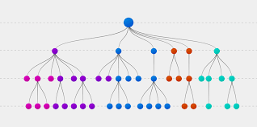
Forms of Boosting
Gradient Boosting
Supervised learning model using gradient descent to add weak models
XG Boosting
Transforms the loss function into a more sophisticated objective function to inhibit overfitting
Image Reference: Explorium.ai

Slide 5

Example of Gradient Boosting
Let us consider a scenario in which we are trying to predict the income of an individual
To train a gradient boosting model, we need labeled training instances
Allows model to learn by example for later non-labeled examples
http://pig.apache.org
Reference: Nvidia RAPIDS
Image Credit: Entrepreneur.com

Slide 6
Dataset for Gradient Boosting
Instance | Age | Has Job | Owns House | Income
0 | 12 | N | N | 0
1 | 32 | Y | Y | 90
2 | 25 | Y | Y | 50
3 | 48 | N | N | 25
4 | 67 | N | Y | 35
5 | 18 | Y | N | 10

Slide 7
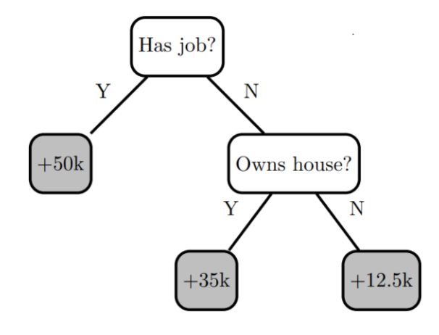
Our First Decision Tree
To start our model, we develop a simple decision tree
Perform well on some examples
Not so well on others
To improve the decision tree, we must add more nodes that account for more possibilities
Reference: Nvidia RAPIDS

Slide 8
Residuals from First Decision Tree
Instance | Age | Has Job | Owns House | Income | Residuals
0 | 12 | N | N | 0 | -12.5
1 | 32 | Y | Y | 90 | 40
2 | 25 | Y | Y | 50 | 0
3 | 48 | N | N | 25 | 12.5
4 | 67 | N | Y | 35 | 0
5 | 18 | Y | N | 10 | -40

Slide 9
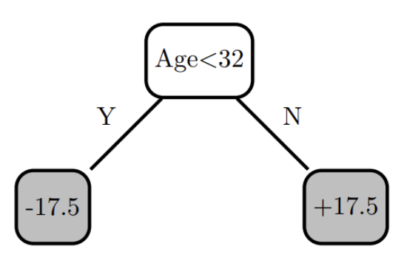
Our Second Decision Tree
To improve model accuracy, we develop a second decision tree on top of the former one
Train on the residuals instead of the original labels
We then recalculate the residuals after the new tree is added
Reference: Nvidia RAPIDS

Slide 10
Residuals from Second Decision Tree
Instance | Age | Has Job | Owns House | Income | Tree 0 Residuals | Tree 1 Residuals
0 | 12 | N | N | 0 | -12.5 | 5
1 | 32 | Y | Y | 90 | 40 | 22.5
2 | 25 | Y | Y | 50 | 0 | 17.5
3 | 48 | N | N | 25 | 12.5 | -5
4 | 67 | N | Y | 35 | 0 | -17.5
5 | 18 | Y | N | 10 | -40 | -22.5

Slide 11
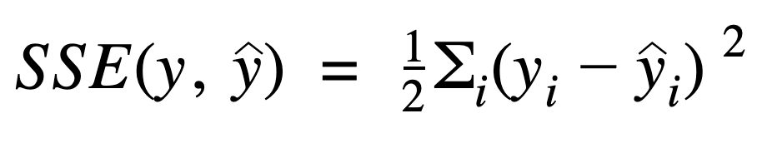
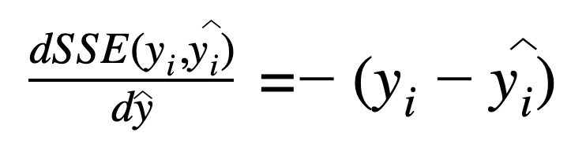
Comparison of Sum of Squared Errors
Model | SSE
No Model (predict 0) | 6275
Tree 0 | 1756
Tree 0 + Tree 1 | 837
When we compare the sum of squared errors, we see a drop after adding the second decision tree
As more trees are added, the SSE will drop steadily
Must be wary of overfitting
This process creates gradient descent algorithm on the squared error loss function
Reference: Nvidia RAPIDS

Slide 12
DLI Accelerated Data Science Teaching Kit
Thank You

