Slide 1
Lecture 14.12 - XGBoost with RAPIDS
DLI Accelerated Data Science Teaching Kit

Slide 2

The Accelerated Data Science Teaching Kit is licensed by NVIDIA, Georgia Institute of Technology, and Prairie View A&M University under the
Creative Commons Attribution-NonCommercial 4.0 International License.

Slide 3
What is XGBoosting?
A more robust and flexible version of gradient boosting
What does it do?
  Uses second-order gradients of the loss function in addition to the first-order gradients, based on Taylor expansion of the loss function
Transforms the loss function into a more sophisticated objective function containing regularization terms
http://pig.apache.org

Slide 4
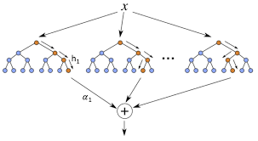
How does XGBoosting improve on Gradient Boosting?
The extended loss function inhibits overfitting
  Adds penalty proportional to size of the leaf weights
This inhibits the growth of the model and prevents it from growing too large
If the model overfits on the training data, it will not generalize well to new data

Slide 5
Example of XGBoost
Let's consider a scenario in which we are trying to predict the income of an individual
Instead of following the process used for gradient boosting, we will use quantiles:
  Cut points that divide a feature into equal-sized groups
http://pig.apache.org
Reference: Nvidia RAPIDS

Slide 6
Original Dataset
Instance | Age | Has Job | Owns House | Income
0 | 12 | N | N | 0
1 | 32 | Y | Y | 90
2 | 25 | Y | Y | 50
3 | 48 | N | N | 25
4 | 67 | N | Y | 35
5 | 18 | Y | N | 10

Slide 7
Converted Quantile Dataset
Reprocess each feature using quantiles:
  Age separated into strata:
    <18: One individual
    <32: Two individuals
    <67: Two individuals
    67+: One individual
  Separates datapoints into roughly even groups
Instance | Age | Has Job | Owns House | Income
0 | 0 | 0 | 0 | 0
1 | 2 | 1 | 1 | 90
2 | 1 | 1 | 1 | 50
3 | 2 | 0 | 0 | 25
4 | 3 | 0 | 1 | 35
5 | 1 | 1 | 0 | 10
Reference: Nvidia RAPIDS

Slide 8
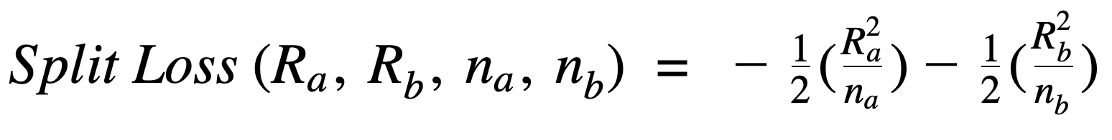
Finding Splits in Decision Trees
We want to optimize trees that limit the depth of the overall model
To achieve this, we need to build nodes that split the data well by minimizing error, in this case sum of squared error (SSE)
  We can reformat the SSE equation into a split loss equation that can be used in our RAPIDS code
Reference: Nvidia RAPIDS

Slide 9
Apply Split Loss Function to Dataset
The split (<18) has the greatest reduction in the SSE functionfunction
Quantile | n | Quantile Sum r | Inclusive Scan n | Inclusive Scan r | Split Loss
<18 | 1 | 0 | 1 | 0
 |  |  |  |  | 4410
<32 | 2 | 60 | 3 | 60
 |  |  |  |  | 4350
<67 | 2 | 115 | 5 | 175
 |  |  |  |  | 3675
67+ | 1 | 35 | 6 | 210

Slide 10

Performing XGBoost on RAPIDS
To run XGBoost efficiently using CUDA, RAPIDS uses bit compression and memory compression
  Implements parallel primitives for processing sparse CSR (Compressed Sparse Row) format input
  Uses symbol compression to store the quantised input matrix
Next, we will see an example of XGBoost on the UCI Higgs dataset
Reference: Nvidia RAPIDS

Slide 11
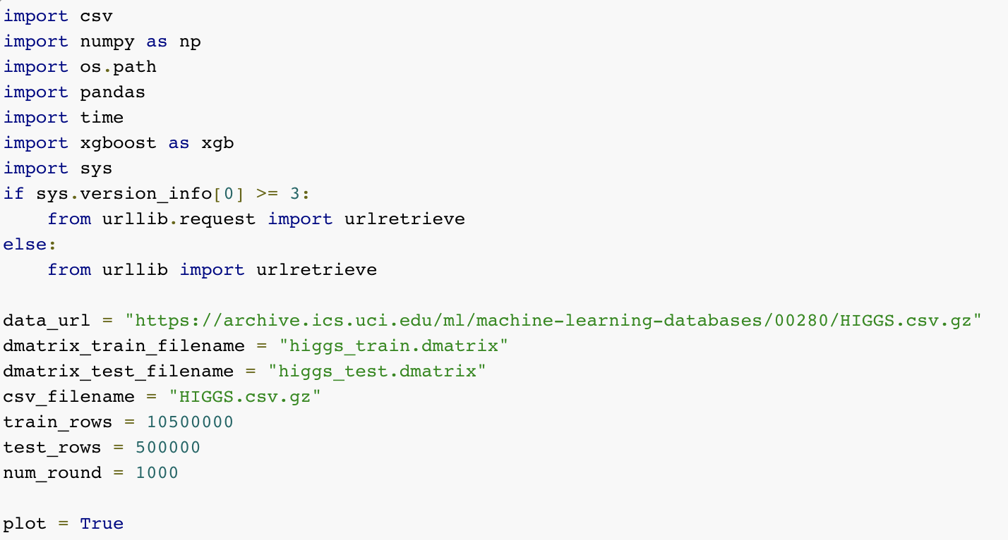
Example: Setting up GPUs
Download the Higgs Dataset

Slide 12
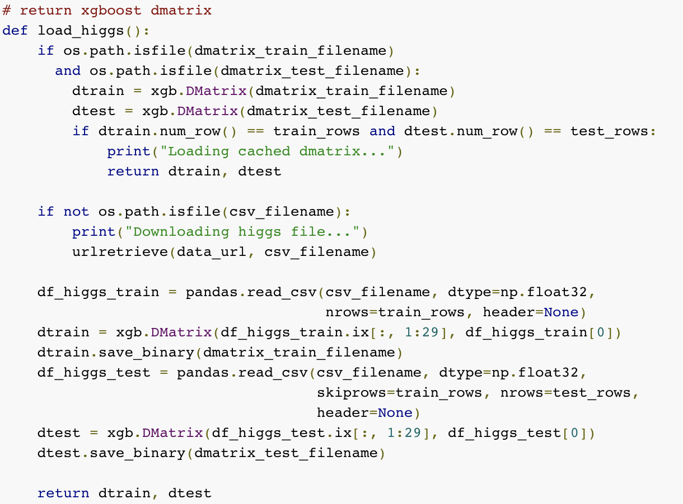
Example: Load Higgs Dataset
Load the Higgs dataset
Split dataset into training and test

Slide 13
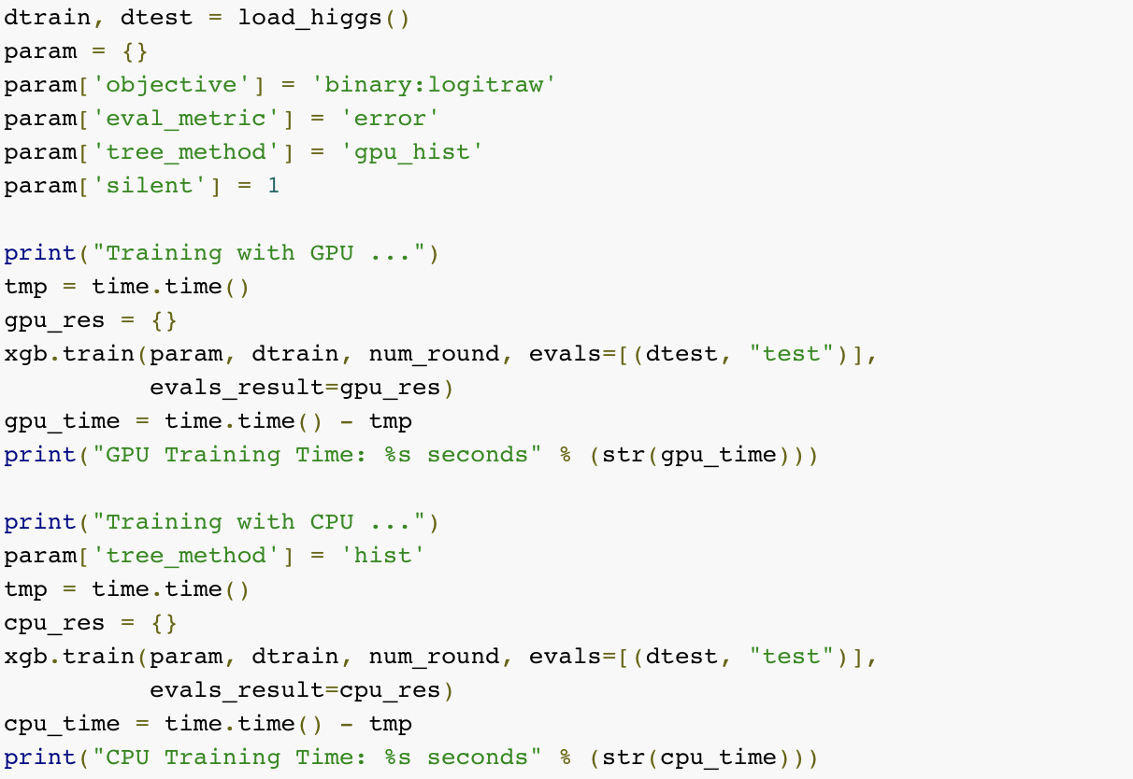
Example: Run on CPU and GPU
Run XGBoost on GPU
Run XGBoost on CPU

Slide 14
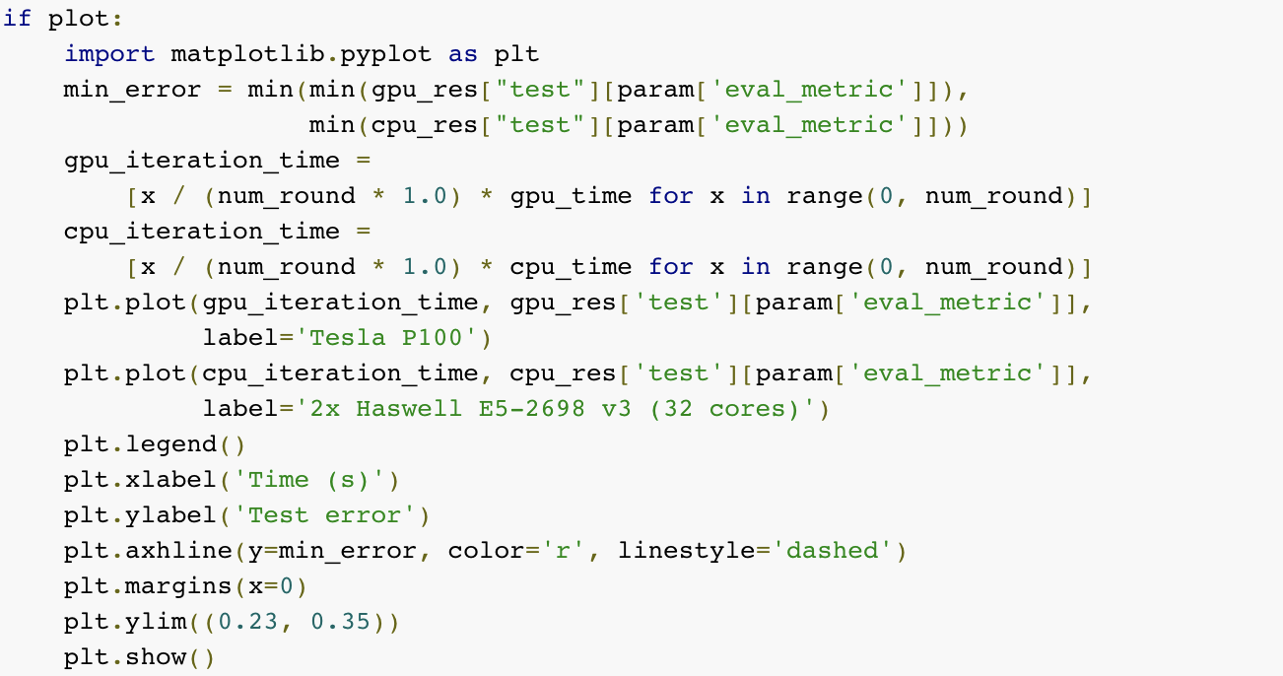
Example: Plot CPU/GPU Results
Plot the Results for GPU and CPU

Slide 15
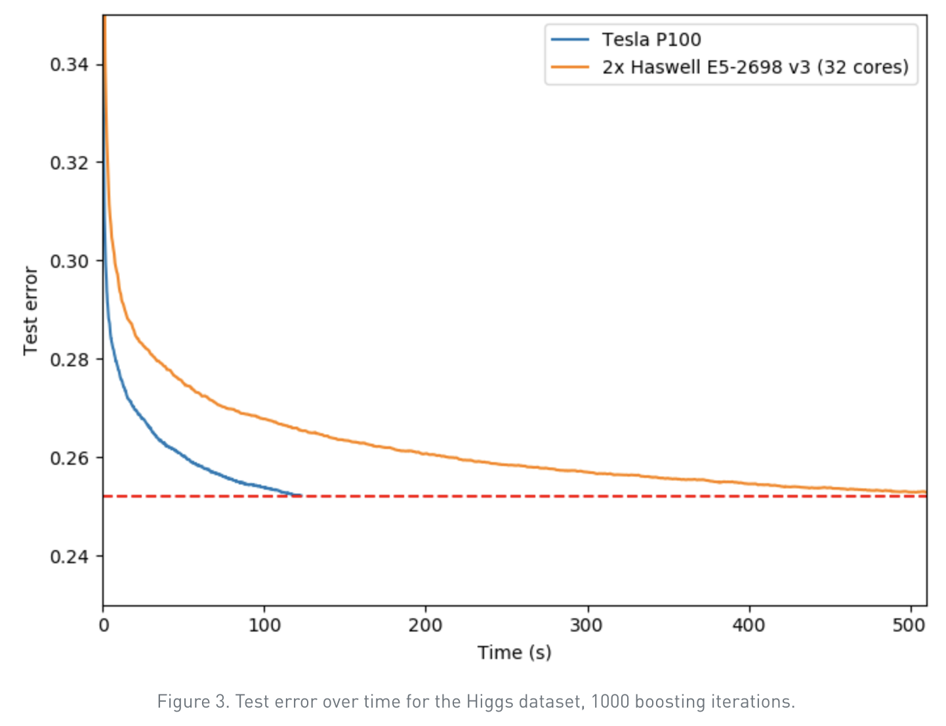
Difference in Performance
4.15x speed improvement for the GPU algorithm with the same accuracy as the CPU algorithm

Slide 16
DLI Accelerated Data Science Teaching Kit
Thank You

