Slide 1
Lecture 14.13 - k-NN with RAPIDS
DLI Accelerated Data Science Teaching Kit

Slide 2

The Accelerated Data Science Teaching Kit is licensed by NVIDIA, Georgia Institute of Technology, and Prairie View A&M University under the
Creative Commons Attribution-NonCommercial 4.0 International License.

Slide 3
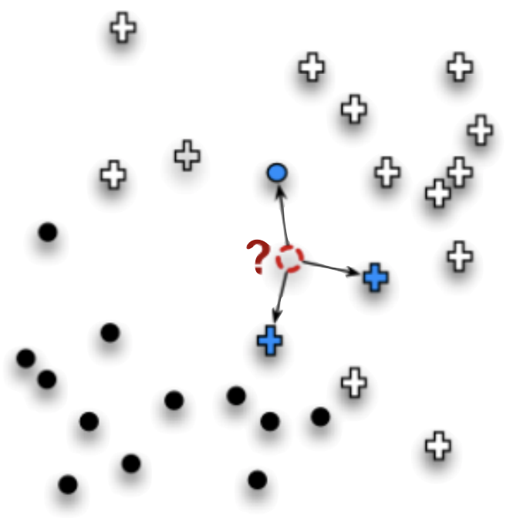
What is KNN?
Stands for K-Nearest Neighbors
Machine learning technique that predicts an unknown observation:
Uses k most similar known observations in the training dataset
No training time
All computation takes place during inference using nearest datapoints in training set
http://pig.apache.org
Image Credit: Data Science for Business

Slide 4
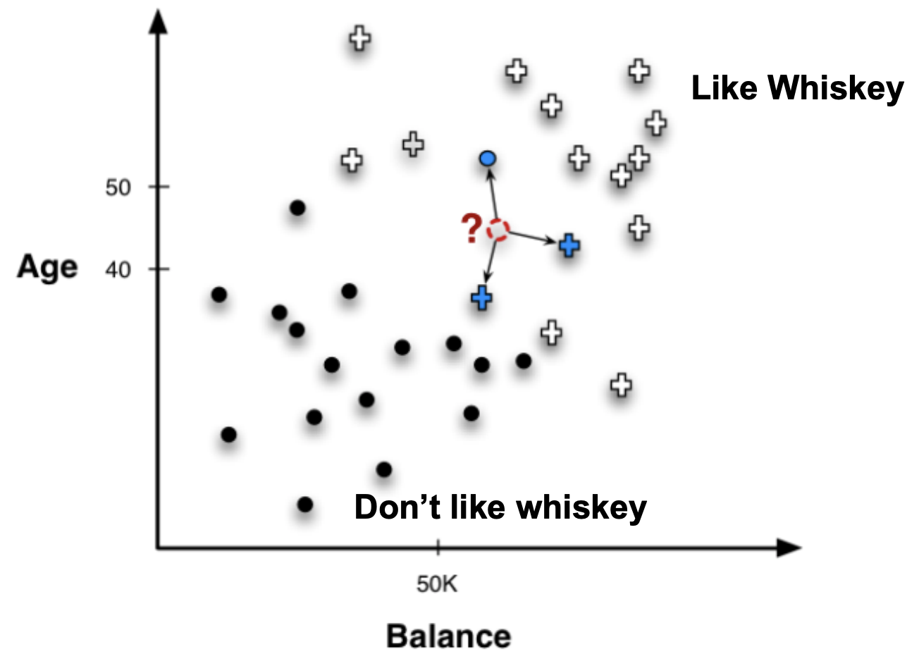
Example KNN Classification
Image Credit: Data Science for Business

Slide 5
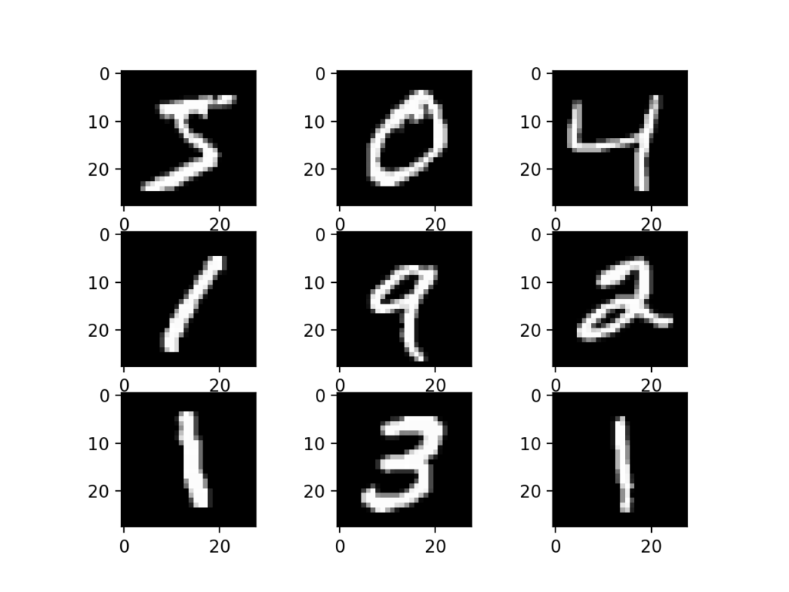
KNN Example using RAPIDS
To show the speed improvement on RAPIDS compared to other platforms, we will explore an example KNN
Uses famous MNIST digit image dataset
Comparison of performance between Nvidia Tesla P100 GPU and classic CPU
http://pig.apache.org
Reference: Medium - Accelerating k-nearest neighbors 600x using RAPIDS cuML

Slide 6
Example: Setting up RAPIDS
import sys !conda create -n rapids -c rapidsai -c nvidia -c conda-forge\ rapids=0.11 python=3.6 cudatoolkit=10.1 -y sys.path = [“/opt/conda/envs/rapids/lib/python3.6/site-packages”]\ + sys.path sys.path = [“/opt/conda/envs/rapids/lib/python3.6”] + sys.path sys.path = [“/opt/conda/envs/rapids/lib”] + sys.path !cp /opt/conda/envs/rapids/lib/libxgboost.so /opt/conda/lib/

Slide 7
Example: Performing KNN Training
# RAPIDS cuML kNN model import cudf, cuml from cuml.neighbors import KNeighborsClassifier as cuKNeighbors train = cudf.read_csv(‘../input/digit-recognizer/train.csv’) test = cudf.read_csv(‘../input/digit-recognizer/test.csv’)
# Run k-NN training and predictions
model = cuKNeighbors(n_neighbors=7) model.fit(train.iloc[:,1:785], train.iloc[:,0]) y_hat = model.predict(test)

Slide 8
Example: Performing Scikit Version
# Scikit-learn kNN model import pandas from sklearn.neighbors import KNeighborsClassifier as skKNeighbors train = pandas.read_csv('../input/digit-recognizer/train.csv') test = pandas.read_csv('../input/digit-recognizer/test.csv') model = skKNeighbors(n_neighbors=7)
# Run scikit-learn training and predictions
model.fit(train.iloc[:,1:785], train.iloc[:,0]) y_hat = model.predict(test)

Slide 9
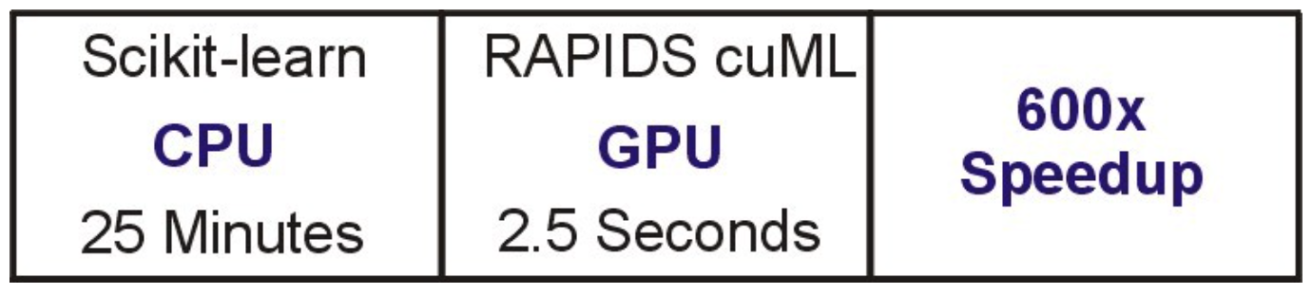
Difference in Performance
Reference: Medium - Accelerating k-nearest neighbors 600x using RAPIDS cuML

Slide 10
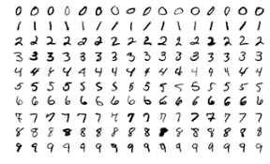
Additional KNN Task
To further improve our KNN model performance, we can perform the following tasks using RAPIDS:
Hyperparameter Tuning
Finding the ideal hyperparameters for the model
Data Augmentation
Adding more training data by manipulating the current data
http://pig.apache.org
Reference: Medium - Accelerating k-nearest neighbors 600x using RAPIDS cuML

Slide 11
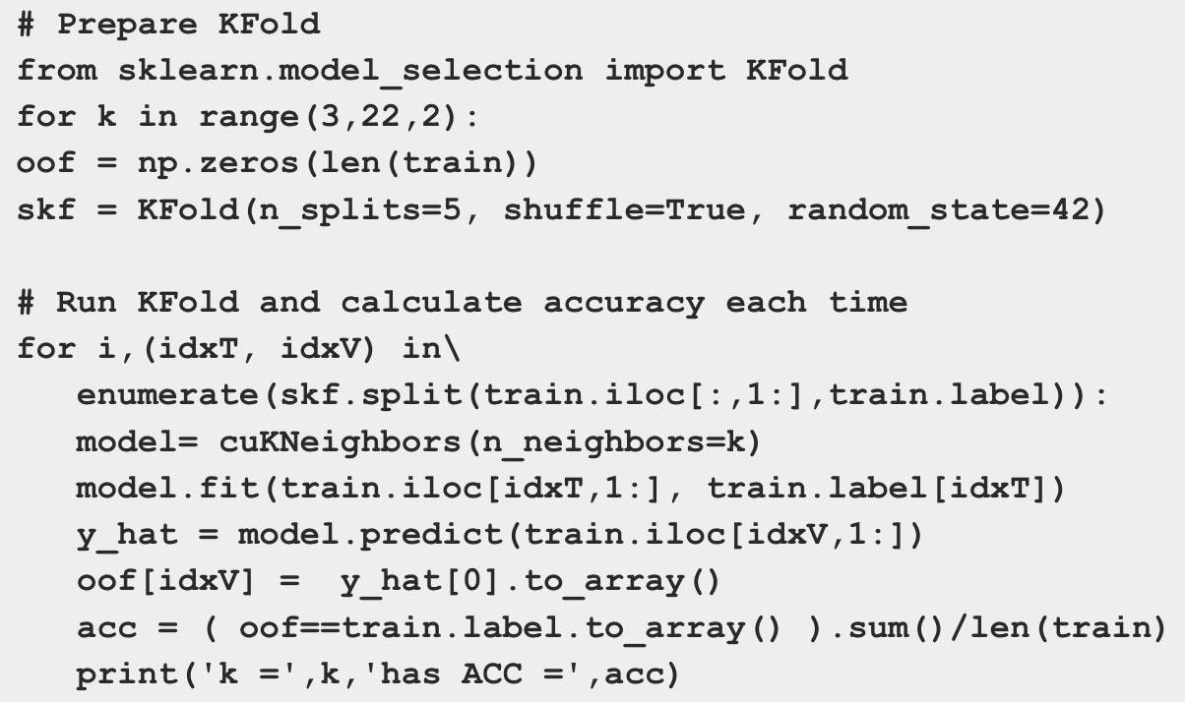
Example: Hyperparameter Tuning

Slide 12
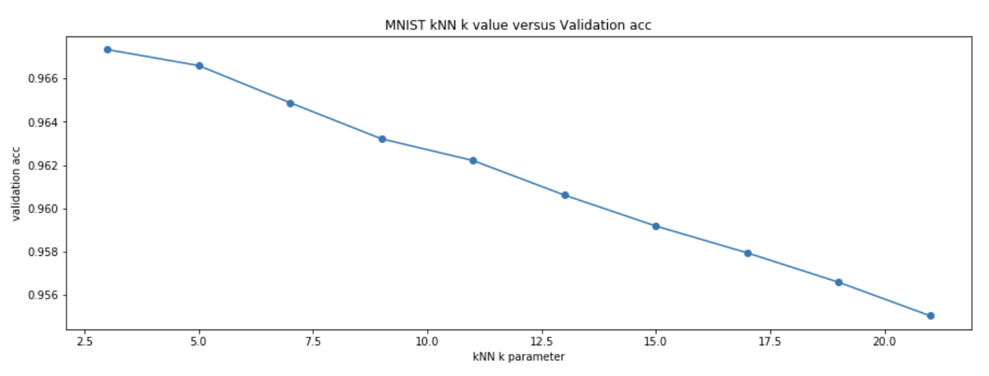
Example: Improvement in Performance
Reference: Medium - Accelerating k-nearest neighbors 600x using RAPIDS cuML

Slide 13
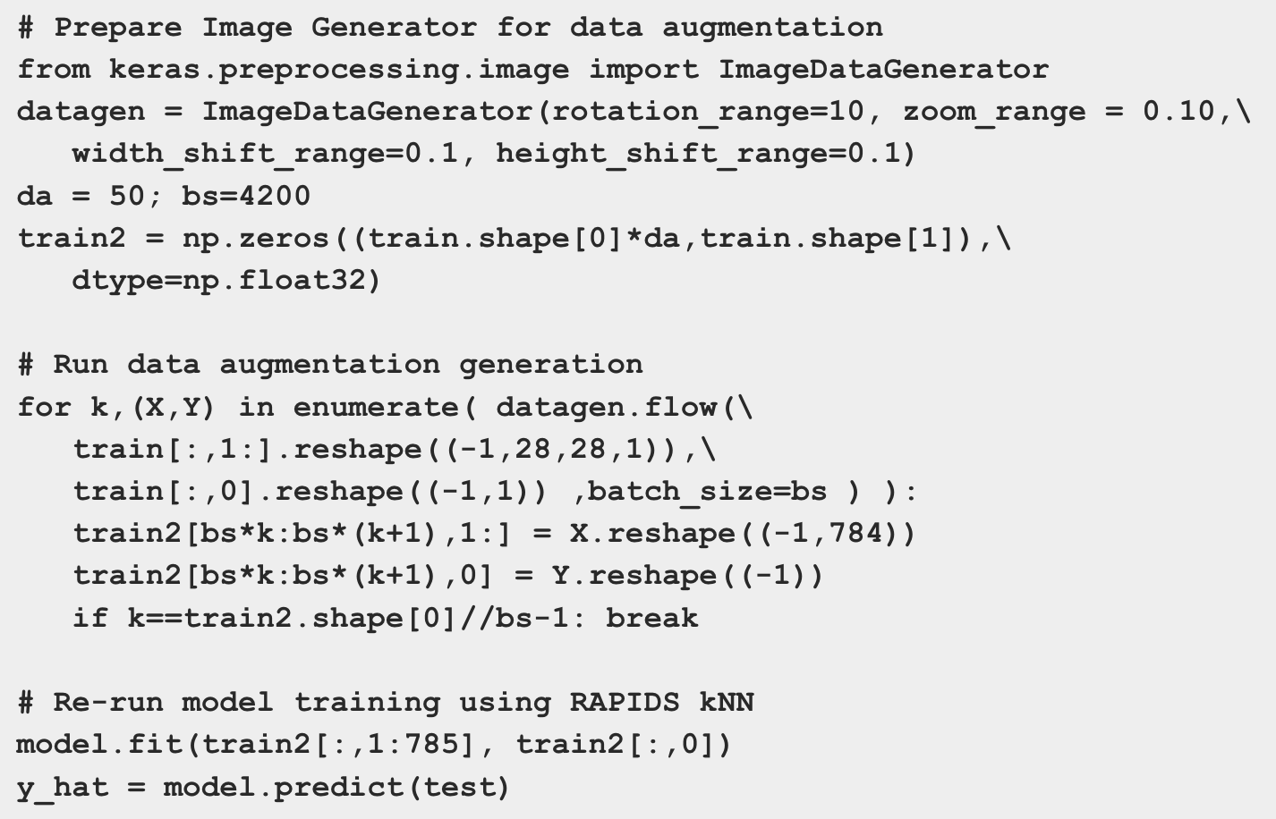
Example: Data Augmentation

Slide 14

Benefits of KNN Rapids
Improved Speed
Accelerated training time by 600x
Improved Accuracy with Hyperparameter Tuning
Increased accuracy with only 2.5 seconds of additional training time
Further improvement with Data Augmentation
Generates new training data and improves accuracy from 96.9% to 98.5%
http://pig.apache.org
Reference: Medium - Accelerating k-nearest neighbors 600x using RAPIDS cuML
Image Credit: Nvidia RAPIDS

Slide 15
DLI Accelerated Data Science Teaching Kit
Thank You

