Slide 1

Lecture 14.2 - Introduction to Supervised Learning
DLI Accelerated Data Science Teaching Kit
Notes:
This section will present a quick overview of supervised learning.

Slide 2

The Accelerated Data Science Teaching Kit is licensed by NVIDIA, Georgia Institute of Technology, and Prairie View A&M University under the
Creative Commons Attribution-NonCommercial 4.0 International License.

Slide 3
Machine Learning
It is a branch of artificial intelligence (AI).
It is a scientific discipline concerned with the design and development of algorithms that allow computers to evolve behaviors based on empirical data.
  Behaviors such as recognizing faces, translating, and searching.
Machine Learning is the science of getting computers to act without being explicitly programmed.
It is a technique of data science that helps computers learn from existing data in order to forecast future behaviors, outcomes, and trends.
Notes:
Machine learning is a branch of artificial intelligence (AI).
It is to design and develop algorithms that allow computers to evolve behaviors based on empirical and historical data without being explicitly programmed, which is to complete human tasks like recognizing faces, translating, and searching.
It can be used to analyze data by learning from existing data in order to forecast future behaviors, outcomes, and trends.

Slide 4
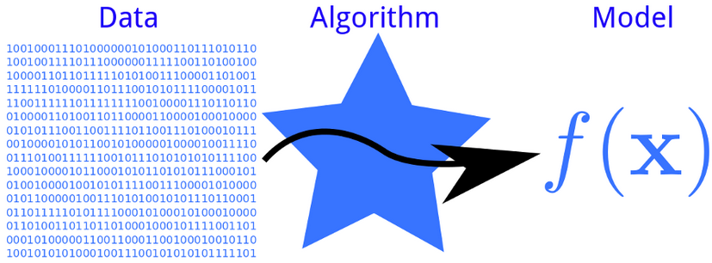
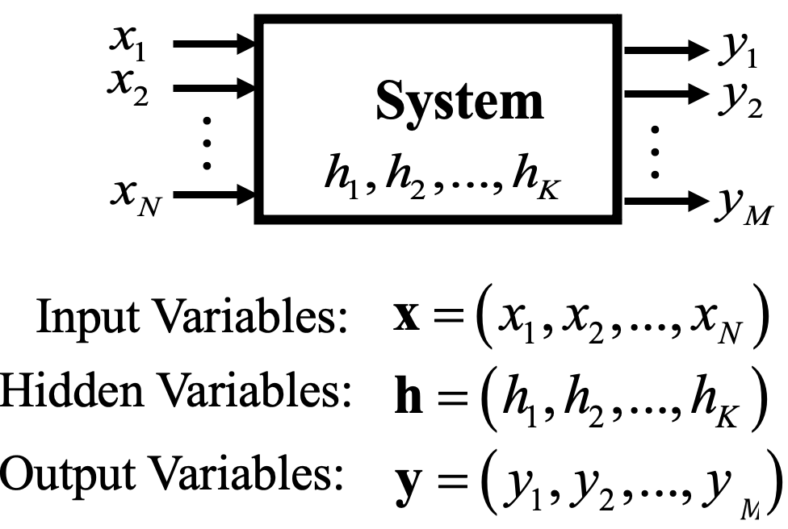
Machine Learning
Machine learning systems automatically learn programs from data to generate a model.
Source: http://phdp.github.io/posts/2013-07-05-dtl.html
Notes:
As a learning system, machine learning system consists of three components, namely, inputs variables, output variables, and hidden variables, where the hidden variables are learned from the data.
Input variables are from the data while output variables are the targets.

Slide 5
Machine Learning Terminology
Samples: Items or instances used for learning (or training) or evaluation (or testing).
Features: Set of attributes represented as a vector associated with a sample.
Labels: Values or categories assigned to examples.
  For classification, the labels are categories;
  For regression, the labels are real numbers.
Output: Prediction labels by using a model of the machine learning algorithm.
Model: Information that the machine learning algorithm stores after training. The model is used when predicting labels of new, unseen examples.
Notes:
Some terminologies are necessary to be figured out first.
Samples are items or instances used for learning (or training) or evaluation (or testing).
Features will be a set of attributes represented as a vector associated with a sample. Generally, they are extracted with feature engineering.
Labels are values or categories assigned to samples. Basically, they are obtained with the huge amount of efforts.
For classification, the labels are categories;
For regression, the labels are real numbers.
Output are predictions from a machine learning model, where the model is information that the machine learning algorithm stores after training. The model is used when predicting labels on new, unseen examples.

Slide 6
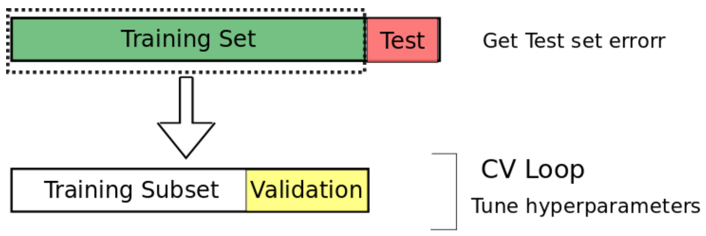
Machine Learning Terminology
Training sample: Examples used to train a machine learning algorithm.
Testing sample: Examples used to evaluate the performance of a learning algorithm. The test sample is not available in the learning stage.
Source: https://medium.com/@fezancs/practical-aspects-of-deep-learning-ba4f4822641b
Notes:
To develop a machine learning algorithm, the data collected will be separated into two subsets including training set and testing set.
The training set contains the examples used to train a machine learning algorithm while the testing set includes examples used to evaluate the performance of a learning algorithm. The test sample is not available in the learning stage. In addition, as shown in the figure, the training set will be divided into training subset and validation subset, where the validation subset is used to search for optimal hyper-parameters for the machine learning models.

Slide 7
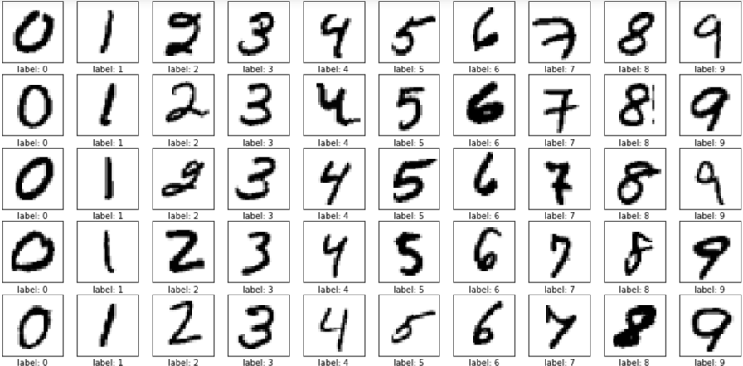
Examples of Machine Learning Terminology
Samples and Labels
Source: https://m-alcu.github.io/blog/2018/01/13/nmist-dataset/
Notes:
Here is an example from image classification for recognizing digits from images.
The samples are images containing digits and the corresponding labels are digits under the images.

Slide 8
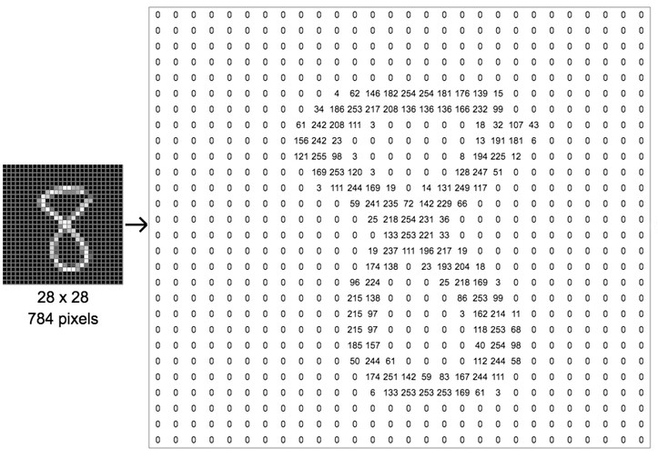
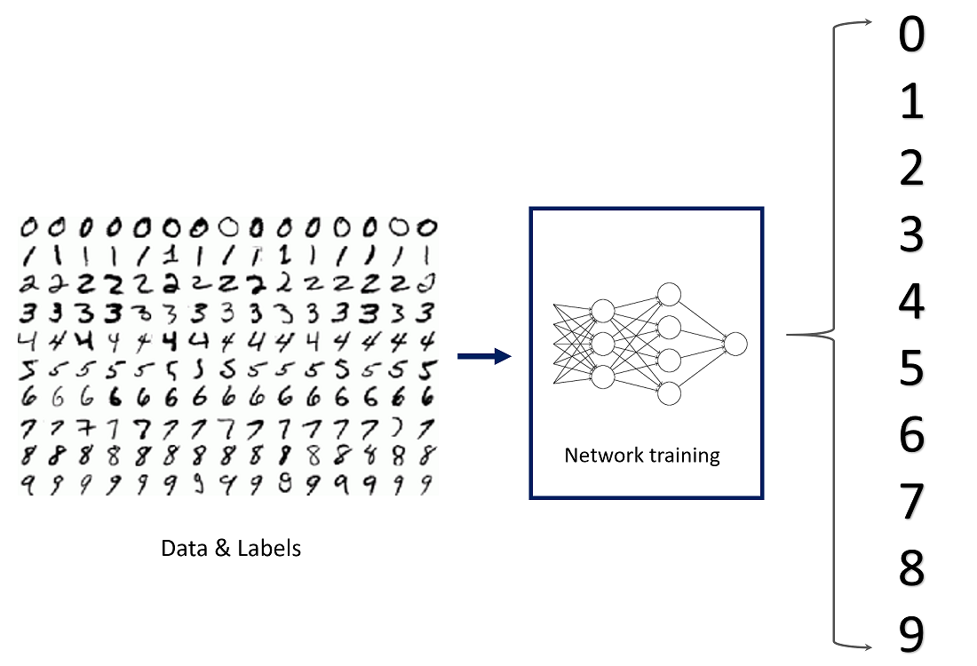
Examples of Machine Learning Terminology
Features
Model
Source 1: https://towardsdatascience.com/how-to-teach-a-computer-to-see-with-convolutional-neural-networks-96c120827cd1
Source 2: https://towardsdatascience.com/image-classification-in-10-minutes-with-mnist-dataset-54c35b77a38d
Notes:
To use these images to learn a model, the data will be represented as features. For instance, the image containing 8 have features on the right side that are pixels.
With these pixels as input, the machine learning algorithm like artificial neural networks can be trained to recognize these digits like 0,1, and 2.

Slide 9
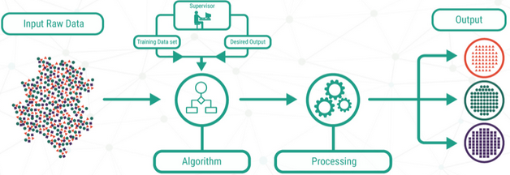
Supervised Learning
Data: (x, y)
Goal: Learn a function to map, discover patterns in the data (samples) that relate data attributes with a target attribute (labels).
Examples: Classification, Regression, Object detection,
Object tracking, etc.
Source: http://bigdata-madesimple.com/machine-learning-explained-understanding-supervised-unsupervised-and-reinforcement-learning/
Notes:
Supervised learning is a category of machine learning models. It is to learn a function to map, discover patterns in the data (samples) that relate data attributes with a target attribute (labels).
This figure show you the general flow for supervised learning. The input row data will be processed by human supervisor to get labels.
Then the input row data and the labels are input to the machine learning algorithms.
Finally, the predictions are processed for the outputs.
It can be applied to Classification, Regression, Object detection,Object tracking, etc.

Slide 10
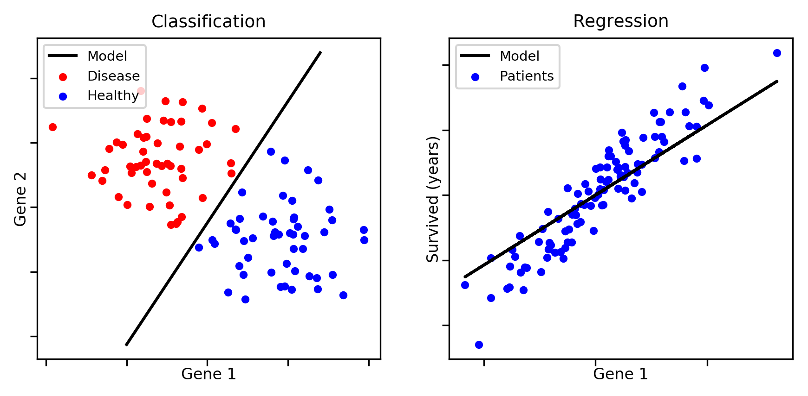
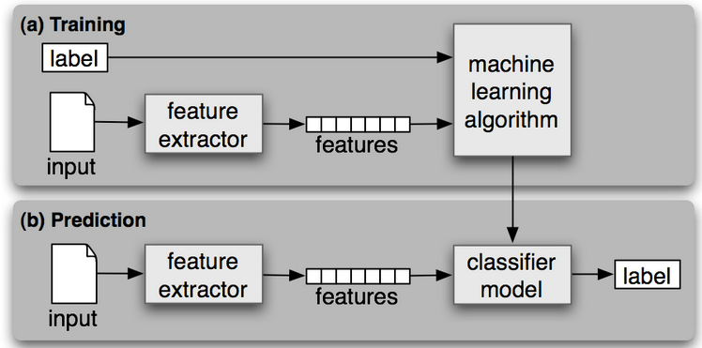
Supervised Learning
Classification: classify the data into predefined classes
Regression: predict a numerical value of samples
Source 1: https://aldro61.github.io/microbiome-summer-school-2017/sections/basics/
Source 2: http://www.nltk.org/book/ch06.html
Notes:
Supervised learning can be used to solve classification and regression problems.
Classification is to classify the data into predefined classes while regression is to predict a numerical value of samples.
For example, the figure for classification shows the goal of classification is to learn a curve to separate the data.
The figure of regression is to learn a curve with minimum distances for all samples.
The figure on the right corner shows the flow of learning a supervised model. The labels and features of the data are inputs to the machine learning algorithms to learn a classifier model. Then it is employed to predict labels for the unseen samples .

Slide 11
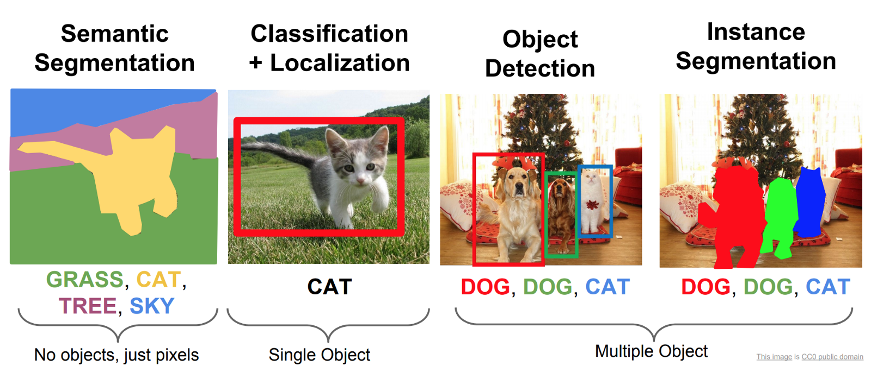

Supervised Learning Applications
Computer Vision
Natural Language Processing
Source 1: https://medium.com/ml-research-lab/what-is-object-detection-51f9d872ece7
Source 2: https://analyticsindiamag.com/google-translate-machine-learning/
Notes:
Supervised learning is a powerful technique for computer vision and natural language processing like object detection and machine translation.

Slide 12
DLI Accelerated Data Science Teaching Kit
Thank You

