Slide 1

Lecture 14.3 - Linear Model
DLI Accelerated Data Science Teaching Kit
Notes:
This section will introduce a standard supervised model, linear supervised model.

Slide 2

The Accelerated Data Science Teaching Kit is licensed by NVIDIA, Georgia Institute of Technology, and Prairie View A&M University under the
Creative Commons Attribution-NonCommercial 4.0 International License.

Slide 3
Linear Supervised Model
Linear Model
Linear Classification
Linear Regression
$$Y=w0+w1×x1+w2×x2+w3×x3+⋯+wn×xn$$
Notes:
The core idea of linear supervised model is demonstrated in the formular, where x is feature and w is corresponding weight. The relation between feature and target Y is linear.
Linear model can be built for resolving problems for linear classification and linear regression.

Slide 4
Linear Classification
Logistic regression is a simple linear classification algorithm that predicts the probability of a binary response belonging to one class or the other.
If the estimated probability is greater than 50%, then the model predicts that the instance belongs to that class (called the positive class, labeled “1”)
Or else it predicts that it does not (i.e., it belongs to the negative class, labeled “0”).
Because of its simplicity, logistic regression is commonly used as a starting point for binary classification problems.
Logistic regression can be used as a baseline for evaluating more complex classification method.
Notes:
Logistic regression is a simple linear classification algorithm that predicts the probability of a binary response belonging to one class or the other.
It employs logistic function to implement classification. If the output of logistic function is greater than 50%, then the model predicts that the instance belongs to the positive class, otherwise, the negative class. It is a good baseline for binary classification.

Slide 5
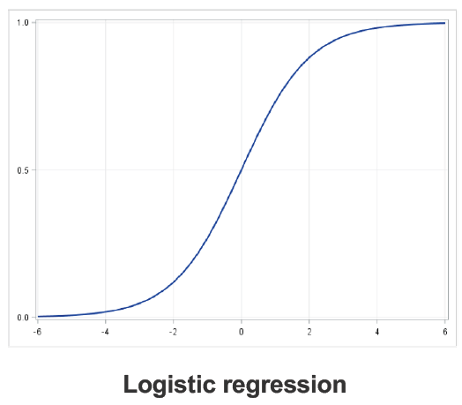
Logistic Regression
It’s a classification rather than regression algorithm.
It uses an 'S'-shaped curve instead of a straight line makes it a natural fit for dividing data into groups.
In this model, the probabilities describing the possible outcomes of a single trial are modeled using a logistic function.
Notes:
One point emphasized is that it is a classification algorithm rather than regression algorithm.
The output of this function is an 'S'-shaped curve instead of a straight line that makes it a natural fit for dividing data into groups.
Specifically, the probabilities describing the possible outcomes of a single trial are modeled with the logistic function.

Slide 6
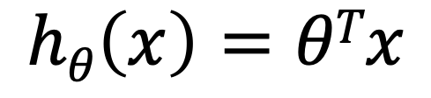
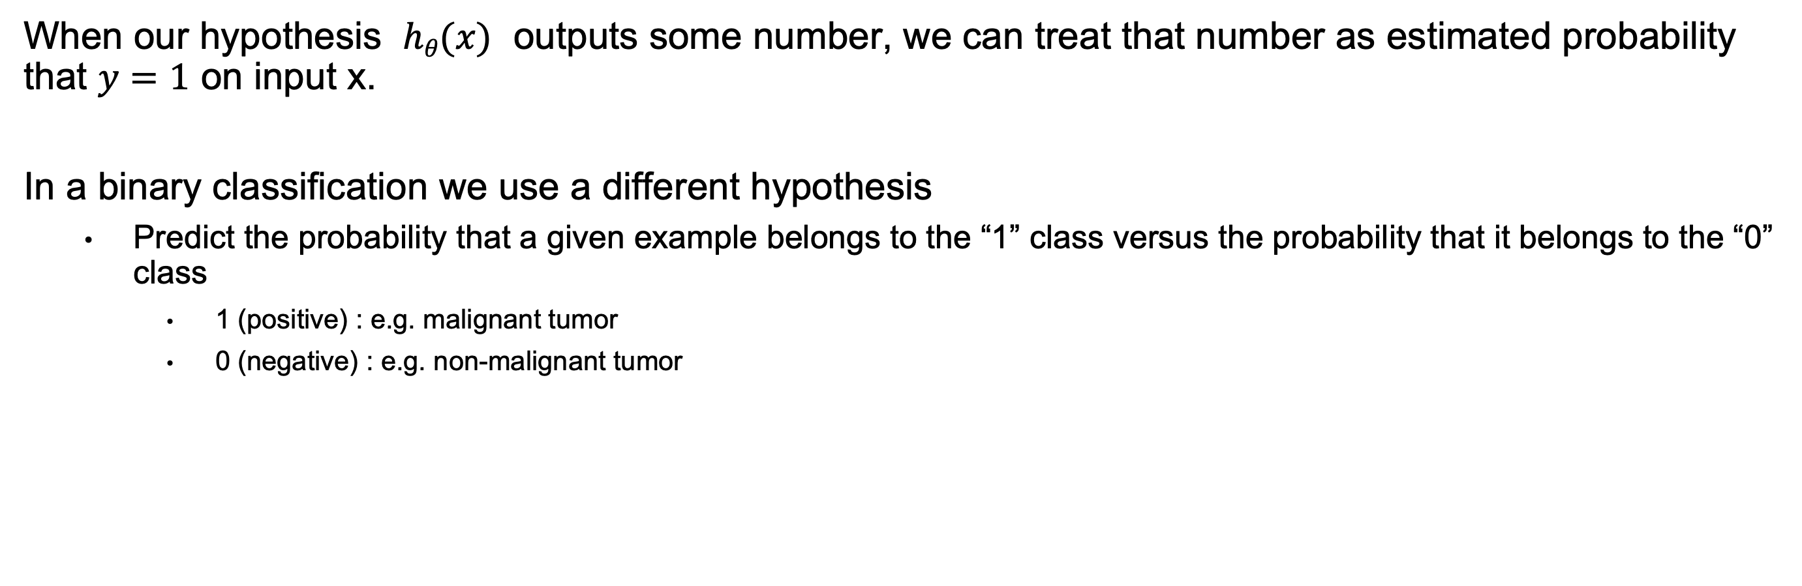
Logistic Regression Hypothesis
$$hθ\left(x\right)=θTx$$
When our hypothesis $hθ(x)$ outputs some number, we can treat that number as estimated probability that $y=1$ on input x.
In a binary classification we use a different hypothesis
Predict the probability that a given example belongs to the “1” class versus the probability that it belongs to the “0” class
1 (positive) : e.g. malignant tumor
0 (negative) : e.g. non-malignant tumor
Notes:
For Logistic Regression , when the hypothesis ℎ_{𝜃}(𝑥) outputs some number, we can treat that number as estimated probability that 𝑦=1 on input x.
In a binary classification we use a different hypothesis.
Predict the probability that a given example belongs to the “1” class versus the probability that it belongs to the “0” class
1 (positive) : e.g. malignant tumor
0 (negative) : e.g. non-malignant tumor

Slide 7
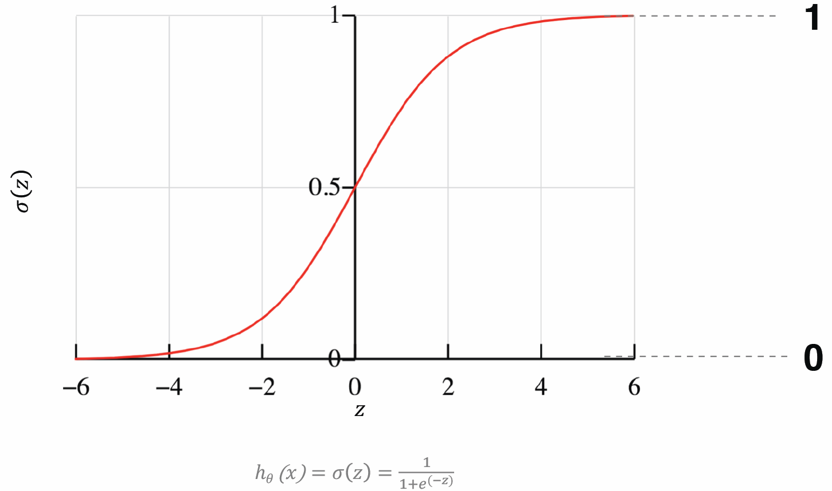
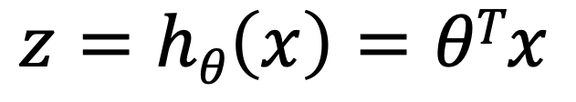
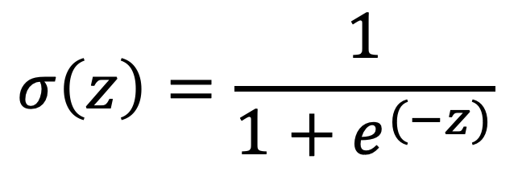
Sigmod Function
Use Sigmod function to transform the linear calculation to probability.
Squash z into (0,1)
$$σ\left(z\right)=\frac{1}{1+e^{(−z)}}$$
$$z=hθ\left(x\right)=θTx$$
Notes:
We Use Sigmod function to transform the linear calculation to probability.
The right figure shows the curve of this function.
The function will squash output z to a range (0,1) that can be treated as probability.

Slide 8
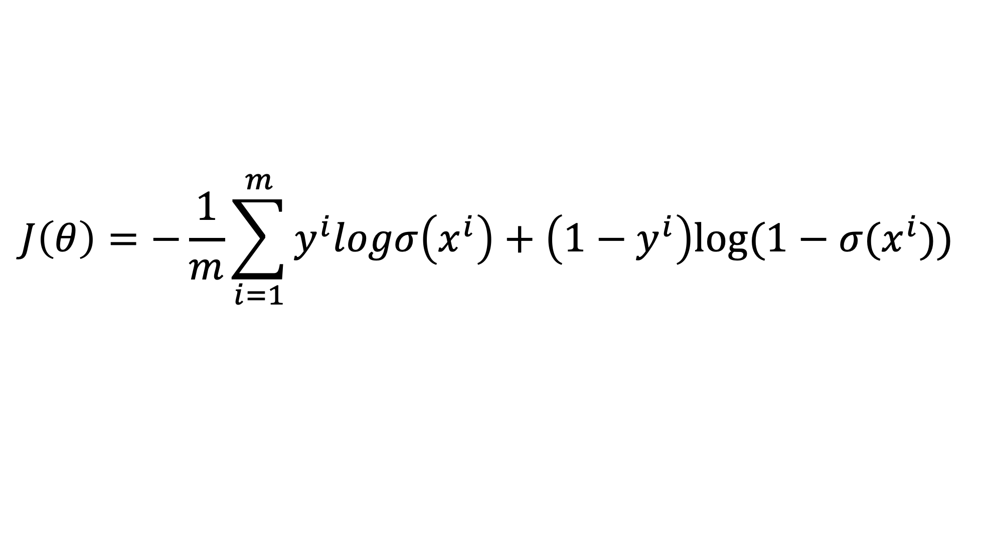
Parameter Learning
Search for a value of θ so that model estimates high probabilities for positive instances (y =1) and low probabilities for negative instances (y = 0)
Logistic regression model uses a different approach with logistic— Maximum Likelihood Estimation.
Loss Function: cross entropy loss
$$J\left(θ\right)=−\frac{1}{m}\sum_{i=1}^{m}{y^{i}logσ\left(x^{i}\right)+\left(1−y^{i}\right)log⁡(1−σ(x^{i}))}$$
Notes:
To learn the parameter θ of linear model, we have to build a loss function that is a guide to tune the parameter θ.
Here is an example of loss function, cross entropy loss, where y^{i} is the target (label) and x^{i} is the ith sample.
And we can apply Maximum Likelihood Estimation to learn θ.

Slide 9
Linear Regression
A supervised machine learning algorithm
Linear relationship between the samples and labels
A linear relationship between a dependent variable and independent variable(s).
The value of the dependent variable of a linear regression model is a continuous value i.e. real numbers.
Notes:
For linear regression, its output is a continuous value, which is main difference to linear classification.

Slide 10
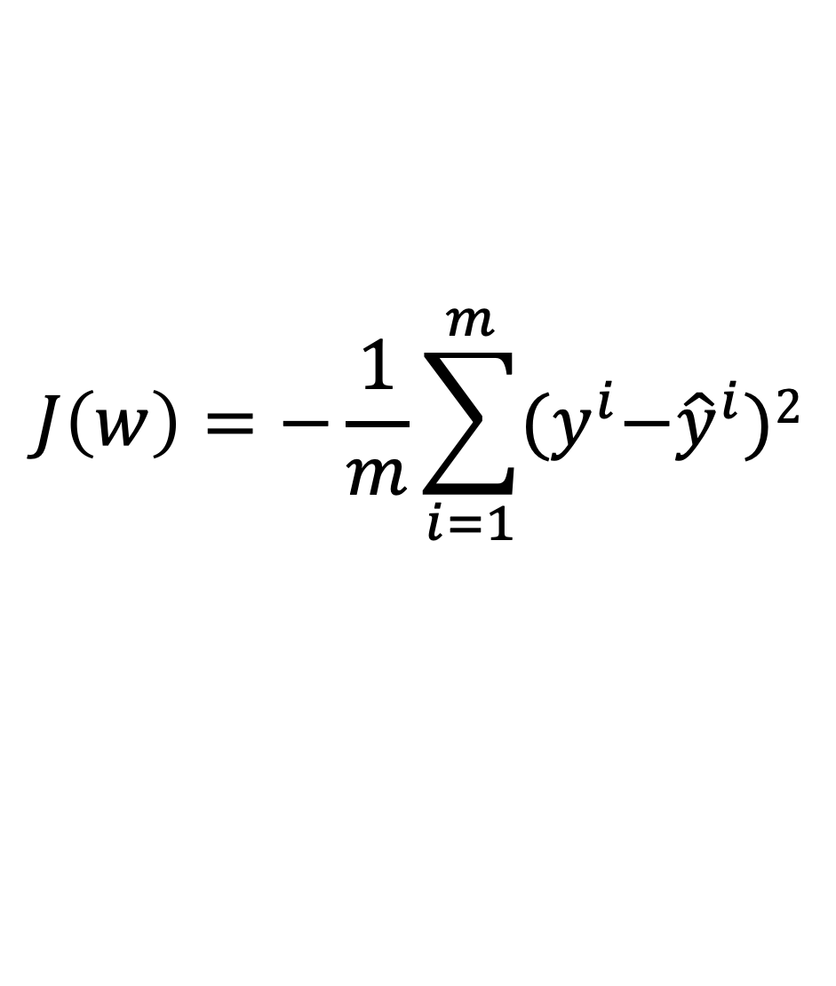
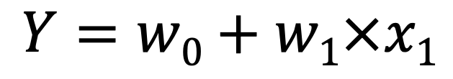
Linear Regression
Simple Linear Regression
Multiple Linear Regression
Loss Function: mean square error
$$Y=w0+w1×x1$$
$$Y=w0+w1×x1+w2×x2+w3×x3+⋯+wn×xn$$
$$J\left(w\right)=−\frac{1}{m}\sum_{i=1}^{m}{{(y}^{i}−{\hat{y}}^{i})2}$$
Notes:
Compared to linear classification, we will employ mean square error as the loss function to learning the parameters w.

Slide 11
DLI Accelerated Data Science Teaching Kit
Thank You

