Slide 1

Lecture 14.4 - RAPIDS Acceleration: Linear Regression
DLI Accelerated Data Science Teaching Kt
Notes:
This section will introduce how to use RAPIDS to accelerate the training of linear regression.

Slide 2

The Accelerated Data Science Teaching Kit is licensed by NVIDIA, Georgia Institute of Technology, and Prairie View A&M University under the
Creative Commons Attribution-NonCommercial 4.0 International License.

Slide 3

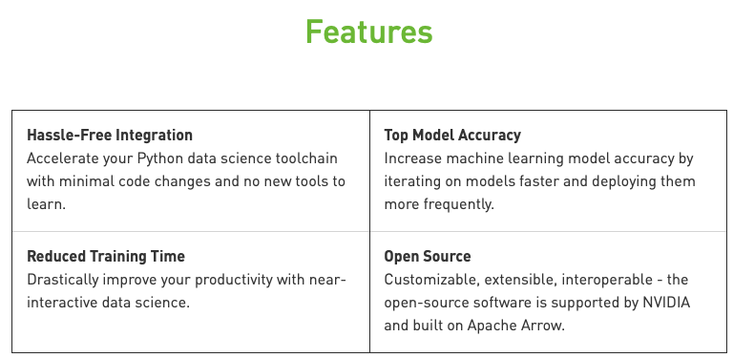
RAPIDS
The RAPIDS data science framework includes a collection of libraries for executing end-to-end data science pipelines completely in the GPU.
It is designed to have a familiar look and feel to data scientists working in Python.
Source: https://rapids.ai/start.html
Notes:
RAPIDS is developed by NVIDIA for accelerating the process of building machine learning models with GPUs.
Moreover, it will help improve the model accuracy.
It is a collection of libraries for executing end-to-end data science pipelines completely in the GPU.
The detailed features are shown on this figure.

Slide 4
Speed Up Learning of Linear Regression
Linear Regression is a simple machine learning model where the response y is modelled by a linear combination of the predictors in X.
The model can take array-like objects, either in host as NumPy arrays or in device (as Numba or cuda_array_interface-compliant), as well as pandas or cuDF DataFrames as the input. You can also use the pandas GPU accelerator extension, cuDF.pandas to speed up the processing.
Notes:
This section will focus on speeding up the process of building linear regression models with RAPIDS.
Linear Regression is a simple machine learning model where the response y is modelled by a linear combination of the predictors/features in X.
The model can take array-like objects, either in host as NumPy arrays or in device (as Numba or cuda_array_interface-compliant), as well as pandas or cuDF DataFrames as the input.
cuDF.pandas GPU acceleration can also be used

Slide 5
Linear Regression vs Linear Regression cuML
Import packages
Setting parameters
# load the cuDF GPU extension for Pandas
%load_ext cudf.pandas
import pandas
# Import CPU based libraries
from sklearn.linear_model import LinearRegression
from sklearn.datasets import make_regression as make_regression_skl
from sklearn.model_selection import train_test_split as train_test_split_skl
from sklearn.metrics import r2_score as r2_score_skl
from sklearn.linear_model import LinearRegression as skLinearRegression
# Import GPU accelerated libraries
from cuml import make_regression as make_regression_cuml, train_test_split as train_test_split_cuml, LinearRegression as LinearRegression_cuml
from cuml.linear_model import LinearRegression as cuLinearRegression
from cuml.metrics.regression import r2_score as r2_score_cuml
n_samples = 2**19 #Change depending on the size of your GPU
n_features = 399
random_state = 23
Notes:
First, some packages should be imported such as cudf and cuml. The details of these packages can be found in the repo of RAPIDS.
Then, we have to set hyper-parameters such as number of samples and number of features. Random state is used to generate data for training the
In the third step, we will generate data and split it into training and testing sets.
In addition, we have to copy the datasets from GPU memory to host memory, which is used later for comparison between CPU results and GPU results.
linear regression model.

Slide 6
Linear Regression vs Linear Regression cuML
Generating Data with Sklearn
Generating Data with GPU Acceleration
%%time
X, y = make_regression_skl(n_samples=n_samples, n_features=n_features, random_state=random_state)
X_train, X_test, y_train, y_test = train_test_split_skl(X, y, test_size=0.2, random_state=random_state)
%%time
X, y = make_regression_cuml(n_samples=n_samples, n_features=n_features, random_state=random_state)
X_train, X_test, y_train, y_test = train_test_split_cuml(X, y, test_size=0.2, random_state=random_state)
Notes:
In the third step, we will generate data and split it into training and testing sets.
In addition, we have to copy the datasets from GPU memory to host memory, which is used later for comparison between CPU results and GPU results.

Slide 7
Linear Regression vs Linear Regression cuML
Sklearn Linear Regression
cuML
Fit
Predict
%%time
ols_skl = skLinearRegression(fit_intercept=True,
n_jobs=-1)
ols_skl.fit(X_train, y_train)
%%time
predict_skl = ols_skl.predict(X_test)
Evaluate
%%time
r2_score_skl = r2_score_skl(y_test, predict_skl)
Predict
Fit
%%time
predict_cuml = ols_cuml.predict(X_test)
%%time
ols_cuml = cuLinearRegression(fit_intercept=True,
normalize=True,
algorithm='eig')
ols_cuml.fit(X_train, y_train)
Evaluate
%%time
r2_score_cuml = r2_score_cuml(y_test, predict_cuml)
Notes:
Here is a comparison on training and testing between traditional ML packages (Sklearn) and RAPIDS (cuML).
It can be observed that the training and prediction time is reduced significantly with cuML, compared to Sklearn.

Slide 8

Linear Regression vs Linear Regression cuML
Compare Results
print("R^2 score (SKL): %s" r2_score_skl)
print("R^2 score (cuML): %s" r2_score_cuml)
Notes:
And the performance of cuML is identical to that of Sklearn.

Slide 9
DLI Accelerated Data Science Teaching Kit
Thank You

