Slide 1
Lecture 14.5 - Overfitting and Cross Validation
DLI Accelerated Data Science Teaching Kit

Slide 2

The Accelerated Data Science Teaching Kit is licensed by NVIDIA, Georgia Institute of Technology, and Prairie View A&M University under the
Creative Commons Attribution-NonCommercial 4.0 International License.

Slide 3
An ideal model should correctly estimate:
  known or seen data examples’ labels
  unknown or unseen data examples’ labels
Song name | Artist | Length | ... | Like?
Some nights | Fun | 4:23 | ...
Skyfall | Adele | 4:00 | ...
Comf. numb | Pink Fl. | 6:13 | ...
We are young | Fun | 3:50 | ...
... | ... | ... | ... | ...
Chopin's 5th | Chopin | 5:32 | ... | ??
Notes:
In classification,
Want model to generliaze

Slide 4
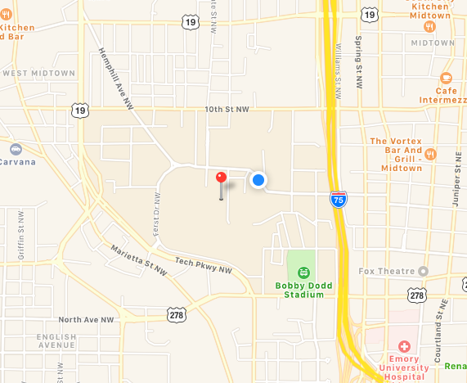
Training a classifier = building the “model”
Q: How do you learn appropriate values for
parameters a, b, c, ... ?
(Analogy: how do you know your map is a “good” map?)
y_{i} = f_{(a,b,c,....)}(x_{i}), i = 1, ..., n
  Low/no error on training data (“seen” or “known”)
y = f_{(a,b,c,....)}(x), for any new x
  Low/no error on test data (“unseen” or “unknown”)
Screenshot from Apple Maps
It is very easy to achieve perfect classification on training/seen/known data. Why?
Notes:
In other words, when we train or build model,
Want to turn knobs so that..
You may ask why distinguish better training and testing data?
Easy to perfect accuracy
Remember exactly all the rules to preciely describe data example.
However those rules may not generalize.

Slide 5
Over fitting
If your model works really well for training data, but poorly for test data, your model is “over fitting”.
How to avoid over fitting?

Slide 6
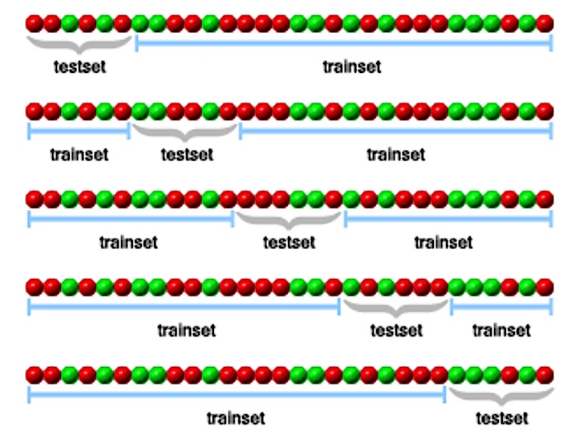
One run of 5-fold cross validation
You should do a few runs and compute the average
(e.g., error rates if that’s your evaluation metrics)
1-ST FOLD
testset
trainset
2-ND FOLD
trainset
testset
trainset
3-RD FOLD
trainset
testset
trainset
4-TH FOLD
trainset
testset
trainset
5-TH FOLD
trainset
testset
Cross-Validation in plain english? (n.d.). Retrieved December 04, 2017, from http://stats.stackexchange.com/questions/1826/cross-validation-in-plain-english

Slide 7
Cross Validation
Divide your data into n parts
Hold 1 part as “test set” or “hold out set”
Train classifier on remaining n-1 parts “training set”
Compute test error on test set
Do the above steps n times, once for each n-th part
Compute the average test error over all n folds
(i.e., cross-validation test error)

Slide 8
Cross-Validation Variations
K-fold cross-validation
Test sets of size (n / K)
K = 10 is most common (i.e., 10-fold CV)
Leave-one-out cross-validation (LOO-CV)
test sets of size 1

Slide 9
DLI Accelerated Data Science Teaching Kit
Thank You

