Slide 1

Lecture 14.6 - Decision Tree
DLI Accelerated Data Science Teaching Kit
Notes:
This section is to introduce a tree model, decision tree.

Slide 2

The Accelerated Data Science Teaching Kit is licensed by NVIDIA, Georgia Institute of Technology, and Prairie View A&M University under the
Creative Commons Attribution-NonCommercial 4.0 International License.

Slide 3
Decision Tree
Decision tree builds classification or regression models in the form of a tree structure.
A decision tree allows to predict the value of a target variable by following the decisions in the tree from the root (beginning) down to a leaf node.
A tree consists of branching conditions where the value of a predictor is compared to a trained weight.
The number of branches and the values of weights are determined in the training process.
Decision trees are prone to overfitting, additional modification, or pruning, may be used to simplify the model.
Notes:
Decision tree is a tree model for classification or regression since it is in the form of a tree structure after training models.
It allows to predict the value of a target variable by following the decisions in the tree from the root (beginning) down to a leaf node.
A decision tree consists of branching conditions where the value of a predictor is compared to a trained weight.
During the the training process, it is to determine the number of branches and the values of weights.
However, decision trees are prone to overfitting. With pruning techniques, the decision tree can be simplified to overcome the overfitting.

Slide 4
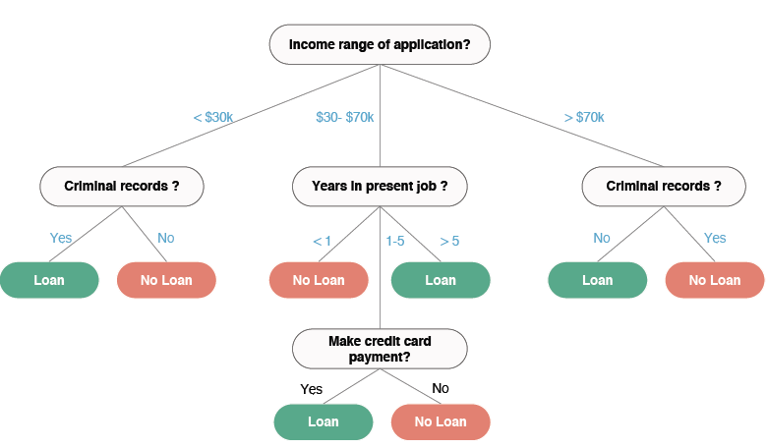
Application
Decide whether or not to offer someone a loan based on features below
Income
Criminal records
Years in present job
Payment for credit card
Notes:
Here is an example on how to use decision tree to decide whether or not to offer someone a loan based on features such as Income, Criminal records, Years in present job, and Payment for credit card.
With these features, we can build a tree and make decision on offering loan.
For example, If the applicant’s income is greater than $70K per year and has criminal records, he/she will not get the loan.

Slide 5
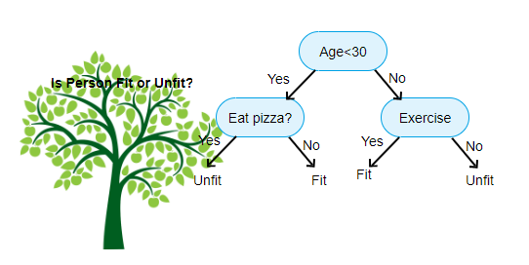
Building a Decision Tree
Decision Tree generates the output as a tree-like structure
Built top-down from a root node
Break down a dataset into smaller and smaller subsets
An associated decision tree is incrementally developed
A tree with decision nodes and leaf nodes.
A decision node has two or more branches.
Leaf node represents a classification or decision.
The topmost decision node in a tree which corresponds to the best predictor called root node.
Source: https://www.aitimejournal.com/@akshay.chavan/a-comprehensive-guide-to-decision-tree-learning
Notes:
Decision Tree generates the output as a tree-like structure.
This tree is built top-down from a root node like Age < 30 by breaking down the dataset into smaller and smaller subsets
Thus, a decision tree is incrementally developed by adding nodes including decision nodes and leaf nodes, where a decision node has two or more branches, and the leaf node represents a classification or decision.
The topmost decision node in a tree is the best predictor called root node.

Slide 6
Building a Decision Tree (Continued)
Strategy: top-down recursive divide-and-conquer fashion
1. First: select attribute for root node
Create a branch for each possible attribute value
2. Then: split the data set into subsets
One for each branch extending from the node
3. Finally: repeat recursively for each branch
Recursively partitions the training set until each partition consists entirely or dominantly of examples from one class.
Each non-leaf node of the tree contains a split point that is a test on one or more attributes and determines how the data is partitioned.
The tree is built by recursively partitioning the data.
Notes:
The strategy to build a decision tree is recursive divide-and-conquer from top to down.
First step is to select attribute for root node and create a branch for each possible attribute value of the root node.
Then the second step is to split the data set into subsets based on these branch, where one subset is for each branch.
Each non-leaf node of the tree contains a split point that is a test on one or more attributes and determines how the data is partitioned.
Finally, repeat recursively for each branch with first and second steps until each partition consists entirely or dominantly of examples from one class. So, the tree is built by recursively partitioning the data.

Slide 7
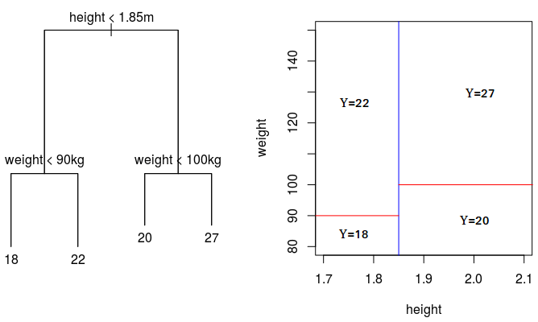
Splitting Data
A decision tree subdivides a feature space into regions of roughly uniform values
Source: https://medium.com/swlh/decision-tree-classification-de64fc4d5aac
Notes:
This figure shows how the decision tree split the data space with two features, weight and height.

Slide 8
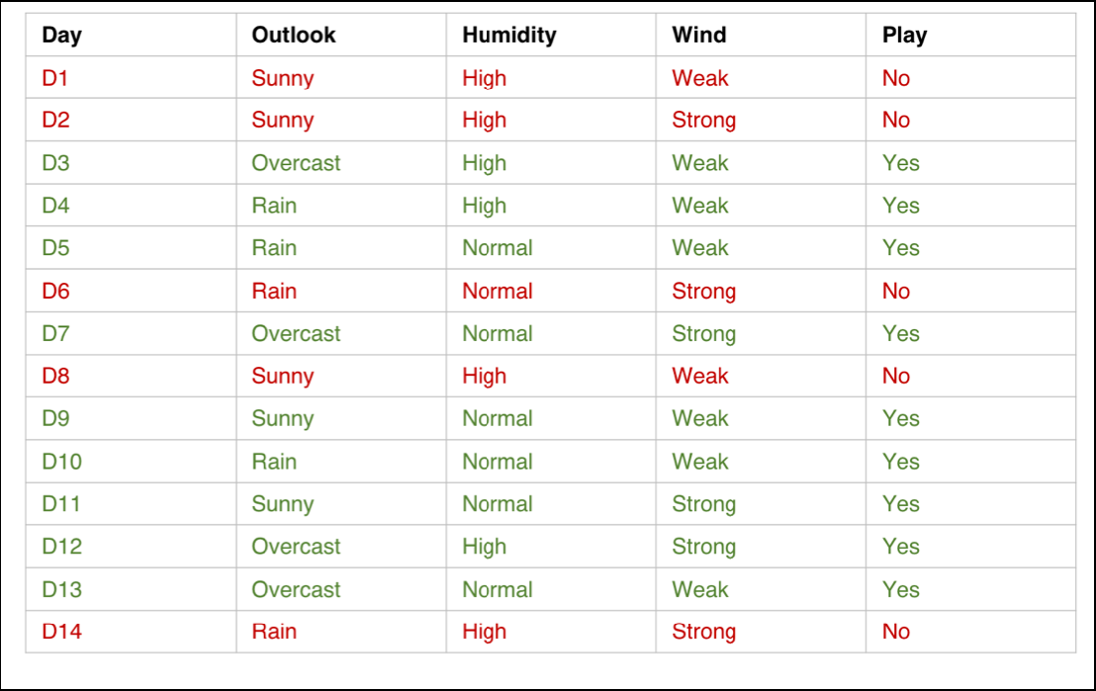
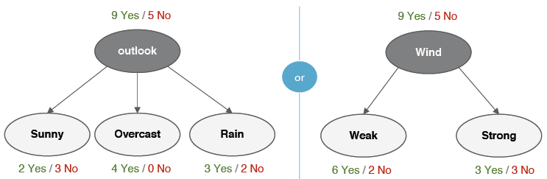
Selecting Feature
Growing a tree involves deciding on which features to choose and what conditions to use for splitting, along with knowing when to stop.
In this procedure all the features are considered, and different split points are tried and tested using a cost function.
The split with the best cost (or lowest cost) is selected.
Compare the different ways to split data in a node
Notes:
Therefore, the whole process of building a decision tree is to select features to split data to generate nodes.
Generally, splitting cost should be minimum in this process.

Slide 9
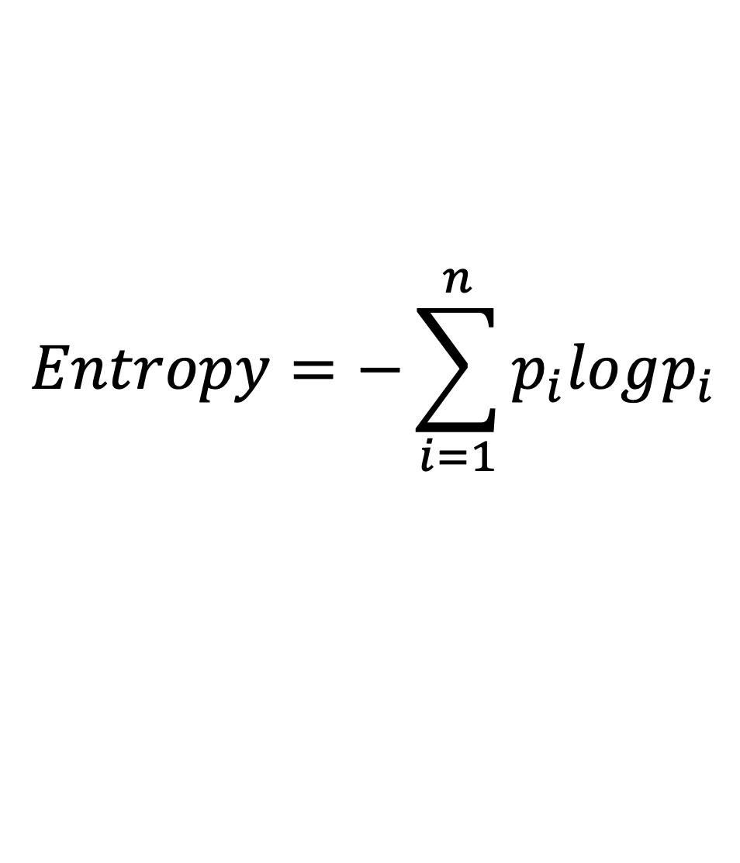
Entropy and Information Gain
Generally, entropy is a measure of disorder or uncertainty
Entropy is a concept used in Physics, mathematics, computer science (information theory) and other fields of science.
Generally, information entropy is the average amount of information conveyed by an event.
The measure of information entropy associated with each possible data value is the negative logarithm of the probability mass function for the value.
$$Entropy=−\sum_{i=1}^{n}{p_{i}logp_{i}}$$
Notes:
Entropy is a concept used in Physics, mathematics, computer science (information theory) and other fields of science, which is a measure of disorder or uncertainty.
Information entropy is employed to evaluate the splitting cost by averaging the amount of information involved in an event.
It is defined as the negative logarithm of the probability mass function for each possible data value.

Slide 10
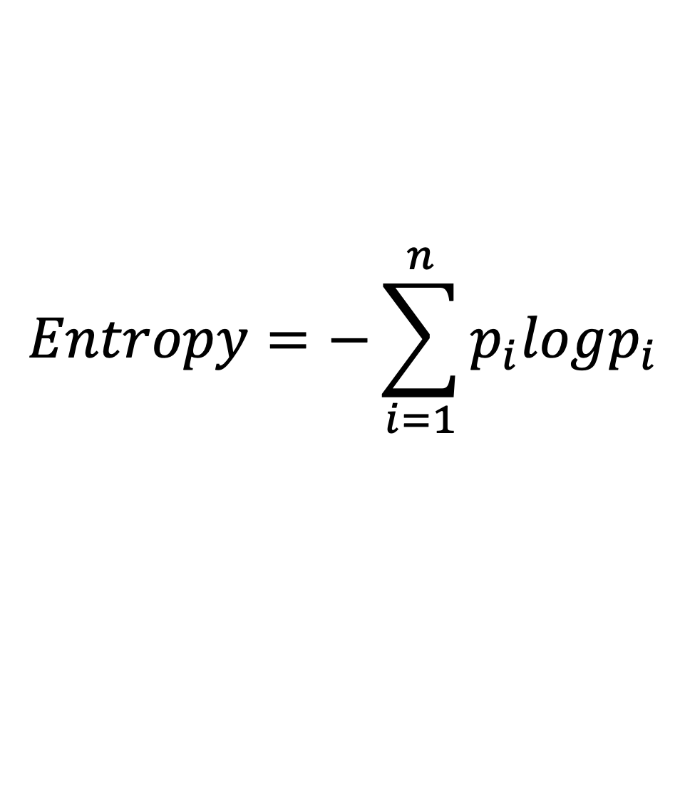
Entropy and Information Gain
The measure of information entropy associated with each possible data value is the negative logarithm of the probability mass function for the value.
where p_{i} is the probability of getting the i^{th} value when randomly selecting one from the set.
In other words, there are n classes, and p_{i} is the probability an object from the i^{th} class appearing.
$$Entropy=−\sum_{i=1}^{n}{p_{i}logp_{i}}$$
Notes:
p_{i} is the probability of getting the i^{th} value when randomly selecting one from the set.
In other words, there are n classes, and p_{i} is the probability an object from the i^{th} class appearing.

Slide 11
Entropy and Information Gain
Information gain increases with the average purity of the subsets.
Strategy: choose attribute that gives greatest information gain.
A reduction of entropy is often called an information gain.
Uses entropy to calculate the homogeneity of a sample.
Constructing a decision tree is all about finding attribute that returns the highest information gain (i.e., the most homogeneous branches)
A decision tree is built to up-down from a root node and involves partitioning the data into subsets that contain instances with similar values (homogenous).
The information gain is based on the decrease in entropy after a dataset is split on an attribute..
Notes:
Information gain is defined based on information entropy.
It increases with the average purity of the subsets, which helps us choose attribute that gives greatest information gain based on the reduction of entropy.
To build a decision tree, it is all about iteratively finding attributes that return the highest information gain until we achieve the leaf of the decision tree, which is to build branches of this tree in the fastest path and reduce the entropy in the highest speed.
The procedure of building this decision tree is in an up-down manner from the root, which is to partition the data into subsets that contain instances with similar values.

Slide 12
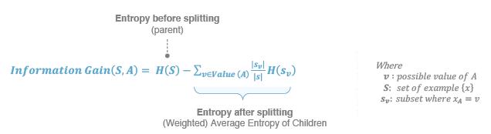
Entropy and Information Gain
The goal is to decrease in entropy (uncertainty) after splitting.
Notes:
The definition of information gain is shown as the equation on the slide.

Slide 13
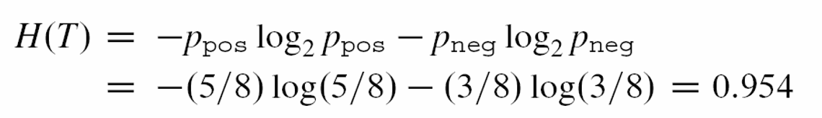
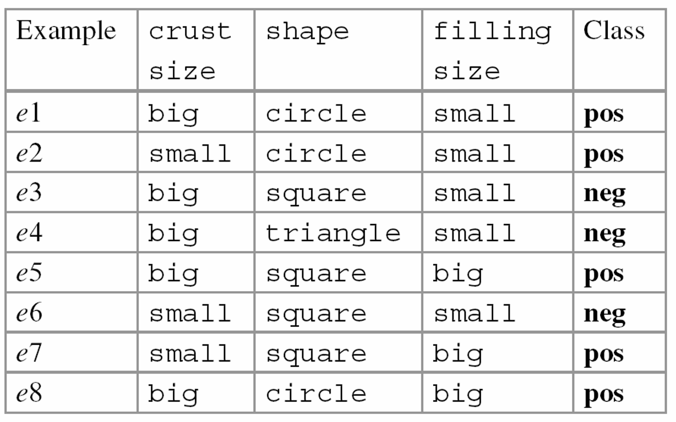
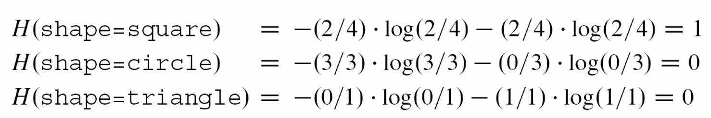
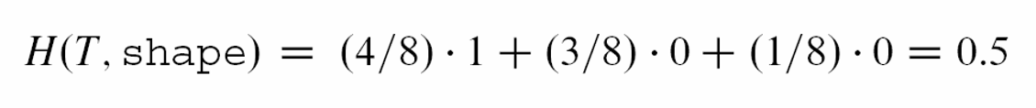
Example
Here is the entropy of the training set where only class labels are known.
Data
Next step is to calculate the entropies of the subsets defined by the values of the attribute shape.
Notes:
Here is an example to show how to choose root node for building a decision tree.
We have three attributes/features including crust size, shape, filling size and one target class.
The first step is to select the root node based on information gain.
We will calculate the information gain on all three attributes, compare them, and choose the attribute with the largest information gain as the the root node.
On the right of the slide, it showed how to calculate class entropy and the entropies of the subsets defined by the values of the attribute shape.

Slide 14
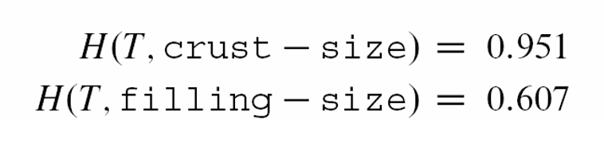
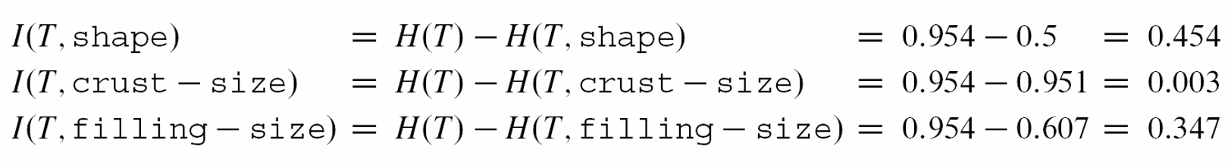
Example
Data
Notes:
We can use the same calculation to obtain the entropies of the subsets defined by the values of the attribute crust-size and filling-size.
Finally, we can obtain the information gain of three attributes shape, crust-size and filling-size.
Through comparing the information gain, we found the attribute shape is with the largest value (0.454).
So, the attribute shape is chosen as the root node for this decision tree
Once we obtain the root node, other node selection will follow the same procedure to build the decision tree.

Slide 15
DLI Accelerated Data Science Teaching Kit
Thank You

