Slide 1
Lecture 14.7 - Visualizing Classification: ROC, AUC, Confusion Matrix
DLI Accelerated Data Science Teaching Kit

Slide 2

The Accelerated Data Science Teaching Kit is licensed by NVIDIA, Georgia Institute of Technology, and Prairie View A&M University under the
Creative Commons Attribution-NonCommercial 4.0 International License.

Slide 3
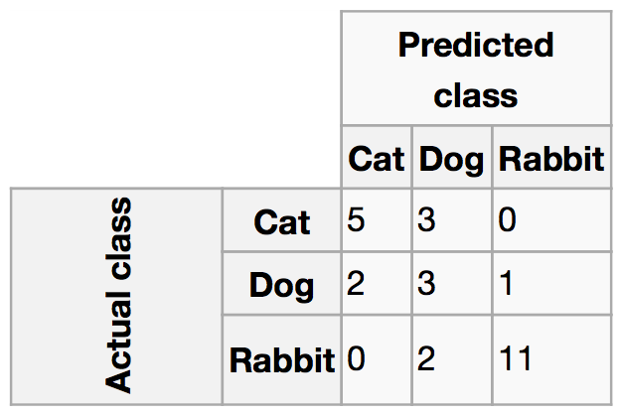
Visualizing Classification Performance
Confusion matrix
Confusion matrix. (2017, November 21). Retrieved December 04, 2017, from https://en.wikipedia.org/wiki/Confusion_matrix

Slide 4
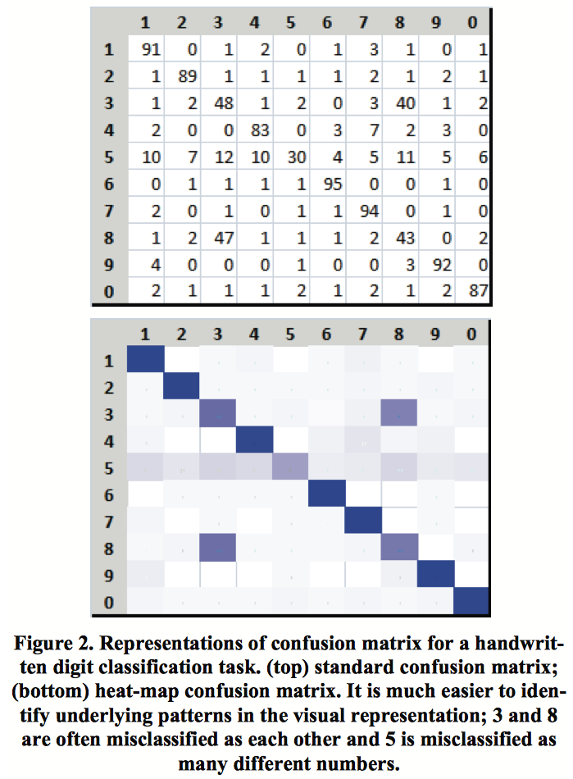
Hard to spot trends and patterns
Easier
http://research.microsoft.com/en-us/um/redmond/groups/cue/publications/CHI2009-EnsembleMatrix.pdf

Slide 5
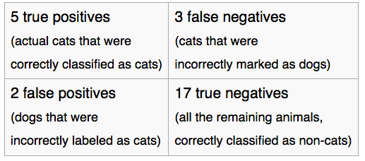
Very Important:
Find out what “Positive” Means
Confusion matrix. (2017, November 21). Retrieved December 04, 2017, from https://en.wikipedia.org/wiki/Confusion_matrix

Slide 6
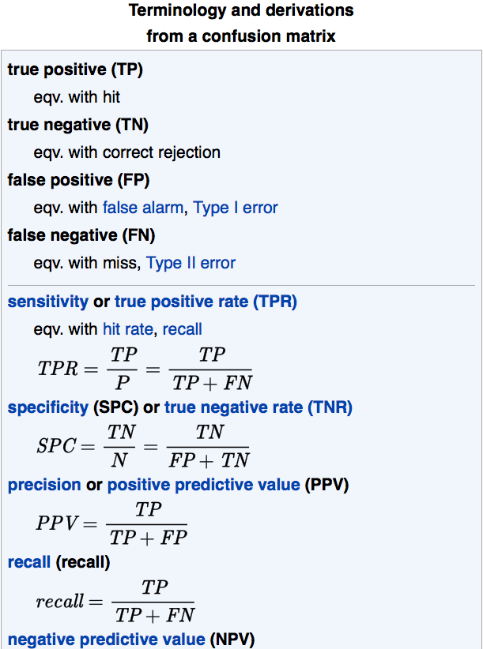
Very Important:
Find out what “Positive” Means
Confusion matrix. (2017, November 21). Retrieved December 04, 2017, from https://en.wikipedia.org/wiki/Confusion_matrix

Slide 7
Visualizing Classification Performance using
ROC curve
(Receiver Operating Characteristic)

Slide 8
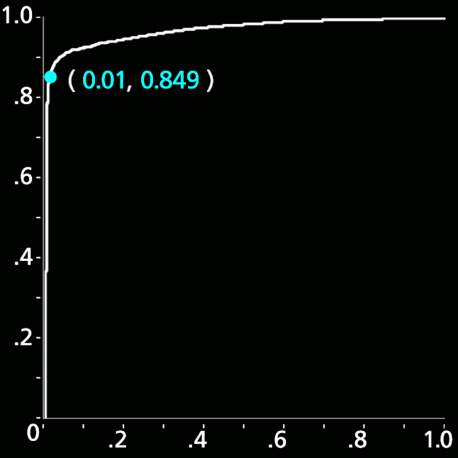
Polonium’s ROC Curve
Ideal
Positive class: malware
Negative class: benign
85% True Positive Rate
1% False Alarms
True Positive Rate
% of bad correctly labeled
False Positive Rate (False Alarms)
% of good labeled as bad

Slide 9
Measuring Classification Performance
using AUC (Area under the curve)
Ideal
85% True Positive Rate
1% False Alarms
9
  False Positive Rate

Slide 10
If a machine learning algorithm
achieves 0.9 AUC (out of 1.0).
That’s a great algorithm, right?

Slide 11
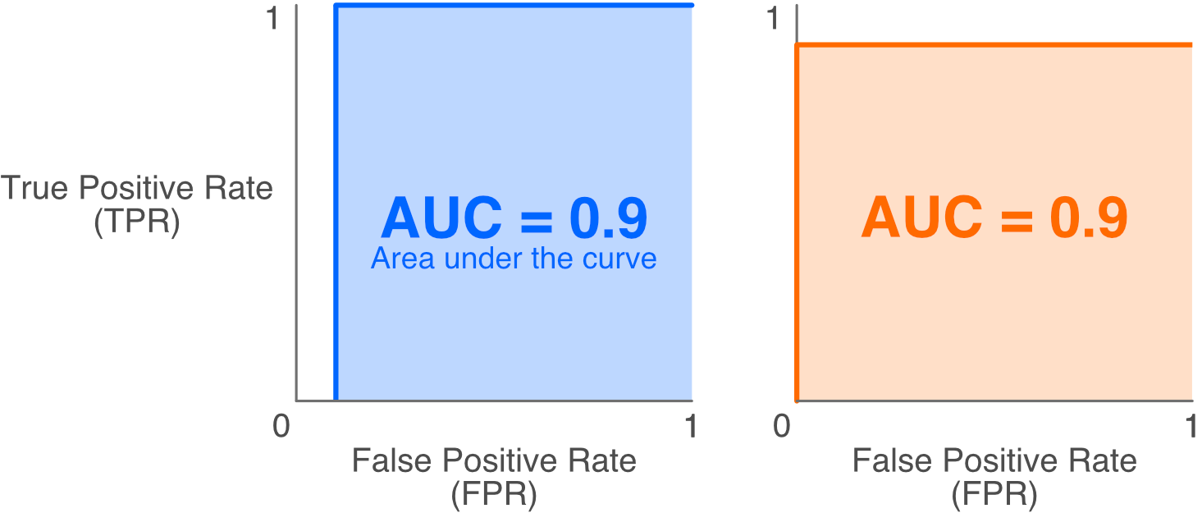
Be Careful with AUC!

Slide 12
DLI Accelerated Data Science Teaching Kit
Thank You

