Slide 1
Lecture 14.8 - Bagging
DLI Accelerated Data Science Teaching Kit

Slide 2

The Accelerated Data Science Teaching Kit is licensed by NVIDIA, Georgia Institute of Technology, and Prairie View A&M University under the
Creative Commons Attribution-NonCommercial 4.0 International License.

Slide 3
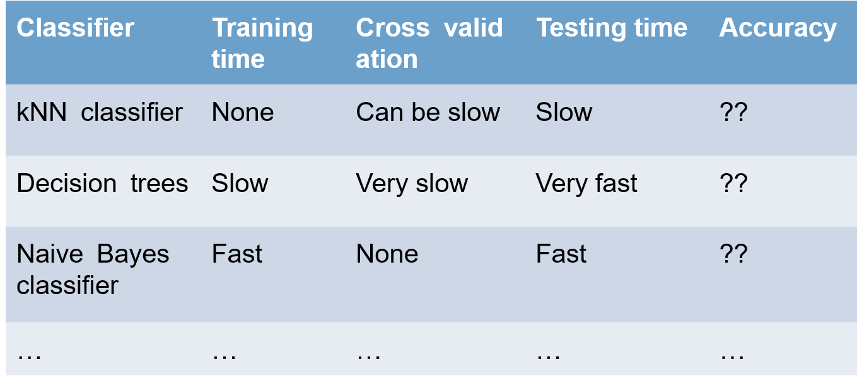
Numerous Possible Classifiers

Slide 4
Which Classifier/Model to Choose?
Possible strategies:
Go from simplest model to more complex model until you obtain desired accuracy
Discover a new model if the existing ones do not work for you
Combine all (simple) models
Common strategy: bagging
- Improve stability and accuracy
- Reduce variance
- Reduce overfitting

Slide 5
Common Strategy: Bagging
(Bootstrap Aggregating)
Consider the data set S = {(x_{i}, y_{i})}_{i=1,..,n}
Pick a sample S* with replacement of size n
(S* called a “bootstrap sample”)
Train on S* to get a classifier f*
Repeat above steps B times to get f₁, f₂,...,f_{B}
Final classifier f(x) = majority{f_{b}(x)}_{j=1,...,B}
http://statistics.about.com/od/Applications/a/What-Is-Bootstrapping.htm
Notes:
Create multiple models from the same dataset, using sampling

Slide 6
Bagging decision trees
Consider the data set S
Pick a sample S* with replacement of size n
Grow a decision tree T_{b}
Repeat B times to get T₁,...,T_{B}
The final classifier will be
Notes:
There is an issue though – the trees can be very similar.
E.g., if we use info gain to pick attribute, then first attribute to split may often the the same, across trees
How to solve this?

Slide 7
Random Forests
Almost identical to bagging decision trees, except we introduce some randomness:
Randomly pick m of the d available attributes, at every split when growing the tree (i.e., d-m attributes ignored)
Bagged random decision trees
= Random forests
Notes:
Solution is to introduce randomness
Make only a subset of attributes available at every split point

Slide 8
DLI Accelerated Data Science Teaching Kit
Thank You

