Slide 1

Lecture 14.9 - Random Forest
DLI Accelerated Data Science Teaching Kit
Notes:
This section is to introduce random forest.

Slide 2

The Accelerated Data Science Teaching Kit is licensed by NVIDIA, Georgia Institute of Technology, and Prairie View A&M University under the
Creative Commons Attribution-NonCommercial 4.0 International License.

Slide 3
Ensemble Learning
Learning methods that learn a single hypothesis, chosen form a hypothesis space that is used to make predictions.
Ensemble learning is to select a collection (ensemble) of hypotheses and combine their predictions in order to reducing the error rate.
Example
Generating 100 different decision trees from the same or different training set and have them vote on the best classification for a testing example.
Notes:
So far, we have learned the machine learning models that learn a single hypothesis, chosen form a hypothesis space that is used to make predictions.
To enhance the performance, we could build multiple models with ensemble learning.
Ensemble learning is to select a collection (ensemble) of hypotheses (machine learning models) and combine their predictions in order to reducing the error rate.
For example, you can build 100 different decision trees from the same or different training sets and have them vote on the best classification for a testing example.

Slide 4
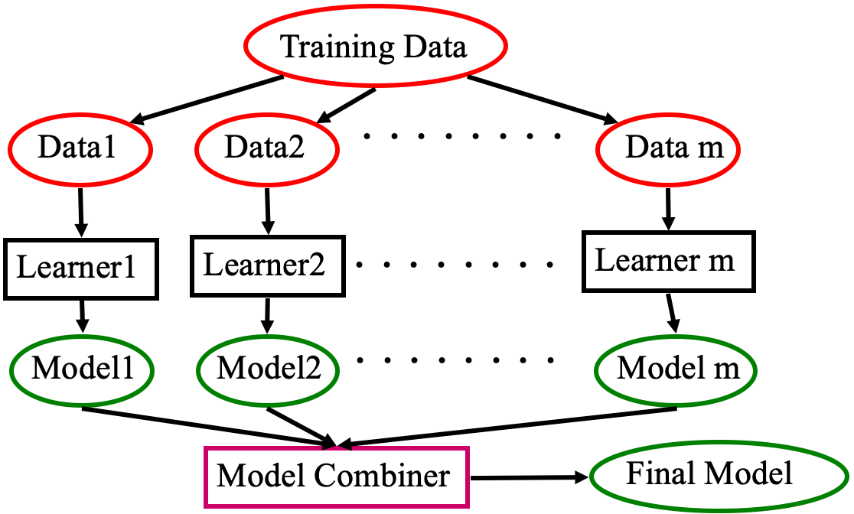
Ensemble Learning
Learn multiple alternative definitions of a concept using different training data or different learning algorithms.
Combine decisions of multiple definitions, e.g., using majority voting.
Notes:
This figure presents an example on how the ensemble learning works.
You can build m subsets on the training data.
Then train m learners on these subsets to obtain m models.
Finally, you can combine the predictions from these m models with majority voting.

Slide 5
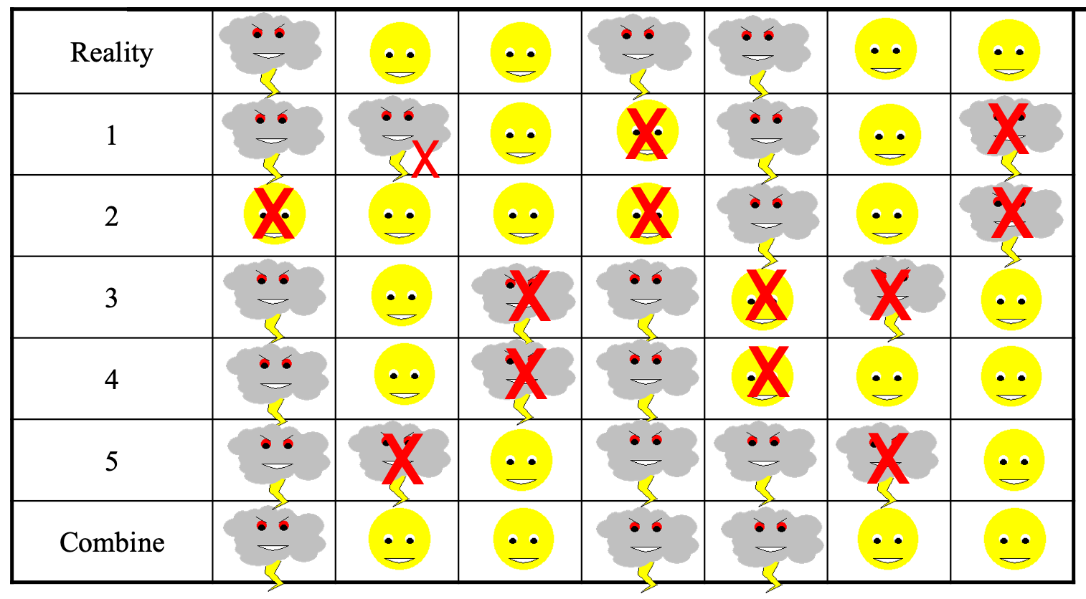
Benefit
“No Free Lunch” Theorem
No single algorithm wins all the time!
When combing multiple independent and diverse decisions each of which is at least more accurate than random guessing, correct decisions are reinforced.
Example: human ensembles are demonstrably better.
How many jellybeans in the jar? Individual estimates vs. group average.
Who Wants to be a Millionaire? Audience vote.
Weather Forecasting
Notes:
Let’s take weather forecasting as an example.
We have five forecasting results with five rows, where each row is a forecasting from one learner.
The Reality is the ground truth.
You can observe that the combined forecasting with majority voting is much better than each individual forecasting (each row).

Slide 6
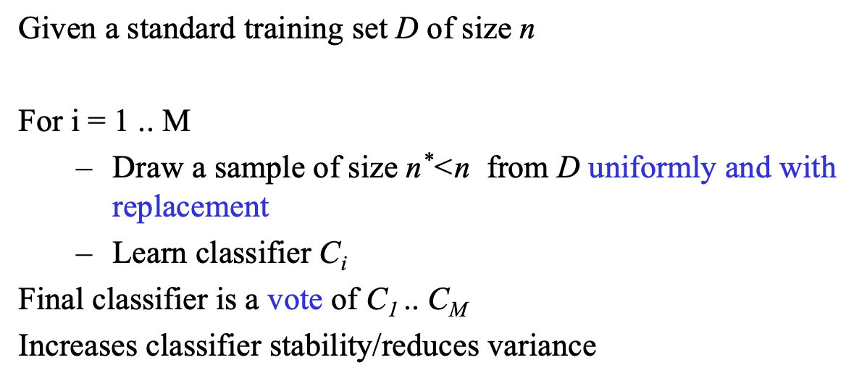
Bagging Learning
Bagging
Train M learners on M bootstrap samples
Combine outputs by voting (e.g., majority vote)
Decreasing error by decreasing the variance in the results due to unstable learners
Algorithms (like decision trees and neural networks) whose output can change dramatically when the training data is slightly changed.
Notes:
Bagging learning is a basic category of ensemble learning. It is to train M learners on M bootstrap samples and combine outputs by voting (e.g., majority vote).
The right side shows the algorithm.
It can decrease error by decreasing the variance in the results due to unstable learners.

Slide 7
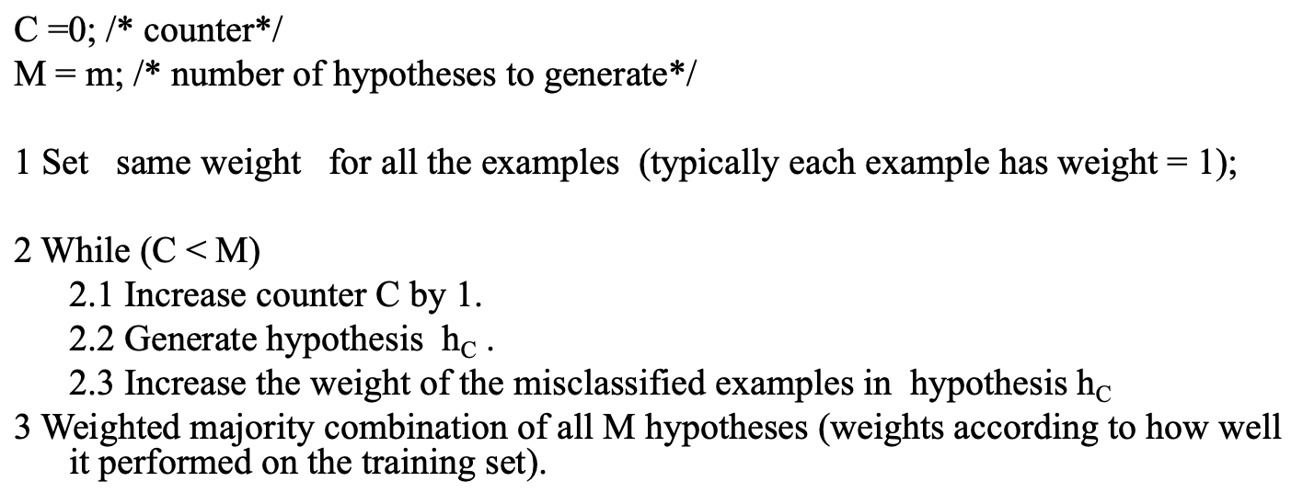
Boosting
Instead of sampling (as in bagging), re-weigh examples!
Samples are given weights.
At each iteration, a new hypothesis is learned (weak learner) and the samples are reweighted to focus the system on examples that the most recently learned classifier got wrong.
Final classification based on weighted vote of weak classifiers
Notes:
Instead of building different subsets by sampling on training data (as in bagging), we can re-weigh examples in the training data to build these subsets.
At each iteration, a new hypothesis is learned (weak learner) and the samples are reweighted to focus the system on examples that the most recently learned classifier got wrong.
Final, we complete classification based on weighted vote of weak classifiers, where the weights of weak classifiers are measured based on the performance on training data.

Slide 8
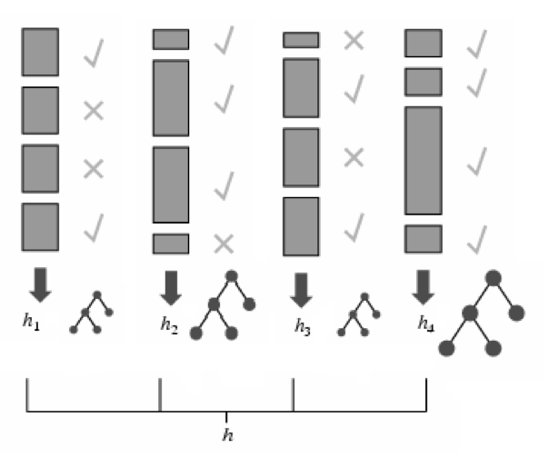
Adaptive Boosting
Each rectangle corresponds to a sample, with weight proportional to its height.
Crosses correspond to misclassified examples.
Size of decision tree indicates the weight of that hypothesis in the final ensemble.
Notes:
The right figure shows you how to obtain the weights for weak learns.
You can see the more accurate the performance of week learner is, the bigger (more weights) the tree is, where size of decision tree indicates the weight of that hypothesis in the final ensemble.

Slide 9
Random Forest
An ensemble learning method for classification, regression and other tasks
Building multiple decision trees at training time
Outputting the class that is the mode of the classes or mean/average prediction of the individual trees
It generates an internal unbiased estimate of the generalization error as the forest building progresses.
Notes:
Random Forest is a standard ensemble learning model, where the week learner can be different decision tree.
It is to build multiple decision trees at training time and output the class that is the mode of the classes or mean/average prediction of the individual trees.
The main benefit is that It generates an internal unbiased estimate of the generalization error as the forest building progresses.

Slide 10
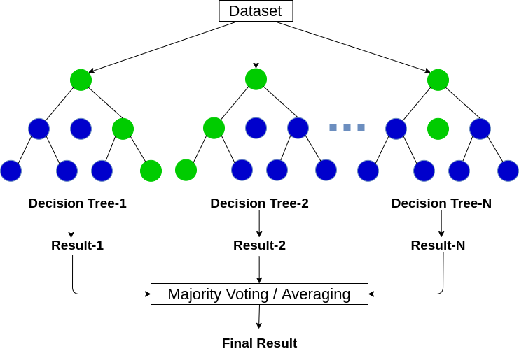
Bagging of Decision Trees
Training random forests applies bagging learning to build tree learners.
Given a training set X = x₁, ..., x_{n} with labels Y = y₁, ..., y_{n}, bagging repeatedly (N times) selects a random sample with replacement of the training set and fits trees on these samples.
After training, predictions for unseen samples x' can be made by averaging the predictions or by making the majority vote in the case of classification trees.
Source: https://www.analyticsvidhya.com/blog/2020/05/decision-tree-vs-random-forest-algorithm/
Notes:
We can apply bagging learning to build tree learners.
It will repeatedly (N times) select a random sample with replacement of the training set and fits trees on these samples to build N decision trees shown on the right side.
After training, predictions for unseen samples x' can be made by averaging the predictions or by making the majority vote in the case of classification trees for the final result.

Slide 11
Discussion on Random Forest
Strength
It is more robust.
It is faster to train (no reweighting, each split is on a small subset of data and feature).
It can handle missing/partial data.
It is easier to extend to online version.
Weakness
The feature selection process is not explicit.
Feature fusion is also less obvious.
Weak performance on small size of training data.
Notes:
General speaking, random forest is more robust and faster to train. In addition, it can handle missing/partial data and is easier to extend to online version.
However, feature selection process is not explicit, compared to decision tree.
Feature fusion is also less obvious.
Usually, it cannot perform well on small size of training data.

Slide 12
DLI Accelerated Data Science Teaching Kit
Thank You

