Slide 1

Lecture 15.2 - KMeans and Hierarchical Clustering
DLI Accelerated Data Science Teaching Kt
Notes:
This section will introduce clustering algorithms including KMeans and Hierarchical Clustering.

Slide 2

The Accelerated Data Science Teaching Kit is licensed by NVIDIA, Georgia Institute of Technology, and Prairie View A&M University under the
Creative Commons Attribution-NonCommercial 4.0 International License.

Slide 3

KMeans Clustering
KMeans is a partitional clustering algorithm.
Let the set of data points (or instances) D be {x₁, x₂, …, , … x_{i}, x_{n}}, where x_{i} = (x_{i1}, x_{i2}, …, x_{ir}) is a vector in a real-valued space $X ⊆R^{r}$, and r is the number of attributes (dimensions) in the data.
The k-means algorithm partitions the given data into k clusters.
Each cluster has a cluster center, called centroid.
k is specified by the user
Notes:
As a partitional clustering algorithm, KMeans is simple but powerful for resolving clustering problems.
It partitions the given data into k clusters, where each cluster has a cluster center, called centroid and k is specified by the user.

Slide 4
Distance Functions
Key to clustering and “similarity” and “dissimilarity” can also commonly used terms.
There are numerous distance functions for
Different types of data
Different specific applications
Most commonly used functions are
Euclidean distance and
Manhattan (city block) distance
They are special cases of Minkowski distance. h is positive integer
Notes:
Clustering is to measure the distance between samples by calculating similarity/dissimilarity.
Numerous distance functions can be utilized for different types of data and different specific applications.
Euclidean distance and Manhattan (city block) distance are most commonly used functions to measure the distance.
Actually, they are special cases of Minkowski distance.

Slide 5
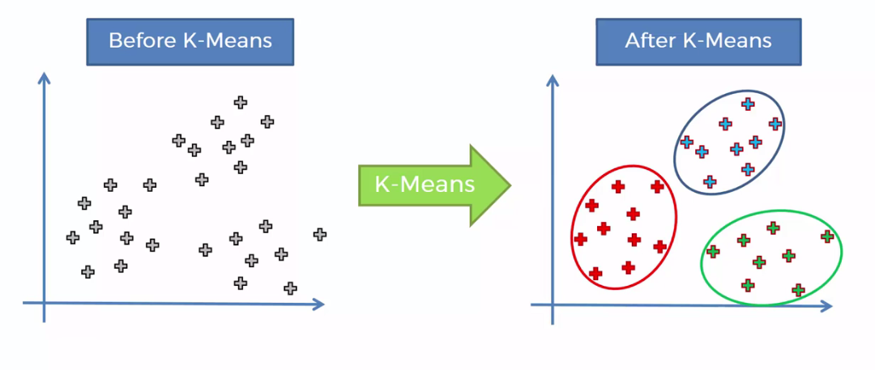
Algorithm
Given k, the kMeans algorithm works as follows:
Randomly choose k data points (seeds) to be the initial centroids, cluster centers
Assign each data point to the closest centroid
Re-compute the centroids using the current cluster memberships.
If a convergence criterion is not met, go to 2).
Source: https://towardsdatascience.com/k-means-clustering-identifying-f-r-i-e-n-d-s-in-the-world-of-strangers-695537505d
Notes:
Here are details on how KMeans works.
The first step is to randomly choose k data points (seeds) to be the initial centroids from the data, cluster centers
The second step is to assign each data point to the closest centroid by calculating the distance between samples and the centroids, which will form new clusters.
With the new clusters, it will re-compute the centroids using the current cluster memberships.
If a convergence criterion is not met, then go to the second step.

Slide 6
Stopping/Convergence Criterion
No (or minimum) re-assignments of data points to different clusters,
No (or minimum) change of centroids, or
Minimum decrease in the sum of squared error (SSE),
C_{i} is the j^{th} cluster, m_{j} is the centroid of cluster C_{j} (the mean vector of all the data points in C_{j}), and dist(x, m_{j}) is the distance between data point x and centroid m_{j}.
Notes:
The stopping/convergence criterion depends on the task and data.
Some examples of stopping/convergence criterion are
No (or minimum) re-assignments of data points to different clusters,
No (or minimum) change of centroids, or
Minimum decrease in the sum of squared error (SSE)

Slide 7
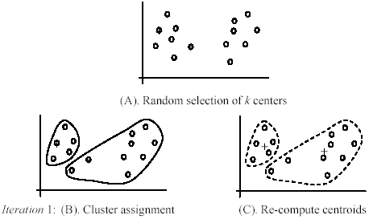
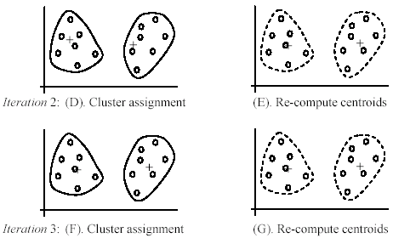
An Example of KMeans Clustering
Notes:
Here is an example of the flow of Kmeans clustering.
In each iteration, it will assign samples to new clusters and recompute centroids.

Slide 8
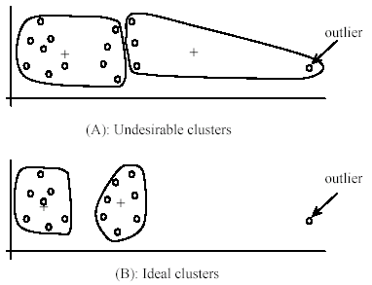
Strengths and Weakness of KMeans
Strength
Simple: easy to understand and to implement
Efficient: Time complexity: O(tkn),
where n is the number of data points,
k is the number of clusters, and
t is the number of iterations.
Since both k and t are small, k-means is considered a linear algorithm
The most popular clustering algorithm
Weakness
The user needs to specify k.
The algorithm is sensitive to outliers
Outliers are data points that are very far away from other data points.
Outliers could be errors in the data recording or some special data points with very different values.
Notes:
Kmeans has its own strength and weakness.
For the strength, it is easy to understand and implement. Its time complexity is not high since both k and t are small for real applications.
For the weakness, the user has to specify the k for clustering based on experiences.
In addition, it is sensitive to outliers, where outliers are data points that are very far away from other data points.
And they could be errors in the data recording or some special data points with very different values.
This figure shows how the outlier affects clustering results.

Slide 9
Strengths and Weakness of KMeans
Weakness
Processing outliers
Remove some data points in the clustering process that are much further away from the centroids than other data points.
To be safe, we may want to monitor these possible outliers over a few iterations and then decide to remove them.
Perform random sampling.
Since in sampling we only choose a small subset of the data points, the chance of selecting an outlier is very small.
Assign the rest of the data points to the clusters by distance or similarity comparison, or classification
Notes:
So, we have to process outliers to enhance the performance.
For instance, we can remove some data points in the clustering process that are much further away from the centroids than other data points.
Moreover, we can try to perform random sampling to avoid outliers.

Slide 10
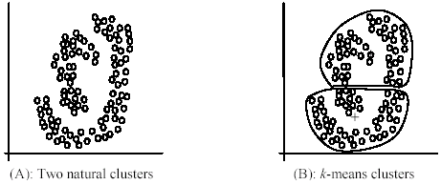
Strengths and Weakness of KMeans
Weakness
The KMeans algorithm is not suitable for discovering clusters that are not hyper-ellipsoids (or hyper-spheres).
Notes:
Furthermore, Kmeans is not suitable for clustering on non-linear data as shown in the figure.

Slide 11
KMeans Summary
Despite weaknesses, k-means is still the most popular algorithm due to its simplicity and efficiency.
No clear evidence that any other clustering algorithm performs better in general
although they may be more suitable for some specific types of data or applications.
Comparing different clustering algorithms is a difficult task.
No one knows the correct clusters!
Notes:
In summary, despite weaknesses, k-means is still the most popular algorithm due to its simplicity and efficiency.
It is challenging to obtain optimal clustering algorithm for all applications since no clear evidence show that any clustering algorithm can performs better than others in general.
Comparing different clustering algorithms is a difficult task since no one knows the correct clusters!

Slide 12
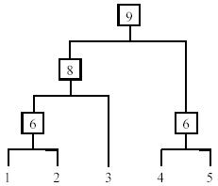
Hierarchical Clustering
Produce a nested sequence of clusters, a tree, also called Dendrogram.
Notes:
Besides partitional clustering methods, hierarchical clustering methods can group the data into a tree structure shown in the figure.

Slide 13
Types of Hierarchical Clustering
Agglomerative (bottom up) clustering: It builds the tree from the bottom level, and
Merges the most similar (or nearest) pair of clusters
Stops when all the data points are merged into a single cluster (i.e., the root cluster).
Divisive (top down) clustering: It starts with all data points in one cluster, the root.
Splits the root into a set of child clusters. Each child cluster is recursively divided further
Stops when only singleton clusters of individual data points remain, i.e., each cluster with only a single point
Notes:
There are two types of hierarchical clustering methods.
One is agglomerative (bottom up) clustering that builds the tree from the bottom level, merges the most similar (or nearest) pair of clusters, and finally stops when all the data points are merged into a single cluster (i.e., the root cluster).
The other is Divisive (top down) clustering which starts with all data points in one cluster, the root, then splits the root into a set of child clusters. Each child cluster is recursively divided further.
Finally, it stops when only singleton clusters of individual data points remain, i.e., each cluster with only a single point.

Slide 14
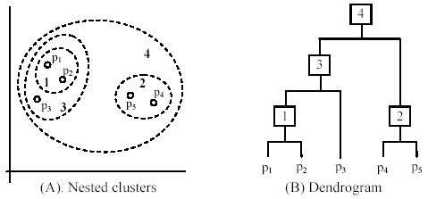
Agglomerative Clustering
It is more popular than divisive methods.
The basic ideas are below:
At the beginning, each data point forms a cluster (also called a node).
Merge nodes/clusters that have the least distance.
Go on merging
Eventually all nodes belong to one cluster
Notes:
For Agglomerative Clustering, at the beginning, each data point forms a cluster (also called a node) and then merge nodes/clusters that have the least distance utile the algorithm is converged.
Eventually all nodes belong to one cluster.

Slide 15
Hard to Evaluate Clustering Performance
The quality of a clustering is very hard to evaluate since we do not know the correct clusters
Some methods are used:
User inspection
Study centroids
For text documents, one can read some documents in clusters.
Notes:
It is extremely difficult to measure the performance of clustering since we do not know the correct clusters.
There are some general rules to measure the clustering quality.
For example, we can employ human to check the quality manually. But this approach is costly

Slide 16
Summary
Clustering (Unsupervised Learning) has along history and is still active.
There are a huge number of clustering algorithms
More are still coming every year.
Clustering is hard to evaluate, but very useful in practice.
Clustering is highly application dependent and to some extent subjective.
Notes:
In summary, clustering is a key task for data analysis. And more algorithms are still coming every year.
Clustering is hard to evaluate, but very useful in practice.
And it is highly application dependent and to some extent subjective.

Slide 17
DLI Accelerated Data Science Teaching Kit
Thank You

