Slide 1

Lecture 15.3 - RAPIDS Acceleration: KMeans
DLI Accelerated Data Science Teaching Kt
Notes:
This section will introduce how to use RAPIDS to accelerate the learning of KMeans.

Slide 2

The Accelerated Data Science Teaching Kit is licensed by NVIDIA, Georgia Institute of Technology, and Prairie View A&M University under the
Creative Commons Attribution-NonCommercial 4.0 International License.

Slide 3

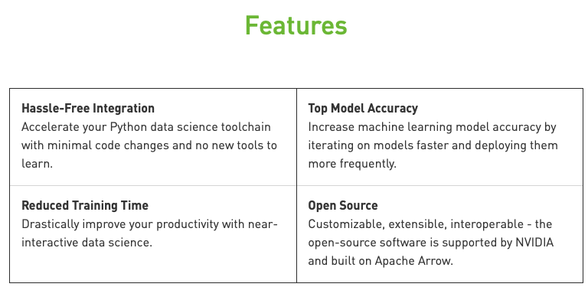
RAPIDS
The RAPIDS data science framework includes a collection of libraries for executing end-to-end data science pipelines completely in the GPU.
It is designed to have a familiar look and feel to data scientists working in Python.
Source: https://rapids.ai/start.html
Notes:
RAPIDS is developed by NVIDIA for accelerating the process of building machine learning models with GPUs.
Moreover, it will help improve the model accuracy.
It is a collection of libraries for executing end-to-end data science pipelines completely in the GPU.
The detailed features are shown on this figure.

Slide 4
Speed Up Learning of KMeans
KMeans is a basic but powerful clustering method.
It randomly selects K data points in X, and computes which samples are close to these points.
For every cluster of points, a mean is computed, and this becomes the new centroid.
cuML’s KMeans supports the scalable KMeans++ intialization method.
This method is more stable than randomly selecting K points.
The model can take array-like objects, either in host as NumPy arrays or in device (as Numba or cuda_array_interface-compliant), as well as pandas or cuDF DataFrames as the input. You can also use the pandas GPU accelerator extension, cuDF.pandas to speed up the processing.
Notes:
As we learned in the previous section, Kmeans is a basic but powerful clustering method. At the start point, it randomly selects K data points in data X, and computes which samples are close to these points to obtain initial clusters and centroid.
For every cluster of points, a mean is computed that becomes the new centroid.
cuML KMeans supports the scalable KMeans++ intialization method, which is more stable than randomly selecting K points.
can take array-like objects, either in host as NumPy arrays or in device (as Numba or cuda_array_interface-compliant), as well as cuDF DataFrames as the input.
It can take array-like objects, either in host as NumPy arrays or in device (as Numba or cuda_array_interface-compliant), as well as cuDF DataFrames as the input.

Slide 5
KMeans vs Kmeans_cuML
Import packages
Setting parameters
# load the cuDF GPU extension for Pandas
%load_ext cudf.pandas
import pandas as pd
# Import CPU based libraries
import matplotlib.pyplot as plt
from sklearn.cluster import KMeans as KMeans_skl
from sklearn.metrics import adjusted_rand_score
from sklearn.datasets import make_blobs as make_blobs_sk
# Import GPU accelerated libraries
from cuml.cluster import KMeans as KMeans_cuml
# Import GPU accelerated libraries
from cuml.cluster import KMeans as KMeans_cuml
from cuml.datasets import make_blobs as make_blobs_cuml
import cupy
n_samples = 10000000
n_features = 2 n_clusters = 5
random_state = 0
Notes:
First, some packages should be imported such as cudf and cuml. The details of these packages can be found in the repo of RAPIDS. Similarly, we will import Sklearn packages for building traditional machine learning model.
Then, we have to set hyper-parameters such as number of samples, number of features, and number of clusters.

Slide 6
KMeans vs Kmeans_cuML
%%time
data_sk, labels_sl = make_blobs_sk(n_samples=n_samples,
n_features=n_features,
centers=n_clusters,
random_state=random_state,
cluster_std=0.1)
host_data = pd.DataFrame(data_sk)
host_labels = pd.Series(labels_sl)
Generating Data with SK Learn
Generating Data with cuML
%%time
data, labels = make_blobs_cuml(n_samples=n_samples,
n_features=n_features,
centers=n_clusters,
random_state=random_state,
cluster_std=0.1)
device_data = pd.DataFrame(data)
device_labels = pd.Series(labels)
Notes:
Here is a comparison on training and testing between traditional ML packages (Sklearn) and RAPIDS (cuML).
It can be observed that the training and prediction time is reduced significantly with cuML, compared to Sklearn.

Slide 7
KMeans vs Kmeans_cuML
SK Learn KMeans
%%time
kmeans_sk = KMeans_skl(init="k-means++",
n_clusters=n_clusters,
random_state=random_state)
kmeans_sk.fit(host_data)
cuML KMeans
%%time
kmeans_cuml = KMeans_cuml(init="k-means||",
n_clusters=n_clusters,
oversampling_factor=40,
random_state=random_state)
kmeans_cuml.fit(device_data)
Notes:
Here is a comparison on training and testing between traditional ML packages (Sklearn) and RAPIDS (cuML).
It can be observed that the training and prediction time is reduced significantly with cuML, compared to Sklearn.

Slide 8
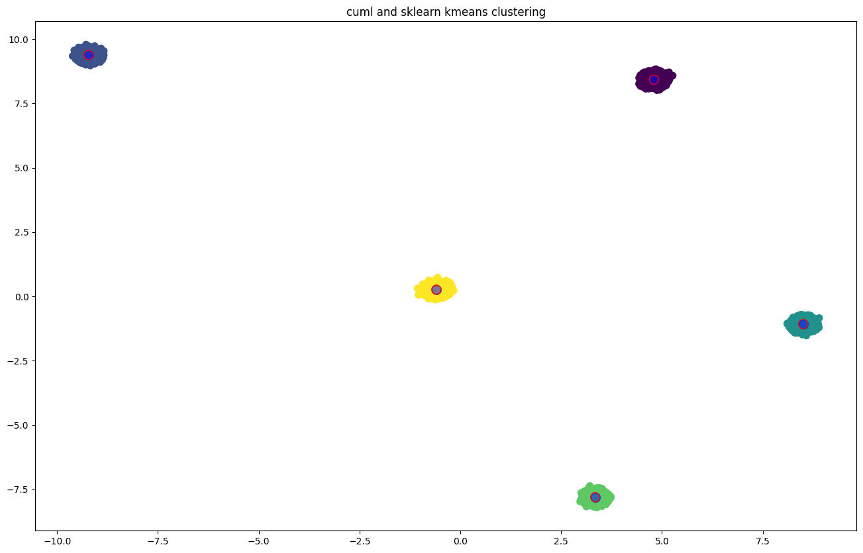
KMeans vs Kmeans_cuML
Visualize Centroids
fig = plt. figure(figsize=(16, 10))
plt.scatter(host_data.iloc[:, 0], host_data.iloc[:, 1], c=host_labels, s=50, cmap='viridis')
# plot the sklearn kmeans centers with blue filled circles
centers_sk = kmeans_sk.cluster_centers_
plt.scatter(centers_sk[:, 0], centers_sk[:, 1], c='blue', s=100, alpha=.5)
# plot the cuml kmeans centers with red circle outlines
centers_cuml = kmeans_cuml.cluster_centers_
plt.scatter(cupy.asnumpy(centers_cuml[0].values),
cupy.asnumpy(centers_cuml[1].values),
facecolors = 'none', edgecolors='red', s=100)
plt.title('cuml and sklearn kmeans clustering')
plt.show()
Notes:
Scikit-learn's k-means implementation uses the k-means++ initialization strategy while cuML's k-means uses k-means. As a result, the exact centroids found may not be exact as the std deviation of the points around the centroids when making_blobs is increased.
Note: Visualizing the centroids will only work when n_features = 2

Slide 9
KMeans vs Kmeans_cuML
Compare Results
%time
cuml_score = adjusted_rand_score(host_labels, kmeans_cuml.labels_.values)
sk_score = adjusted_rand_score(host_labels, kmeans_sk.labels_)
threshold = 1e-4
passed = (cuml_score - sk_score) < threshold
print("compare kmeans: cuml vs sklearn labels are " + ("equal" if passed else "NOT equal"))
Notes:
We can observe that the prediction of cuML is identical to that of Sklearn for clustering with Kmeans.

Slide 10
DLI Accelerated Data Science Teaching Kit
Thank You

