Slide 1
Lecture 15.4 - DBSCAN
DLI Accelerated Data Science Teaching Kit

Slide 2

The Accelerated Data Science Teaching Kit is licensed by NVIDIA, Georgia Institute of Technology, and Prairie View A&M University under the
Creative Commons Attribution-NonCommercial 4.0 International License.

Slide 3
DBSCAN
“Density-based spatial clustering with noise”
Received “test-of-time award” at KDD’14 — an extremely prestigious award.
Only need two parameters:
1. “radius” epsilon
2. minimum number of points (e.g., 4) to form a dense region
(Yellow “border points” are density-reachable from red “core points”, but not vice-versa.)
Images: https://en.wikipedia.org/wiki/DBSCAN

Slide 4
DBSCAN
Main ideas
Group closely-packed “high-density” points (i.e., many nearby neighbors)
Outliers in “low-density” not grouped (i.e., few or no nearby neighbors)
Red core points (each surrounded by 4 points, including self), reachable from each other, thus from a cluster
Yellow density-reachable points from red points, thus also join the cluster
Blue outlier point not reachable from other points
Images: https://en.wikipedia.org/wiki/DBSCAN

Slide 5
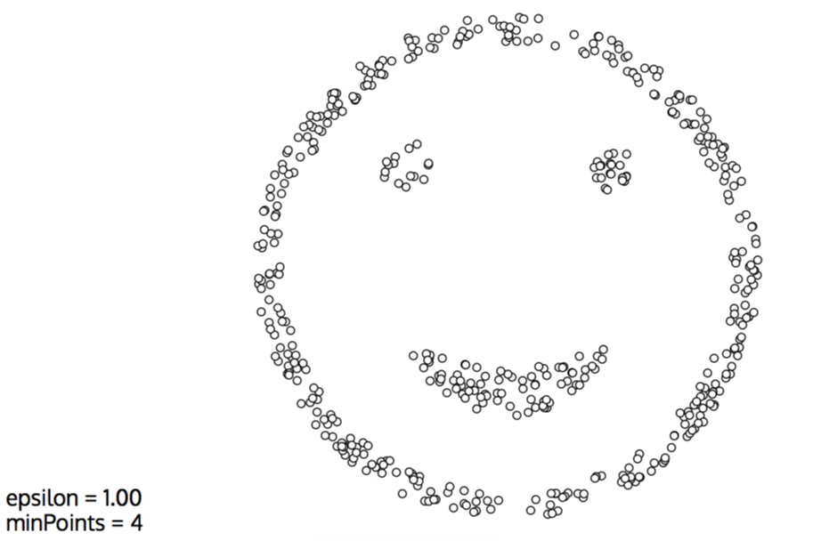
Excellent Interactive DBSCAN Demo
https://www.naftaliharris.com/blog/visualizing-dbscan-clustering/
Notes:
https://www.naftaliharris.com/blog/visualizing-dbscan-clustering/

Slide 6
DLI Accelerated Data Science Teaching Kit
Thank You

