Slide 1
Lecture 15.5 - t-SNE
DLI Accelerated Data Science Teaching Kit

Slide 2

The Accelerated Data Science Teaching Kit is licensed by NVIDIA, Georgia Institute of Technology, and Prairie View A&M University under the
Creative Commons Attribution-NonCommercial 4.0 International License.

Slide 3
t-SNE
t-distributed Stochastic Neighbor Embedding
Non-linear dimensionality reduction method developed for visualizing high-dimensional data in low-dimensional space (e.g., 2D, 3D) [1]
Widely used in numerous fields and applications
Main ideas
Models similarities between data points as joint probabilities
Similar (dissimilar) points assigned a higher (lower) probability
Represents each high-dimensional point by a low-dimensional version (e.g., 2D)
Minimizes KL divergence between the joint probabilities between originally high-dimensional data and low-dimensional representation
[1] L. v. d. Maaten and G. Hinton. Visualizing data using t-sne. Journal of machine learning research, 9(Nov):2579–2605, 2008.

Slide 4
t-SNE
t-distributed Stochastic Neighbor Embedding
For super-high dimensional data, typically first apply another dimensionality reduction method (e.g., SVD)
Can help discover patterns other techniques cannot (e.g., when linear assumptions violated for PCA)
Extension over SNE
t-SNE uses heavy-tailed t-distribution (vs Gaussian)
Suitable for reducing to a very low dimensions (e.g., 2D)
Used to be considered a “slow” method (solving n-body problem)
Now has fast approximate algorithms, and GPU acceleration (available in RAPIDS)
[1] L. v. d. Maaten and G. Hinton. Visualizing data using t-sne. Journal of machine learning research, 9(Nov):2579–2605, 2008.

Slide 5
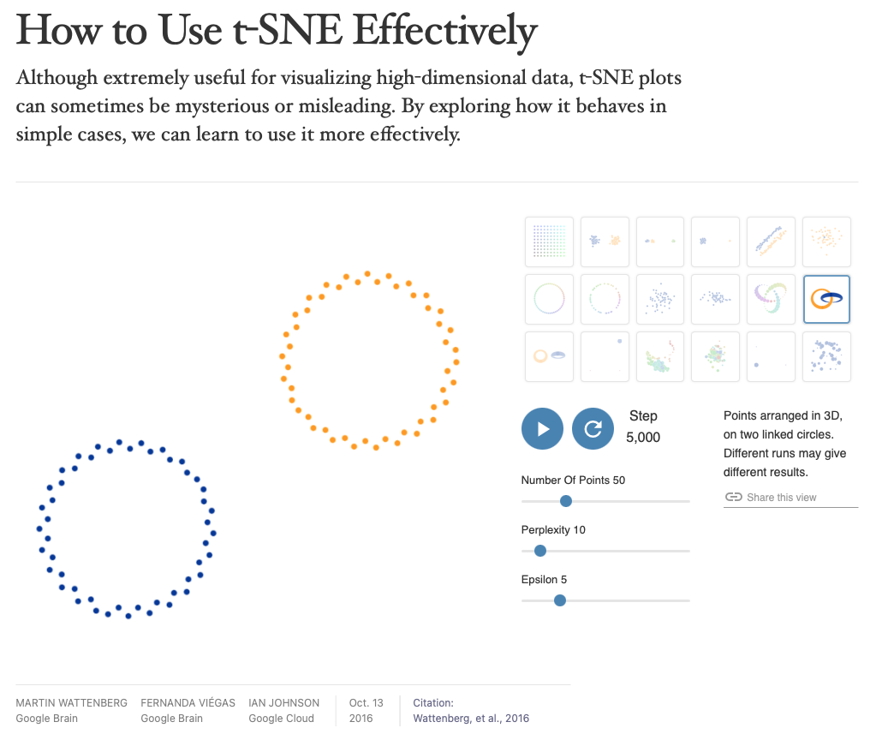
Important Considerations when Using t-SNE
Try at https://distill.pub/2016/misread-tsne/

Slide 6
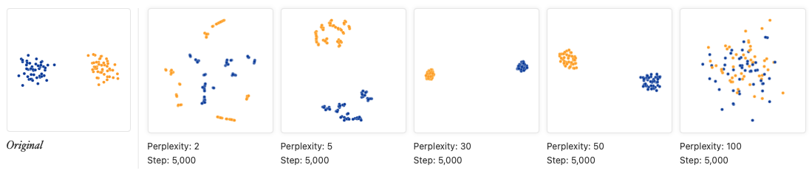
1. Hyperparameters really matter
Perplexity recommended to be 5-50. Should be smaller than number of data points.

Slide 7
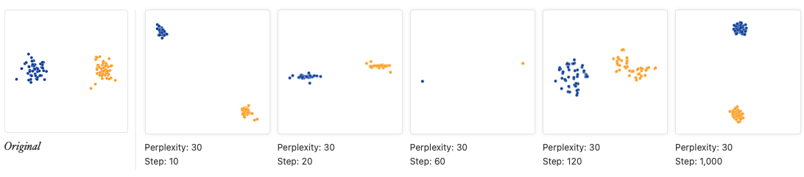
1. Hyperparameters really matter
“Pinched” may indicate stopping too early. Should wait until convergence.

Slide 8
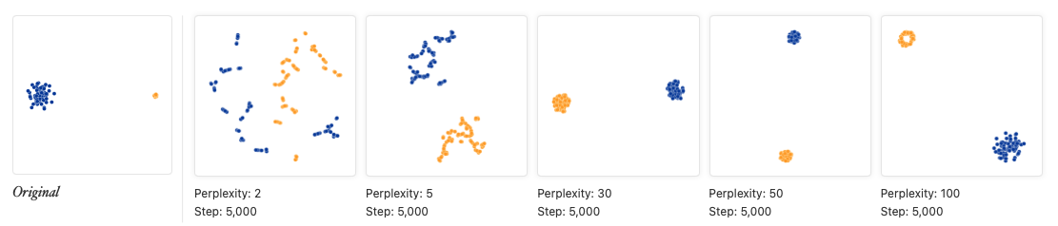
2. Cluster sizes in a t-SNE plot mean nothing

Slide 9
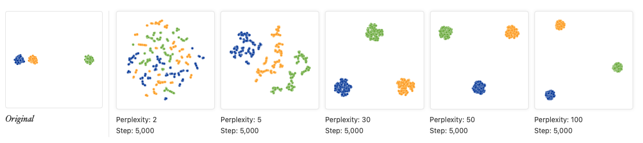
3. Distances between clusters might not mean anything

Slide 10
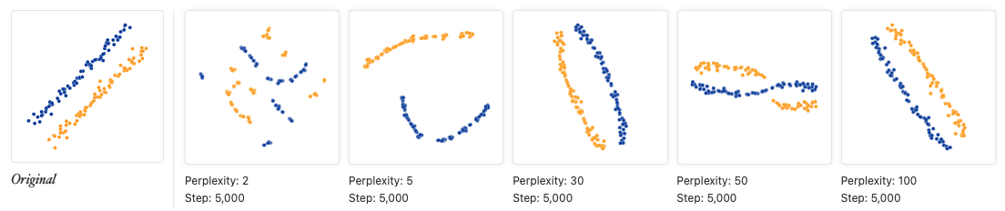
5. You can see some shapes, sometimes
See shapes as “right” perplexity. t-SNE tends to magnify dense regions.

Slide 11
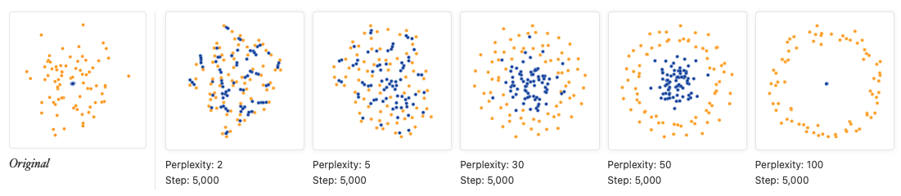
6. For topology, you may need more than one plot

Slide 12
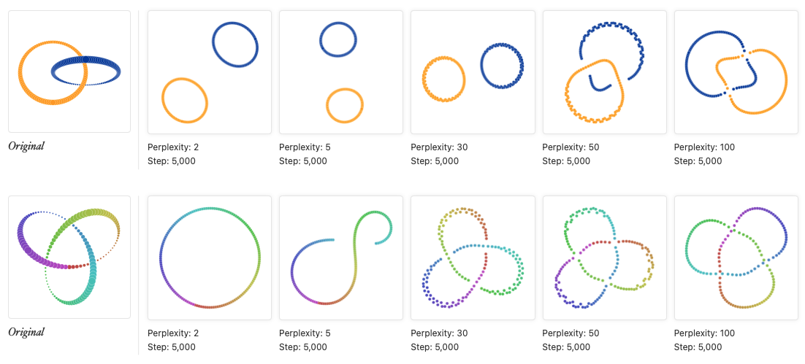
6. For topology, you may need more than one plot

Slide 13
DLI Accelerated Data Science Teaching Kit
Thank You

