Slide 1
Lecture 15.6 - UMAP
DLI Accelerated Data Science Teaching Kit

Slide 2

The Accelerated Data Science Teaching Kit is licensed by NVIDIA, Georgia Institute of Technology, and Prairie View A&M University under the
Creative Commons Attribution-NonCommercial 4.0 International License.

Slide 3
UMAP for Dimensional Reduction
Matrix Factorization
Example: Principle Component Analysis
Good at capturing the Global Structure of the data
Only keeping the principle component, meaning there is a loss in information
Neighbor Graph
Example: UMAP, t-SNE
Good at capturing the Local Strcutre of the data
Simplices: Topological structure in multi dimentional space
Nerve Theorem: We can keep all information in the topological space

Slide 4
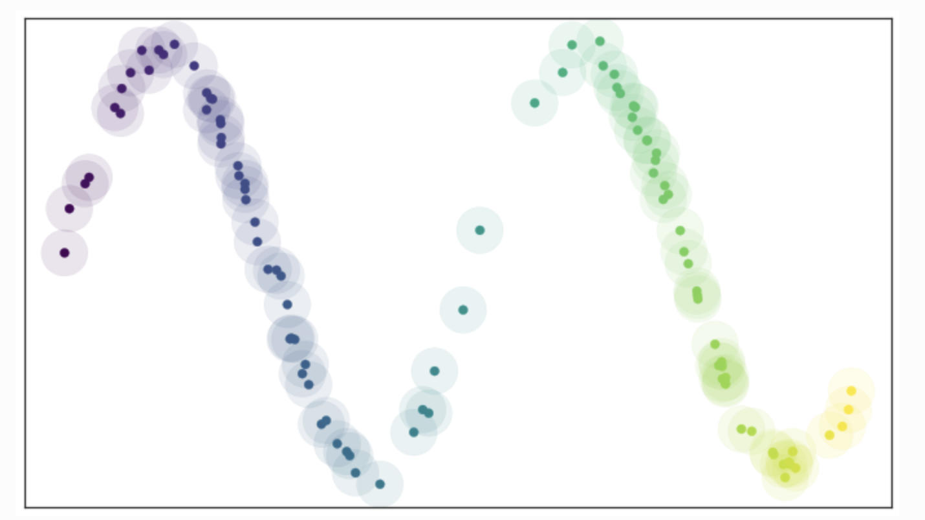
UMAP Overview
Uniform Manifold Approximation and Projection
Based on creating simplex in high-dimensional space
Points are connected with a line if the distance between them is under a certain threshold
We can use different distance metrics (e.g., Euclidean)
Problem: Data are not usually uniformly distanced
We can have points that are disconnected from other points
https://umap-learn.readthedocs.io/en/latest/how_umap_works.html
Notes:
https://umap-learn.readthedocs.io/en/latest/how_umap_works.html

Slide 5
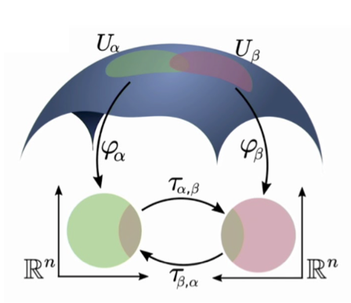
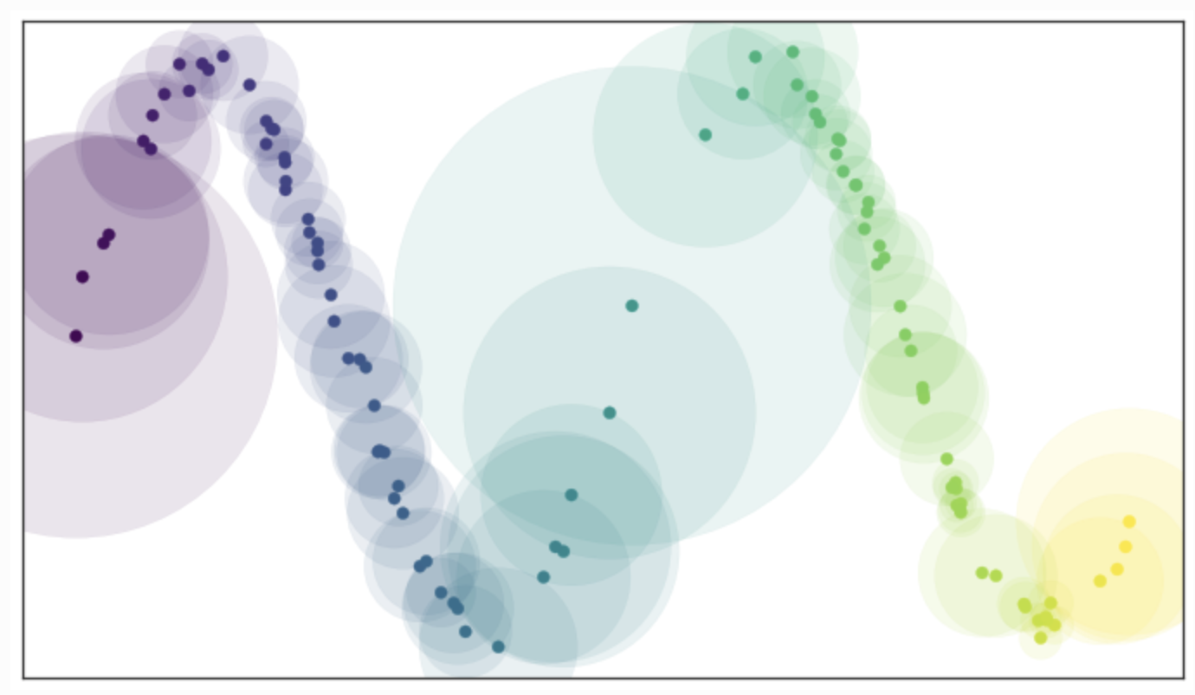
Uniform Manifold
Solution: Uniform Manifold & Riemannian Metrics
Stretching or shrinking according to where the data appear sparser or denser
We define a Uniform Manifold where each points are equally distanced from each other
Manifold & Riemannian Metrics
Distance in the manifold projected onto the real space
https://umap-learn.readthedocs.io/en/latest/how_umap_works.html
Notes:
https://umap-learn.readthedocs.io/en/latest/how_umap_works.html

Slide 6
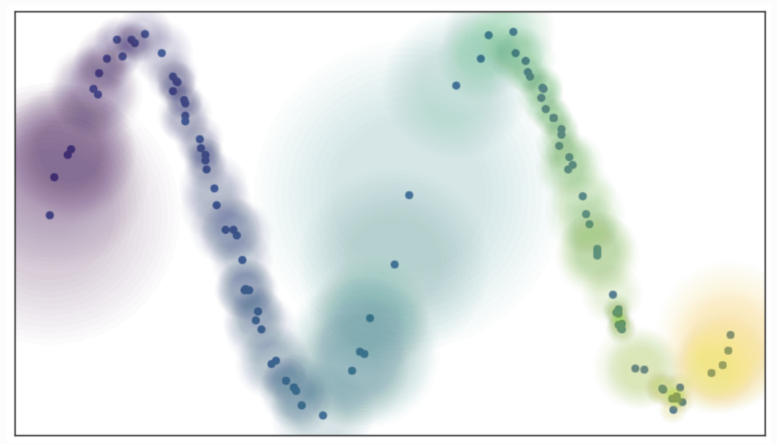
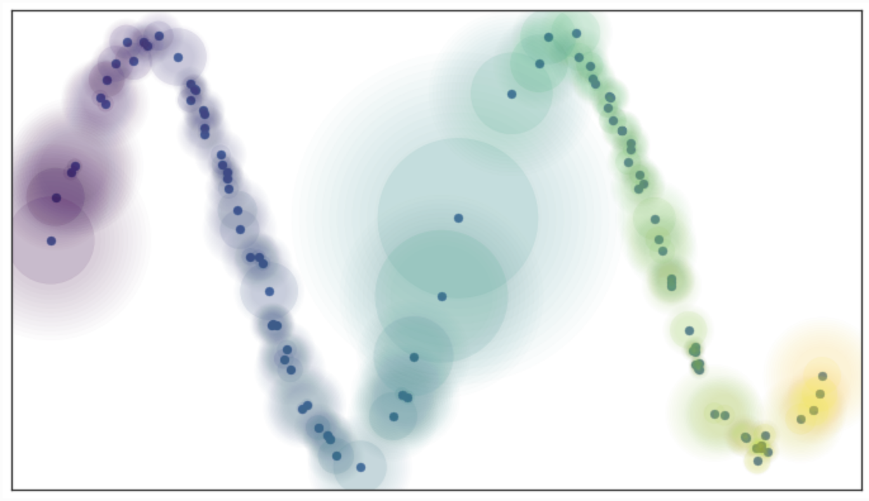
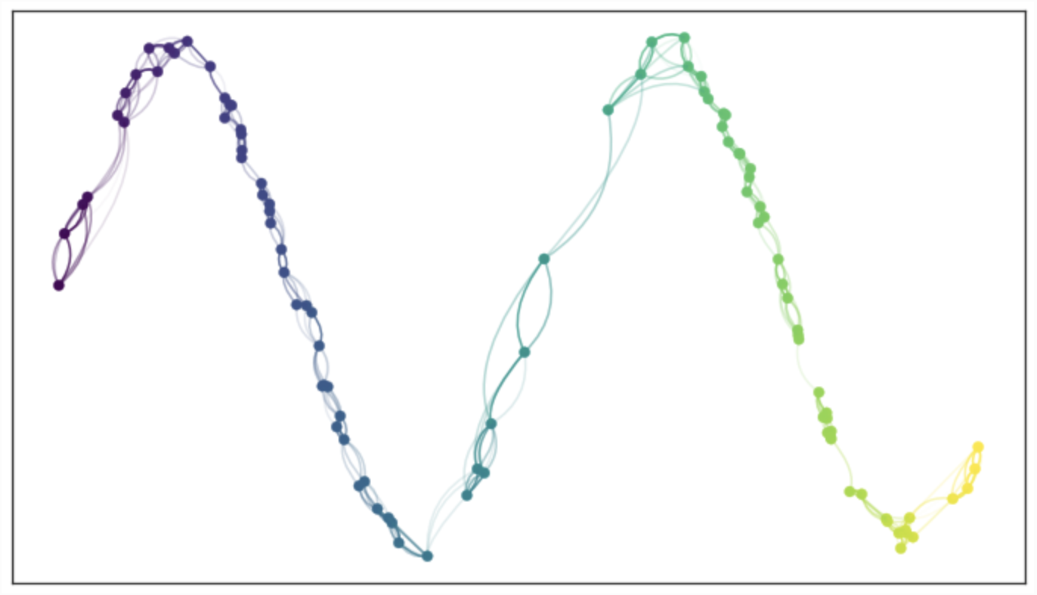
Fixed Radius vs. Fuzzy cover
We can now generate a simplex where all data points are connected
Problem: Cannot differentiate distance in this simplex.
We are using a fixed radius to determine if two data points should be connected.
Solution: Fuzzy cover
We still need the manifold to be locally connected
Fuzzy Cover
Fuzzy Cover + Locally connected
Edges with incompatible weight (Differentiate by different color)
https://umap-learn.readthedocs.io/en/latest/how_umap_works.html
Notes:
https://umap-learn.readthedocs.io/en/latest/how_umap_works.html

Slide 7
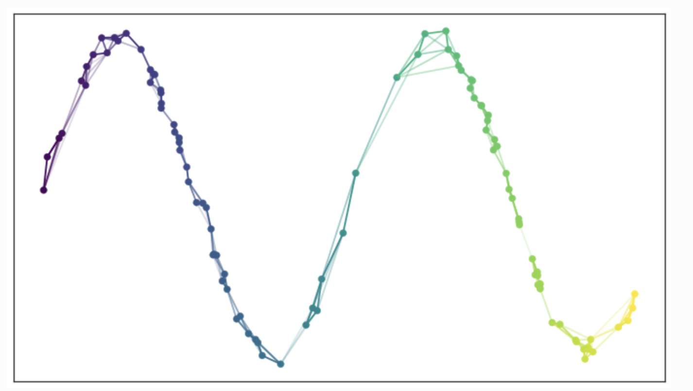

UMAP Adjunction
Problem: Local metrics are not compatible
Solution: UMAP Adjunction
We can combine weights in different edges in this form: $f\left(α ,β\right)=α+β−αβ$
Graph with combined weight
https://umap-learn.readthedocs.io/en/latest/how_umap_works.html
Notes:
https://umap-learn.readthedocs.io/en/latest/how_umap_works.html

Slide 8
UMAP Hyperparameter
n_neighbors
The number of approximate nearest neighbors used to construct the initial high-dimensional graph
Most important
Local versus global structure
Low: focus more on local structure
High: focus more on global structure
min_dist
The minimum distance between points in low-dimensional space
How tightly UMAP clumps points together
Low: More tightly packed embeddings
High: More loosely packed embeddings
https://pair-code.github.io/understanding-umap/index.html

Slide 9
UMAP Hyperparameter
n_neighbors
The number of approximate nearest neighbors used to construct the initial high-dimensional graph
Most important
Local versus global structure
Low: focus more on local structure
High: focus more on global structure
min_dist
The minimum distance between points in low-dimensional space
How tightly UMAP clumps points together
Low: More tightly packed embeddings
High: More loosely packed embeddings
https://pair-code.github.io/understanding-umap/index.html

Slide 10
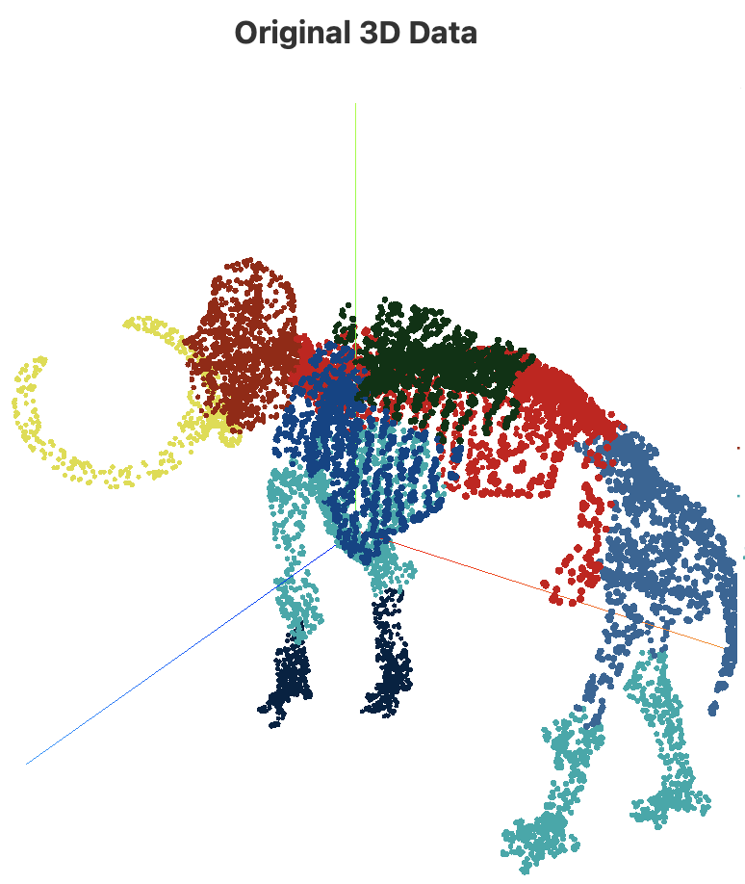
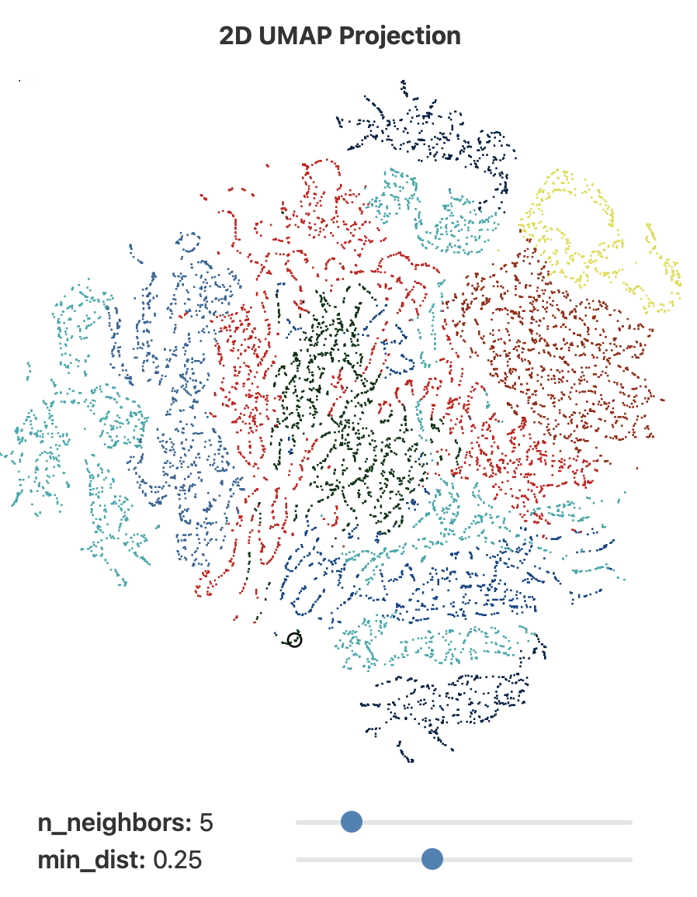
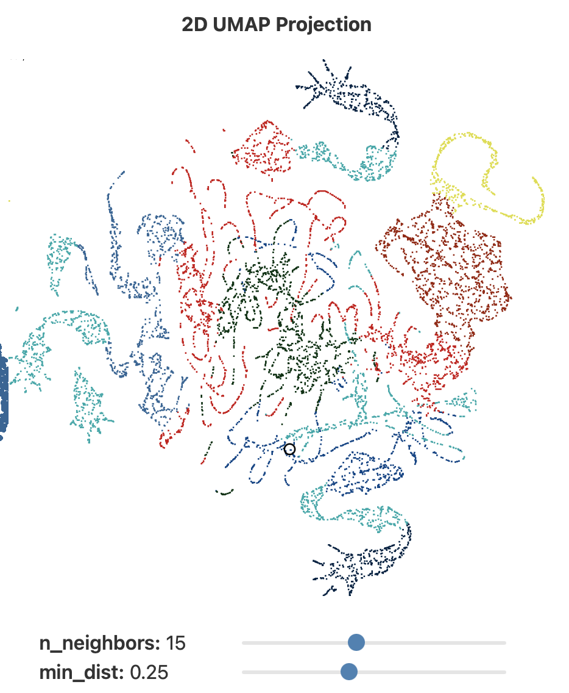
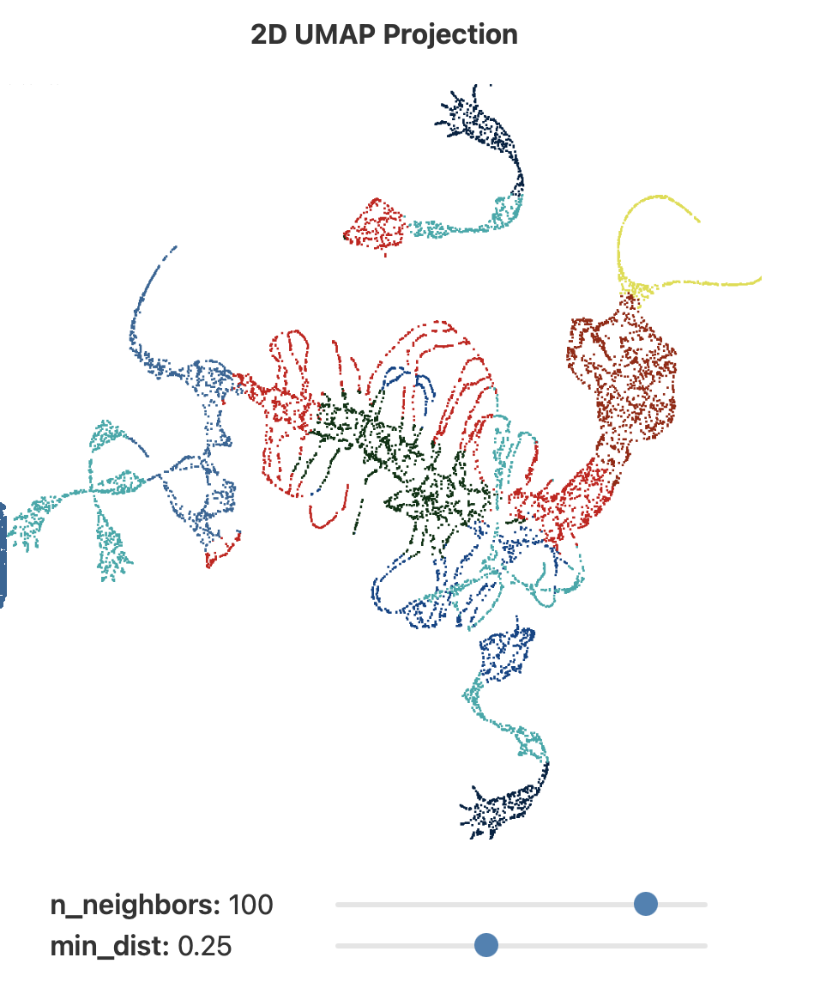
UMAP Hyperparameter (n_neighbors)
https://pair-code.github.io/understanding-umap/index.html

Slide 11
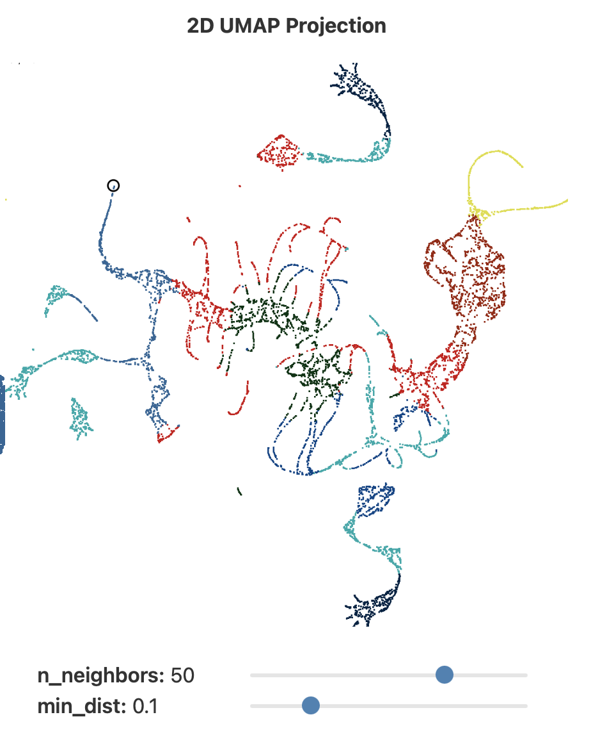
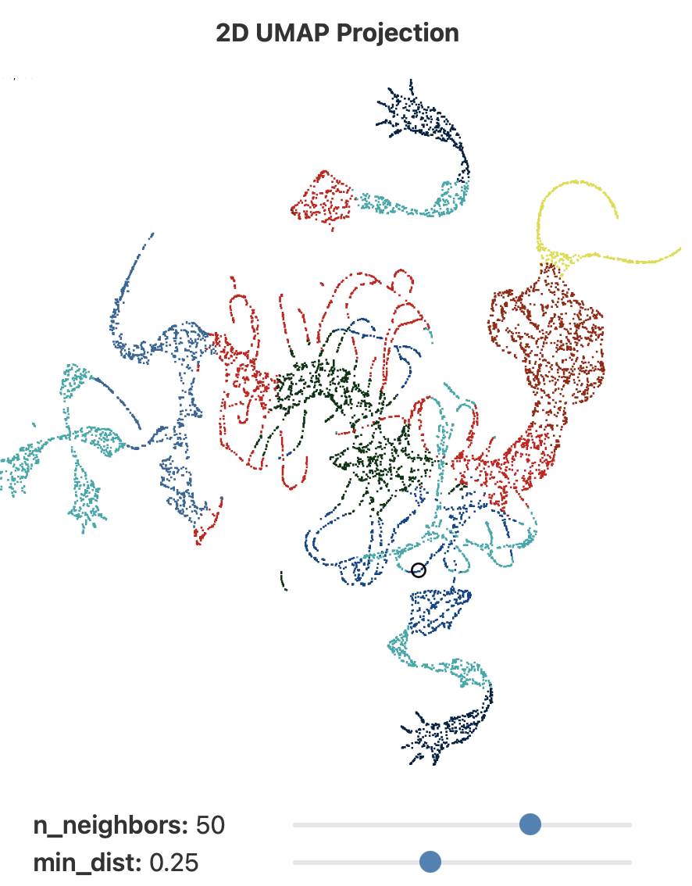
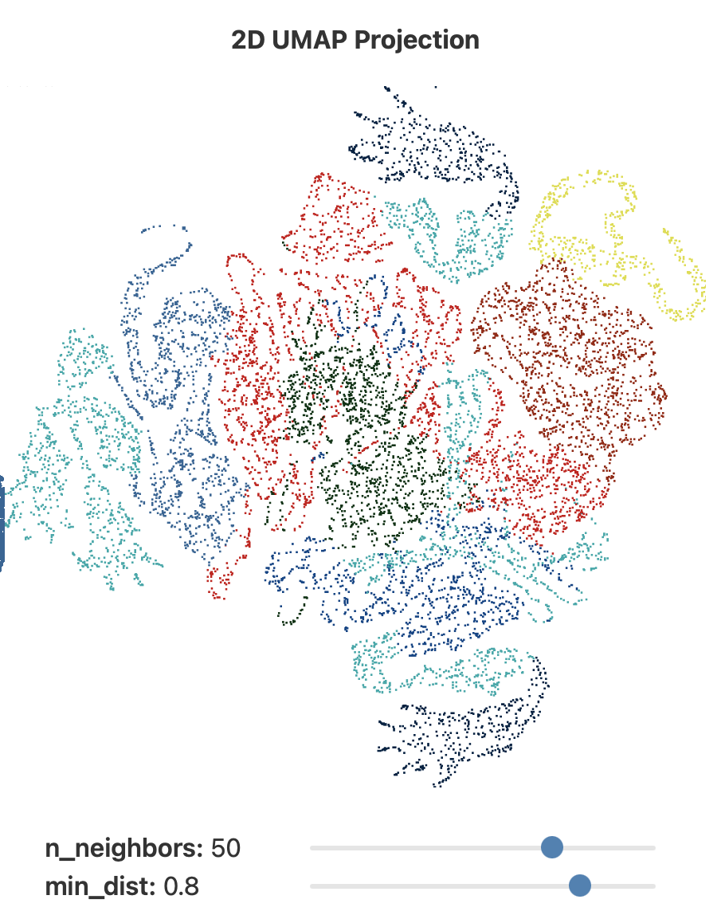
UMAP Hyperparameter (min_dist)
https://pair-code.github.io/understanding-umap/index.html

Slide 12
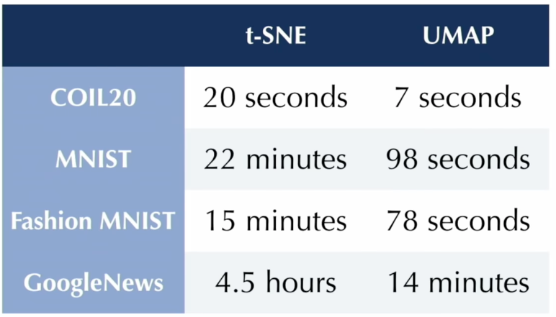
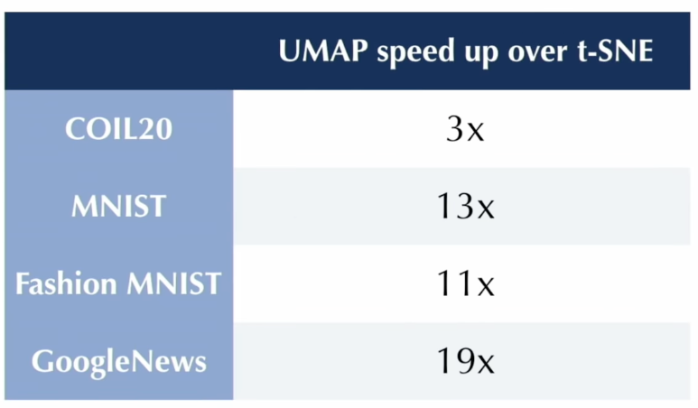
Performance
https://www.youtube.com/watch?v=nq6iPZVUxZU

Slide 13
DLI Accelerated Data Science Teaching Kit
Thank You

