Slide 1
Lecture 15.7 - Visualizing Clusters
DLI Accelerated Data Science Teaching Kit

Slide 2

The Accelerated Data Science Teaching Kit is licensed by NVIDIA, Georgia Institute of Technology, and Prairie View A&M University under the
Creative Commons Attribution-NonCommercial 4.0 International License.

Slide 3
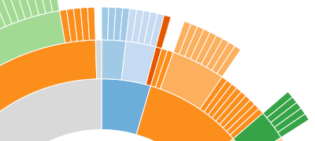
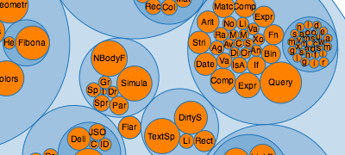
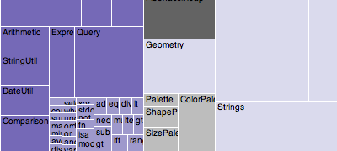
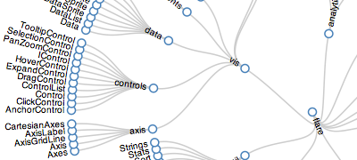
D3 has some built-in techniques
https://github.com/mbostock/d3/wiki/Hierarchy-Layout

Slide 4
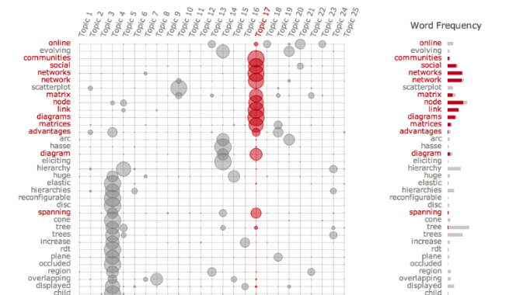
Visualizing Topics as Matrix
Termite: Visualization Techniques for Assessing Textual Topic Models
Jason Chuang, Christopher D. Manning, Jeffrey Heer. AVI 2012.
http://vis.stanford.edu/papers/termite
Notes:
If you have text clusters or topics, where a topicis determined by the strength of participation in that topic

Slide 5
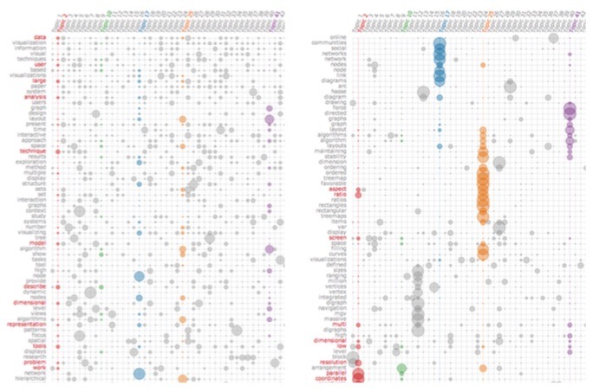
Termite: Topic Model Visualization
Using “Seriation”
http://vis.stanford.edu/papers/termite

Slide 6
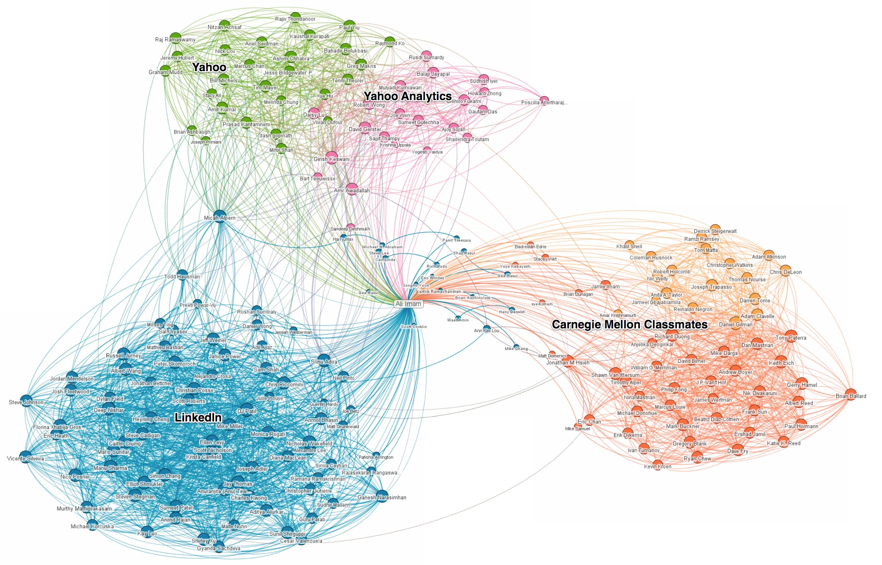
Visualizing Graph Communities (using colors)

Slide 7
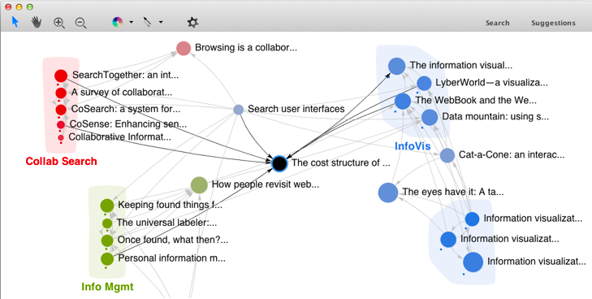
Visualizing Graph Communities
(using colors and convex hulls)
http://www.cc.gatech.edu/~dchau/papers/11-chi-apolo.pdf

Slide 8
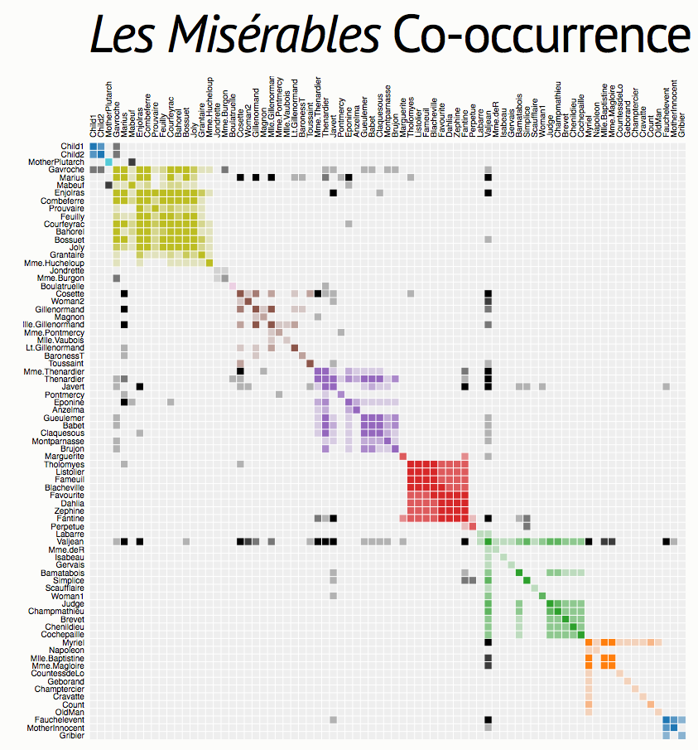
Visualizing Graph Communities as Matrix
Require good node ordering!
https://bost.ocks.org/mike/miserables/

Slide 9
DLI Accelerated Data Science Teaching Kit
Thank You

