Slide 1
Lecture 15.8 - RAPIDS Acceleration: PCA, UMAP, DBSCAN
DLI Accelerated Data Science Teaching Kit

Slide 2

The Accelerated Data Science Teaching Kit is licensed by NVIDIA, Georgia Institute of Technology, and Prairie View A&M University under the
Creative Commons Attribution-NonCommercial 4.0 International License.

Slide 3
PCA Refresher
Principal Component Analysis
Linear feature extraction method
Find orthogonal axes that best “fit” the data points
Typically use only the first few principal components for visualization
Principal components are eigenvectors of data’s covariance matrix
Hyperparameter: n_components

Slide 4
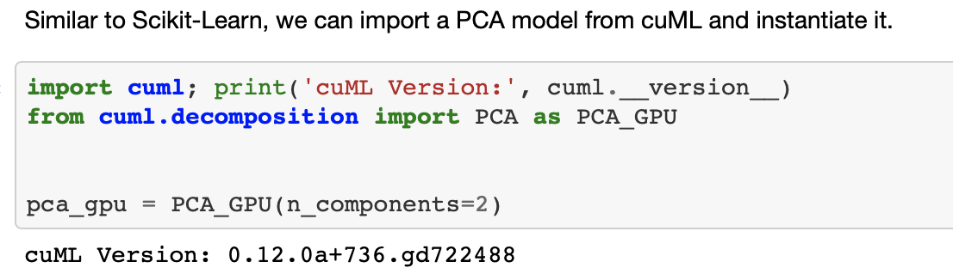
Running PCA in cuML

Slide 5
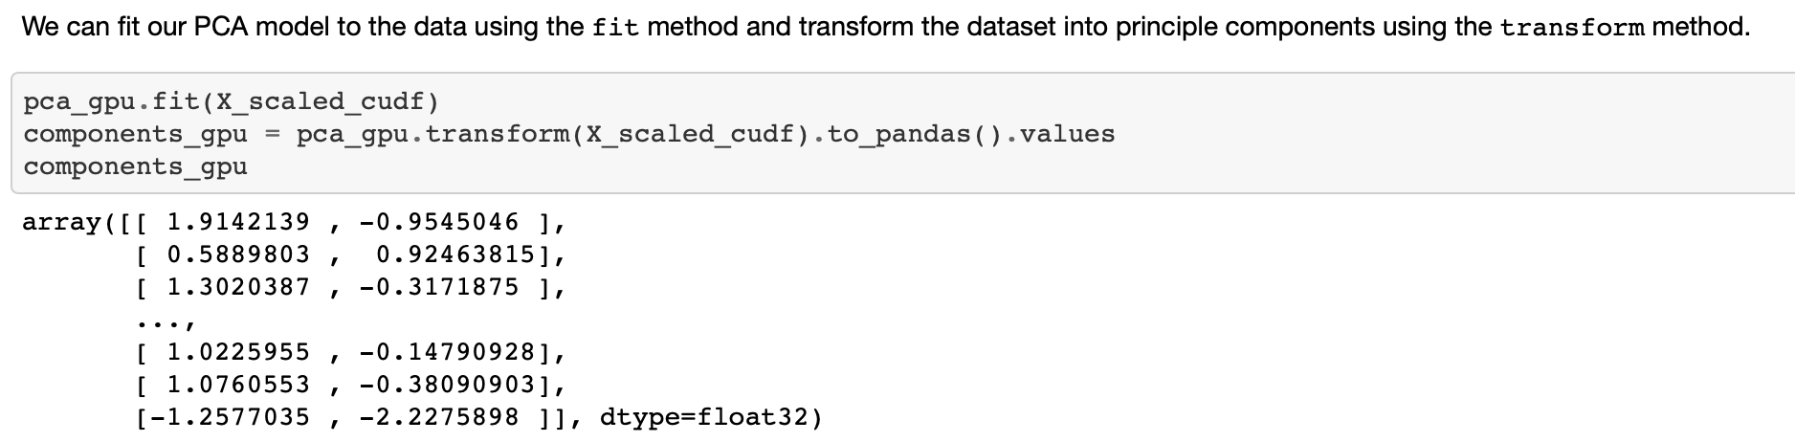
Running PCA in cuML

Slide 6
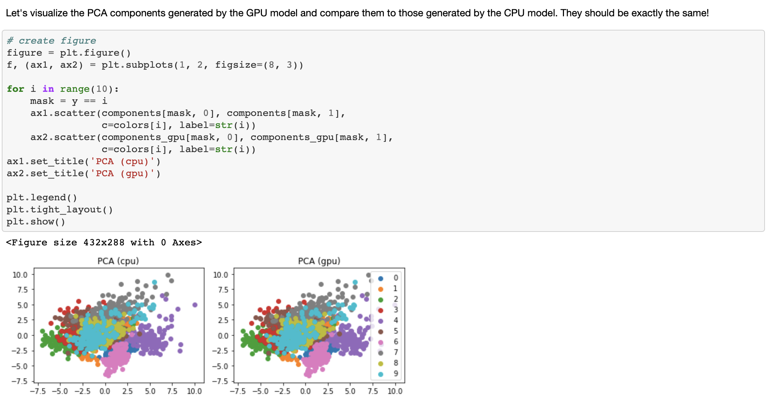
Running PCA in cuML

Slide 7
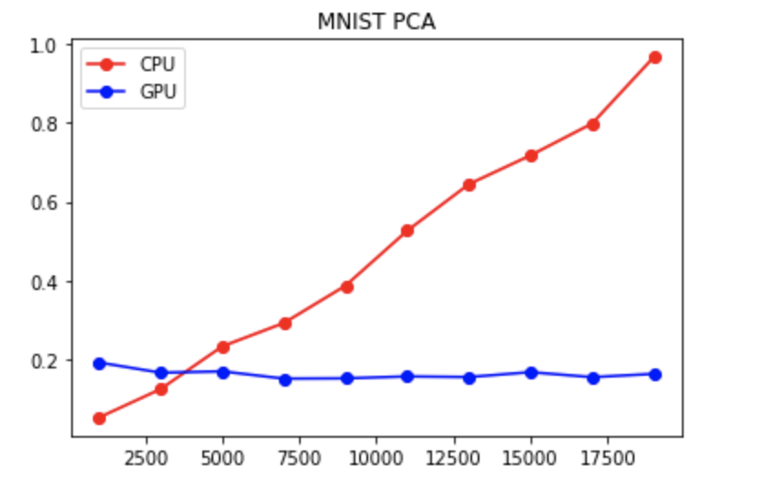
Rapids PCA performance

Slide 8
UMAP Overview
Uniform Manifold Approximation Projection
Dimensional reduction based on neighbor graph
Project points onto a Uniform Manifold
Create a topological simplex
Hyperparameter: n_neighbors, n_components

Slide 9
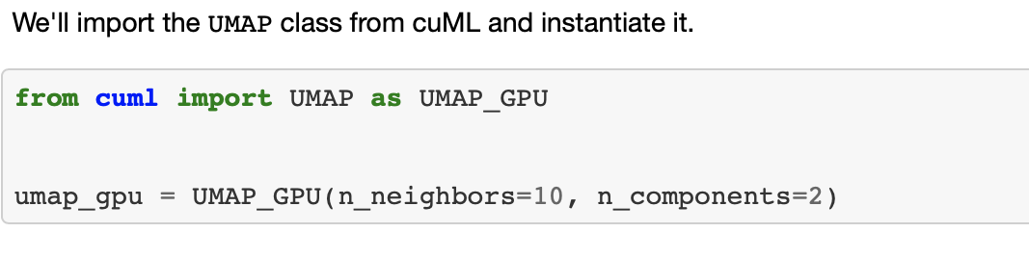
Running UMAP in cuML

Slide 10
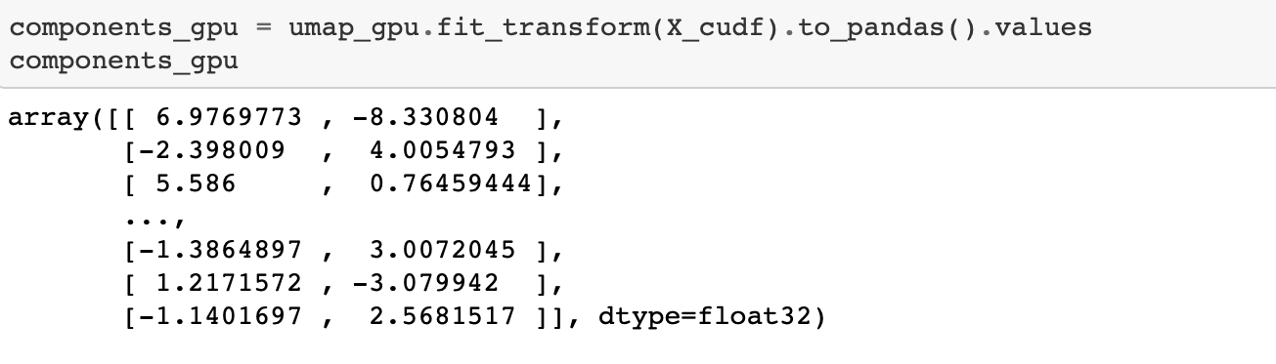
Running UMAP in cuML
We first use fit_transform() to fit the model and transform the data.

Slide 11
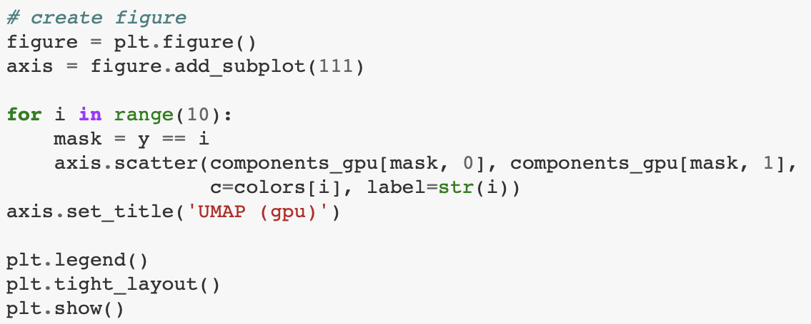
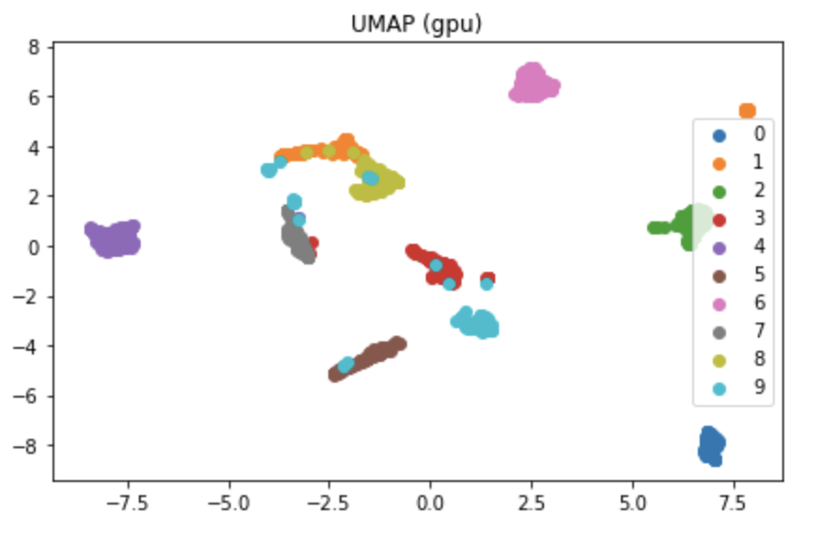
Running UMAP in cuML
Then, we visualize the results

Slide 12
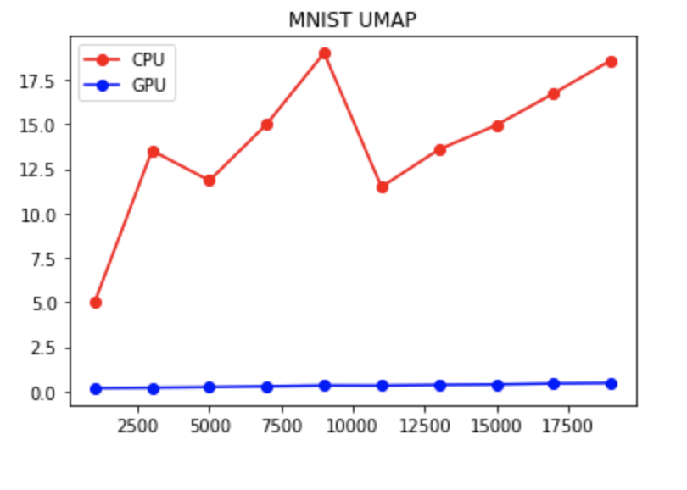
RAPIDS UMAP Speed

Slide 13
DBSCAN Refresher
Density-based spatial clustering of applications with noise
Main idea: closely-packed points (high-density; many neighbors nearby) are grouped
Points are categorized into three category
  Core points
  Reachable points
  Outlier
Hyper parameter: eps and minPts

Slide 14
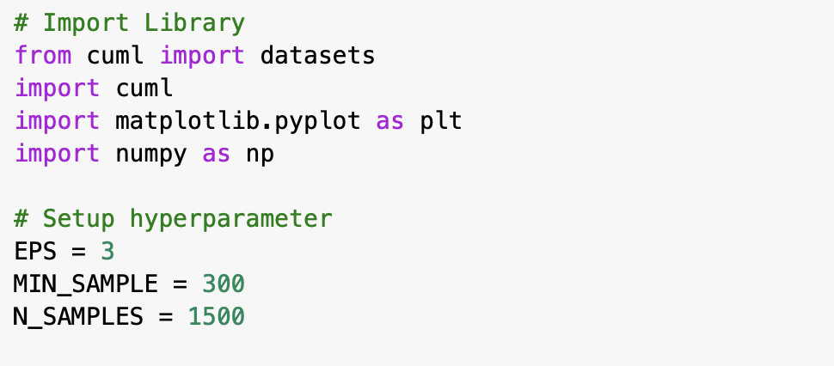
How to run DBSCAN in cuML?

Slide 15
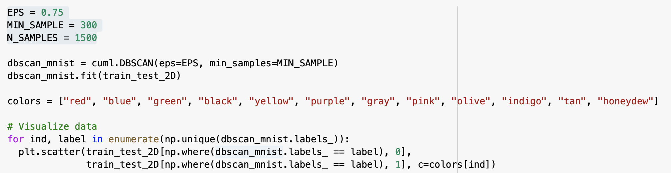
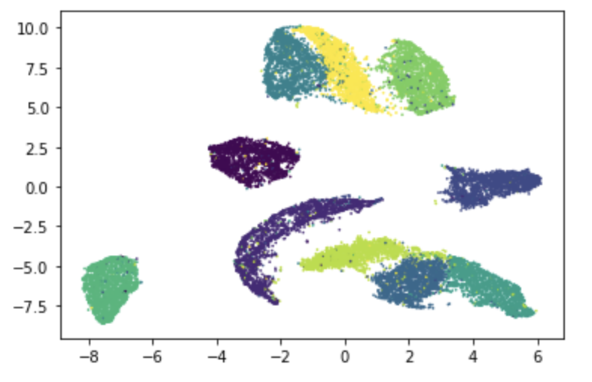
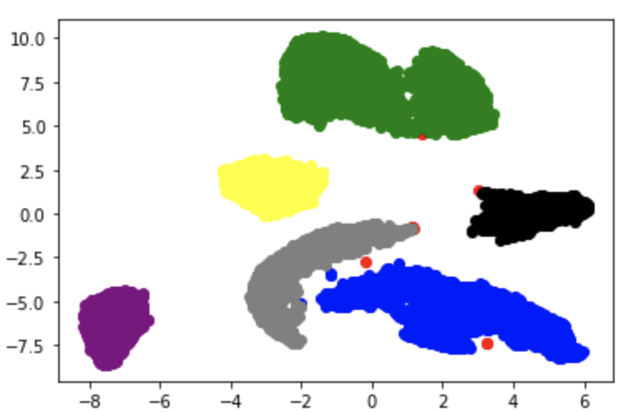
Running DBSCAN in cuML
We use UMAP to first reduce the dimensions of MNIST.
Then, we run DBSCAN on the 2-dimentional data.

Slide 16
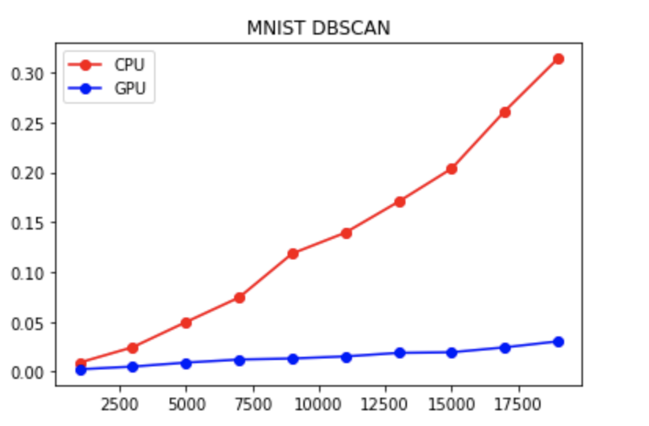
RAPIDS DBSCAN Speed

Slide 17
DLI Accelerated Data Science Teaching Kit
Thank You

