Slide 1

Lecture 16.1 -​ ​Introduction to Artificial Neural Networks
DLI Accelerated Data Science Teaching Kit
Notes:
This section will introduce artificial neural networks.

Slide 2

The Accelerated Data Science Teaching Kit is licensed by NVIDIA, Georgia Institute of Technology, and Prairie View A&M University under the
Creative Commons Attribution-NonCommercial 4.0 International License.

Slide 3
A Brief History of Artificial Neural Networks
Perceptron: a single neuron that can learn for classification. (1958)
Backpropagation for neural networks (1988): Learning representations by back-propagation errors
Successful applications such as character recognition
Limitations: overfitting, challenging hyper-parameter tuning such as number of neuron numbers, number of layers, and so on.
Deep Learning (2006)
Autoencoder
Convolutional Neural Networks
Recurrent Neural Networks
Notes:
In 1958, the first and simplest neural networks, Perceptron, was proposed with a single neuron for classification.
Then in 1988, networks of neurons were built with backpropagation, which is applied to character recognition. But it has limitations such as overfitting, challenging hyper-parameter tuning that involves selecting number of neurons, number of layers, and so on.
In 2006, it became a breakthrough for AI AND machine learning. Deep learning was proposed with deep neural networks such as Autoencoder, Convolutional Neural Networks, and Recurrent Neural Networks.

Slide 4
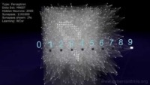
Neural Network 3D Simulation
Perceptron
Multilayer Perceptron
Convolutional Neural Networks
Spiking Neural Networks
Source: https://www.youtube.com/watch?v=3JQ3hYko51Y
Notes:
This short video will present how different neural networks work including Perceptron (simplest neural networks), Multilayer Perceptron, Convolutional Neural Networks, and Spiking Neural Networks.

Slide 5
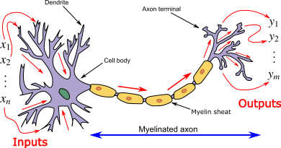
Structure of Neurons in Human Brain
Dendrite: It receives signals from other neurons
Cell body: It sums all the incoming signals to generate input
Axon: When the sum reaches a threshold value, neuron fires and the signal travels down the axon to the other neurons
Source: https://en.wikipedia.org/wiki/Artificial_neural_network
Notes:
Artificial neural networks is composed of artificial neurons, which is inspired by human neurons.
The structure of the human neuron includes three main components: dendrite receiving signals from other neurons, the Cell body which sums all the incoming signals to generate input, and the axon the path through which signals travel to other neurons when the neuron fires as the sum reaches a threshold value.

Slide 6
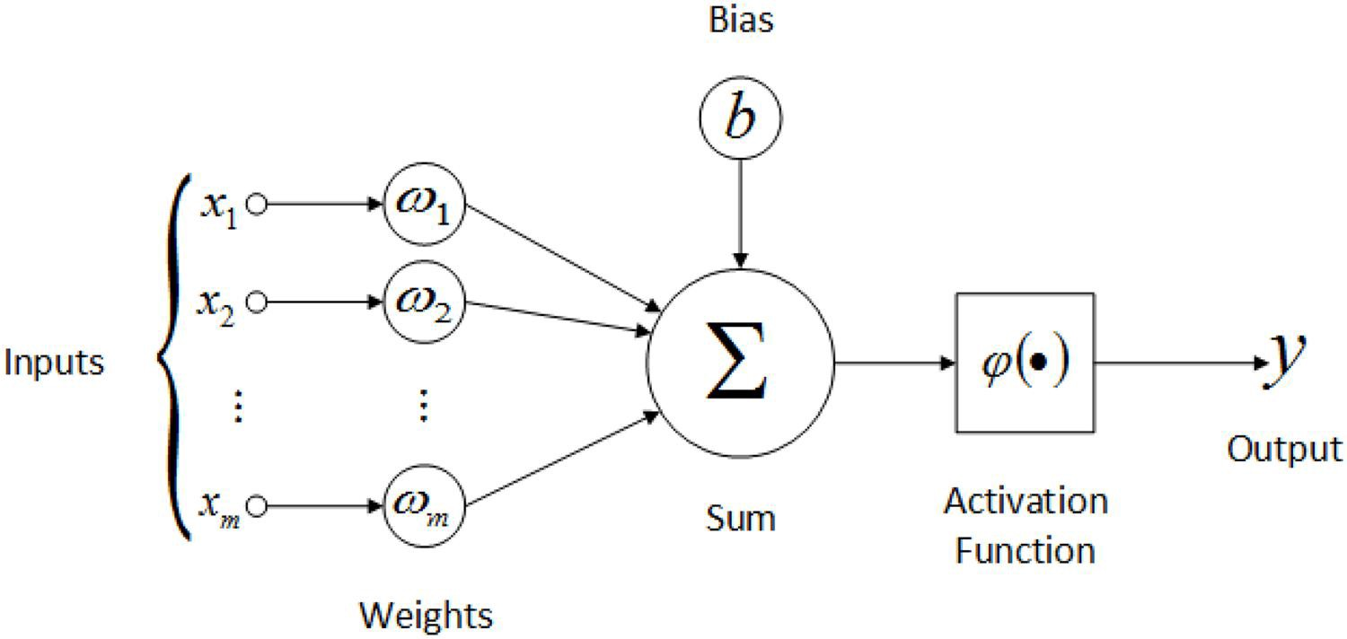
Basic Computational Unit
Artificial neuron, often called a node or unit, receives input from some other neurons, or from an external source and computes an output.
Each input has an associated weight (w), which is assigned on the basis of its relative importance to other inputs.
The node applies an activation function to the weighted sum of its inputs.
Source: https://dzone.com/articles/the-artificial-neural-networks-handbook-part-4
Notes:
Artificial neuron called a node or unit receives input (x_{i} as shown in the figure) from some other neurons, or from an external source and computes an output (y as shown in the figure) .
Each input has an associated weight (w_{i} as shown in the figure), which is assigned on the basis of its relative importance to other inputs.
The node applies an activation function to the weighted sum of its inputs.

Slide 7
Artificial neural network (ANN)
A network of artificial neurons (also known as "nodes")
These nodes are connected to each other.
The strength of their connections to one another is assigned a value based on their strength.
If the value of the connection is high, then it indicates that there is a strong connection.
The network is trained by iteratively modifying the strengths of the connections so that given inputs map to the correct response
Notes:
Artificial neural network consists of multiple artificial neurons connected to each other.
The strength of connections between artificial neurons is assigned a value as the weight, where the value of the connection is high, then it indicates that there is a strong connection.
The network is trained by iteratively modifying the strengths of the connections so that given inputs map to the correct response.

Slide 8
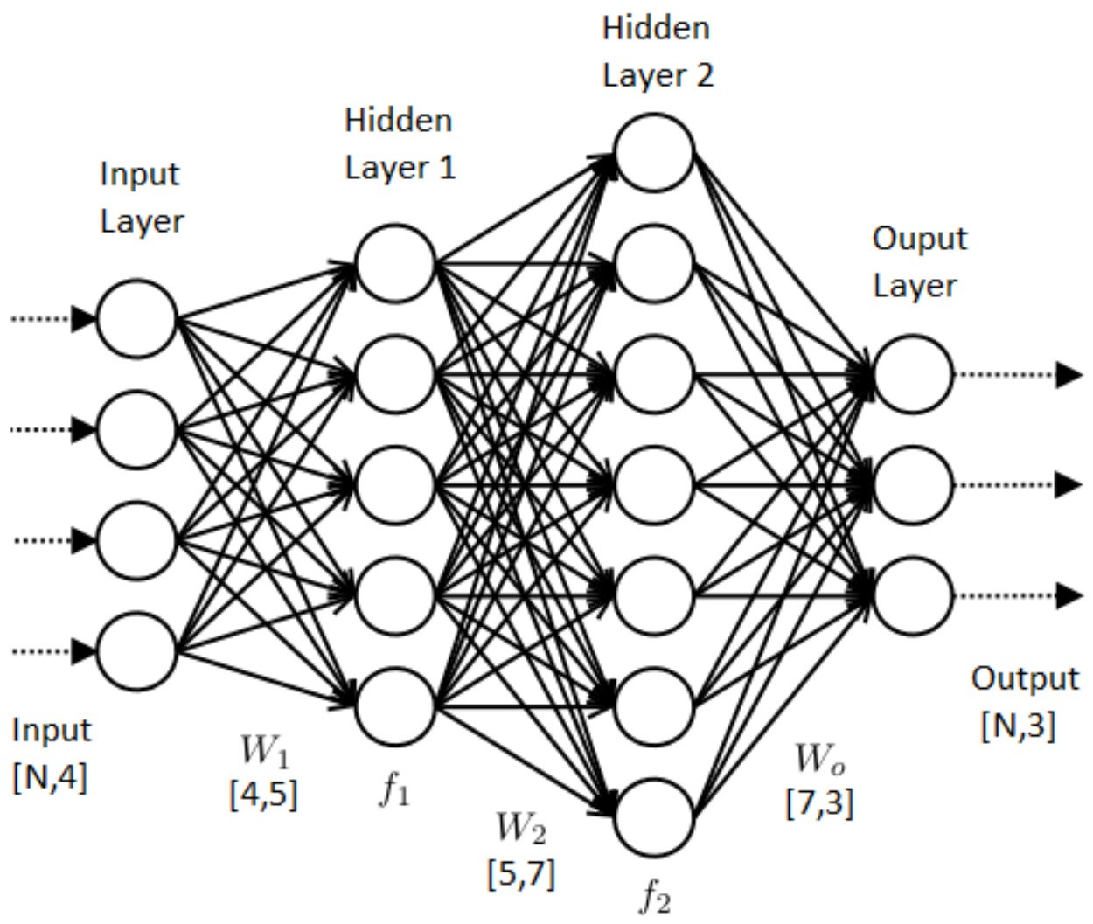
Feedforward Neural Network
A feedforward neural network is an artificial neural network where connections between the units do not form a cycle.
In this network, the information moves in only one direction, forward, from the input nodes, through the hidden nodes (if any) and to the output nodes.
No cycles or loops in the network.
Source: https://dzone.com/articles/the-artificial-neural-networks-handbook-part-1-1
Notes:
The Feedforward Neural Network is a category of artificial neural network, where there is no connections between the units to form a cycle.
It is composed of multiple layers and the information moves in only one direction, forward, from the input nodes (input layer), through the hidden nodes (if any in the hidden layers) and to the output nodes ( output layer), which is shown in the right figure.

Slide 9
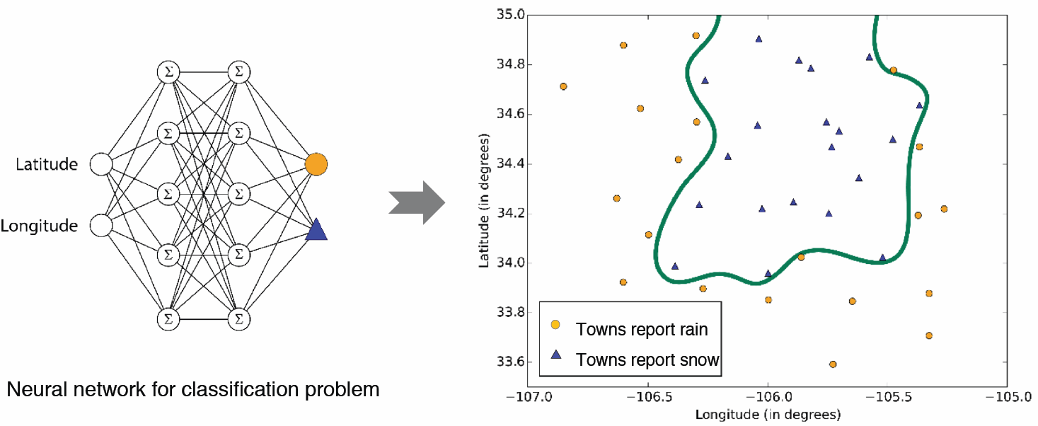
Applications
For modeling highly nonlinear systems
When data is available incrementally and you wish to constantly update the model
When there could be unexpected changes in your input data
When model interpretability is not a key concern
Source: https://www.researchgate.net/figure/Some-applications-of-AI-neural-network-accelerators_fig1_343711174
Notes:
The boundaries learned by neural networks can be complex and irregular
This high performance doesn‘t come for free, though.
Neural networks can take a long time to train, particularly for large data sets with lots of features.
They also have more parameters than most algorithms, which means that parameter sweeping expands the training time a great deal.

Slide 10
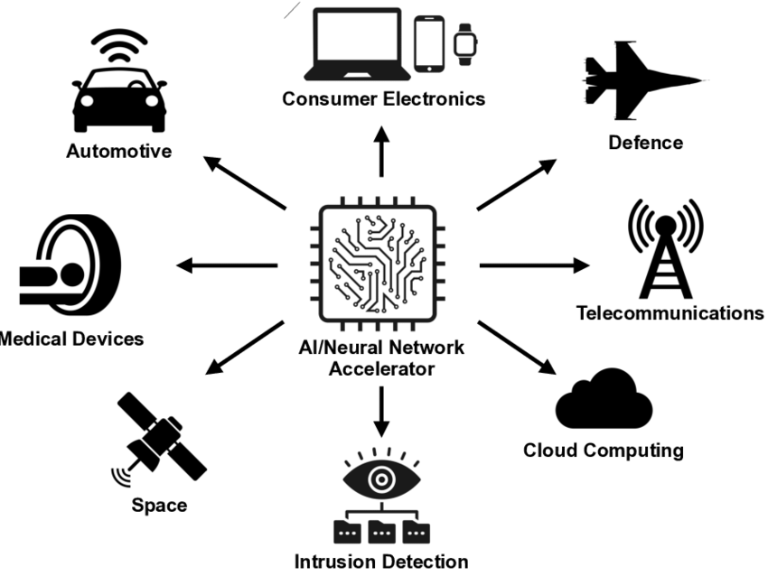
Applications
Applications in various domains and scenarios
Auto-drive
Communication
Medicine
… …
Source: https://www.researchgate.net/figure/Some-applications-of-AI-neural-network-accelerators_fig1_343711174
Notes:
With the development of neural networks and hardware, it becomes so powerful to be applied to various fields such as autodrive, medical devices and cloud computing.

Slide 11
DLI Accelerated Data Science Teaching Kit
Thank You

