Slide 1

Lecture 16.2 - Activation Function and Perceptron
DLI Accelerated Data Science Teaching Kit
Notes:
This section will introduce Activation Function and Perceptron (simplest neural networks).

Slide 2

The Accelerated Data Science Teaching Kit is licensed by NVIDIA, Georgia Institute of Technology, and Prairie View A&M University under the
Creative Commons Attribution-NonCommercial 4.0 International License.

Slide 3
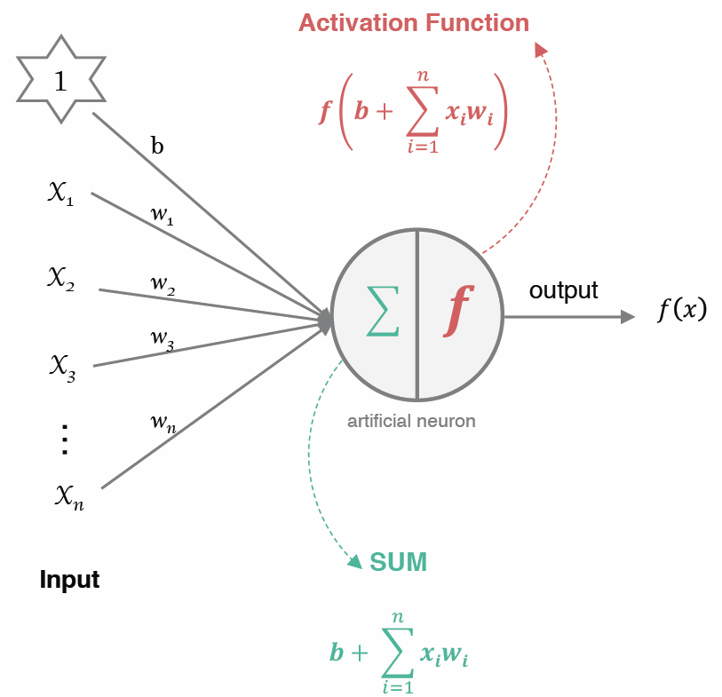
How does artificial neuron work ?
Artificial neurons are most basic units of information processing in an artificial neural network.
Each neuron takes information from a set of neurons, processes it, and gives the result to another neuron for further processing.
Notes:
The artificial neuron receives one or more inputs and sums them to produce an output .
Each of these neurons has some weight associated with ithem
Usually each input is separately weighted, and the sum is passed through a non-linear function known as an activation function or transfer function.

Slide 4
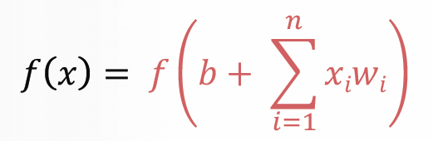
How does artificial neuron work ?
All the inputs x are multiplied with their weights w, and added together
The weighted sum is passed to activation function
Notes:
The activation function is a set of the transfer function used to get desired output.
There are many types of activation function.

Slide 5
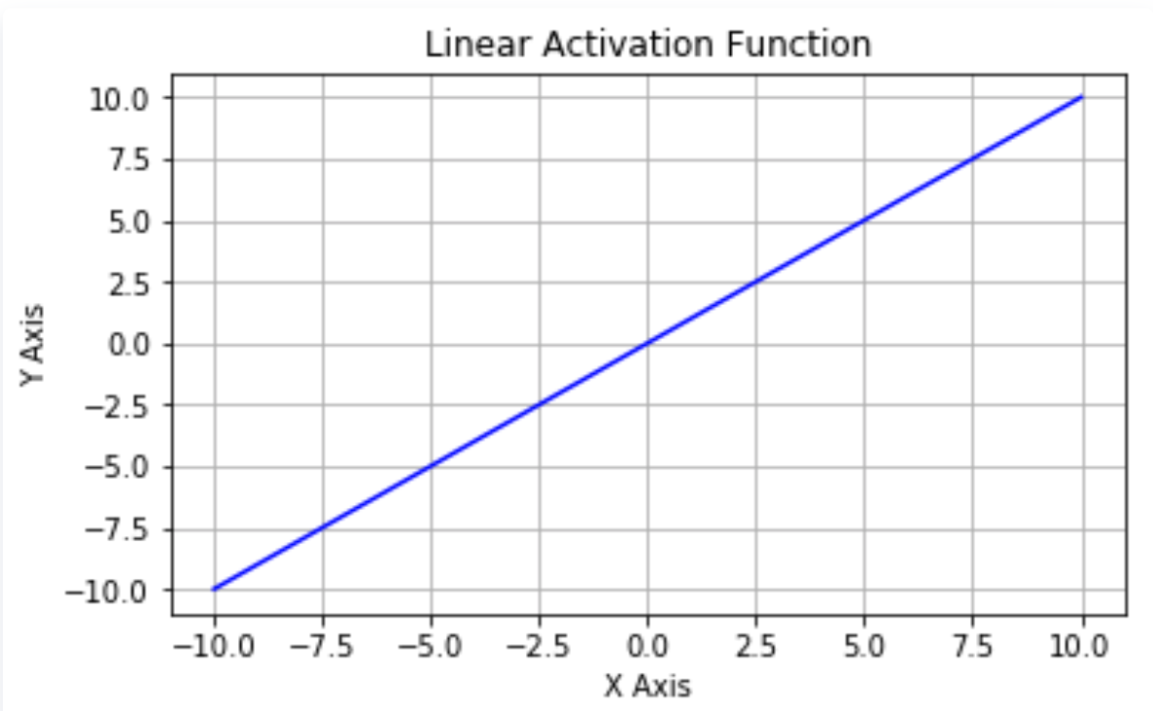
What is Activation Function?
The activation function of a node defines the output of that node given an input or set of inputs.
Biologically inspired, it is usually an abstraction representing the rate of action potential firing in the cell.
These functions should be nonlinear to encode complex patterns of the data.
Linear activation function
f(x) = x
Notes:
The activation function of an artificial neuron defines the output of that neuron given an input or set of inputs, which is inspired by human neurons to build the abstraction representing the rate of action potential firing in the cell.
Generally, we will employ nonlinear functions for activation functions regarding the nonlinear characters of data since linear activation function is too weak to extract useful relations from data for real applications.

Slide 6
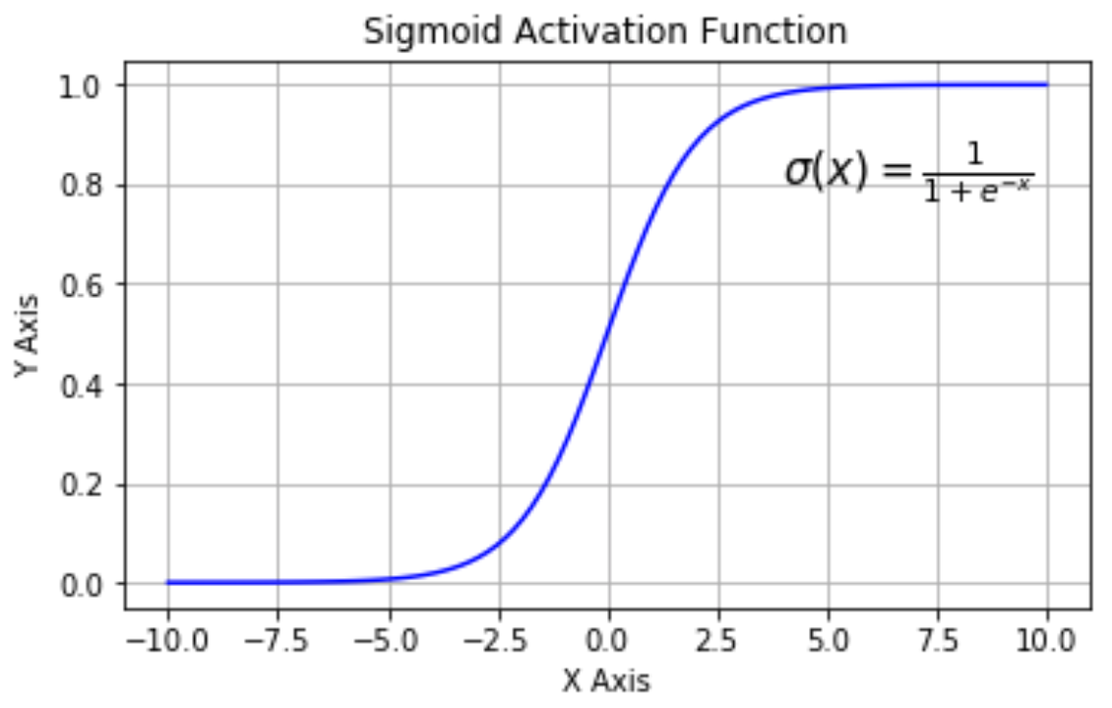
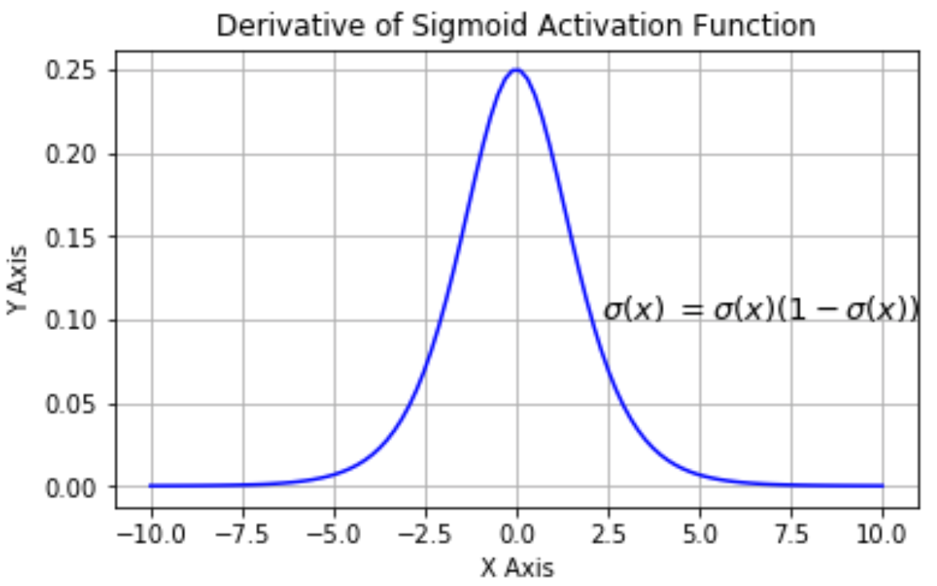
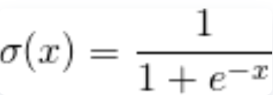
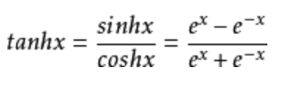
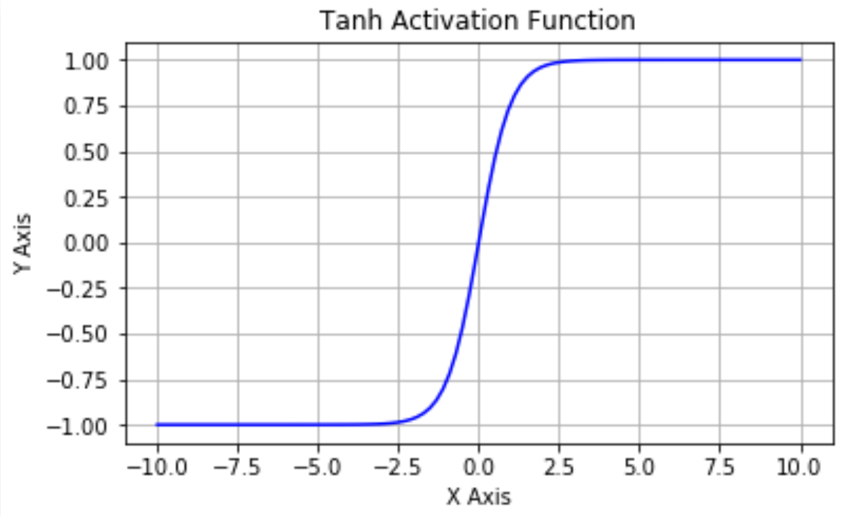
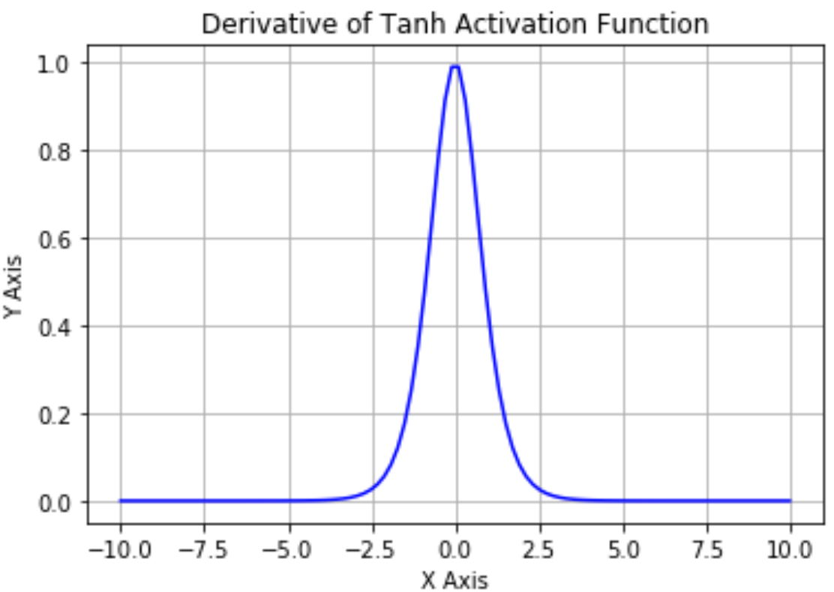
Non-linear Activation Function
Sigmod function
  Tanh Function
Notes:
Here are some examples of nonlinear activation functions including sigmod function and Tanh functions with their curves.
When we check the curves of derivatives of these functions, we can observe that the Gradient Disappears. this refers to the zero values. Taking the sigmod function as an example, when x value is less than -5.5 or larger than 5.5, the value of its derivatives is 0. It means that there is no update to the weights and the neural networks cannot learn anything from the data.
In addition, High Computation Cost is required for the nonlinear activation functions.

Slide 7
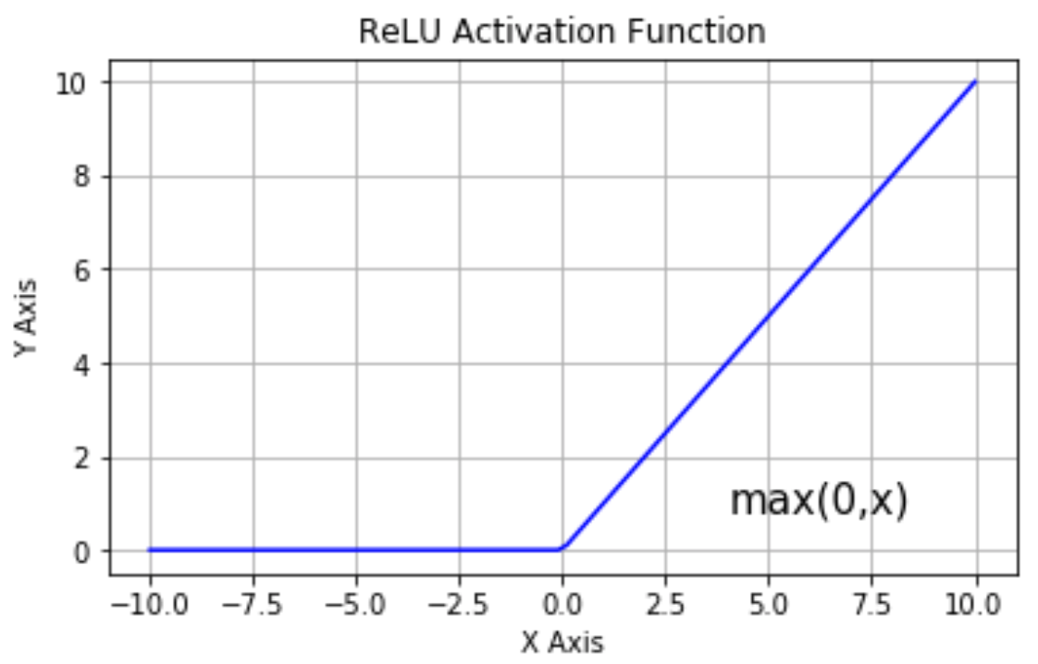
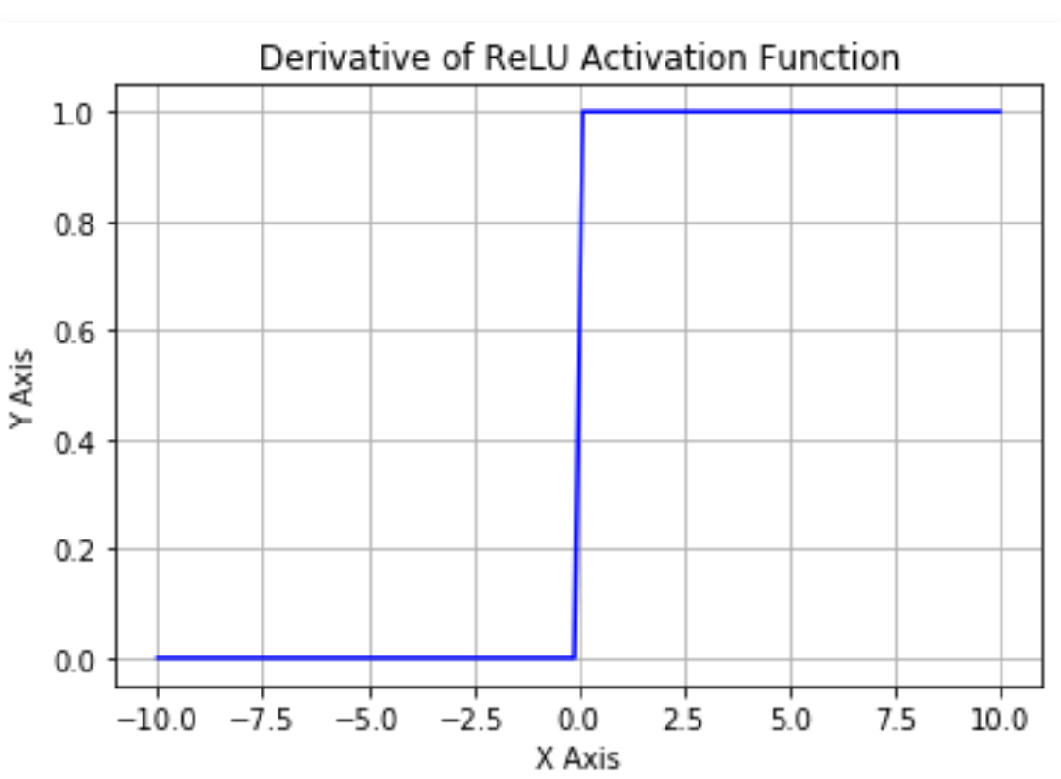

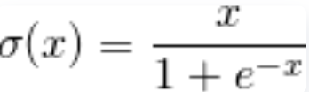

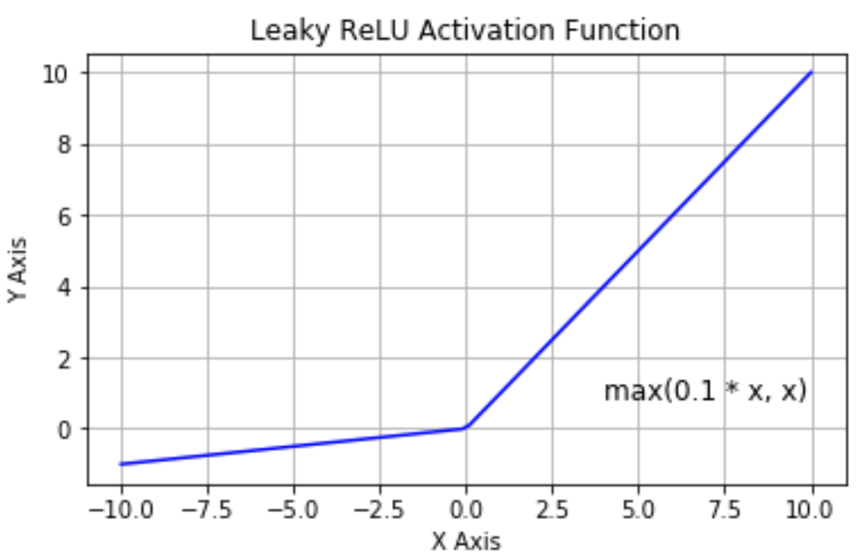
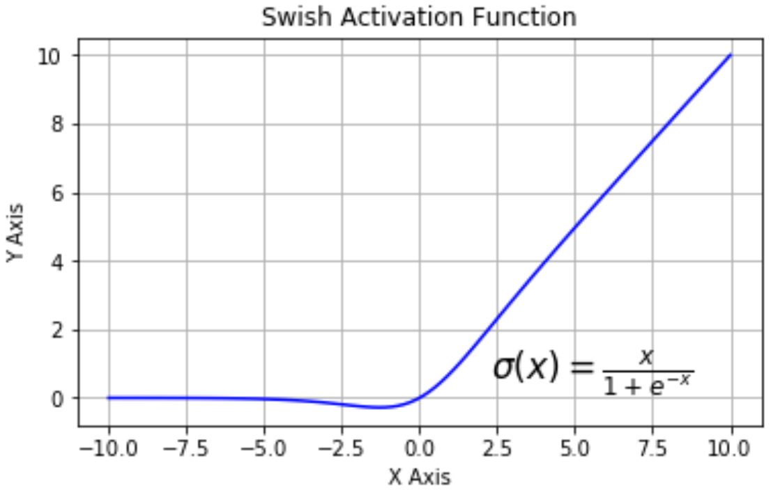
Non-linear Activation Function
Rectified Linear Function (ReLU)
  Leaky Rectified Linear Function (LReLU)
Swish Function (Google)
Notes:
To avoid Gradient Disappearance, we will construct other nonlinear functions such as ReLU and LReLU that can learn from data in the whole range.

Slide 8
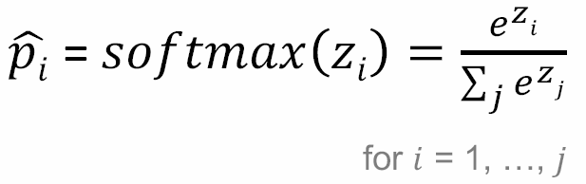
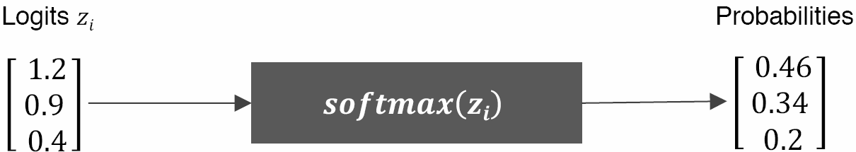
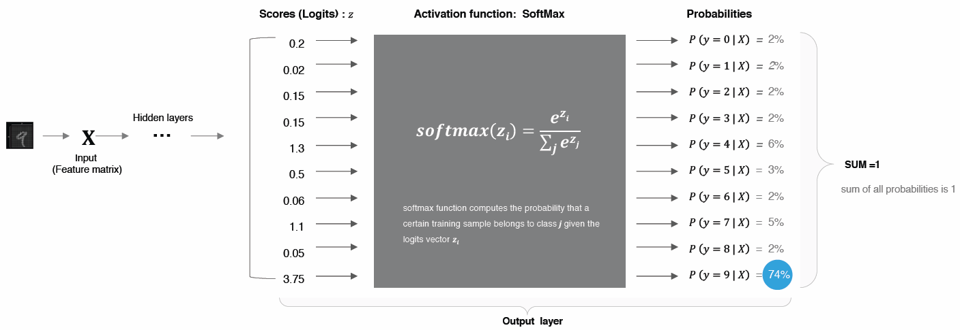
Non-linear Activation Function
Softmax function
Used in multiclass classification
A generalization of Logistic Regression.
It converts linear inputs to probabilities.
Squashes the outputs of each unit to be between 0 and 1, just like a Logistic/Sigmoid function.
Unlike logistic regression which is for the binary classification, softmax allows for classification into any number of possible classes.
Notes:
Another special activation function is Softmax function that is only used in the output layer of neurons for multiclass classification application (including binary classification).
It is built by generalizing Logistic Regression (sigmod function) function.
This function squashes the outputs of each unit to be between 0 and 1 as probabilities.

Slide 9
Which Activation Function is Optimal?
In Hidden Layer
By Default use ReLU function
Always keep in mind that ReLU function should only be used in the hidden layers
Never use Sigmoid and TanH function due to the vanishing gradient problem
In Output Layer
Use SoftMax function for classification problem
Use Linear function for regression problem
Notes:
Here are some suggestions to choose activation functions for different layers.
In Hidden Layer
By Default please use ReLU function
Always keep in mind that ReLU function should only be used in the hidden layers
Never use Sigmoid and TanH function due to the vanishing gradient problem (gradient disappear)
In Output Layer
Use SoftMax function for classification problem
Use Linear function for regression problem
In addition, you probably needs to design new activation functions for your special problems.

Slide 10
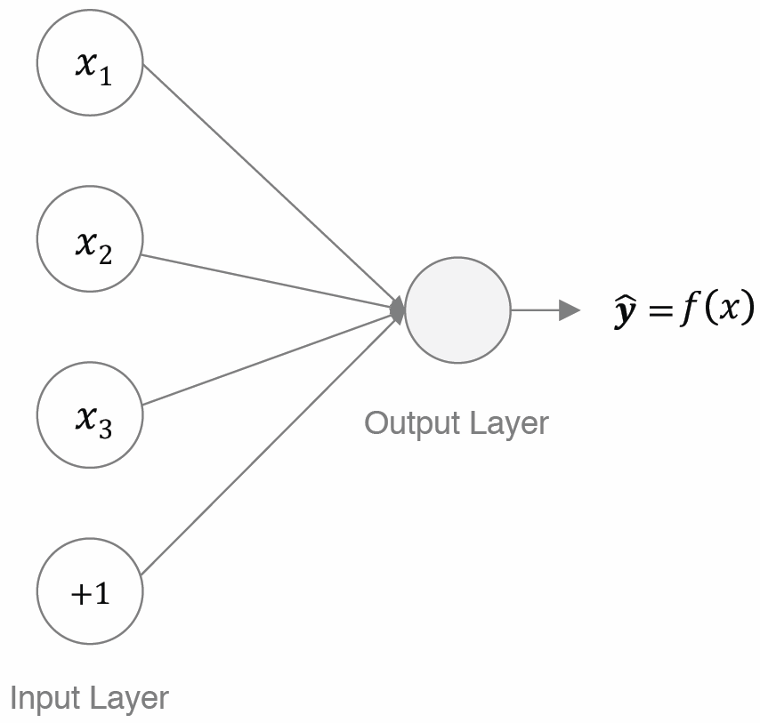

Perceptron: the simplest neural networks
Simplest Feedforward Neural Network
It does not contain any hidden layers.
Bias nodes
Increase the flexibility of the model to fit the data
It allows you to move the line up and down to fit the prediction with the data better.
Without b the line always goes through the origin (0, 0) .
Notes:
Here we would like to go through the simplest neural networks, Perceptron.
Perceptron only has one artificial neuron for output layer without hidden layer.
In the input layer, we add bias node (show in red circle) to increase the flexibility of the model to fit the data, which allows you to move the line up and down to fit the prediction with the data better.

Slide 11
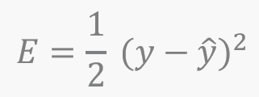
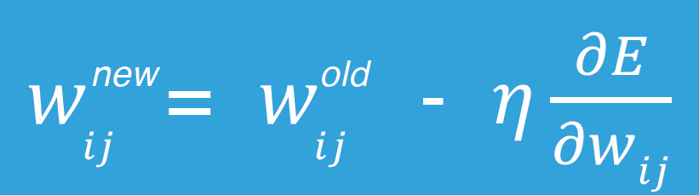
Loss Function
Loss function is used to measure exactly how wrong our predictions are.
The loss is high when the neural network makes a lot of mistakes, and it is low when it makes fewer mistakes.
Adjust the weights to minimize the loss
Update the weight parameters iteratively in order to make the error (loss function) as small as possible.
Notes:
For the output layer, when we obtain the output (y), we have to calculate the loss between the output and the ground truth ($\hat{y}$), which is used to measure exactly how wrong our predictions are.
The loss is high when the neural network makes a lot of mistakes, and it is low when it makes fewer mistakes.
Squared errors are the general loss used for regression problems.
The learning process is to adjust the weights to minimize the loss by updating the weight parameters iteratively.
$η is$the learning rate that controls the learning step.

Slide 12
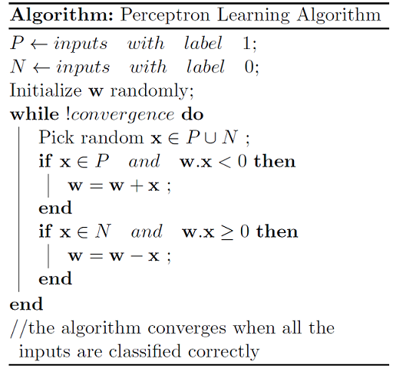
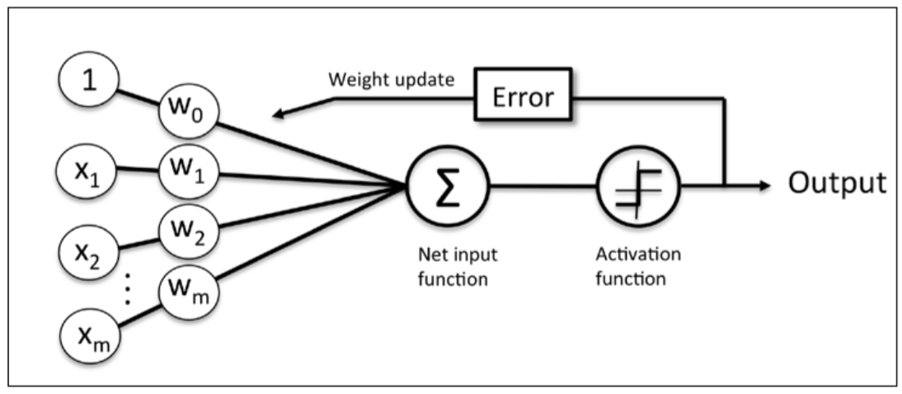
Learning
Update weights based on errors
Notes:
Here is the learning algorithm for Perceptron.

Slide 13
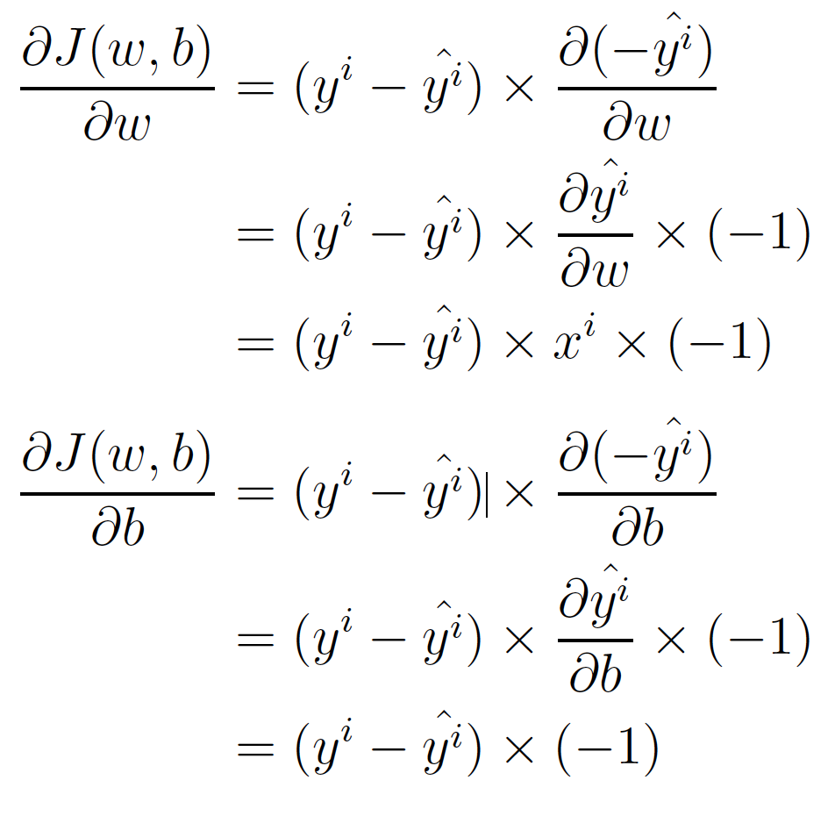

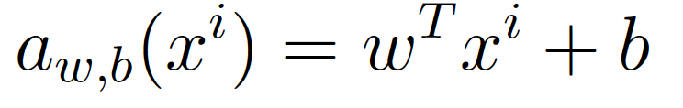
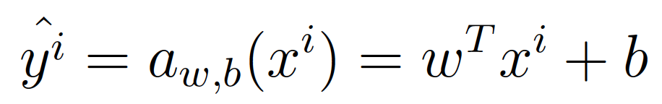
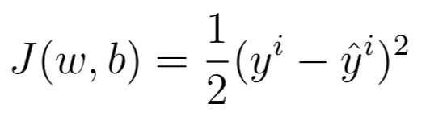
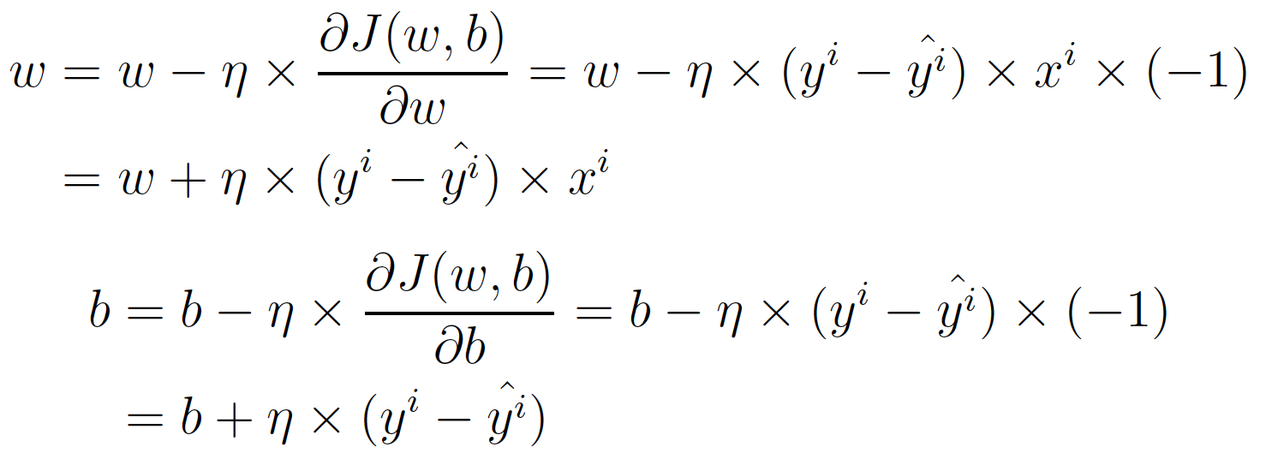

Backpropagation
Activation function
Output
Loss
Notes:
Here is to present the process of updating parameters including neuron weights and bias node weight.

Slide 14
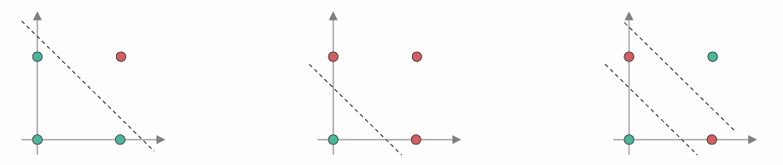
Limitations of Perceptron
Only learn linearly separable problems
If the vectors are not linearly separable, learning will never reach a point where all vectors are classified properly.
Notes:
The limitation of Perceptron is only learning linearly separable problems.
If the vectors of data are not linearly separable, learning will never reach a point where all vectors are classified properly.

Slide 15
DLI Accelerated Data Science Teaching Kit
Thank You

