Slide 1

Lecture 16.3 - Multilayer Perceptron
DLI Accelerated Data Science Teaching Kit
Notes:
This section will introduce multilayer perceptron that contains multiple layers of artificial neurons.

Slide 2

The Accelerated Data Science Teaching Kit is licensed by NVIDIA, Georgia Institute of Technology, and Prairie View A&M University under the
Creative Commons Attribution-NonCommercial 4.0 International License.

Slide 3
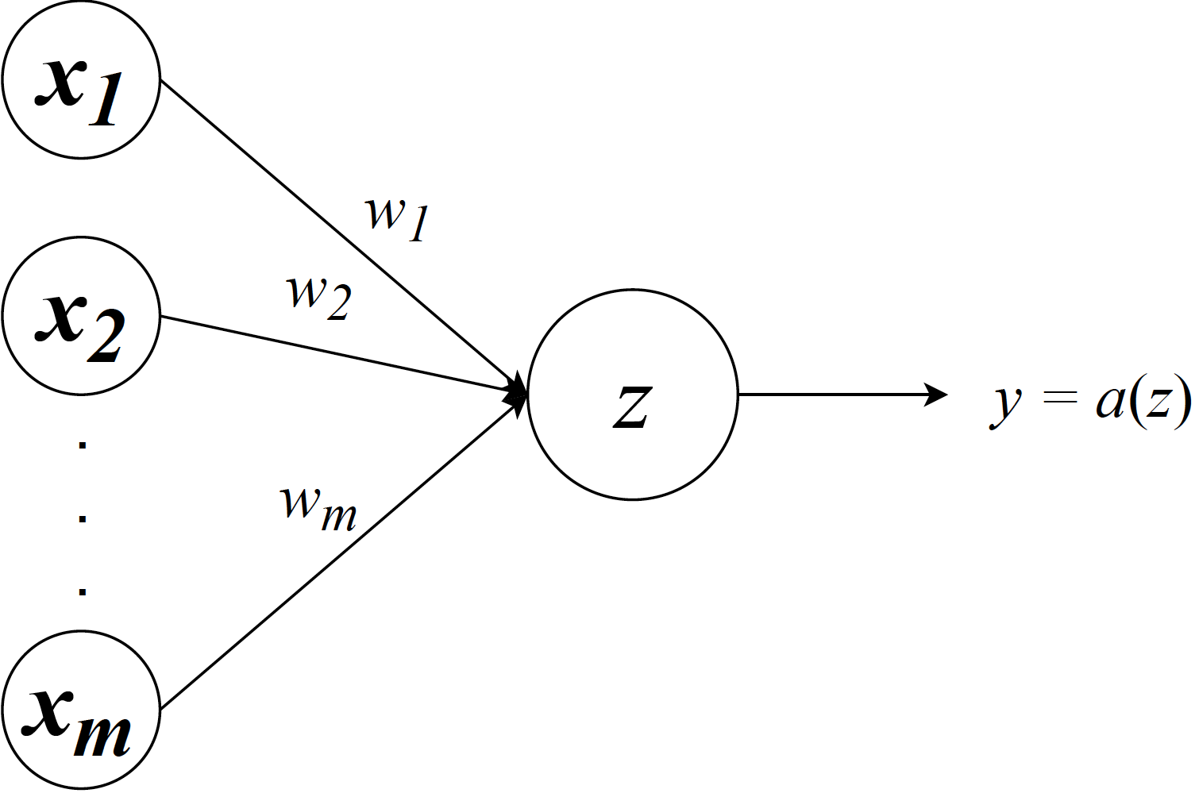

Perceptron
Feedforward neural networks
Single Artificial Neuron
Outputs
Input
Notes:
Let’s review the perceptron.
The perceptron only contains one neuron shown in the figure.
It receives multiple inputs x₁, x₂, .., x_{m.}
In the neuron, the weighted summation of these inputs is calculated. In addition, we add one bias w₀ to enhance the flexibility of perceptron, which can improve its ability of fitting data.
Once we obtain the summation result z, we will apply an activation a to control the output.

Slide 4
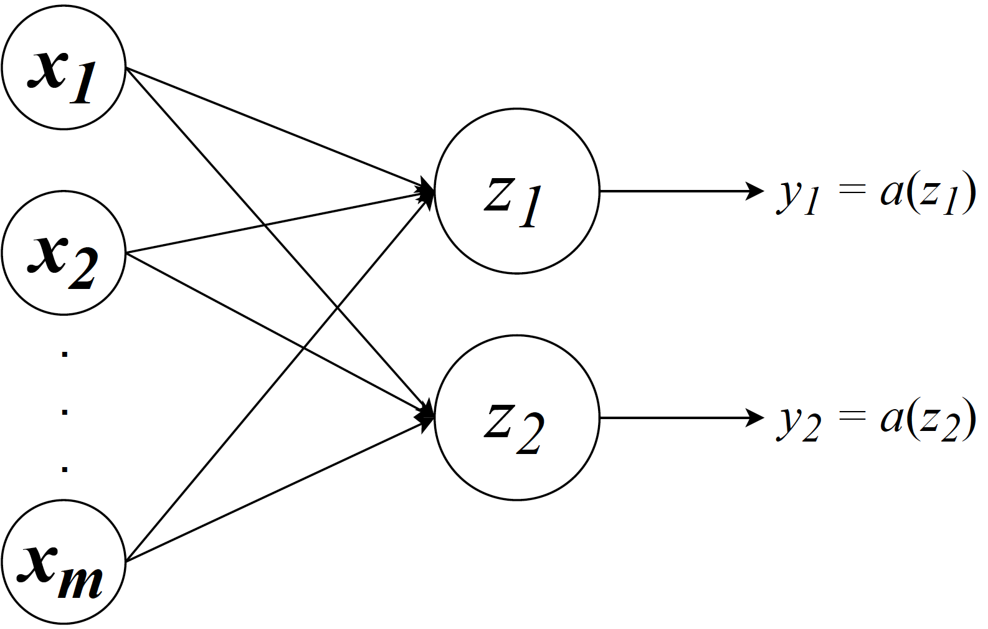

Perceptron with Two Outputs
Feedforward neural networks
Two Artificial Neurons
Outputs
Input
Notes:
We can have multiple outputs such as two neurons for perceptron.

Slide 5
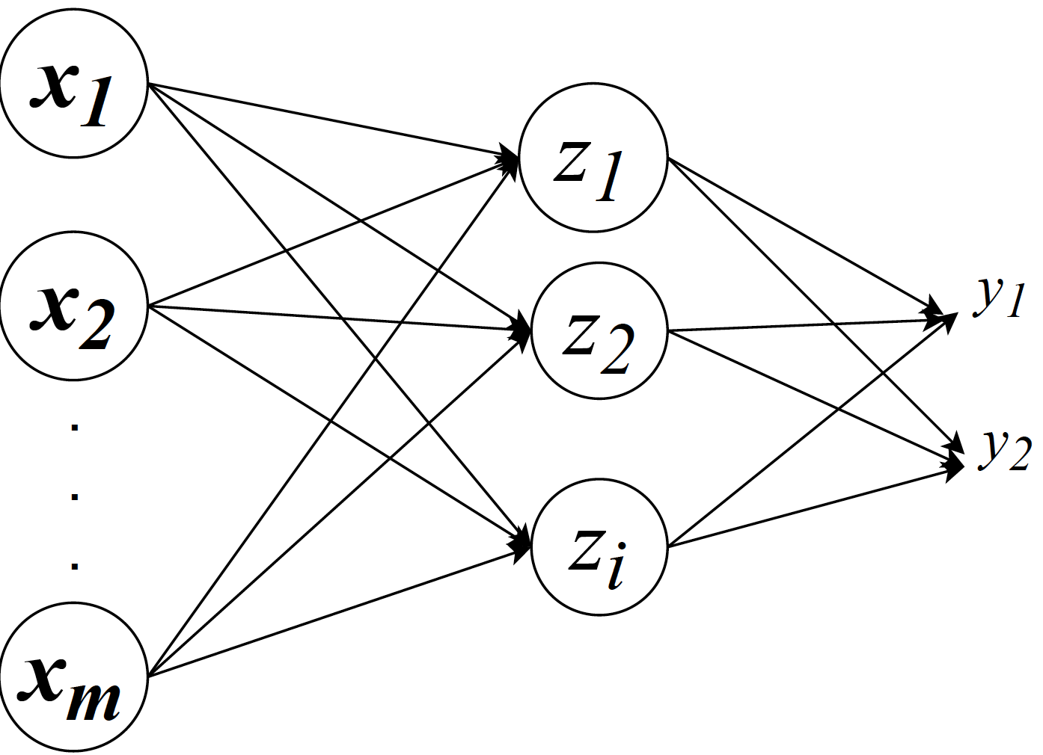
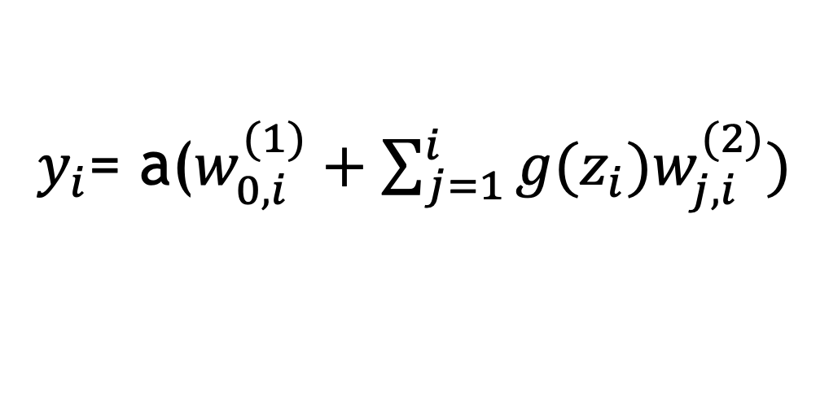
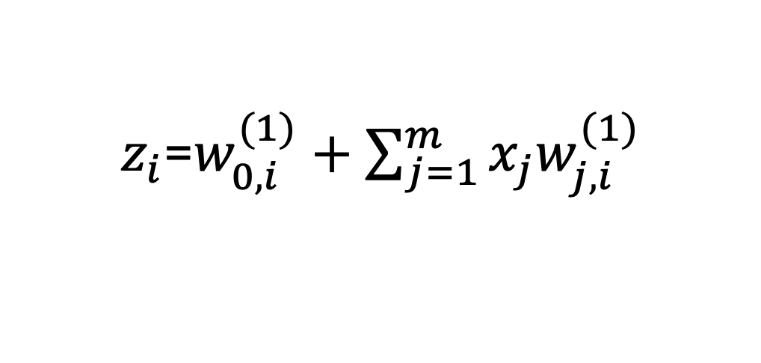
A Single Hidden Layer Perceptron with Two Outputs
Feedforward neural networks
A Layer of Artificial Neurons
$z_{i}$=$w_{0,i}^{(1)}+\sum_{j=1}^{m}{x_{j}w_{j,i}^{(1)}}$
$y_{i}$= a($w_{0,i}^{(1)}+\sum_{j=1}^{i}{{g(z}_{i})w_{j,i}^{(2)})}$
Output
Hidden
Input
Notes:
Moreover, we can extend the perceptron with a hidden layer of neurons and an output layer.
Then, we have one hidden layer of neurons in this neural network and one output layer containing two outputs y₁ and y₂.

Slide 6
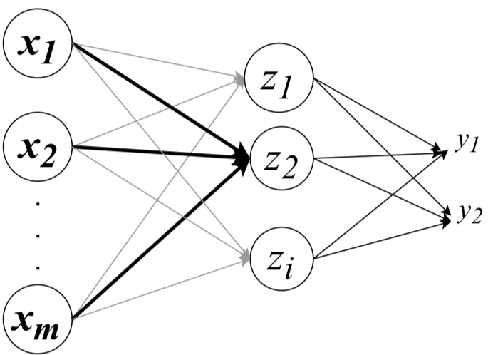
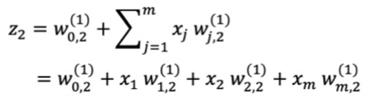
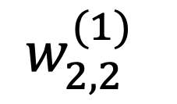
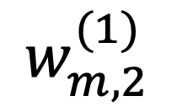
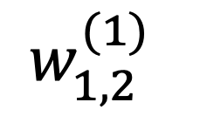
A Single Hidden Layer Perceptron with Two Outputs
Feedforward neural networks
A Layer of Artificial Neurons
$$w_{1,2}^{(1)}$$
$$w_{2,2}^{(1)}$$
$$w_{m,2}^{(1)}$$
Output
Hidden
Input
Notes:
For different neurons in the hidden layer, it will employ corresponding weights and bias to generate the output.
For example, the weighted summation of z₂ is shown on the slide.

Slide 7
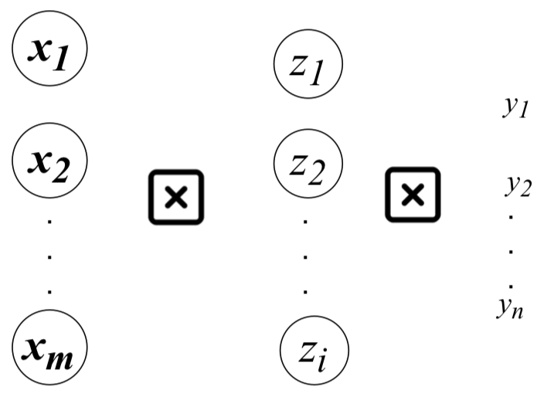
A Single Hidden Layer Perceptron with Multiple Outputs
Feedforward neural networks
Multiple outputs
Fully connected
Output
Input
Hidden
Notes:
When we extend it to multiple outputs y₁, y₂, … , y_{n}, we will have a standard neural network with one input layer, one hidden layer and one output layer.
We have fully connected networks between these three layers, but no connections in each layer.

Slide 8
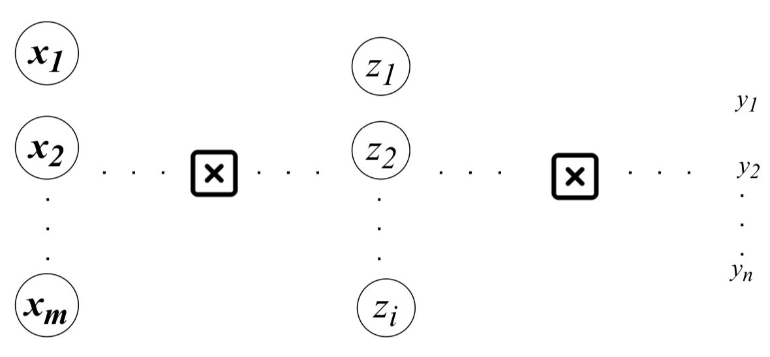
Multilayer Perceptron
Feedforward neural networks
Multiple outputs
Fully connected
Multiple hidden layers
Output
Input
Hidden
Notes:
Furthermore, we will extend it with multiple hidden layers, we will have multilayer perceptron.
It means for each neuron in the hidden layer or output layer, its function is similar with a perceptron that receives multiple inputs, completes weighted summation, and applies an activation function to generate outputs.

Slide 9
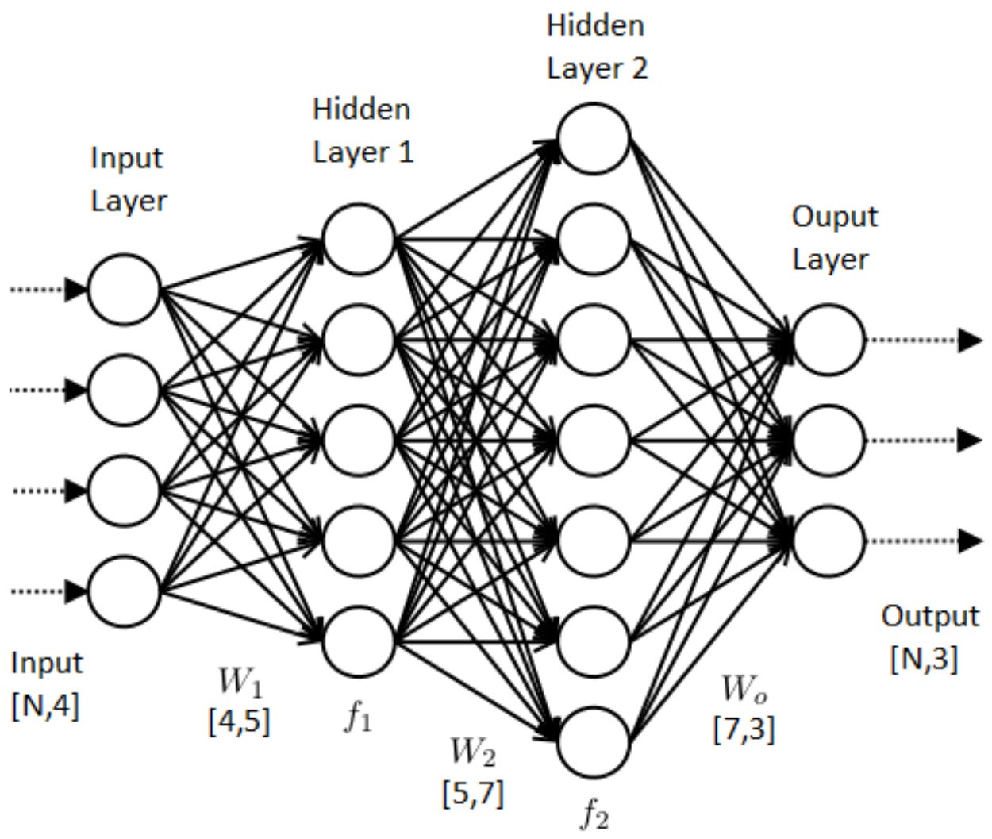

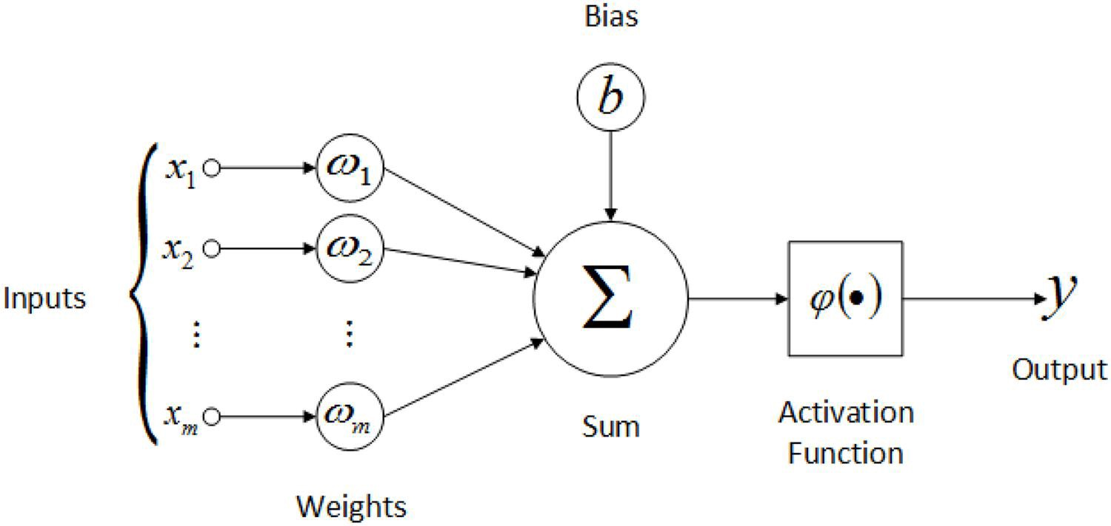
Multilayer Perceptron
Feedforward neural networks
Information flows through function being evaluated from x through intermediate computations used to define f and finally to output y
No feedback connections
Many different neurons (Perceptron)
A directed acyclic graph
Perceptron
Notes:
Here is a diagram to show the relation between multilayer perceptron and the perceptron.
Information flows through function being evaluated from x through intermediate computations used to define f and finally to output y
Specially, there is no feedback connections, which means it forms a directed acyclic graph.

Slide 10

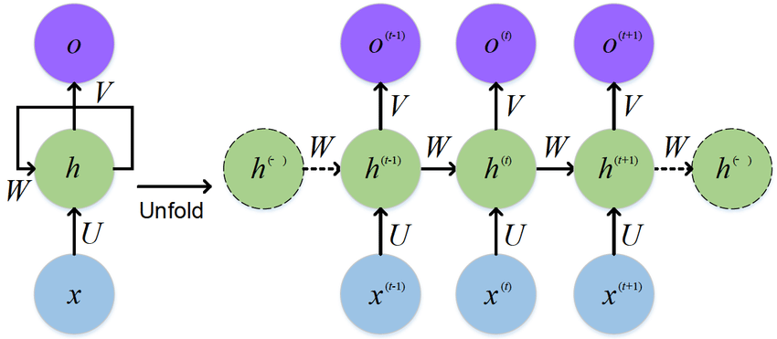
Special Multilayer Perceptron
Recurrent Neural Networks
“Feedback connections”
Notes:
With the development of neural networks, some special architecture of neural networks were developed.
One example is about recurrent neural networks.
It contains connections between neurons in the same layers.
In other words, we will have indirect feedbacks in the hidden layer.
If you are interested to this neural networks, you can join some class like deep learning to figure out the details.

Slide 11
DLI Accelerated Data Science Teaching Kit
Thank You

