Slide 1

Lecture 16.4 - Advanced Neural Networks
DLI Accelerated Data Science Teaching Kit
Notes:
This section will introduce some advanced neural networks.

Slide 2

The Accelerated Data Science Teaching Kit is licensed by NVIDIA, Georgia Institute of Technology, and Prairie View A&M University under the
Creative Commons Attribution-NonCommercial 4.0 International License.

Slide 3
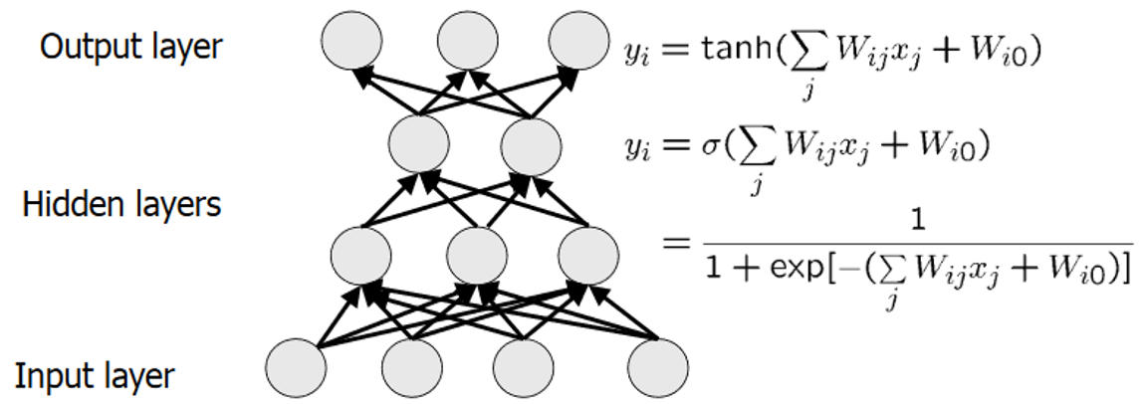
Breakthrough of Machine Learning/Artificial Intelligence
Deep Learning
Advanced Neural Networks
Machine learning algorithms based on learning
multiple levels of representation/abstraction
Deep architectures consists of multiple levels of
non-linear operations.
Amazing improvements in error rate
  Object detection
  Object recognition
  Speech recognition
  Machine translation
  Natural language understanding
Notes:
Recent years witnesses that deep learning has promoted developments of AI in different fields such as Object detection and Machine translation.
Actually, deep learning are Advanced Neural Networks that are able to learn multiple levels of representation/abstraction.

Slide 4
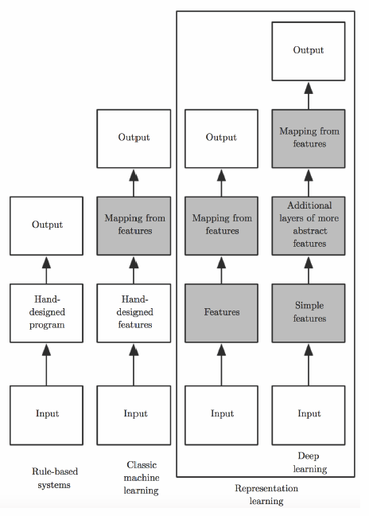
Comparison Between Traditional ML and Deep Learning
Traditional ML algorithms depend heavily on representation of given data
  Feature Extraction and Selection
  Feature Relations: Linear vs Non-linear
Learn not only the mapping from representation to output but the representation itself
  Learned representations often provide much better results than hand-coded representations
Notes:
Comparing traditional machine learning, rule-based system, and deep learning, we can observe three differences:
Rule-based system will implement hard mapping from input to output based on the hand-designed features.
For traditional machine learning, it can enhance the performance of this mapping by adding a soft mapping from hand-designed features to the output.
Deep learning can learn this mapping from input to output and optimize the features automatically in the learning process.

Slide 5
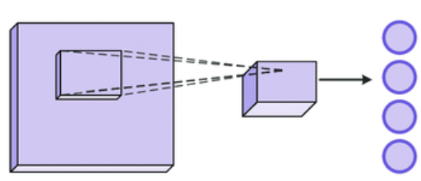
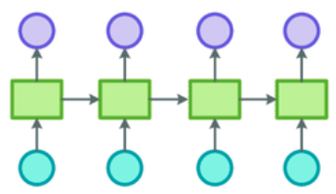
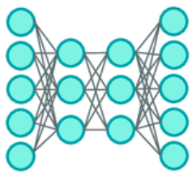
Deep Learning Models
Convolutional Neural Networks
Recurrent Neural Networks
Autoencoder
Notes:
Deep learning models include different types of models such as Convolutional Neural Networks, Recurrent Neural Networks, and Autoencoder.
Their architectures will be different.
Let’s check out them one by one.

Slide 6
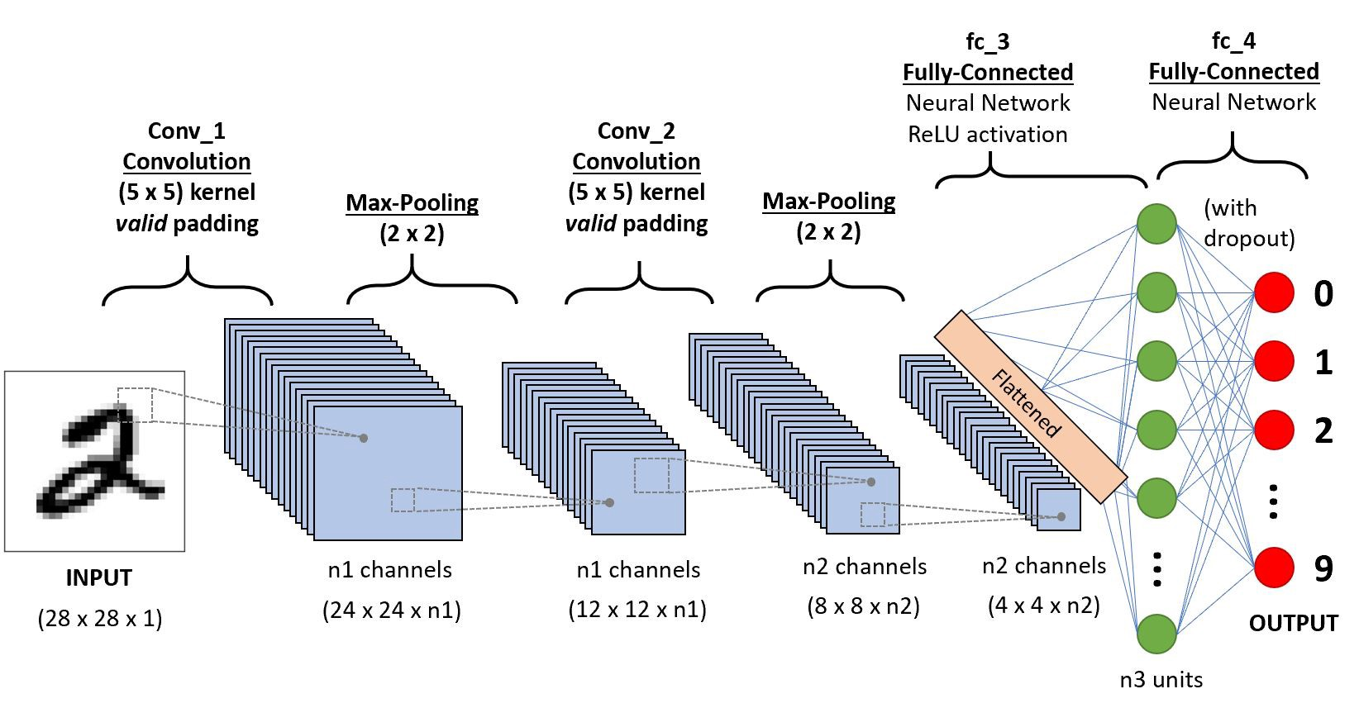
Convolutional Neural Networks
Motivation
  Reducing model complexity by removing redundancy connections between neurons
  Improving effectiveness and efficiencies of feature extraction by sharing parameters
General Architecture
  Digital Recognition
Application
  Time series data: 1-D grid taking samples at discrete intervals
  Image Data: 2-D grid of pixels
Source: https://towardsdatascience.com/a-comprehensive-guide-to-convolutional-neural-networks-the-eli5-way-3bd2b1164a53
Notes:
Convolutional neural networks (CNN) is developed for processing grid-like data such as 1. Time series data: which is a 1-D grid taking samples at discrete intervals, and 2. Image Data: 2-D grid of pixels.
It reduces model complexity by removing redundancy connections between neurons by convolutional operations.
In addition, it improves effectiveness and efficiencies of feature extraction by sharing parameters among different convolutional filters.
The general architecture is shown on the right side of the slide, which is to implement digit recognition on images.

Slide 7
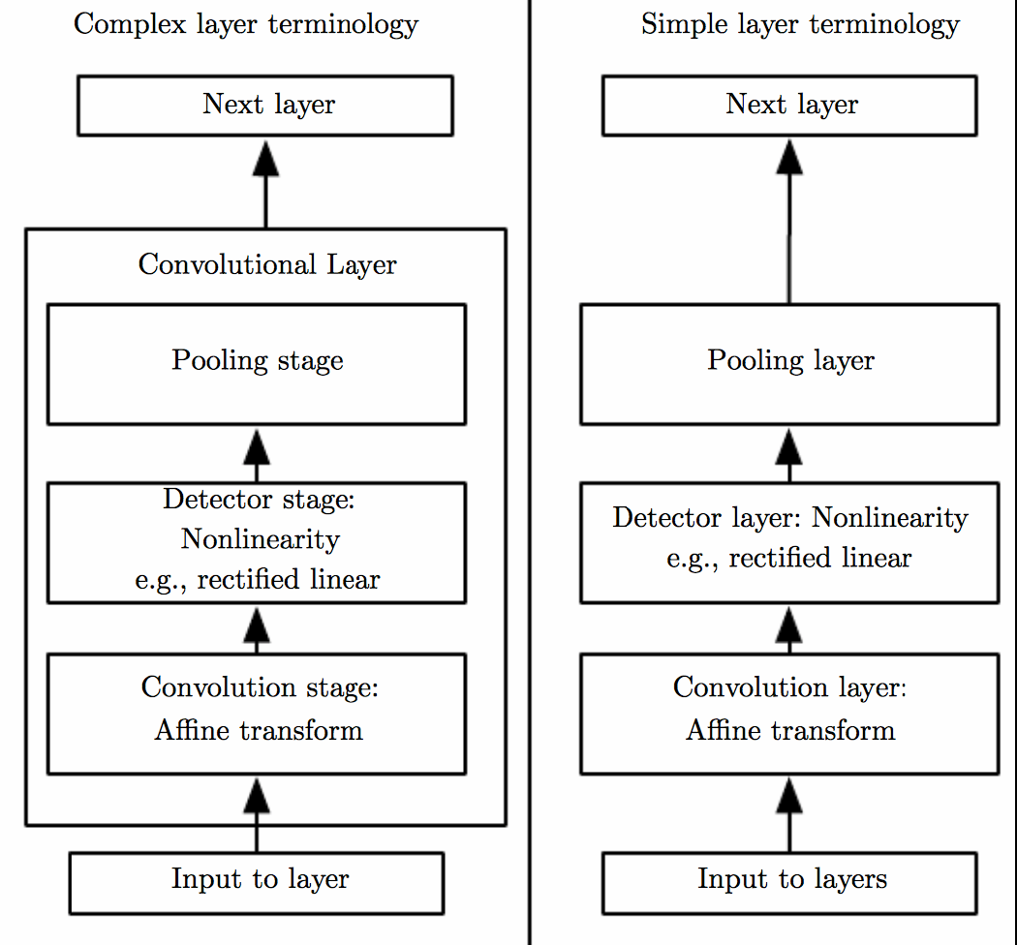
Components of a typical CNN layer
Two terminologies for describing layers
  Left: convolutional net is viewed as a small no. of relatively complex layers, each layer having many stages
  Right: CNN is viewed as a larger no. of simple layers
Notes:
We can use two terminologies for describing layers
Complex layer contains different simple layers such as convolutional layer and pooling layer.
Not every layer has parameters such as pooling layer
Number of layers for the case of complex layers is less than that of simple layer.
Detector stage (Nonlinearity e.g. rectified linear) is to use activation functions to get the outputs of convolutional operations.

Slide 8
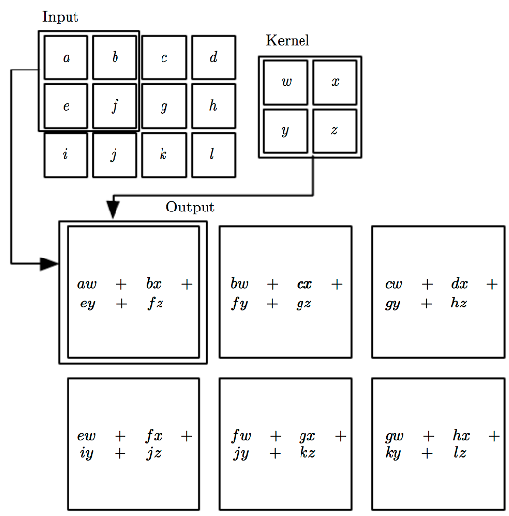
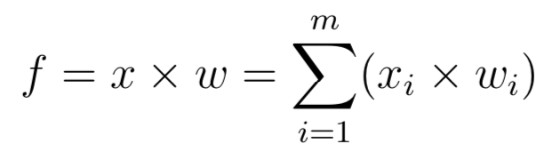
Convolution Operation for CNN
In convolution network terminology the first function x is referred to as the input, the second function w is referred to as the kernel
The output s is referred to as the feature map
Notes:
Equation on the slide shows convolution operation.
x refers local inputs
w refers the weights that are values in the filter
learning w on the data, is not designed manually.
One example is shown on the right side.
Local inputs will be x like {a, b, e, f}
Weights will be w like {w, x, y, z} learned on the data.
Input size is 3 * 4 while the output size is 2 * 3
Kernel size is 2 * 2.

Slide 9
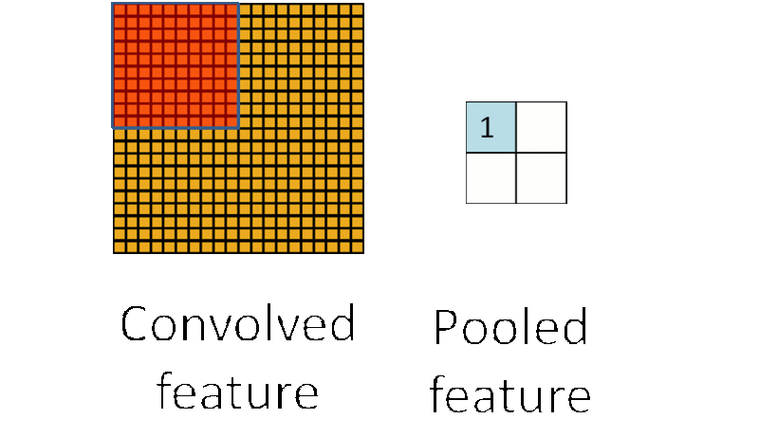
Pooling Operation for CNN
Typical layer of a CNN consists of three stages
  Stage 1: perform several convolutions in parallel to produce a set of linear sum
  Stage 2 (Detector): each linear sum is run through a nonlinear activation function such as ReLU
  Stage 3 (Pooling): Use a pooling function to modify output of the layer further
Pooling significantly reduce the number of features.
Notes:
CNN layer consists of three stages: 1. perform several convolutions in parallel to produce a set of linear sum; 2. each linear sum is run through a nonlinear activation function such as ReLU; 3. Use a pooling function to modify output of the layer.
Pooling layer is to reduce the number of features by pooling operations.
The right side shows how max-pooling works, which is to select the max value in a region as a pooling feature.

Slide 10
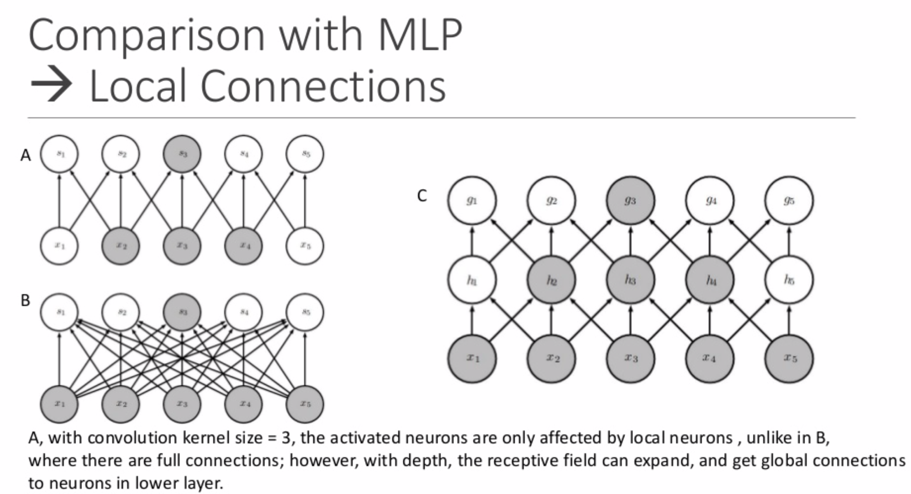
Benefits
Convolution leverages three important ideas to improve ML systems:
  Sparse connections
    A refers to local connections with convolutional operation. One output neuron connected to three inputs (gets three inputs).
    In C subfigure, with depth, the receptive field becomes larger. It means g3 will directly obtain inputs not only from middle layer, but also from the bottom layer indirectly.
    B refers fully connections in the standard neural networks.
Notes:
Compared to standard neural networks, one main benefit with CNN is to reduce the number of parameters with sparse connections. This figure shows how to implement sparse connection.
Subfigure A refers to local connections with convolutional operation. One output neuron only connected to three inputs (gets three inputs).
On the contrary, subfigure B refers fully connections in the standard neural networks.
Through comparing subfigure A and B, we can observe that the number of connections (parameters) is reduced significantly.
In addition, losing a large number of inputs, which is caused by the local connections, can be ovecome with more layers shown in subfigure C. With depth, the receptive field becomes larger. It means g3 will directly obtain inputs not only from middle layer, but also from the bottom layer indirectly.

Slide 11
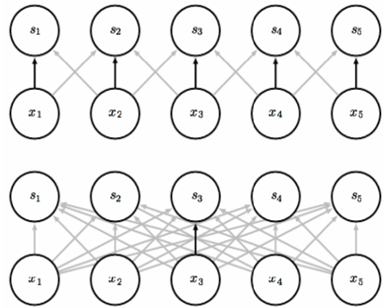
Benefits
Convolution leverages three important ideas to improve ML systems:
  Parameter Sharing
    Using the same parameter for more than one function in a model
    Black arrows: connections that use a particular parameter in two different models
    Top: use of the central element
    Bottom: no parameter sharing
Top
Bottom
Notes:
In addition, CNN reduces the numbers of parameters by parameter sharing.
In the top figure, all neurons, s₁,... , s₅, shared the same weights (parameters) on their three connections.
In the bottom figure, it is a fully connected neural networks, where all connections have different weights (parameters).

Slide 12
Convolution and Pooling can Cause Under-fitting
If a task relies on preserving precise spatial information, then using pooling on all features can increase the training error.
Some Solution
  Pooling on some channels but not on other channels, in order to get both highly invariant features and features that will not under-fit.
  When a task involves incorporating information from very distant locations in the input, then the prior imposed by convolution may be inappropriate.
Notes:
However, convolution and pooling operations can cause under-fitting regarding the sparse connections and max-value selection.
For example, if a task relies on preserving precise spatial information, then using pooling on all features can increase the training error.
Some potential solutions are below.
First, we can run pooling on some channels but not on other channels, in order to get both highly invariant features and features that will not under-fit.
Secondly, when a task involves incorporating information from very distant locations in the input, the prior imposed by convolution should be avoided.

Slide 13
Recurrent Neural Networks
Recurrent neural networks or RNNs are a family of neural networks for processing sequential data.
  Natural Language Processing
Most recurrent networks can also process sequences of variable length.
Sharing parameters across different parts of a model.
This morning I took a dog for a walk
Given these two words
Predict next word
This morning I took a dog for a walk
Given these words
Predict next word
Notes:
Recurrent neural networks or RNNs are a family of neural networks for processing sequential data.
For example, it can be applied to next word forecasting, which is shown on the figure.
RNNs can process variable length of sequences.
Specially, it can reduce the number of parameters by parameter sharing.

Slide 14
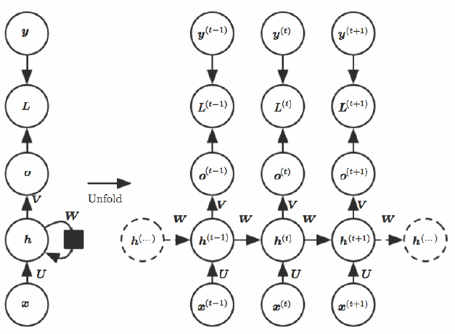
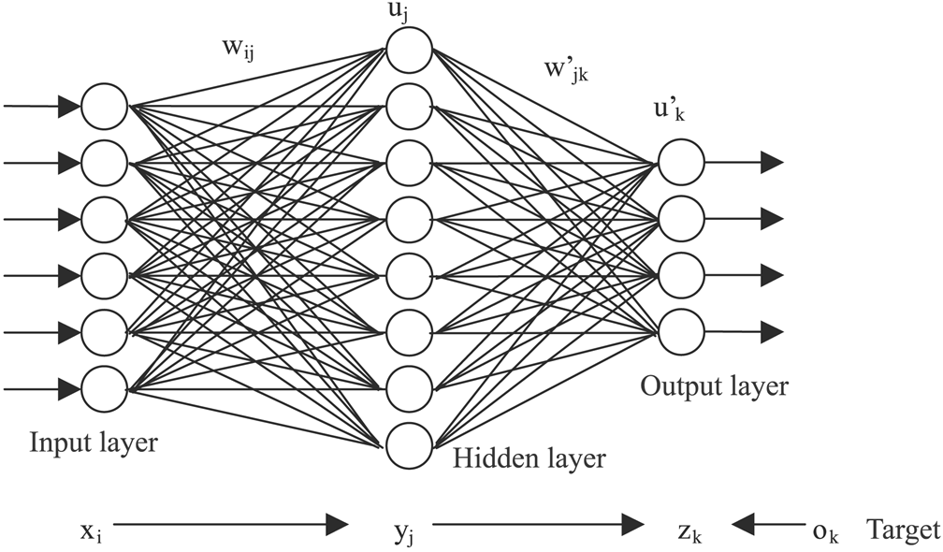
Recurrent Neural Networks VS Neural Networks
RNNs
NNs
Notes:
This figure presents the comparison between RNNs and standard neural networks.
The main difference of architectures of RNNs and standard neural networks is that RNNs contains connections between neurons in the hidden layer.

Slide 15
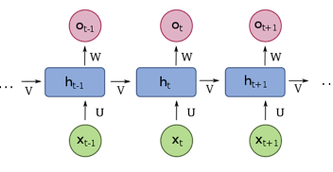
Parameter Sharing
Each member of the output is a function of
the previous members of the output.
Each member of the output is produced
using the same update rule applied to
the previous outputs.
Notes:
Parameter sharing is implemented as below.
Each member of the output is a function of the previous members of the output.
Each member of the output is produced using the same update rule applied to the previous outputs.

Slide 16
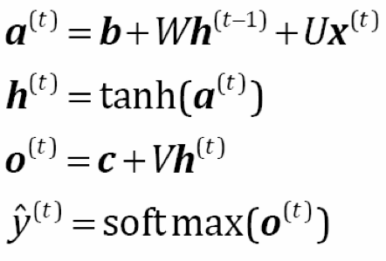
Forward Propagation
Begins with initial specification of h(0)
Then for each time step from t = 1 to t = τ we apply the following update equations
Target
Target
Fully Connected
Output
a^{(t-1)}
a^{(t)}
a^{(t+1)}
Notes:
Equations above show the whole process with calculations, where the parameters are the bias vectors b and c along with the weight matrices U, V and W respectively for the input-to-hidden, hidden-to-output and hidden-to-hidden connections.

Slide 17
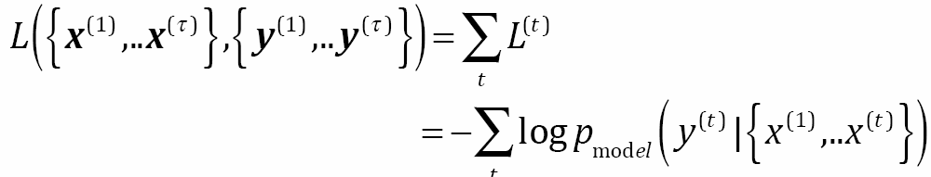
Loss function for a given sequence
Total loss for a given sequence of x values with a sequence of y values is the sum of the losses over the time steps
  If L(t) is the negative log-likelihood of y(t) given x(1),..x(t) then
    where p_{model} is given by reading the entry for y(t)
Notes:
When we have multiple outputs, the loss will be the summation of all the losses of these outputs.

Slide 18
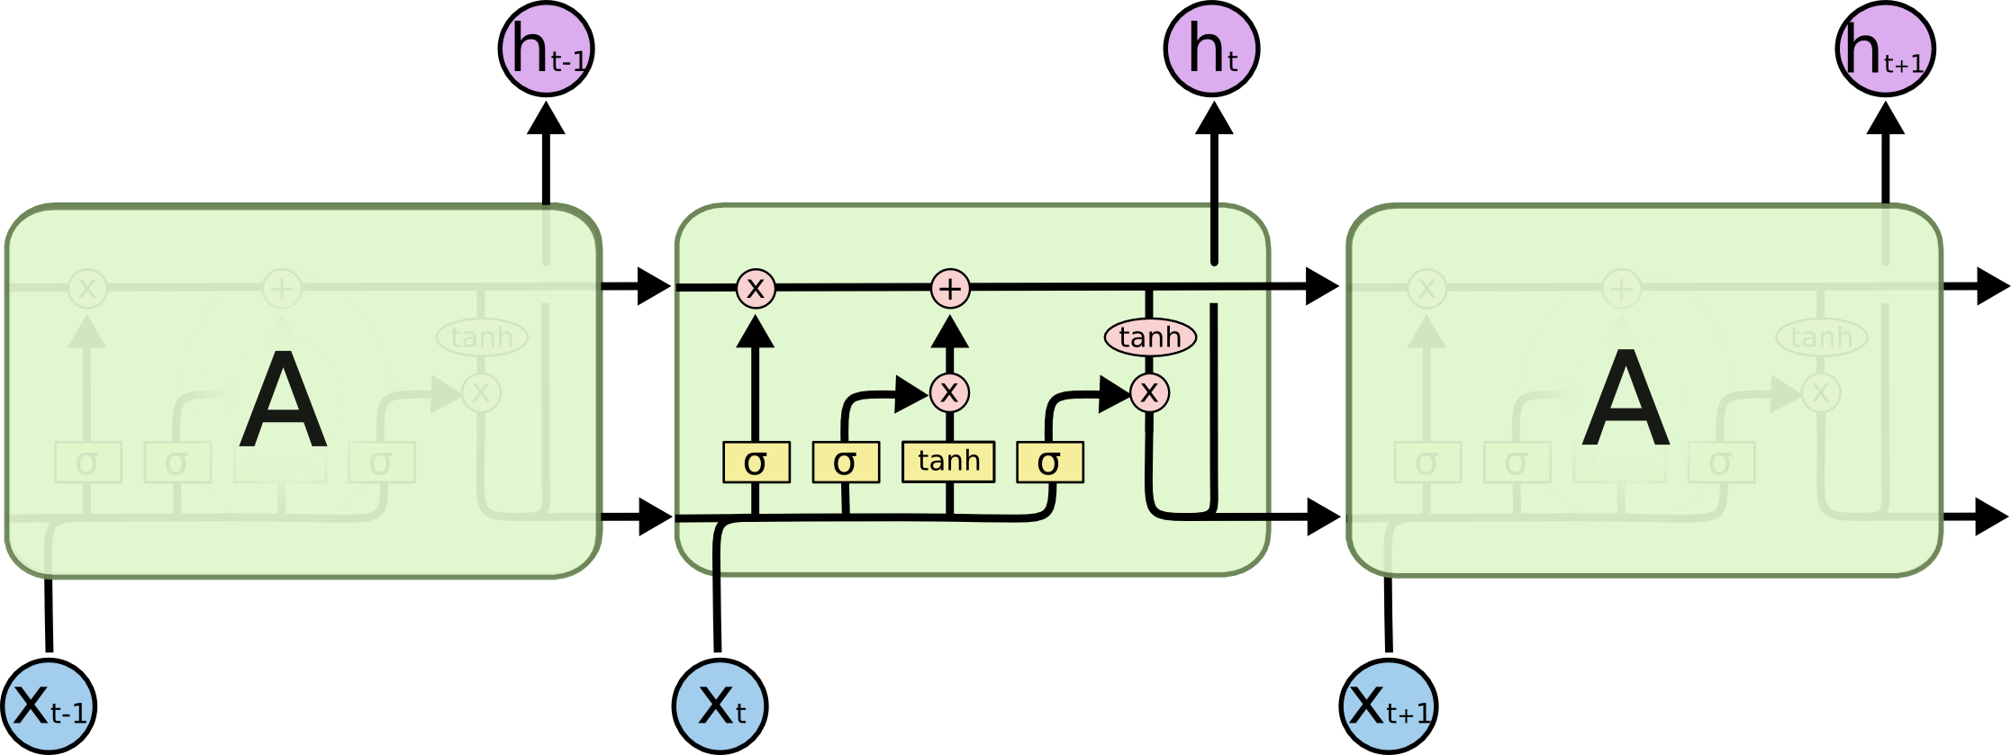
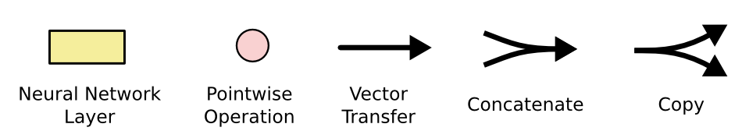
Long Short-Term Memory (LSTM) RNNs
Each line carries an entire vector, from the output of one node to the inputs of others
The pink circles represent pointwise operations, like vector addition, while the yellow boxes are learned neural network layers.
Lines merging denote concatenation, while a line forking denote its content being copied and the copies going to different locations.
Source: https://colah.github.io/posts/2015-08-Understanding-LSTMs/
Notes:
Standard RNNs can’t build long dependencies of elements in a sequence.
Long Short-Term Memory (LSTM) RNNs is proposed to overcome this issue.
Compared to the RNNs, it introduces more operations in the neuron to control information flows.
Each line carries an entire vector, from the output of one node to the inputs of others
The pink circles represent pointwise operations, like vector addition, while the yellow boxes are learned neural network layers.
The merging line denote concatenation, while the forking line denotes its content being copied and the copies going to different locations.

Slide 19
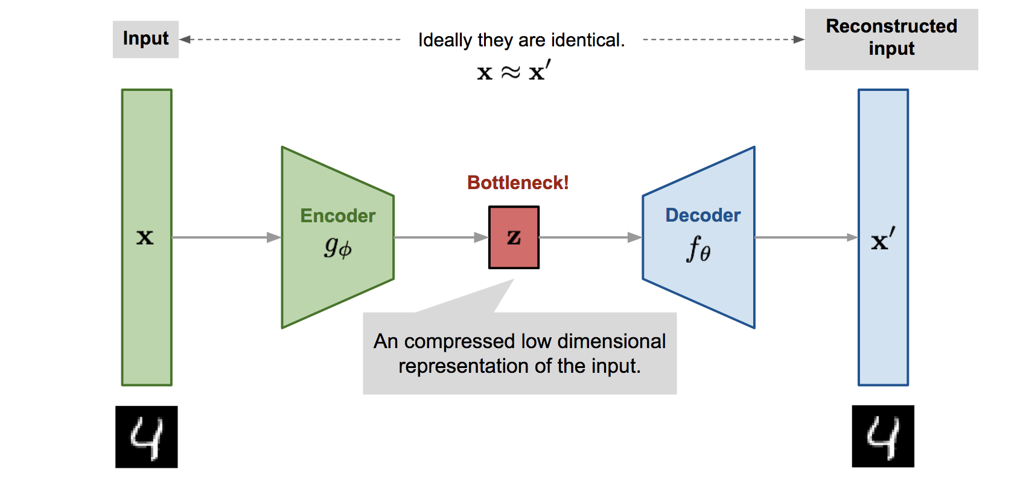
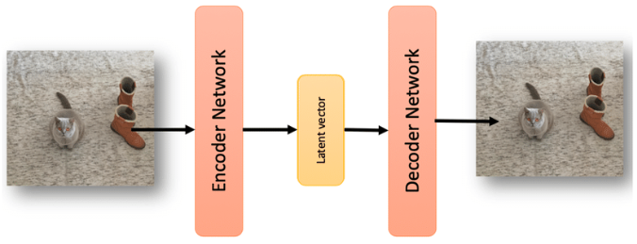
Autoencoder
An autoencoder is a feed-forward neural net whose job it is to take an input and predict the reconstruction.
To make this non-trivial, we need to add a bottleneck layer whose dimension is much smaller than the input.
Source 1: https://spraphul.github.io/blog/VAE
Source 2: https://www.researchgate.net/figure/In-a-a-Variational-AutoEncoder-VAE-scheme-with-the-mean-and-standard-deviation_fig1_339447623
Notes:
Autoencoder is a type of neural networks for unsupervised learning.
Its architecture is special with a bottle-neck layer along with two components: encoder and decoder..
It is to learn the low dimensional representations by minimizing differences between the input and the corresponding reconstruction.

Slide 20
Autoencoder
Motivation
  Mapping high-dimensional data to two dimensions for visualization like PCA
  Data Compression (i.e., reducing the file size)
  Learning abstract features in an unsupervised way so you can apply them to a supervised task.
  Unlabeled data can be much more plentiful than labeled data for certain tasks.
Bottleneck hidden layer forces network to learn a compressed latent representation.
Reconstruction loss forces the latent representation to capture as much information about the data as possible.
Autoencoding = Automatically encoding data
Main limitation
  Autoencoder cannot generate data without input images since it required latent vectors z to conduct data.
Notes:
The main motivations to build autoencoder is to implement data compression through learning abstract features in an unsupervised way.
Reconstruction loss forces the latent representation (data compression) to capture as much information about the data as possible.
However, autoencoder cannot generate data without input images since it required latent vectors to conduct data.

Slide 21
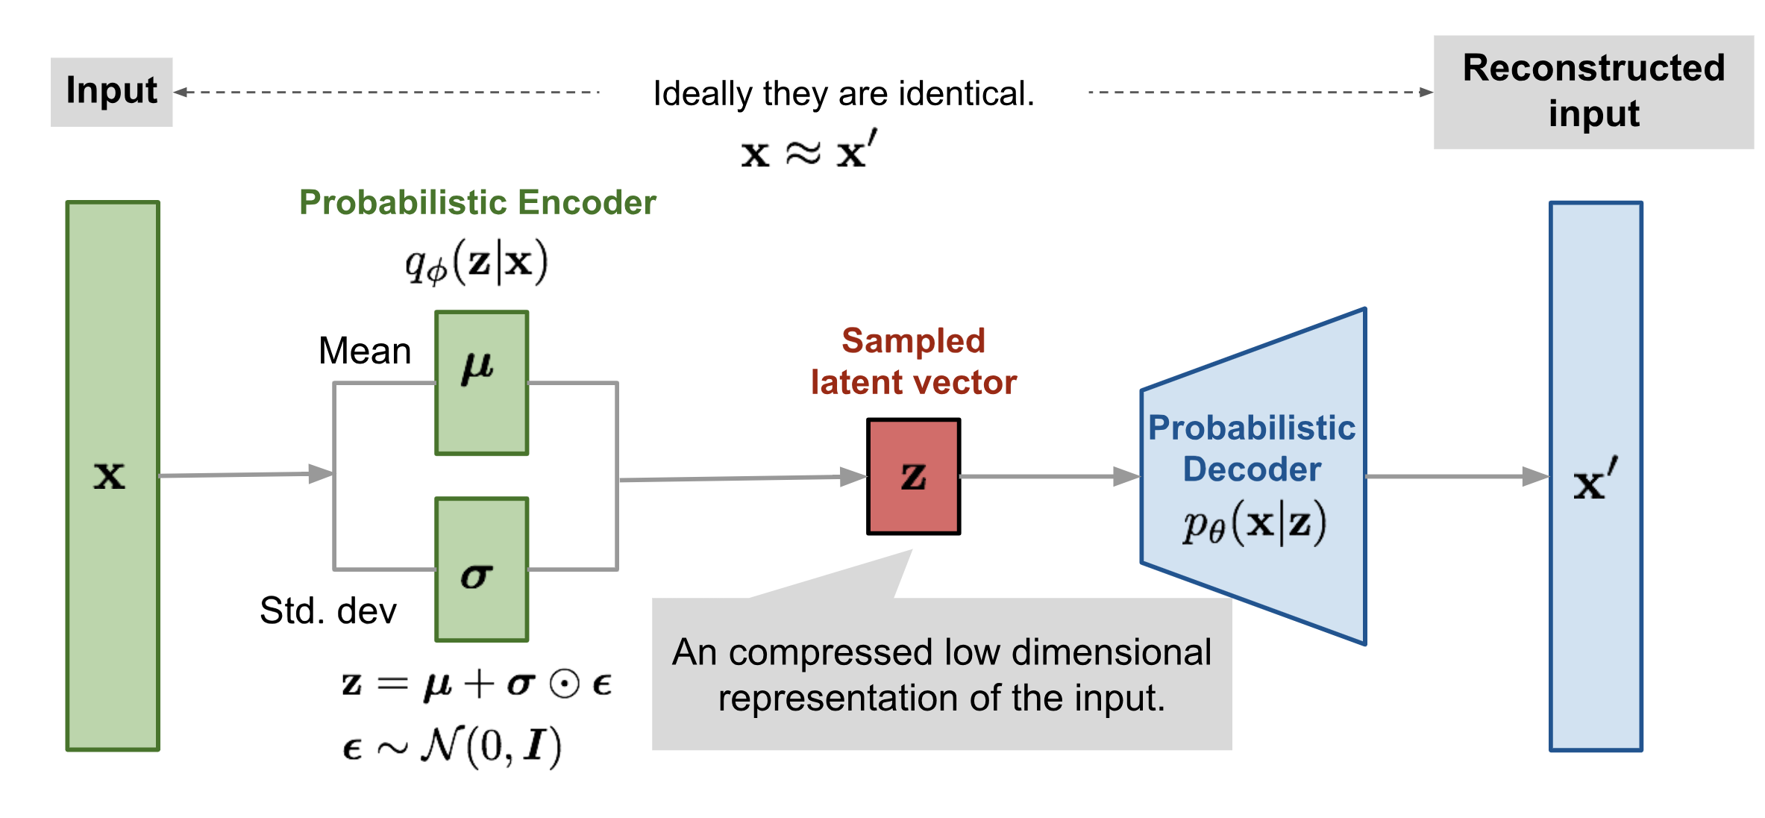
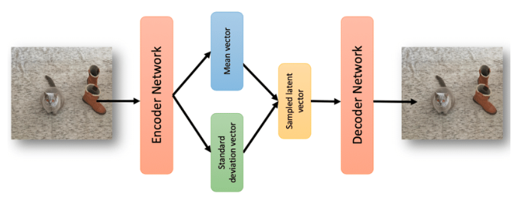
Variational Autoencoder
Variational autoencoder is a probabilistic twist on autoencoder.
Sample from the mean and standard dev. to compute latent samples (vectors)
Source 1: https://spraphul.github.io/blog/VAE
Source 2: https://www.researchgate.net/figure/In-a-a-Variational-AutoEncoder-VAE-scheme-with-the-mean-and-standard-deviation_fig1_339447623
Notes:
To generate the data with less inputs, we can build variational autoencoder that is to add constrains to the latent vectors.
For example, we can assume the mean and standard dev. of latent vector meet with certain requirements.
Then, samples from the mean and standard dev. can be used to generate latent vectors to generate data.

Slide 22
DLI Accelerated Data Science Teaching Kit
Thank You

