Slide 1
Lecture 17.1 - How to Represent and Store Graphs
DLI Accelerated Data Science Teaching Kit

Slide 2

The Accelerated Data Science Teaching Kit is licensed by NVIDIA, Georgia Institute of Technology, and Prairie View A&M University under the
Creative Commons Attribution-NonCommercial 4.0 International License.

Slide 3

This work is licensed under a Creative Commons Attribution-NonCommercial 4.0 International License.
© 2014 by LyonLabs, LLC and Barrett Lyon. Hosted by Defense.Nethttp://www.opte.org/the-internet/

Slide 4


Slide 5
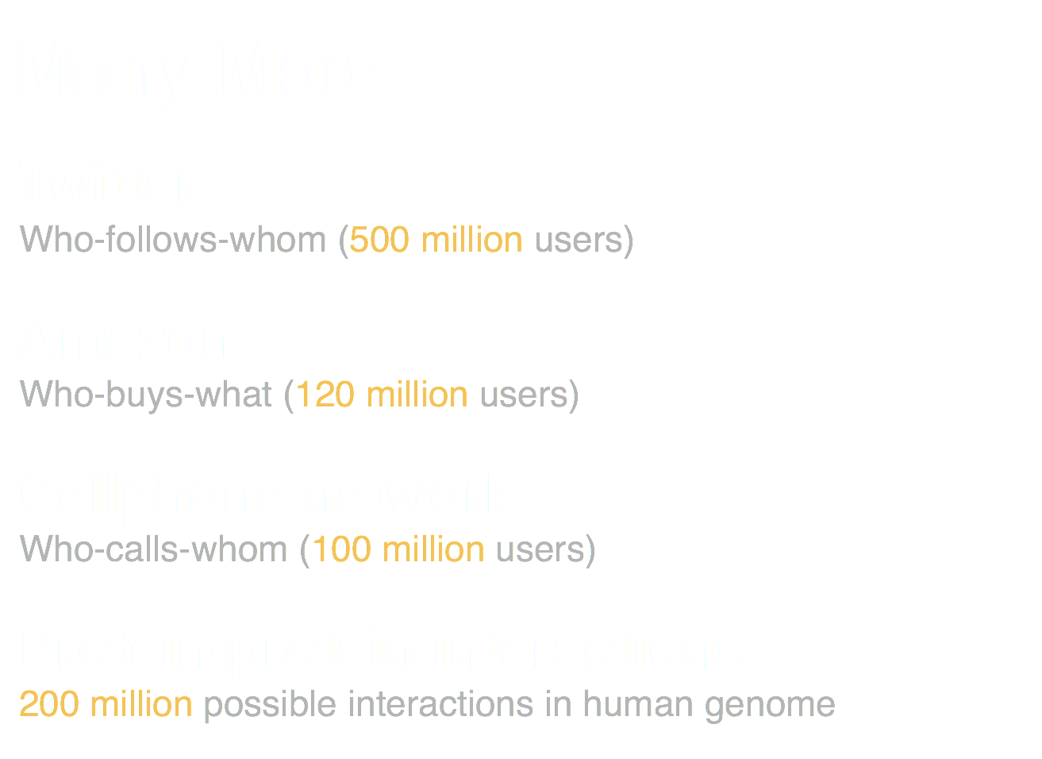

Slide 6
How to Represent a Graph?
Conceptually.
Visually.
Programmatically.

Slide 7
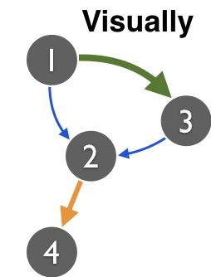
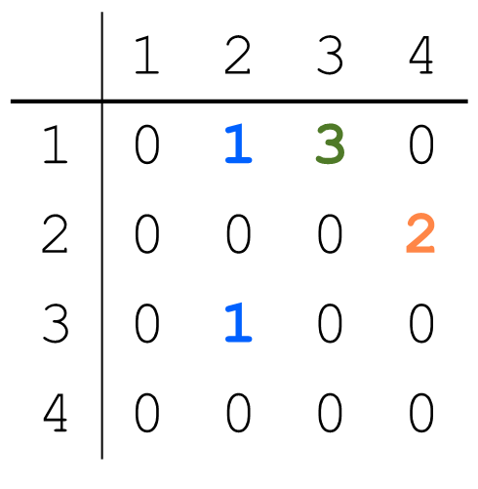
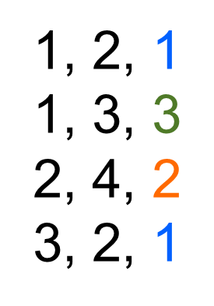
How to Represent a Graph?
  Adjacency matrix
  Adjacency list
  Target node
1: 2, 3
2: 4
3: 2
  Source
  node
Edge list
Most common distribution format
Can be painful to parse when edges/nodes have many attributes/columns (e.g., text with quotes)

Slide 8
How to Represent a Graph?
  Adjacency matrix
  Adjacency list
  Target node
1: 2, 3
2: 4
3: 2
  Source
  node
Edge list
Each node is often identified by a numeric ID. Why?

Slide 9
Assigning an ID to a Node
Use a “map” (Java) / “dictionary” (Python) / SQLite
Same concept: given an entity/node (e.g., “Tom”) not seen before, assign a number to it

Slide 10
Assigning Node IDs using SQLite
Create an index for “name”. Then write a join query.
rowid name
1 Tom
2 Sandy
3 Richard
4 Polo
source target
Tom Sandy
Polo Richard
source target
1 2
4 3
Rowid is a hidden column
automatically created by SQLite

Slide 11
How to Store (Large) Graph?
On your laptop computer
SQLite
  Neo4j (GPL license)
  http://neo4j.com/licensing/
On a server
MySQL, PostgreSQL, etc.
Neo4j (?)
With a cluster of machines
Titan (on top of HBase), S2Graph — if you need real time read and write
Hadoop (generic framework) — if batch processing is fine
Hama, Giraph, inspired by Google’s Pregel
FlockDB, by Twitter

Slide 12
Storing Large Graphs
My research group like to use SQLite. Why? Great for our use cases.
  Easily handle up to gigabytes ~ tens of millions of nodes/edges!
  Very easy to maintain: one cross-platform file (even works on iPad)
  APIs in many languages
  Queries are easy! e.g., find all nodes’ degrees = 1 SQL statement
  Bonus: SQLite supports full-text search

Slide 13
SQLite Graph Database Schema
Simplest schema:
  edges(source_id, target_id)
More sophisticated (flexible; lets you store more things):
CREATE TABLE nodes (
id INTEGER PRIMARY KEY,
type INTEGER DEFAULT 0,
name VARCHAR DEFAULT '');
CREATE TABLE edges (
source_id INTEGER,
target_id INTEGER,
type INTEGER DEFAULT 0,
weight FLOAT DEFAULT 1,
timestamp INTEGER DEFAULT 0,
PRIMARY KEY(source_id, target_id, timestamp));

Slide 14
DLI Accelerated Data Science Teaching Kit
Thank You

