Slide 1
Lecture 17.2 - Graph Power Laws
DLI Accelerated Data Science Teaching Kit

Slide 2

The Accelerated Data Science Teaching Kit is licensed by NVIDIA, Georgia Institute of Technology, and Prairie View A&M University under the
Creative Commons Attribution-NonCommercial 4.0 International License.

Slide 3
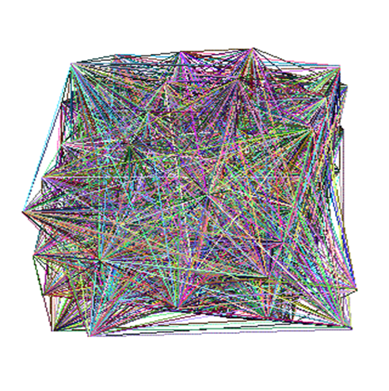
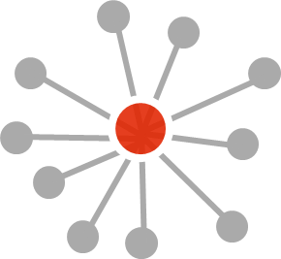
I have a graph. Now what?
Analyze it! Do “data mining” or “graph mining”. And visualize it if it’s small.
Does it follow any expected patterns? Or does it not follow patterns (outliers)?
Why does this matter?
If we find patterns (models), we can do prediction, recommendation, e.g., is Alice going to “friend” Bob on Facebook?
Outliers often give us new insights e.g., telemarketer’s friends don’t know each other
Yuck.

Slide 4
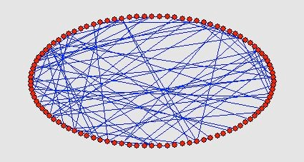
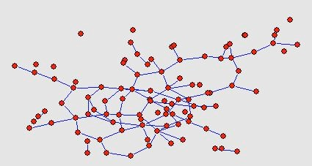
Are Real Graphs Random?
Random graph (Erdos-Renyi): edges are independent, and have equal chance in forming → no obvious patterns
Are real-world graphs (e.g., social networks) random?
Before layout
After layout
Graph and layout generated with pajek http://vlado.fmf.unilj.si/pub/networks/pajek/

Slide 5
Laws and Patterns
Nope! Real graphs are NOT random.
Diameter (longest shortest path)
In-degree and out-degree distributions
Other (surprising) patterns
So, let’s look at the data

Slide 6
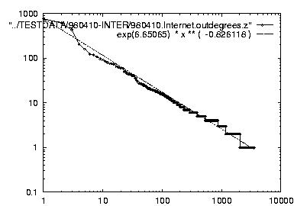
Power Law in Degree Distribution
Faloutsos, Faloutsos, Faloutsos [SIGCOMM99] Seminal paper, by 3 brothers. Must read!
Christos Faloutsos was Polo’s advisor
att.com
internet domains
ibm.com
log(degree)
-0.82
log(rank)

Slide 7
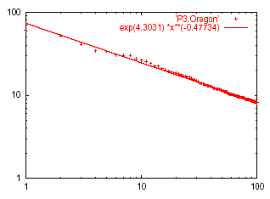
Power Law of Eigenvalues
Eigenvalue
Eigen exponent = slope = -0.48
Rank of decreasing eigenvalue

Slide 8
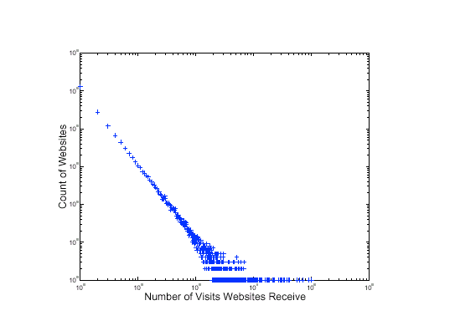
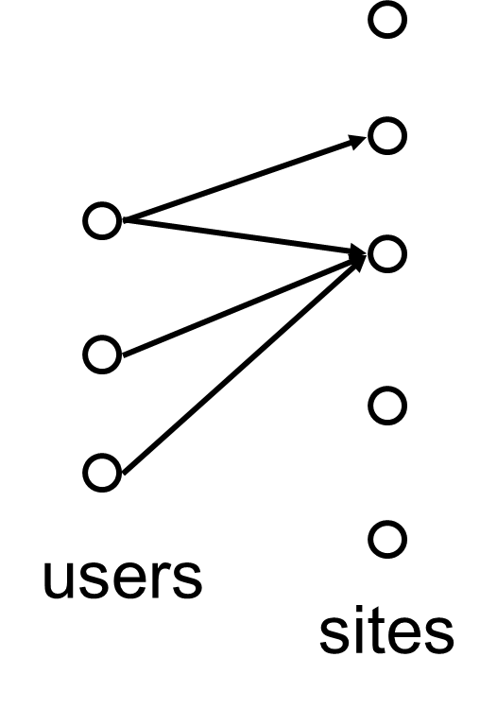
Power Laws in Many Domains
Web site traffic [Alan L. Montgomery and Christos Faloutsos]
# of sexual contacts
Income [Pareto]: 80-20 distribution
Duration of downloads [Bestavros+]
Duration of UNIX jobs
File sizes
…
log(#website)
ebay
log(#website visit)

Slide 9
Any other ‘laws’?
Yes! Small diameter (~ constant!)
Six degrees of separation / ‘Kevin Bacon’
Small worlds [Watts and Strogatz]
But how does the graph diameter change over time?

Slide 10
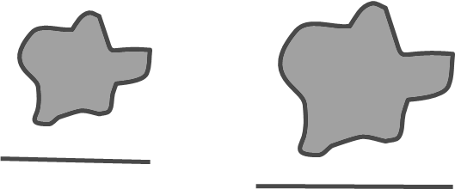
Evolution of the Diameter
By Leskovec, Kleinberg, Faloutsos
Prior work on Power Law graphs hints at slowly growing diameter:
diameter ~ O(log N)
diameter ~ O(log log N)
What is happening in real data?

Slide 11
Evolution of the Diameter
By Leskovec, Kleinberg, Faloutsos
Prior work on Power Law graphs hints at slowly growing diameter:
diameter ~ O(log N)
diameter ~ O(log log N)
What is happening in real data?
Diameter shrinks over time!

Slide 12
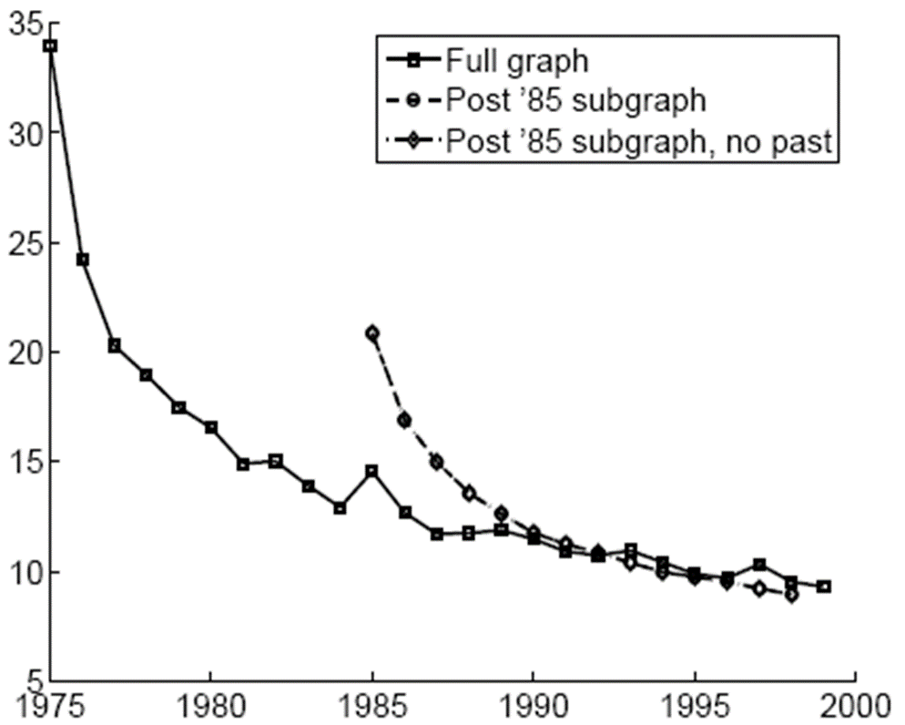

Diameter – Patents Network
Patent citation network
25 years of data
@1999
2.9 M nodes
16.5 M edges
Effective diameter
Time (year)

Slide 13
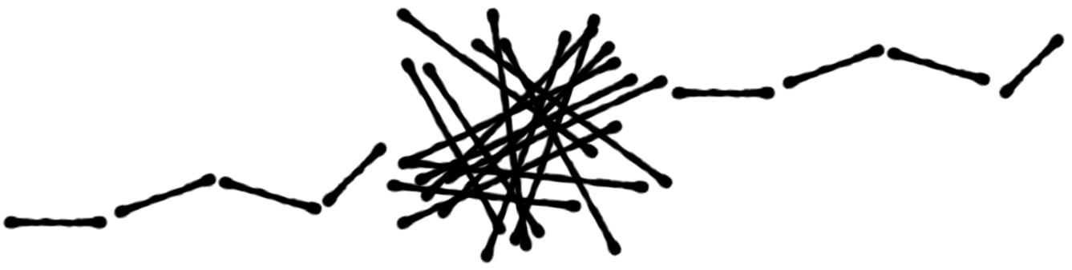
Why Effective Diameter?
The maximum diameter is susceptible to outliers
So, we use effective diameter instead
Defined as the minimum number of hops in which 90% of connected node pairs can reach each other

Slide 14
Evolution of #Node and #Edge
N(t) = nodes at time t
E(t) = edges at time t
Suppose. N(t+1) = 2 * N(t)
Q: What is your guess for E(t+1)? 2 * E(t) ?

Slide 15
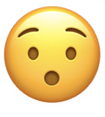
Evolution of #Node and #Edge
N(t) = nodes at time t
E(t) = edges at time t
Suppose. N(t+1) = 2 * N(t)
Q: What is your guess for E(t+1)? 2 * E(t) ?
A: Over-doubled! And obeying the “Densification Power Law’’

Slide 16
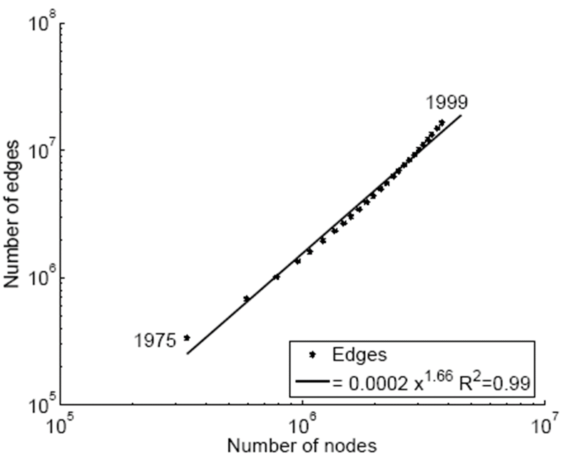
Diameter – Patents Network
Patent citation network
25 years of data
@1999
2.9 M nodes
16.5 M edges
1.66
E(t)
N(t)

Slide 17
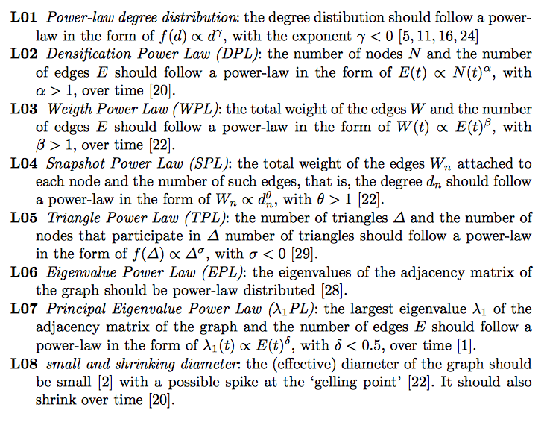
So Many Laws!
There will be more to come...
To date, there are 11 (or more) laws
RTG: A Recursive Realistic Graph Generator using Random Typing [Akoglu, Faloutsos]

Slide 18
So Many Laws!
What should You Do?
Try as many distributions as possible and see if your graph fits them.
If it doesn’t, find out the reasons. Sometimes it’s due to errors/problems in the data; sometimes, it signifies some new patterns!

Slide 19
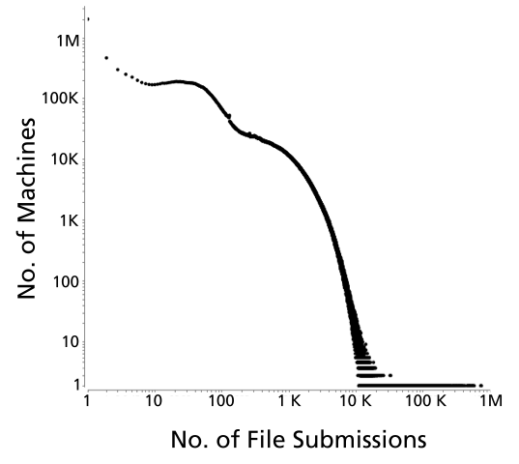
What might be the reasons for the “hills”?
Polonium: Tera-Scale Graph Mining and Inference for Malware Detection [Chau, et al]

Slide 20
DLI Accelerated Data Science Teaching Kit
Thank You

