Slide 1
Lecture 17.3 - Centralities: Degree, Betweenness, Clustering Coefficient
DLI Accelerated Data Science Teaching Kit

Slide 2

The Accelerated Data Science Teaching Kit is licensed by NVIDIA, Georgia Institute of Technology, and Prairie View A&M University under the
Creative Commons Attribution-NonCommercial 4.0 International License.

Slide 3
Centrality
= “Importance”

Slide 4


Why Node Centrality?
What can we do if we can rank all the nodes in a graph (e.g., Facebook, LinkedIn, Twitter)?
Find celebrities or influential people in a social network (Twitter)
Find “gatekeepers” who connect communities (headhunters love to find them on LinkedIn)

Slide 5
Why Node Centrality?
Helps graph analysis, visualization, understanding, e.g.,
Let us rank nodes, group or study them by centrality
Only show subgraph formed by the top 100 nodes, out of the millions in the full graph
Similar to google search results (ranked, and they only show you 10 per page)
Most graph analysis packages already have centrality algorithms implemented. Use them!
Can also compute edge centrality. Here we focus on node centrality.

Slide 6
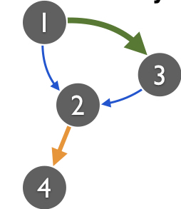
Degree Centrality (Easiest)
Degree = number of neighbors
For directed graphs
In degree = No. of incoming edges
Out degree = No. of outgoing edges
For undirected graphs, only degree is defined.
Algorithms?
Sequential scan through edge list
What about for a graph stored in SQLite?
1, 2
1, 3
2, 4 3, 2

Slide 7
Computing Degrees using SQL
Recall simplest way to store a graph in SQLite:
edges(source_id, target_id)
1. If slow, first create index for each column
2. Use group by statement to find out degrees
select count(*) from edges group by source_id;
1, 2
1, 3
2, 4 3, 2

Slide 8
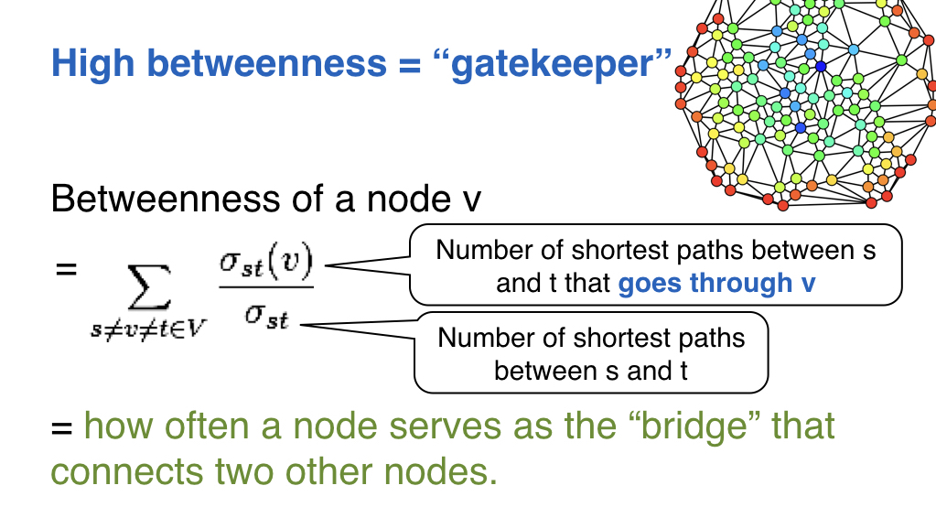
Betweenness Centrality

Slide 9
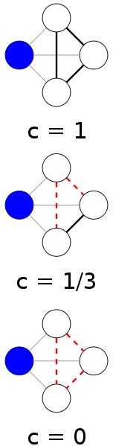
(Local) Clustering Coefficient
A node’s clustering coefficient is a measure of how close the node’s neighbors are from forming a clique.
1 = Neighbors form a clique
0 = No edges among neighbors
(Assuming undirected graph)
“Local” means it’s for a node; can also compute a graph’s “global” coefficient
Image source: http://en.wikipedia.org/wiki/Clustering_coefficient

Slide 10
Computing Clustering Coefficients...
Requires triangle counting
Real social networks have a lot of triangles Friends of friends are friends
Triangles are expensive to compute (neighborhood intersections; several approx. algos)
Can we do that quickly?
Algorithm details: Faster Clustering Coefficient Using Vertex Covers
http://www.cc.gatech.edu/~ogreen3/_docs/2013VertexCoverClusteringCoefficients.pdf

Slide 11
Super Fast Triangle Counting [Tsourakakis ICDM 2008]
details
But: triangles are expensive to compute
(3-way join; several approx. algos)
Q: Can we do that quickly?
A: Yes!
#triangles = 1/6 Sum ( λi³ )
Because of skewness, we only need top few eigenvalues!

Slide 12
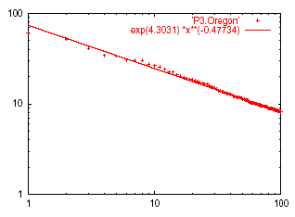
Power Law in Eigenvalues
Eigenvalue
Eigen exponent = slope = -0.48
Rank of decreasing eigenvalue

Slide 13
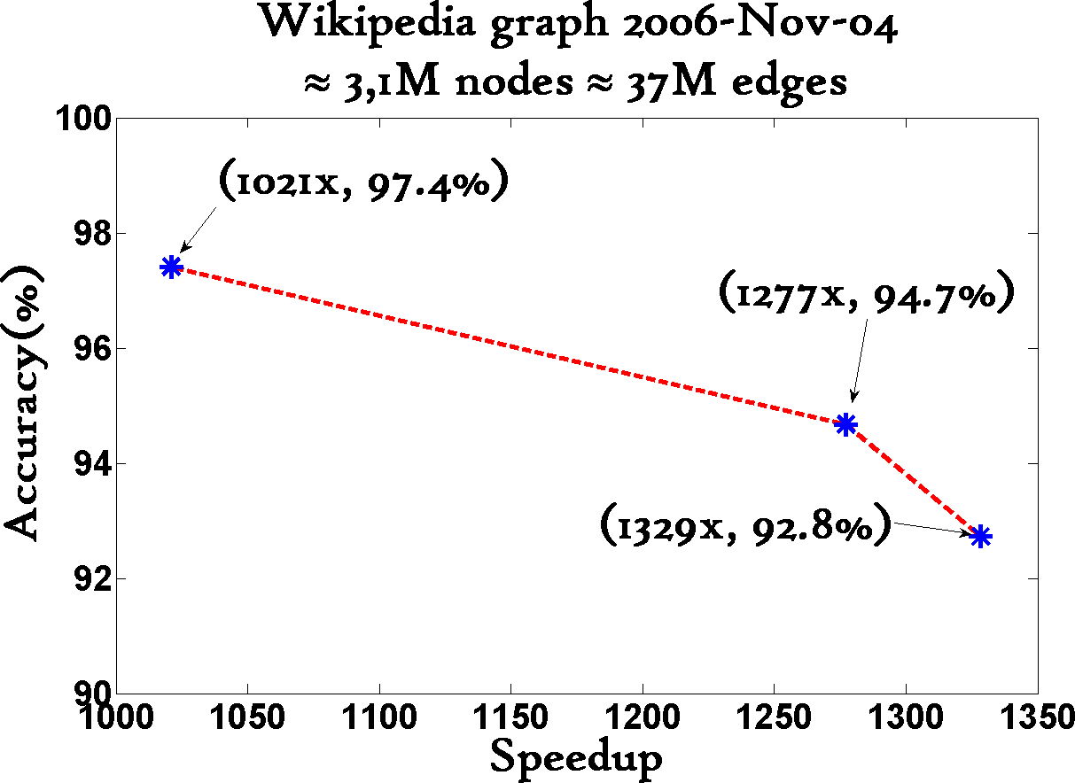
1000x+ speed-up, >90% accuracy

Slide 14
More Centrality Measures…
Degree
Betweenness
Closeness, by computing
Shortest paths
“Proximity” (e.g., via random walks)
Eigenvector
…

Slide 15
DLI Accelerated Data Science Teaching Kit
Thank You

