Slide 1
Lecture 17.4 - PageRank and Personalized PageRank
DLI Accelerated Data Science Teaching Kit

Slide 2

The Accelerated Data Science Teaching Kit is licensed by NVIDIA, Georgia Institute of Technology, and Prairie View A&M University under the
Creative Commons Attribution-NonCommercial 4.0 International License.

Slide 3
PageRank
Brin, Sergey and Lawrence Page (1998). Anatomy of a Large-Scale Hypertextual Web Search Engine. 7th Intl World Wide Web Conf.

Slide 4
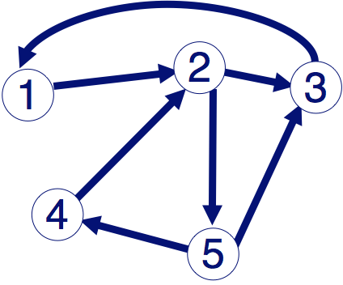
PageRank: Problem
Given a directed graph, find its most interesting/central node
A node is important, if it is connected with important nodes (recursive, but OK!)

Slide 5
PageRank: Solution
Given a directed graph, find its most interesting/central node
Proposed solution: use random walk; most “popular” nodes are the ones with highest steady state probability (ssp)
A node is important, if it is connected with important nodes (recursive, but OK!)
“state” = webpage

Slide 6
(Simplified) PageRank
Let B be the transition matrix: transposed, column-normalized
From
B
p
=
p
To
 |  | 1
1 |  |  | 1
 | 1/2 |  |  | 1/2
 |  |  |  | 1/2
 | 1/2
p1
p2
p3
p4
p5
p1
p2
p3
p4
p5
=
How to compute SSP:
https://fenix.tecnico.ulisboa.pt/downloadFile/3779579688473/6.3.pdf
http://www.sosmath.com/matrix/markov/markov.html

Slide 7
(Simplified) PageRank
B p = 1 * p
Thus, p is the eigenvector that corresponds to the highest eigenvalue (=1, since the matrix is column-normalized)
Why does such a p exist?
  p exists if B is nxn, nonnegative, irreducible
  [Perron–Frobenius theorem]

Slide 8
(Simplified) PageRank
In short: imagine a person randomly moving along the edges/links
A node’s PageRank score is the steady-state probability (ssp) of finding the person at that node
Full version of algorithm:
  With occasional random jumps to any nodes
Why? To make the matrix irreducible.
  Irreducible = from any state (node), there’s non-zero probability to reach any other state (node)

Slide 9
Full Algorithm
With probability 1-c, fly-out to a random node
Then, we have
  p = c B p + (1-c) 1
1/n
1/n
1/n
1/n
1/n
n

Slide 10
Run PageRank for Huge Matrix?
Use the power iteration method
  p’ = c B p + (1-c) 1
n
p’
B
p
p’1
p’2
p’3
p’4
p’5
 |  | 1
1 |  |  | 1
 | 1/2 |  |  | 1/2
 |  |  |  | 1/2
 | 1/2
p1
p2
p3
p4
p5
1
1
1
1
1
(1-c)
=
c
+
n
http://en.wikipedia.org/wiki/Power_iteration
Can initialize this vector to any non-zero vector, e.g., all “1”s

Slide 11
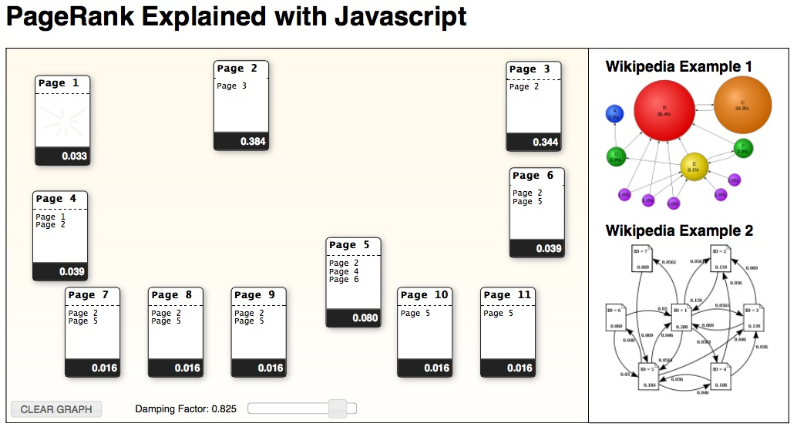
Also great for checking the correctness of your PageRank Implementation.
http://www.cs.duke.edu/csed/principles/pagerank/

Slide 12
PageRank for Graphs (Generally)
You can run PageRank on any graphs
  All you need are the graph edges!
Should be in your algorithm “toolbox”
  Better than degree centrality
  Fast to compute for large graphs, runtime linear in the number of edges, O(E)
But can be “misled” (Google Bomb)
  How?

Slide 13
Personalized PageRank
Intuition: not all pages are equally relevant
Goal: rank pages such that those more relevant to you will be ranked higher
How? Make just ONE small change to PageRank

Slide 14
Personalized PageRank
With probability 1-c, fly-out to
a random node some preferred nodes`
0
1
0
0
1
  = c B p + (1-c) 1
p’
n
B
p
p’1
p’2
p’3
p’4
p’5
 |  | 1
1 |  |  | 1
 | 1/2 |  |  | 1/2
 |  |  |  | 1/2
 | 1/2
p1
p2
p3
p4
p5
1
1
1
1
1
0.2
=
0.8
+
5
Default value for c
Can initialize this vector to any non-zero vector, e.g., all “1”s

Slide 15
Why Personalized PageRank?
For recommendation
  If I like webpage A, what else do I like?
  If I bought product A, what other products would I also buy?
Visualizing and interacting with large graphs
  Instead of visualizing every single nodes, visualize the most important ones
Very flexible — works on any graph

Slide 16
Related “Guilt-by-Association”/Diffusion Techniques
Personalized PageRank
(= Random Walk with Restart)
“Spreading activation” or “degree of interest” in Human-Computer Interaction (HCI)
Belief Propagation
(powerful inference algorithm, for fraud detection, image segmentation, error-correcting codes, etc.)

Slide 17
Why are These Algorithms Popular?
Intuitive to interpret
Uses “network effect”, homophily
Easy to implement
Math is relatively simple (mainly matrix-vector multiplication)
Fast
Run time linear to #edges, or better
Probabilistic meaning

Slide 18
DLI Accelerated Data Science Teaching Kit
Thank You

