Slide 1
Lecture 17.5 - Interactive Graph Exploration
DLI Accelerated Data Science Teaching Kit

Slide 2

The Accelerated Data Science Teaching Kit is licensed by NVIDIA, Georgia Institute of Technology, and Prairie View A&M University under the
Creative Commons Attribution-NonCommercial 4.0 International License.

Slide 3
Human-In-The-Loop Graph Mining
Apolo: Machine Learning + Visualization CHI 2011
Apolo: Making Sense of Large Network Data by Combining Rich User Interaction and Machine Learning

Slide 4

Finding More Relevant Nodes
HCI
Paper
Data Mining Paper
Citation network

Slide 5
Finding More Relevant Nodes
HCI
Paper
Data Mining Paper
Citation network
Apolo uses guilt-by-association (Belief Propagation, similar to personalized PageRank)

Slide 6
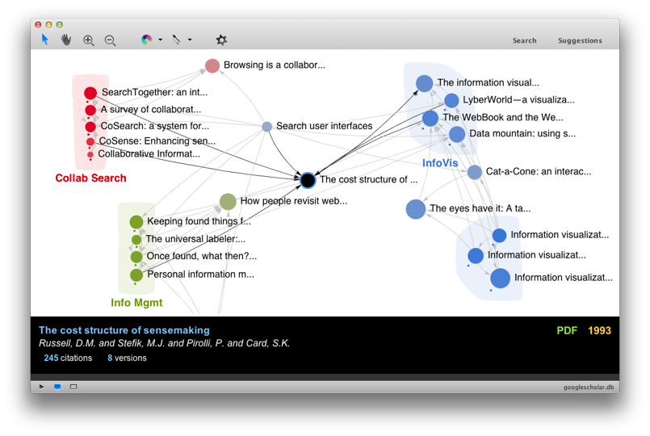
Mapping the Sensemaking Literature
Nodes: 80k papers from Google Scholar (node size: #citation)
Edges: 150k citations

Slide 7
Key Ideas in Apolo
Specify exemplars
Find other relevant nodes (BP)

Slide 8
Apolo’s Contributions
Human + Machine
Apolo User
Personalized Landscape

Slide 9
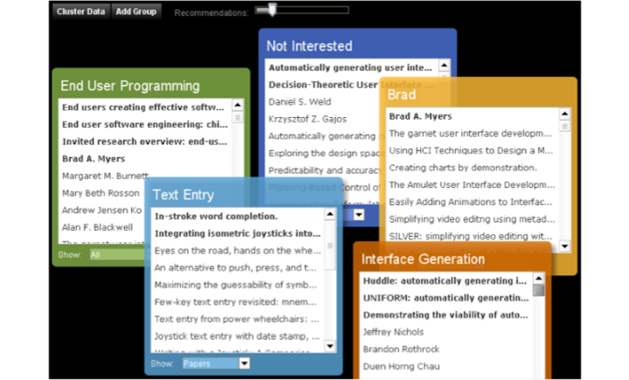
Apolo v1

Slide 10
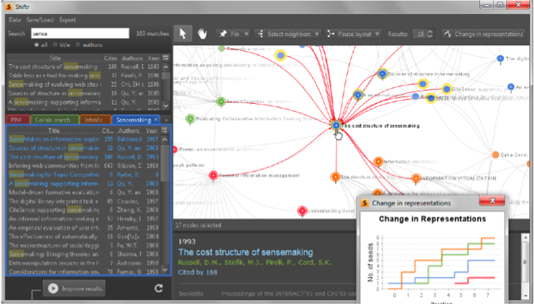
Apolo v2

Slide 11
Apolo v3
22,000 lines of code. Java 1.6. Swing. Uses SQLite3 to store graph on disk

Slide 12

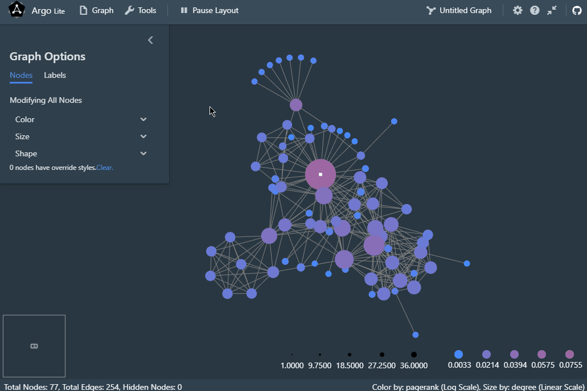
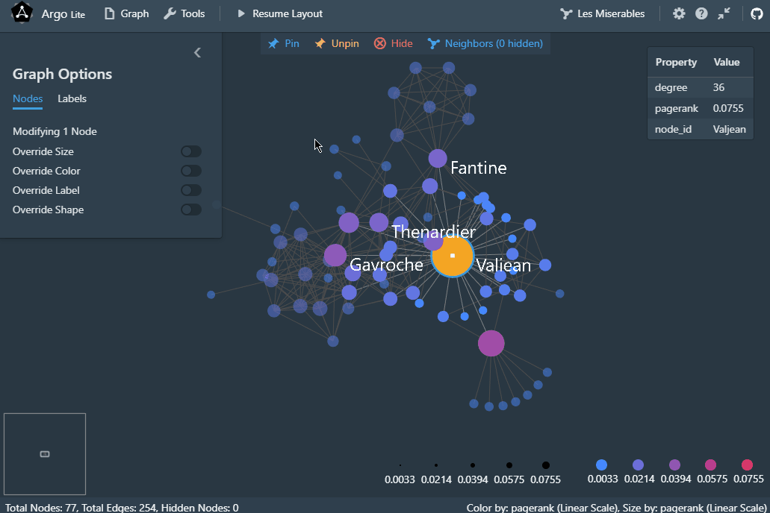
CIKM 2020 | MIT License
Interactive Graph Visualization in Browsers
Try at poloclub.github.io/argo-graph-lite
Runs on desktops & mobile devices
Easy sharing or embedding via URLs
Argo Lite: Open-Source Interactive Graph Exploration and Visualization in Browsers. Siwei Li, Zhiyan Zhou, Anish Upadhayay, Omar Shaikh, Scott Freitas, Haekyu Park, Zijie J. Wang, Susanta Routray, Matthew Hull, Polo Chau. CIKM 2020.

Slide 13

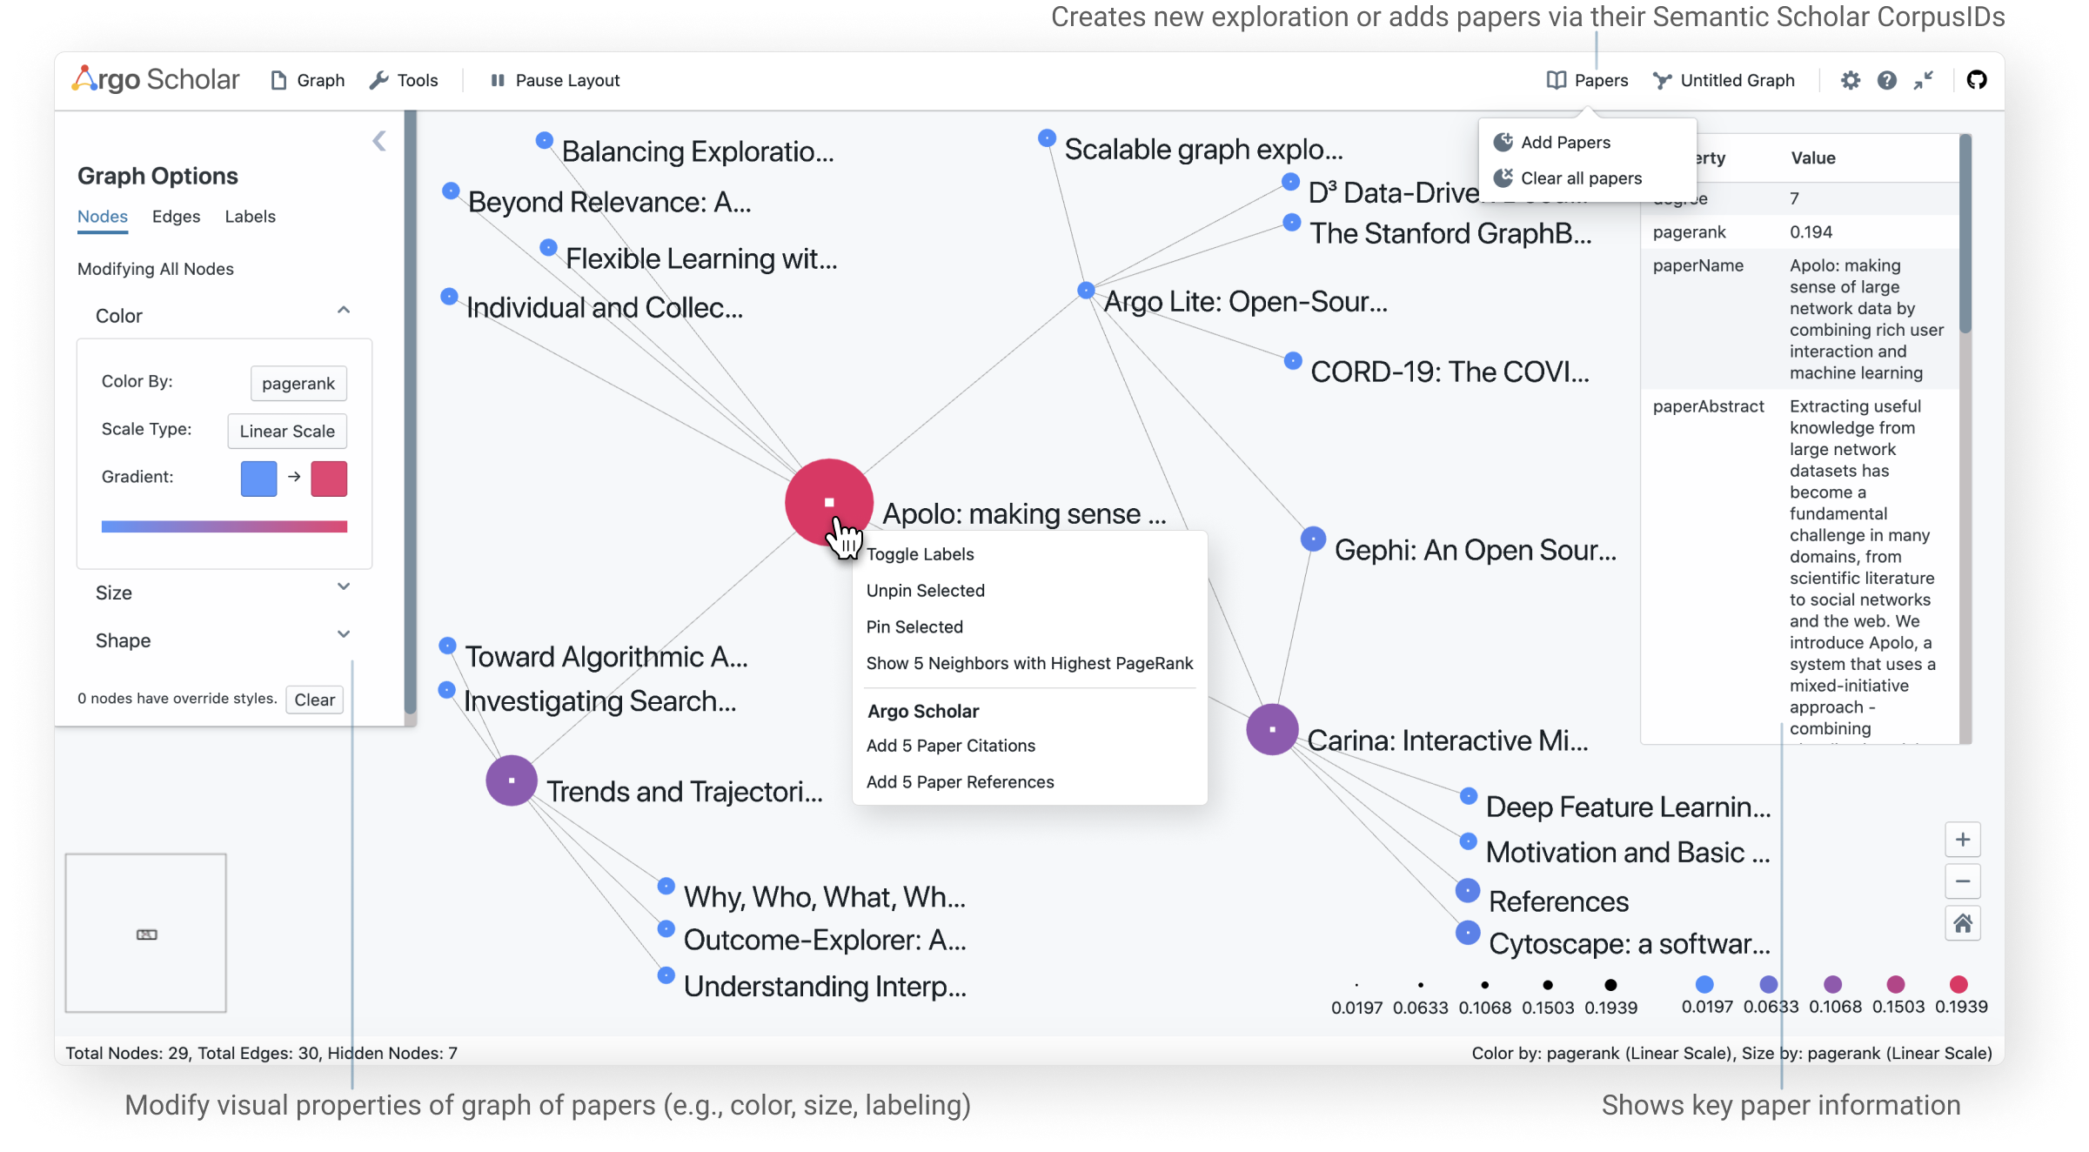
VIS 2021 | MIT License
Visual Exploration of Literature in Browsers
Try at poloclub.github.io/argo-scholar
1. Access ~200M Papers on Semantic Scholar
2. Shareable Literature Graphs via URLs
3. Incremental Exploration of paper references & citations
Argo Scholar: Interactive Visual Exploration of Literature in Browsers. Kevin Li, Haoyang Yang, Anish Upadhayay, Zhiyan Zhou, Jon Saad-Falcon, Polo Chau. VIS 2021 Research Poster.

Slide 14
Practitioners’ Guide to Building (Interactive) Applications
What kinds of prototypes?
Paper prototype, lo-fi prototype, high-fi prototype
Important to involve REAL users as early as possible
Recruit your friends to try your tools
Lab study (controlled, as in Apolo)
Longitudinal study (usage over months)
Deploy it and see the world’s reaction!
Take courses on human-computer interaction (HCI), human factors, user interface design

Slide 15
Practitioners’ Guide to Building (Interactive) Applications
Think about scalability early
Identify candidate scalable algorithms early on
Use iterative design approach, as in Apolo and industry
Why? It’s hard to get it right the first time
Create prototype, evaluate, modify prototype, evaluate, ...
Quick evaluation helps you identify important fixes early — save you a lot of time overall
Waterfall model (software engineering)

Slide 16
DLI Accelerated Data Science Teaching Kit
Thank You

