Slide 1

Lecture 18.1 -​ ​Machine Learning for Streaming Data Analysis
DLI Accelerated Data Science Teaching Kit
Notes:
This section will show you how to use machine learning techniques to complete streaming data analysis.

Slide 2

The Accelerated Data Science Teaching Kit is licensed by NVIDIA, Georgia Institute of Technology, and Prairie View A&M University under the
Creative Commons Attribution-NonCommercial 4.0 International License.

Slide 3
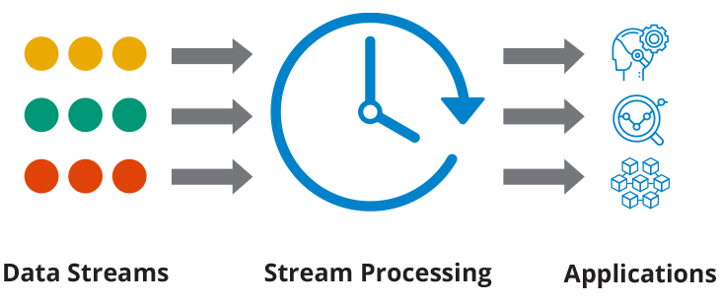
Streaming Data
Streaming data is generated continuously by various data sources.
  It is the continuous flow of data generated by different sources, in various formats and volumes.
  It is generated by applications from networking devices, and server log files, to website activity, banking transactions, and location data.
Source: https://hazelcast.com/glossary/streaming-database/
Notes:
Steaming data is not stable since it is generated continuously by various data sources, typically sending the data records simultaneously.
It will generate new data continuously from different sources, in various formats and volumes in different applications from networking devices, and server log files, to website activity, banking transactions, and location data.

Slide 4
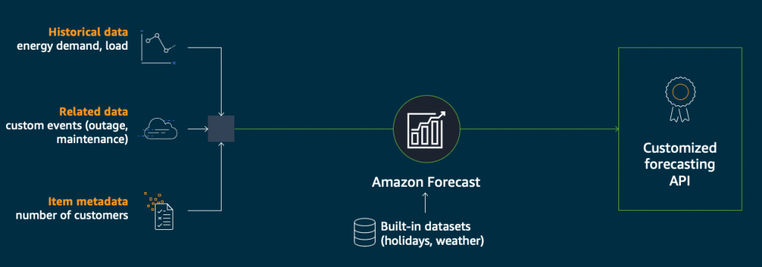
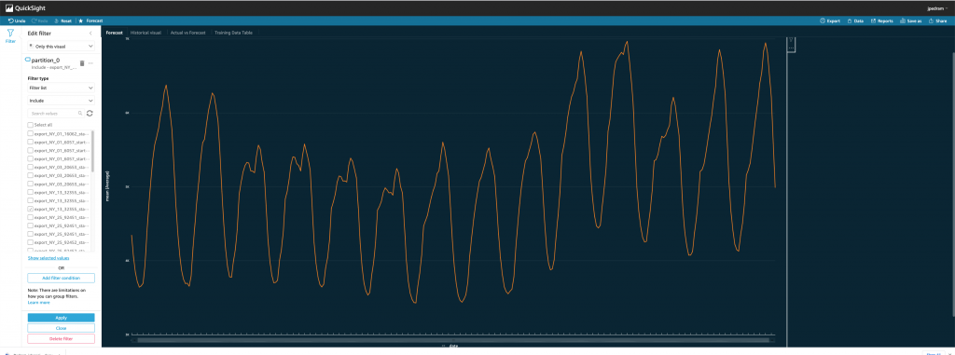
Streaming Data Application
Real-time stock trades
Power load forecasting
Social media data analysis
Multiplayer game interactions
Ride-sharing application
Source: https://tdwi.org/articles/2020/07/13/arch-all-new-approach-to-streaming-analytics-million-data-sources.aspx
Notes:
There are various applications built on streaming data such as Power load forecasting and Real-time stock trades.

Slide 5
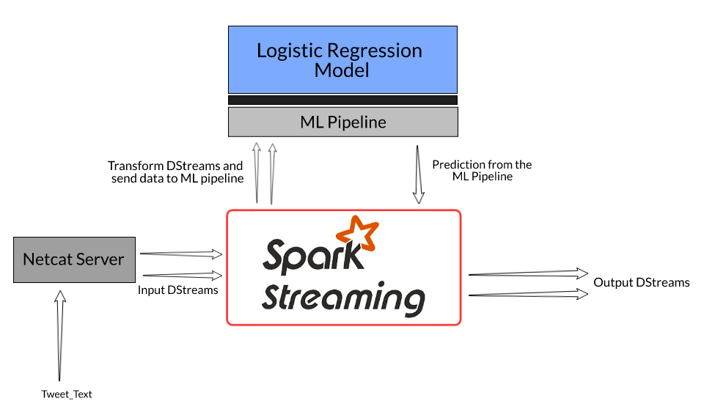
Machine Learning for Streaming Data
Machine learning based streaming data analysis employed supervised learning models, especially classifiers to address the problem of changes to the underlying data distribution over time.
In general, it has to overcome one specific challenge: developing methods that maintain an accurate decision model with the ability to learn and forget concepts incrementally.
Source: https://www.analyticsvidhya.com/blog/2019/12/streaming-data-pyspark-machine-learning-model/
Notes:
Machine learning techniques are useful to streaming data analytics.
We can employ supervised learning models, especially classifiers to address the problem of changes to the underlying data distribution over time.
In general, it has to overcome one specific challenge that is to develop methods to maintain an accurate decision model and learn and forget concepts incrementally.
Machine learning can be combined with Sparking system for streaming data analysis.

Slide 6
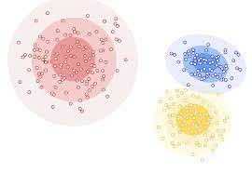
Tasks
Data stream clustering
Pattern mining
Anomaly detection
Multi-output learning
Novel class detection
… …
Source: https://developers.google.com/machine-learning/clustering/clustering-algorithms
Notes:
On streaming data, we can mine patterns and implement and anomaly detection.

Slide 7
DLI Accelerated Data Science Teaching Kit
Thank You

