Slide 1

Lecture 18.2 - Data Preprocessing
DLI Accelerated Data Science Teaching Kit
Notes:
This section will show some knowledge points on data preprocessing for streaming data analysis.

Slide 2

The Accelerated Data Science Teaching Kit is licensed by NVIDIA, Georgia Institute of Technology, and Prairie View A&M University under the
Creative Commons Attribution-NonCommercial 4.0 International License.

Slide 3
Data Preprocessing
Data preparation is an essential step to build a machine learning model.
To enhance the model performance, it requires transforming raw data and even select relevant attributes by data processing.
Two reasons for performing data preprocessing before training a machine learning model:
To improve fitting of learning algorithms on the data;
To extract or keep only the most relevant data.
Basic preprocessing methods like normalization will be more complicated in a streaming setting since statistics about the data will be an unknown priori, e.g., the minimum and maximum values of a given feature/attribute.
Notes:
Data preparation is a key step to build a machine learning model since it can improve fitting of learning algorithms on the data and extract or keep only the most relevant data.
Generally, it requires transforming raw data and even select relevant attributes.
Some traditional preprocessing methods will not be suitable for streaming data analysis.
For example, data normalization will not work well since some methods needs the minimum and maximum values of a given feature/attribute, this is usually not known priori to processing streaming data.

Slide 4
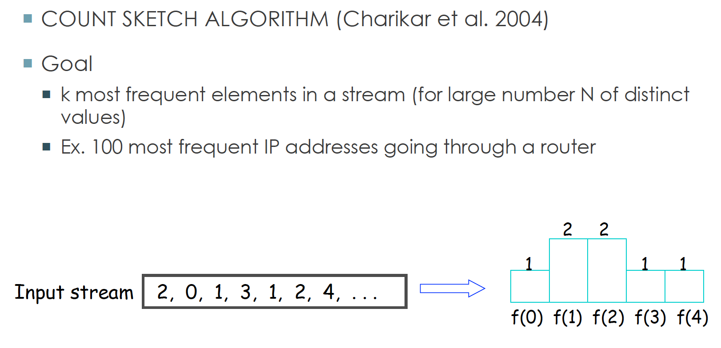
Feature Transformation
Summarization Sketches
A ‘sketch’ of the data refers to the summary to avoid storing and maintaining a large amount of data.
Sketches are probabilistic data structures that summarizes streams of data, such that any two sketches of individual streams can be combined into the sketch of the combined stream in a space-efficient way.
Using sketches requires a number of compromises. For example, sketches must be created by using a constrained amount of memory and processing time. If the sketches are not accurate, then the information derived from them may be misleading.
Source: https://www.slideshare.net/rchiky/dds-workshop05122014
Notes:
So, some novel methods are developed like Summarization Sketches
A ‘sketch’ of the data will present the summary of the data, which can avoid storing and maintaining a large amount of data.
It will show you a probabilistic summary of the data to summarize streams of data. On the right side, here is a figure on how it works. For the streaming input, we can build various function to show the frequencies of data as a summary of the input rather than storing all data.
However, it will require a number of compromises. For example, it will meet memory and time constrain for applications. Regarding these constrains, the sketches built might not be accurate, which results in that the information derived from them may be misleading.

Slide 5
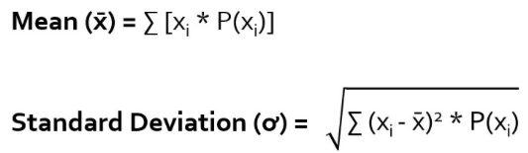
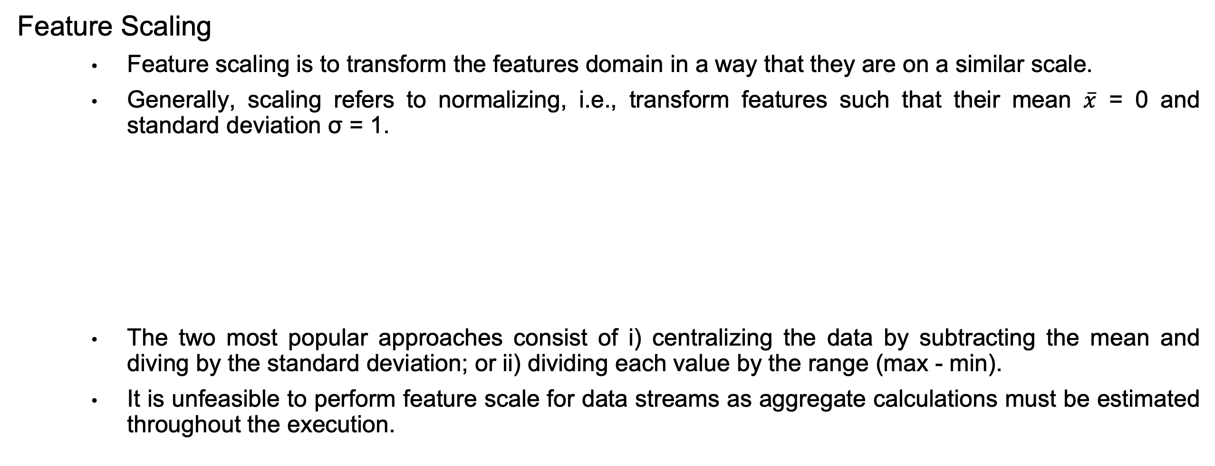
Feature Transformation
Feature Scaling
Feature scaling is to transform the features domain in a way that they are on a similar scale.
Generally, scaling refers to normalizing, i.e., transform features such that their mean $\overline{x}$ = 0 and standard deviation σ = 1.
The two most popular approaches consist of i) centralizing the data by subtracting the mean and diving by the standard deviation; or ii) dividing each value by the range (max - min).
It is unfeasible to perform feature scale for data streams as aggregate calculations must be estimated throughout the execution.
Source: https://www.educba.com/probability-distribution-formula/
Notes:
Another method is Feature Scaling that is to transform the features domain in a way that they are on a similar scale.
For example, we can employ statical methods such as mean and standard deviation to scale data.
However, some popular approaches such as centralizing, and max-min scaling will not be feasible to perform feature scale for data streams as aggregate calculations must be estimated throughout the execution.

Slide 6
Feature Transformation
Feature Discretization
It is to divide numeric features into categorical ones using intervals.
Depending on the application and predictive model, discretization can bring several benefits
Speeds up computation time as discrete variables are usually easier to handle compared to numeric ones;
Decreases the chances of overfitting since the feature space becomes less complex.
Similar to feature scaling, the effort on feature discretization should target the provisioning of efficient implementations that integrate with different parts of the streaming process, such as image classification and concept drift detection.
Notes:
Feature discretization is used to simplify features by dividing numeric features into categorical ones using intervals.
It will speed up computation time as discrete variables are usually easier to handle compared to numeric ones and decrease the chances of overfitting since the feature space becomes less complex.
It can be applied to image classification and concept drift detection.

Slide 7
Dimensionality Reduction
Dimensionality reduction is to represent the data with lower space.
Dimensionality reduction techniques that apply transformations to the input data, e.g., Principal Component Analysis (PCA) (Linear method), and Autoencoder (Non-linear method).
Notes:
Dimensionality reduction is also an effective method to data preprocessing for streaming data analysis.
It is to represent the data with lower dimensional space.

Slide 8
Feature Selection
Feature selection targets the identification of which features are relevant to the learning task.
In contrast to dimensionality reduction, feature selection does not apply transformations to the data, and thus, the features can still be interpreted.
Feature selection methods require the entire dataset to determine which features are the most relevant according to some goodness-of-fit criterion. Nevertheless, this is a requirement that does not hold in streaming scenarios, as new data becomes available over time.
Feature selectors are expected to be “stable”, meaning that they should select the same features despite being trained with different subsets of data
Notes:
Feature selection could be employed to enhance the quality of streaming data for data analysis.
It is to identify which features are relevant to the learning task.
Compared to dimensionality reduction, it does not apply transformations to the data, and thus, the features can still be interpreted.
However, it requires the entire dataset to determine which features are the most relevant according to some goodness-of-fit criterion. So, it might not hold in streaming scenarios, as new data becomes available over time.

Slide 9
DLI Accelerated Data Science Teaching Kit
Thank You

