Slide 1

Lecture 18.3 -​ ​Learning Process
DLI Accelerated Data Science Teaching Kit
Notes:
This section will show some examples on learning on streaming data.

Slide 2

The Accelerated Data Science Teaching Kit is licensed by NVIDIA, Georgia Institute of Technology, and Prairie View A&M University under the
Creative Commons Attribution-NonCommercial 4.0 International License.

Slide 3
Learning on Streaming Data
Learning from streaming data requires real-time (or near real-time) updates to a model with these challenges:
  Building the relationship between data streams and time series;
  Addressing the problem of dealing with partially and delayed labels;
  Learning on imbalanced data streams;
  Detecting anomalies from streaming data
Notes:
Real-time (or near real-time) updates are required for learning on streaming data, which introduces new challenges.
It has to build the relationship between data streams and time series;
Also address partially and delayed labels;
Sometimes it has to learn on imbalanced data streams and detecting anomalies from streaming data to avoid low performance.

Slide 4
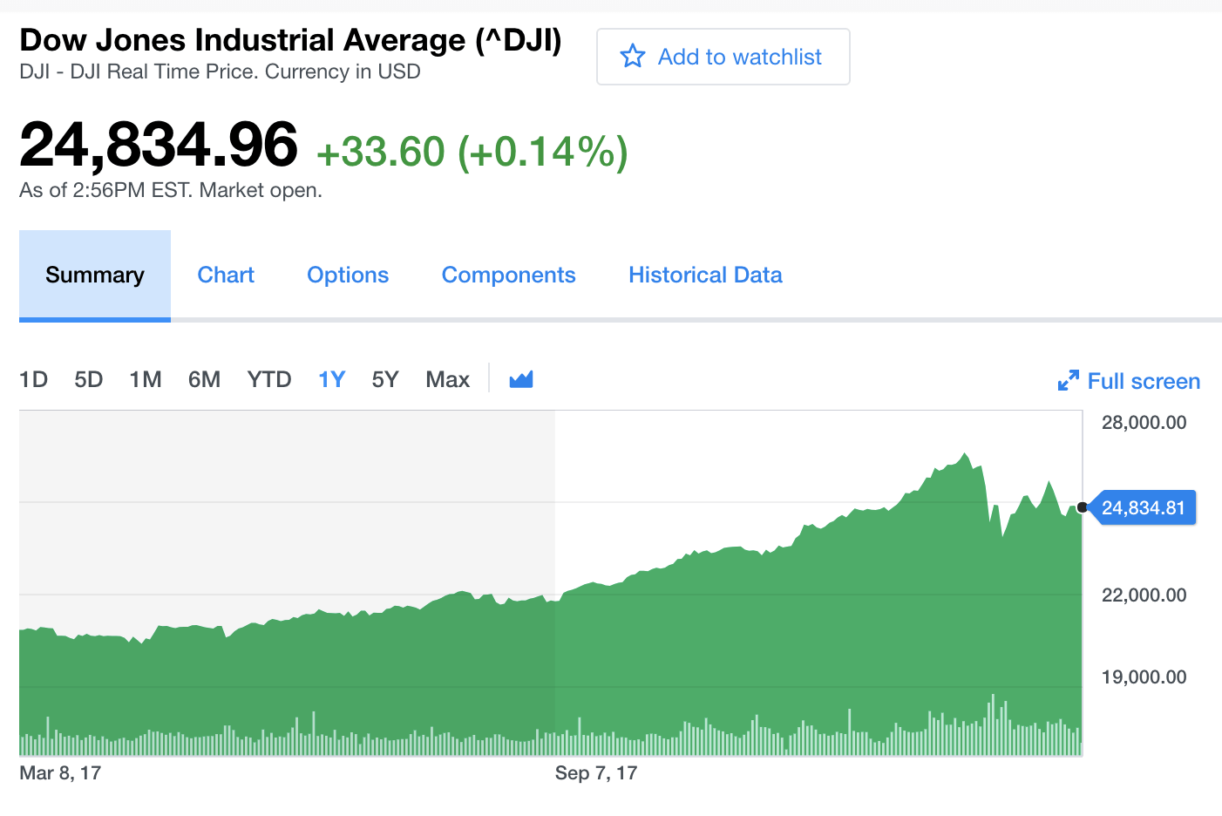
Time Series
Time series data may commonly arrive in the real-time manner, and it thus can be treated as a data stream.
Data streams may often involve temporal dependence and thus be considered as time series.
Unlike a regular data stream, where instances are assumed to be independently and identically distributed (i.i.d.), data points in a time series are expected to exhibit strong temporal dependence.
Source: https://www.influxdata.com/what-is-time-series-data/
Notes:
Time-series data can be treated as a data stream arriving in the real-time manner like stock data shown in the right figure.
It involves temporal dependence and thus be considered as time series.

Slide 5
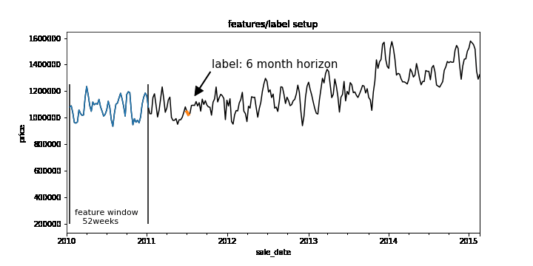
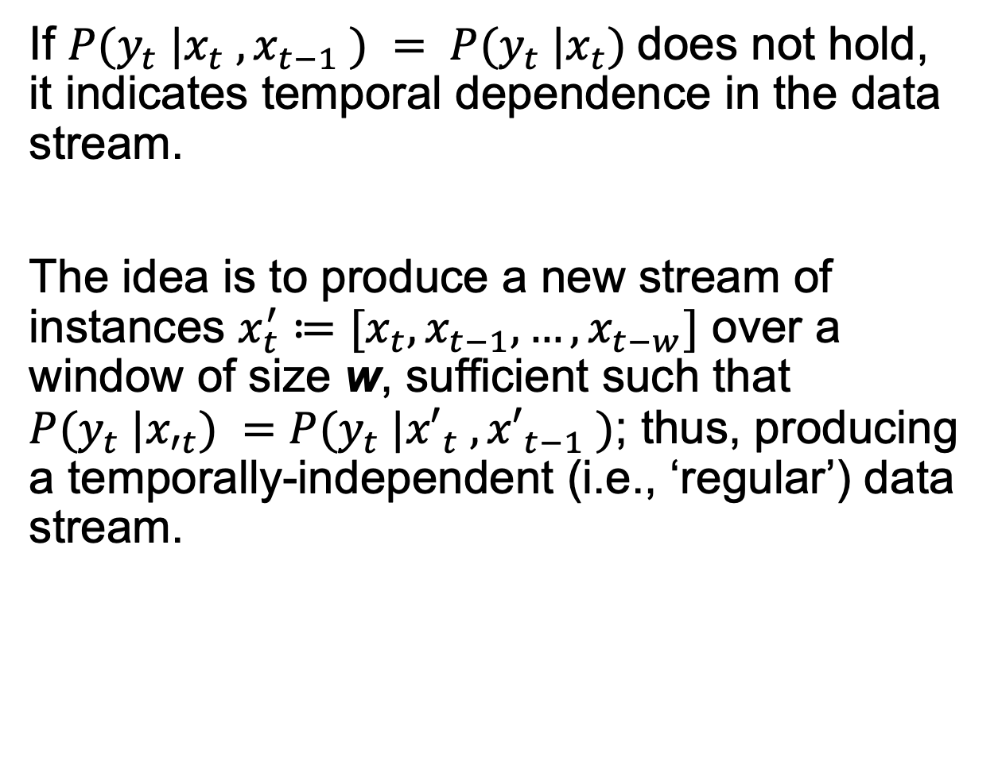
Time Series
If $P(y_{t} |x_{t} , x_{t−1} ) = P(y_{t} |x_{t})$does not hold, it indicates temporal dependence in the data stream.
The idea is to produce a new stream of instances $x_{t}^{′}≔[x_{t},x_{t−1},…,x_{t−w}]$ over a window of size w, sufficient such that $P(y_{t} |x_{′t}) =P(y_{t} |{x′}_{t} , {x′}_{t−1} )$; thus, producing a temporally-independent (i.e., ‘regular’) data stream.
Source: https://cloud.google.com/blog/products/ai-machine-learning/how-to-quickly-solve-machine-learning-forecasting-problems-using-pandas-and-bigquery
Notes:
In other words, If $P(y_{t} |x_{t} , x_{t−1} ) = P(y_{t} |x_{t})$does not hold, it indicates temporal dependence in the data stream.
The right figure shows an example of obtaining a time-series data with a window.

Slide 6
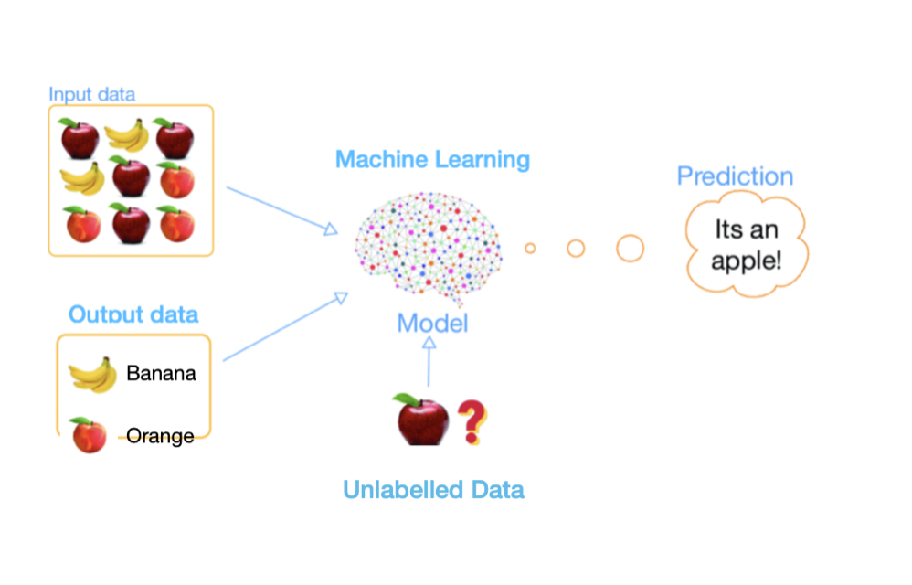
Semi-supervised Learning
Semi-supervised learning (SSL) is particularly relevant to streaming applications where data are abundant but labeled data may be rare.
The SSL techniques for streaming data includes unsupervised learning combined with supervised learning; It is hybrid approach.
  Each of these approaches makes assumptions about the problem and the data distribution, but not very often these assumptions are explicitly discussed.
Source: https://www.enjoyalgorithms.com/blogs/supervised-unsupervised-and-semisupervised-learning
Notes:
As mentioned in the previous slides, it is very challenging to label streaming data since it comes in real-time manner.
So, more effective methods should be able to use partially labeled data to complete data analysis.
Semi-supervised learning (SSL) is particularly relevant to streaming applications where data are abundant but labeled data may be rare.
It can implement effective data analysis on streaming data with SSL since it can leverage unlabeled data plus a minor labeled data by combining unsupervised learning with supervised learning.

Slide 7
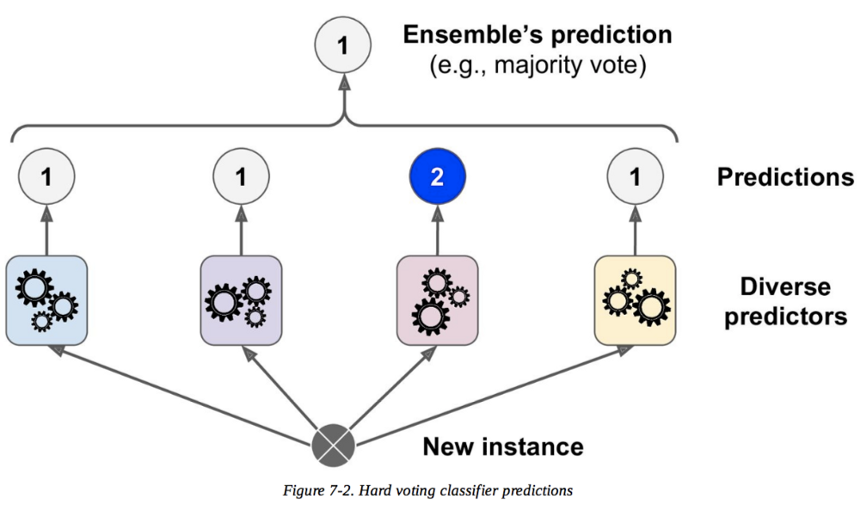
Ensemble Learning
Ensemble learning receives much attention for data stream learning as ensembles can be integrated with drift detection algorithms and incorporate dynamic updates.
Ensemble models can rely on the reactive strategy to cope with concept drift that continuously updates the ensemble, often assigning different weights to base models according to their prediction performance.
The challenge is how to maintain the characteristics of the ensemble methods and efficiently train them over several machines.
Source: https://www.kdnuggets.com/2019/01/ensemble-learning-5-main-approaches.html
Notes:
Another challenge for streaming data analysis is concept drift.
Ensemble learning receives much attention for data stream learning as ensembles can be integrated with drift detection algorithms and incorporate dynamic updates.
It relies on the reactive strategy to cope with concept drift that continuously updates the ensemble, often assigning different weights to base models according to their prediction performance.
The challenge is how to maintain the characteristics of the ensemble methods and efficiently train them over several machines.

Slide 8
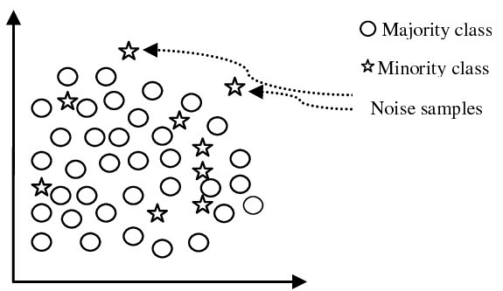
Imbalanced Learning
Imbalanced datasets are characterized by one class outnumbering the instances of the other one. The latter is referred to as the minority class, while the former is identified as the majority class.
The imbalance may be inherent to the problem (intrinsic) or caused by some fault in the data acquisition (extrinsic).
Learning from imbalanced datasets is challenging as most learning algorithms are designed to optimize for generalization, and as a consequence, the minority class may be completely ignored.
Source: https://www.semanticscholar.org/paper/A-Review-on-Class-Imbalance-Problem%3A-Analysis-and-Maheshwari-Jain/70b83c369dce441b765bcf5a8f16550c7e87b53f
Notes:
Here are some challenges on learning on imbalance data.
Imbalanced datasets are characterized by one class outnumbering the instances of the other one.
The latter class is referred to as the minority class, while the former class is identified as the majority class.
It is very challenging to learn on imbalance data since traditional machine learning models are designed to optimize for generalization, and therefore, the minority class may be completely ignored.

Slide 9
DLI Accelerated Data Science Teaching Kit
Thank You

