Slide 1

Lecture 18.4 -​ ​Reasoning and Data Resource
DLI Accelerated Data Science Teaching Kit
Notes:
This section will introduce some applications on streaming data.

Slide 2

The Accelerated Data Science Teaching Kit is licensed by NVIDIA, Georgia Institute of Technology, and Prairie View A&M University under the
Creative Commons Attribution-NonCommercial 4.0 International License.

Slide 3
Monitor Learning System
Learning from data streams is a continuous process.
The learning systems need to monitor their working conditions since they act in dynamic environments, where working conditions change and evolve.
They need to monitor the learning process for change detection, emergence of novel classes, changes in the relevance of features, changes in the optimal parameter settings, and others.
In a general sense, these learning systems should be able of self-diagnosis when performance degrades, by identifying the possible causes of degradation and self-repairing or self-reconfiguring to recover to a stable status.
Notes:
Compared to stable data, learning from data streams is a continuous process since it learns in dynamic environments where working conditions change and evolve.
So, it is necessary to monitor the learning process for change detection, emergence of novel classes, changes in the relevance of features, changes in the optimal parameter settings, and others.
Generally, these learning systems should be able to complete self-diagnosis when performance degrades, by identifying the possible causes of degradation and self-repairing or self-reconfiguring to recover to a stable status.

Slide 4
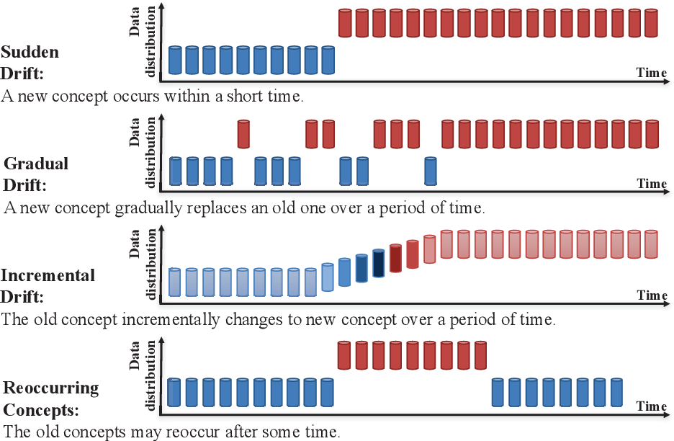
Concept Drift
During classification, a change in the concept or distribution of dataset over the time is termed as concept drift.
Algorithms focusing on drift detection on delayed or partially labeled streams exists.
Source: https://www.semanticscholar.org/paper/Concept-drift-adaptation-for-learning-with-data-Liu/5b105e357936f989cfb46ddd055ea44a2b0aed04
Notes:
Here are some concreate examples on data changes in streaming data.
To complete classification on streaming data, a common challenge is concept drift that refers to a change in the concept or distribution of dataset over the time, where the right figure shows examples on different categories of concept drift such as sudden drift and incremental drift.
Algorithms focusing on drift detection on delayed or partially labeled streams have been developed.

Slide 5
Feature Drift
Data streams are subject to different types of feature drifts.
  changes in the values of a feature and their association with the class
  changes in the domain of features
  changes in the subset of features that are used to label an instance
A feature drift occurs when a subset of features becomes relevant to the learning task.
The assessment of feature drifting scenarios should not only account for the accuracy rates of learners, but also whether the feature selection process correctly flags the changes in the relevant subset of features and if it identifies the features.
Notes:
Furthermore, concept drift of streaming data is subject to different types of feature drifts like changes in the values of a feature and their association with the class, changes in the domain of features, and changes in the subset of features that are used to label an instance.
It occurs when a subset of features becomes relevant to the learning task.
For feature drift, it should account for the accuracy rates of learners and whether the feature selection process correctly flags the changes in the relevant subset of features, and if it identifies the features.

Slide 6
Hyperparameter Tuning for Evolving Data Streams
Hyperparameter tuning (or optimization) is often treated as a manual task where experienced users define a subset of hyperparameters and their corresponding range of possible values to be tested exhaustively.
The brute force approach of trying all possible combinations of hyperparameters and their values is time-consuming but can be efficiently executed in parallel.
The challenge is to design an approach that incorporate the hyperparameter tuning as part of the continual learning process, which might involve data preprocessing, drift detection, drift recovery, and others.
Notes:
Hyperparameter Tuning is another challenge to implement data analysis on streaming data.
It is often treated as a manual task where experienced users define a subset of hyperparameters and their corresponding range of possible values to be tested exhaustively.
The brute force approach of trying all possible combinations of hyperparameters.
Moreover, their values is time-consuming but can be efficiently executed in parallel.
It is challenging to incorporate the hyperparameter tuning as part of the continual learning process.
It would involve data preprocessing, drift detection, drift recovery, and others.

Slide 7
Data Resources
Data stream algorithms are usually assessed using a benchmark that is a combination of synthetic generators and real-world datasets.
The synthetic data is used to allow showing how the method performs given specific problems (e.g., concept drifts, concept evolution, feature drifts, and so forth) in a controlled environment.
The real-world datasets are used to justify the application of the method beyond hypothetical situations; however, they are often used without guarantees that the issues addressed by the algorithm are present. For example, it is difficult to check if, and when, a concept drift takes place in a real dataset.
Notes:
To evaluating algorithms of streaming data analysis, we need to verify them on benchmarks, where a benchmark is a combination of synthetic generators and real-world datasets.
The synthetic data allows to show how the method performs given specific problems in a controlled environment while the real-world datasets are used to justify the application of the method beyond hypothetical situations;
however, the real-world datasets are often used without guarantees that the issues addressed by the algorithm are present.
For example, it is difficult to check if, and when, a concept drift takes place in a real dataset.

Slide 8
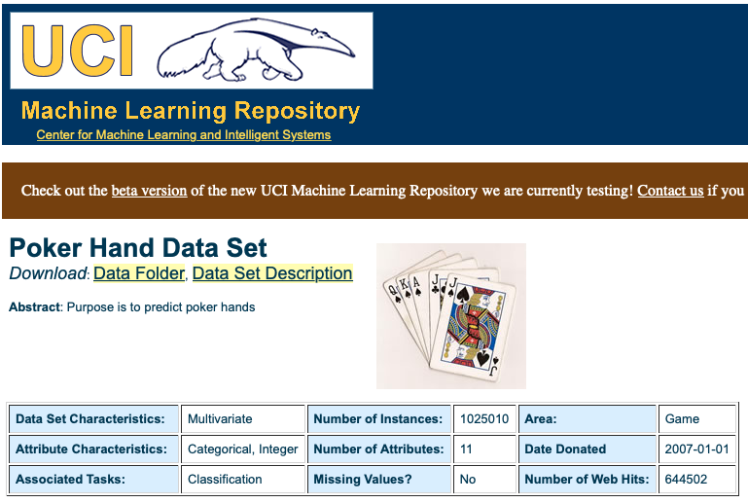
Data Resources
When it comes to real-world data streams, some researchers use datasets that do not represent data streams or that are synthetic data masquerade as real datasets.
Source: https://archive.ics.uci.edu/ml/datasets/Poker+Hand
Notes:
UCI machine learning repository provides many datasets for data analysis.
However, it should select data carefully since some researchers use datasets that do not represent data streams or that are synthetic data masquerade as real datasets.

Slide 9
DLI Accelerated Data Science Teaching Kit
Thank You

